Slide 1
Digitizing Religious Manuscript as an Effort to Support Open Access Movement
HARIYAH AND RIYAN ADI PUTRA
© 2017

Slide 2
1. Introduction

Slide 3
1. Introduction
Indonesia is very rich in cultural relics, a number of national manuscript is very much
The manuscripts scattered in various countries, such as England, Germany, France, Netherlands, Malaysia, Singapore, and Brunei Darussalam
No awareness of the importance of these manuscripts as cultural heritage
By digitizing manuscripts “make them available to a national and international scholarly audience and, at the same time to support critically important conservation and cataloguing efforts
This paper intends explores religious manuscript digitization activities undertaken by Puslitbang Lektur dan Khasanah Keagamaan as part of the state institutions which participate in saving the intellectual property of the nation and as part of a move to support open access

Slide 4
2. Research Methods

Slide 5
2. Research Methods
Literature review that assessment of religious manuscripts from various literature
Including research that have been done by the Center for Development Research Lektur dan Khazanah Keagamaan Balitbangdiklat Ministry of Religious Affairs

Slide 6
3. Result

Slide 7
3. Result
Basic concept of digitization
Religious manuscripts
The Institution that Undertakes Preservation of Ancient Manuscripts
Digitizing Religious Manuscript, Experience of Puslitbang Lektur dan Khazanah Keagamaan
Thesaurus of Indonesian Islamic Manuscripts (TIIM)
Open Access Movement

Slide 8
A. Digitization
Digitizing is the process of transferring manuscripts from its original form into a digital form or copy it by scanning (scanner) or photographed with a digital camera
To preserve the value or content of information
Improving access to information and knowledge
Promoting resource that never existed
For future keep
Simultaneously making it accessible globally
The most important thing is to define the formal rules which would be worldwide acceptable, this format must fit with the necessary standards for dissemination of data via Internet.

Slide 9
B. Religious Manuscript
Manuscripts can also define as all the written heritage of our ancestors on paper, papyrus, bark and rattan
There are two popular terms in study of religious manuscript
Codicology
Philology
Study of philology known manuscripts of Indonesia is divided into 14 categories
Religious | The Language | Philosophy and Folklore | The Mystic Secret | The Moral Teaching | The Regulations and Legal Experience | The Genealogy of The Kings
The Buildings and Architecture | About Medicines | The Meaning of Astrology | The Prophecy | Literature | Historical | The Calculation of Time

Slide 10
C. The Institution that Undertakes Preservation of Ancient Manuscripts
Manassa (Masyarakat Pernaskahan Nusantara)
Badan Litbang dan Diklat Ministry of Religious Affairs through Puslitbang Lektur dan Khasanah Keagamaan
National Library

Slide 11
D. Digitizing Religious Manuscript, Experience of Puslitbang Lektur dan Khazanah Keagamaan (1)
Puslitbang Lektur Keagamaan has been researching religious manuscripts archipelago
Tens of thousands of manuscripts in various languages successfully tracked, either stored at home and abroad
The manuscript usually written around the 18th century until the 20th, the condition is still "scattered" in a number of libraries, museums, public and private collections
Most of the manuscripts are already vulnerable and damaged with age
Puslitbang Lektur Keagamaan in collaboration with UIN, IAIN, STAIN, STAHN, and STAKN have been inventoried 1266 religious manuscript

Slide 12
D. Digitizing Religious Manuscript, Experience of Puslitbang Lektur dan Khazanah Keagamaan (2)
Puslitbang Lektur dan Khazanah Keagamaan has been doing rescue to the Lektur Klasik Keagamaan (hereinafter referred to as LKK)
Digitizing up to 1500 LKK today, placed into a CD and hard drive
This rescue needs to be optimized in publication by placing in special page, include a watermark in each article and a description of each manuscript

Slide 13
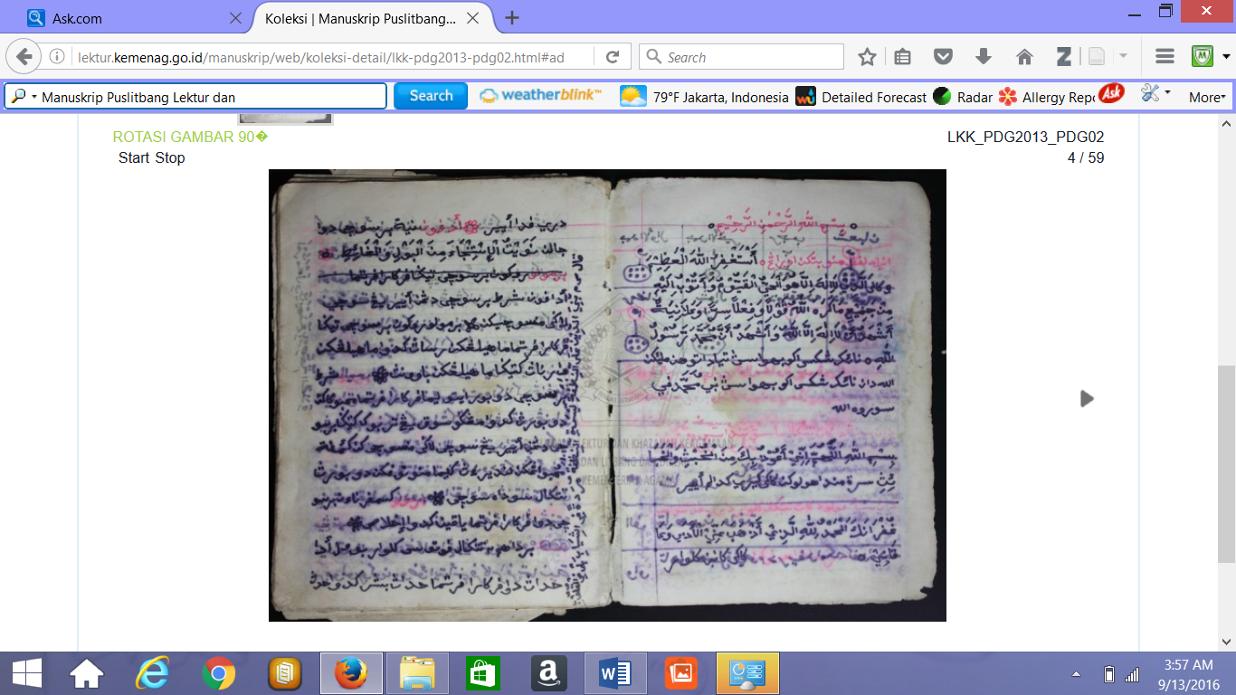
Examples of Religious manuscripts belonging to the Puslitbang Lektur dan Khazanah Keagamaan with watermark

Slide 14
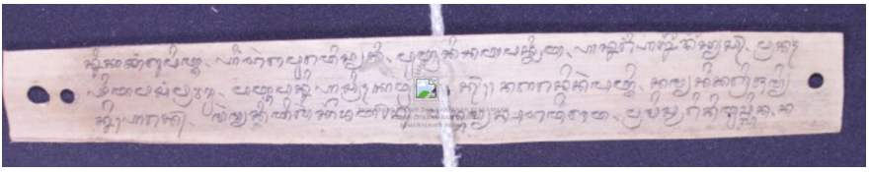
Examples of Religious manuscripts belonging to the Puslitbang Lektur dan Khazanah Keagamaan with watermark

Slide 15
D. Digitizing Religious Manuscript, Experience of Puslitbang Lektur dan Khazanah Keagamaan (3)
Inclusion watermark in each page of a manuscript is important
To maintain the authenticity of the LKK as the property of the Puslitbang Lektur dan Khazanah Keagamaan,
To getting legacy of intellectual property rights

Slide 16
D. Digitizing Religious Manuscript, Experience of Puslitbang Lektur dan Khazanah Keagamaan (4)
Optimization Conservation Program LKK:
Substantively includes classical religious texts
Methodologically/procedure
Providing a watermark and a detailed description for each of the LKK

Slide 17
D. Digitizing Religious Manuscript, Experience of Puslitbang Lektur dan Khazanah Keagamaan (5)
Activities aimed at rescuing the ancient manuscripts :
Improving and Developing Quality of Technical Staff Digitations of Religious Manuscripts
In House Training about Digital Photography
Manuscripts Digitization Workshop and Development of National Manuscripts Portal
Exploration and Digitization Religious Manuscripts

Slide 18
E. Thesaurus of Indonesian Islamic Manuscripts (TIIM)
The Thesaurus of Indonesian Islamic Manuscripts (TIIM) intended to provide complete information as possible about the Indonesian Islamic manuscripts, both written in Arabic and local languages
TIM was initiated by the Puslitbang Lektur dan Khasanah Keagamaan
To provide access to hundreds or even thousands of religious manuscripts that are not always easily accessible
TIIM available in digital form and can be downloaded

Slide 19
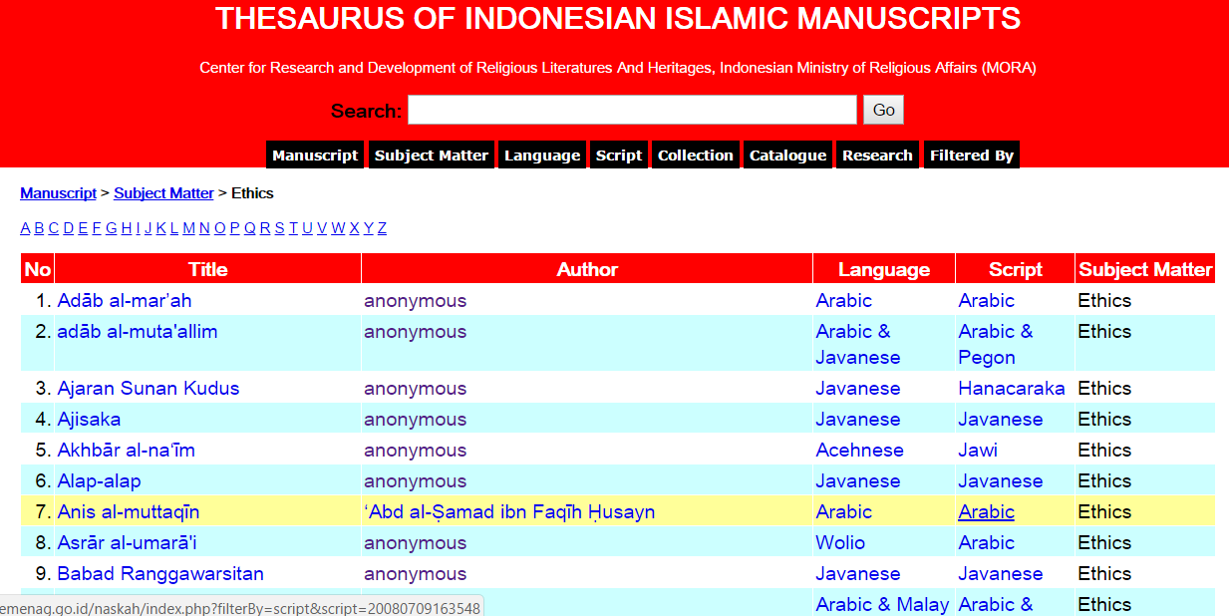
Example Display of TIIM (http://lektur.kemenag.go.id/)

Slide 20
F. Open Access Movement (OAM)
One of the dissemination of knowledge through Open Access (OA)
OA through a digital library can indeed be considered as a new phenomenon, especially Indonesian manuscript
In the context of the national manuscript, the manuscript development of digital libraries means that by itself will open the widest access for academics, researchers, enthusiasts, observers, and society in general, both at home and abroad, the various collections of national manuscripts
The role of librarians appears here
Example in Malay and United States

Slide 21
4. Conclusion

Slide 22
4.Conclusion
The Effort of Puslitbang Lektur dan Khazanah Keagamaan in digitizing religious manuscript should be appreciated, Already thousands of manuscripts succeeded in "capture“
The effort to create portals that facilitate global access digital religious texts is constantly being developed through Thesaurus of Indonesian Islamic Manuscripts (TIIM)
The development of a thesaurus is also balanced with human resource development

Slide 23
THANK YOU
© 2017 Hariyah & RIYAN

