Slide 1
A Search for Historical Values on Asian-African Conference :
A Content Analysis
Kamaludin
Pustakawan Madya
at UPT Balai Informasi Teknologi LIPI
Jl. Sangkuriang, Gedung 40,
Bandung 40135
kamaludin1961@gmail.com

Slide 2
Introduction
Great nation is a nation that respects the sacrifice of their heroes, the sacrifice of these heroes recorded in history. If a nation forget the historical trail, the nation will lose the past, and live without an identity, a nation that will not ever have to build a future.

Slide 3
Conference of the Asian-African (KAA)
Conference of the Asian-African (KAA) is a conference between the countries of Asia and Africa, most of whom had just gained independence.
Hosted by Indonesia, Myanmar (formerly Burma), Sri Lanka (formerly Ceylon), India and Pakistan and co-ordinated by the Indonesian Foreign Minister Sunario.

Slide 4
Took place at Gedung Merdeka, Bandung, Indonesia, between April 18-24, 1955
The aim of promoting economic cooperation and culture of Asia and Africa and against colonialism or neocolonialism United States, the Soviet Union or other imperialist countries.
A total of 29 countries representing more than half the total population of the world at that time sent representatives.

Slide 5
Why KAA
The conference is to reflect on what they saw as the unwillingness of the Western powers to consult with them about the decisions that affect Asia during the Cold War;
Their concerns regarding tensions between the People's Republic of China and the United States;
Their desire to expand the foundation for a peaceful relationship between them and China with the West;
Their opposition to colonialism, especially the French influence in North Africa and the French colonial rule in Algeria;
Indonesia's wish to promote their rights in contradiction with the Netherlands over West Irian.

Slide 6
A 10-point "declaration on promotion of world peace and cooperation," incorporating the principles of the United Nations Charter was adopted unanimously:
Respect for fundamental human rights and for the purposes and principles of the charter of the United Nations
Respect for the sovereignty and territorial integrity of all nations
Recognition of the equality of all races and of the equality of all nations large and small

Slide 7
4. Abstention from intervention or interference in the internal affairs of another country
5. Respect for the right of each nation to defend itself, singly or collectively, in conformity with the charter of the United Nations
6. (a) Abstention from the use of arrangements of collective defence to serve any particular interests of the big powers
(b) Abstention by any country from exerting pressures on other countries
7. Refraining from acts or threats of aggression or the use of force against the territorial integrity or political independence of any country

Slide 8
8. Settlement of all international disputes by peaceful means, such as negotiation, conciliation, arbitration or judicial settlement as well as other peaceful means of the parties own choice, in conformity with the charter of the United Nations
9. Promotion of mutual interests and cooperation
10.Respect for justice and international obligations.

Slide 9
Asian-African Conference, meets the requirements as a world heritage, because it has a huge impact for humans, it does not only involve the Indonesian people but involves a lot of people, events that provide a new awareness to many people.

Slide 10
Purpose of study
Based on the description above, the purpose of this study is to determine :
Content of the message of the role of Asian-African Conference Museum to preserve and to socialize the history of the nation, and
Content of the message of teens’ appreciation to the Asian-African Conference history presented in the movie with the title “Konferensi Asia Afrika. Mencari Nilai Historis Konferensi Asia Afrika”

Slide 11
Methodology
The method used in this research is the method of qualitative content analysis that are not only able to identify manifest messages, but also latent messages of a document is being investigated.
So it is more able to see the trend of media content based on the context (social situation around the document or text studied), process (how a production process media or the content of the message created actual manner and organized jointly) and emergence (the formation of a gradual or phased out of the meaning of a message through the understanding and interpretation) of the documents studied (Bungin, 2004).

Slide 12
Macnamara (2003)
Content analysis is used to study a broad range of ‘texts’ from transcripts of interviews and discussions in clinical and social research to the narrative and form of films, TV programs and the editorial and advertising content of newspapers and magazines.

Slide 13
Berelson (1952) said the main purpose of content analysis there are five, namely:
  To describe substance characteristics of message content;
  To describe form characteristics of message content;
  To make inferences to producers of content;
  To make inferences to audiences of content;
  To predict the effects of content on audiences.

Slide 14
Results and Disccussion
“Konferensi Asia Afrika. Mencari Nilai Historis Konferensi Asia Afrika” movie was produced by the UPT Balai Informasi Teknologi LIPI (UPT BIT-LIP), Bandung, in 2014.
The film duration is 23 minutes 36 seconds,

Slide 15
Results and Disccussion
Featuring three interviewees, namely
Mukhlis Paeni (Historian),
Mustari Irawan (Director of the National Archives of the Republic of Indonesia),
Thomas A. Siregar (Director of Museum Konfernsi Asia Afrika, Bandung).
As well aired four testimonials of teenagers
Snopshoot copy of “Asian-African Conference” movie.

Slide 16
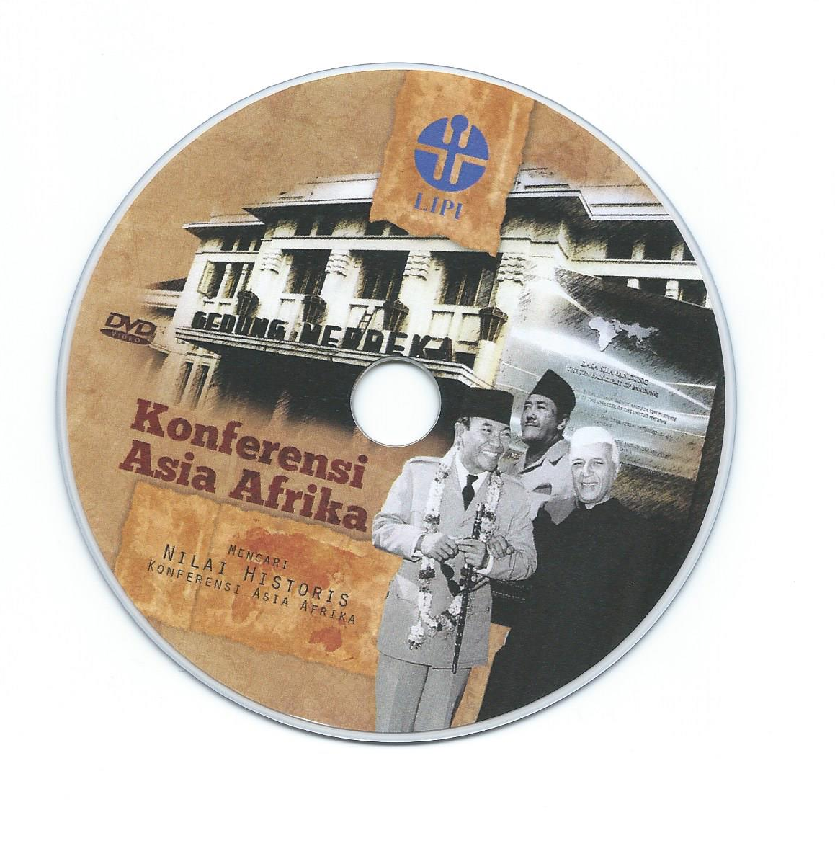
OPENING MOVIE

Slide 17
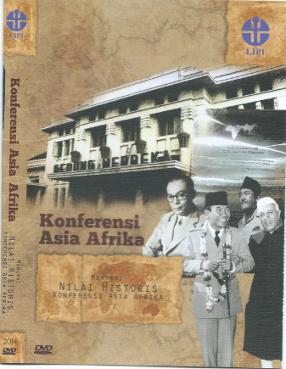
FULL MOVIE

Slide 18
To make it easier in analyzing the content of the messages, then the messages are grouped into four groups, namely :
Asian-African Conference;
Footage Asian-African Conference movie;
The role of the Asian-African Conference Museum; and
Appreciation of teens to Asian-African Conference.

Slide 19
1. Asian-African Conference
Mukhlis Paeni (Historian) (1) :
In 1955, we have come out of the atmosphere of the second world war. With the 2nd World War, resulted in various upheavals in Asia, especially in Africa.
They were led by the realization that they must be independent, they have to fight the powers that had been pressing their lives, raised resistance everywhere after year 1945, postwar world.

Slide 20
Mukhlis Paeni (Historian) (2) :
After the year 1945, raised awareness that the nations of Asia and Africa must rise and resurrection was to be separated from the two major poles, so that it can be referred to as a force in addition to a third country west block and east block.
Indonesia is considered as a symbol of a successful country in the fight to break away from colonial powers, the power of imperialism.

Slide 21
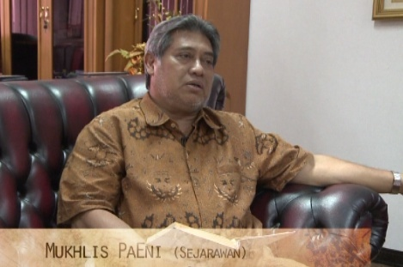
Mukhlis Paeni (Historian)

Slide 22
Mustari Irawan, Director of ANRI
So at the time of the conference, discussed, formulated, issues related to independence, world peace, freedom and cooperation among Asian countries and Africa.
There are some points that we can understand the Ten Principles of Bandung (Dasasila Bandung), the first related to the problem of world peace, which is the second issue of independence and freedom, the third related to the welfare, fourth and fifth internationalization issues related to human rights.

Slide 23
Mustari Irawan, Director of ANRI
We want that the world is no conflict, there is no dispute, there is no war. The countries of Asia and Africa was agreed that the colonial occupation of this earth to be destroyed, must be removed.
Then internationalization, how do we also have to play a role in regional, international and all the circle of countries in the world. We are now eager to be the axis of a force, that name is a maritime power. And this is actually also the desire to build that we still have a role internationally.

Slide 24
Mustari Irawan, Director of ANRI
Which is related to welfare issues, I think all countries in Asia and Africa, eager to work and build welfare. For the cooperation it becomes something very important. This is related to human rights.
It is stated in the first of Ten Principles of Bandung, I guess being an international issue, all countries desirous. Issues of human rights must be built every independent country. Every independent country, they must have human rights. We must also respect the country has human rights, so that we can uphold human rights.

Slide 25
Mustari Irawan, Director of ANRI
it is known that the Asian-African Conference event is a very big event, uniting two continents, Asia and Africa.
This event arises from the awareness that they should be independent and fight colonization of the nations of Asia and Africa. At the time of the conference, fought, formulated, issues related to independence, world peace, freedom and cooperation among Asian and African countries

Slide 26
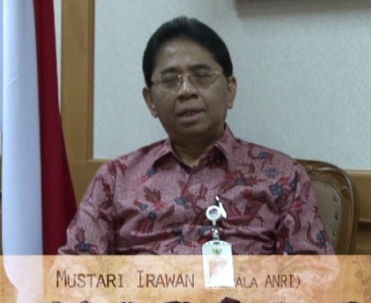
Mustari Irawan (Director of ANRI)

Slide 27
Footage of the Asian-African Conference movie
Testimonials First President of Republic of Indonesia in the Asian-African Conference.
Messages that appear in this movie trailer is that the intercontinental conference is the first event in history and a pride for the Indonesian nation, leaders of Asia and Africa could meet to discuss mutual concerns

Slide 28
Footage of…
This is the first intercontinental conference of color people in the history of main time. I am proud that my country is your host, it is a new departure in the history of the world that leaders of Asian and African people can meet together in there own countries to discuss and deliberate upon matters of common concern.
In spite of diversity that exists among its participant, let’s this conference be a great success. Yes, there is diversity among us, who denies it? Small and great nations are represented here, with people professing almost every religion under the sun, Budhism, Islam, Christianity, Confucianism, Hindhuism, Jainism, Sikhism, Zoroasthrinishm, Shintoism, and others.

Slide 29
Footage of…
Almost every political faith we encounter here, Democracy. Monarchism, Theocracy, with innumerable variants. And practically every economic doctrine has its representative in this hall Marhaenism, Socialism, Capitalism, Communism, in all their manifold variations and combinations.
But what harm is in diversity, when there is unity in desire? This conference is not to a push each other, it is a conference of brotherhood.

Slide 30
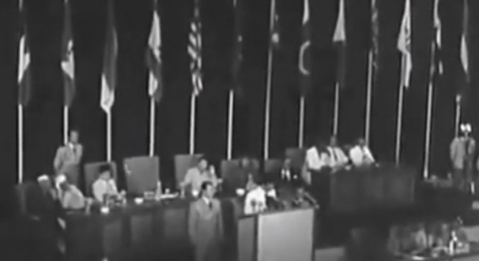
Footage Asian-African Conference Movie

Slide 31
The role of the Asian-African Conference Museum
Thomas A. Siregar (Head of the Museum of Asian-African Conference) :
The most real we saw from the Asian-African Conference history, their willingness to sacrifice for the nation and the State. I think it was a very important value to be kept in teen's mind.
We see the predecessors of our nation, they could be creative, they could create an activity, an event, with limited means, with limited equipment, fixtures.

Slide 32
The role of the Asian-African Conference Museum
They actually relied on the ability of their human resources, brainpower, negotiating skills, ability to interact.
Predecessors could well learned about other cultures, then appreciate them.
This is what I think we also have to learn from them, we live in an age that there is much information and culture around us, we're not used to use them. We prefer to take an easy ones.
This is a valuable lesson from the past.

Slide 33
The role of the Asian-African Conference Museum
The willingness of the heroes to sacrifice for the nation and the state.
The predecessor of our nation, they can be creative, they can create an activity, an event, with limited means, with limited equipment, fixtures.
In terms of preserving and popularize the Asian-African Conference has been run well through the activities carried out at the Museum of Asian-African Conference.

Slide 34
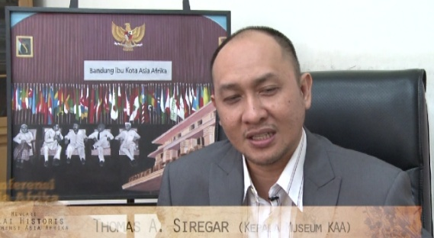
Thomas A. Siregar
(Director of Museum Asian-African Conference)

Slide 35
Asian-African Conference as part of world heritage
We all know that the Asian-African Conference in 1955 also was the forerunner of the establishment of the non-aligned movement. So when Asian African countries, especially the countries have not yet gained independence, they have not had the courage to sovereignty and fight the occupation.
It is important to be documented as part of world heritage. Asian-African Conference was born in 1955 from the Non-Aligned Movement, as well as other movement that spoke the countries were not yet independent and other developing countries.
So why do we need to raise to UNESCO ? Lest at any time the matter was forgotten. Yet this is the most important part of the history of world politics.

Slide 36
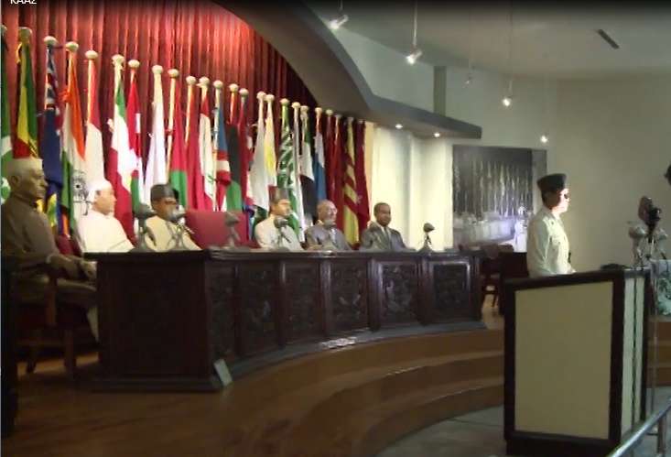

Slide 37
What has been done by museum Asian-African Conference to help teens better recognize the history of their people, greater appreciation for the efforts of our nation predecessors, doing various activities that make them aware of the history , So history does not have to be rigidly displayed in the form of seminars, workshops, but in the form of appreciation.

Slide 38
So the most important things, they come here, we most emphasize is, they feel re-energized atmosphere of Asian-African Conference. Because we have some advantages of building as silent witness, that still exist here (main hall), so usually we receive them here first, we invite them to feel how the atmosphere on that time.
The atmosphere of the conference, how people from different countries, with various cultural backgrounds, ideologies, they can sit down together for several days here, equating opinion, make a commitment, we invite teens to feel the atmosphere first.

Slide 39
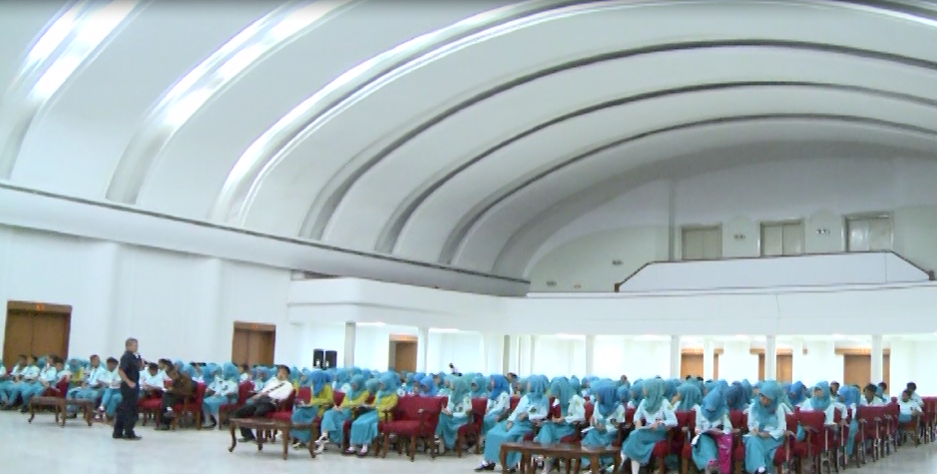

Slide 40
Appreciation of Teens to the Asian-African Conference
At the beginning of scene of the movie was filed some questions to teens, with questions and answers as follows:
Where the Asian-African Conference was held ?
I do not know, forget On Asia Afrika street, Braga street
Who was the Pioneers of the Asian-African Conference ?
I do not know, forgot to mention.
What year was Asian-African Conference held?
I do not know, forgot to mention.
You are now standing in front of Asian-African Conference Museum. What are you doing here ?
I want to see the kingdom heritage

Slide 41
Appreciation of Teens to the Asian-African Conference
From the answers delivered by these teenagers above showed that the role of the Asian-African Conference Museum to preserve and to socialize the Asian-African Conference is needed to be provided.

Slide 42

Teenagers before entering the Asian African Conference Meseum

Slide 43
Lucky at minute 21:10 of the movie which is also the end of the movie there was testimony teenagers were so positive as follows: It is necessary. If the younger generation does not know the history of, how the next younger generation ? If we do not study our own history.

Slide 44
Because if we do not know the history, we can not appreciate the sacrifice our heroes. Then we do not know our origins, why Indonesia could be independence ? Then we also can not know the people who supported Indonesia's independence.
In terms of measuring the appreciation of the teenagers to the Asian-African Conference on the Konferensi Asia Afrika. Mencari Nilai Historis Konferensi Asia Afrika movie to be scrutinized, it is hard to be scrutinized because the appreciation messages that was conveyed, not delivered by the same teenagers who were asked at the beginning of the scene of this movie, so inconclusive in increasing of appreciation of the teenagers.

Slide 45
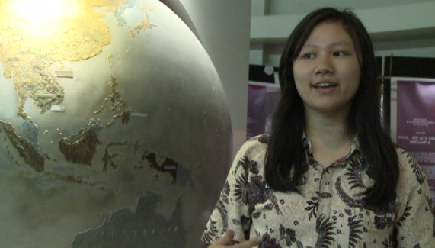
Teenagers after entering the Asian African Conference Meseum

Slide 46
Conclusion
1. Role of the KAA Museum
The content of the message in film with title “Konferensi Asia Afrika. Mencari Nilai Historis Konferensi Asia Afrika”, about role of the Asian-African Conference Museum in preserving and socializing the Asian-African Conference history has done well, it can be seen from the testimony presented by the interviewees.

Slide 47
2. Teenagers’ appreciation to the KAA Conference history
The content of the message in film “Konferensi Asia Afrika. Mencari Nilai Historis Konferensi Asia Afrika”, about teenagers’ appreciation to the history of the Asian-African Conference after entering the Museum of Asian-African Conference was very positive at all.
Museum of Asian-African Conference is indispensable to know and preserve the history for the current generation and the future.

Slide 48
Recomendation
The weakness of this film is in measuring appreciation of teenagers to the role of Asian-African Museum: the questions were not asked to the same teenagers, before and after they entering the museum.
To find and to measure teens’ knowledge and appreciation to the Asian-African Conference, it is recommended posed the same question to the same teenagers before and after entering the Museum of Asian-African Conference, so it will get a more objective answer.

Slide 49
References
Berelson, B. (1952). Content analysis in communication research. New York: Hafner.
Bungin, B. (2004). Analisis data penelitian kualitatif. Jakarta: PT Raja Grafindo.
Indonesia, R. (n.d.). Undang-undang nomor 33 tahun 2009. Retrieved 01 09, 2017, from disbudpar.kutaikartanegarakab.go.id/: http://disbudpar.kutaikartanegarakab.go.id/uploads/kebijakan/UNDAND%20UNDANG/UU%2033%202009%20Perfilman.pdf
KBBI. (2017). Apresiasi. Retrieved 01 09, 2017, from KBBI : http://kbbi.web.id/apresiasi
Macnamara, J. (2003). Media content analysis : Its uses; benefits and best practice methodology. Asia Pacific Relation Journal, 6(1) , 1-23.
Widjaja. (2008). Komunikasi dan hubungan masyarakat. Jakarta: PT. Bumi Aksara.
Wikiindonesia. (2017). Apresiasi. Retrieved 01 09, 2017, from Wikiindonesia: http://wikiindonesia.org/wiki/apresiasi
wikipedia. (n.d.). Museum Konferensi Asia Afrika. Retrieved 01 09, 2017, from wikipedia.org/wiki/sejarah: https://id.wikipedia.org/wiki/museum_konferensi_Asia_Afrika
wikipedia. (n.d.). Sejarah. Retrieved 01 09, 2017, from wikipwdia: https://id.wikipedia.org/wiki/Sejarah

Slide 50
THANK YOU

