Slide 1

The Collaboration between Librarians and Faculties in Preserving and Publishing the Intellectual Heritages through the Institutional Repositories: a Case at Syarif Hidayatullah State Islamic University, Jakarta
Ulpah Andayani Senior Librarian UIN Syarif Hidayatullah Jakarta

Slide 2
Contents
Introduction
Profile of UIN Jakarta’s Repository
The Development of IRs
The Development Phases
The Submission Processes
The Partnership in the Development of IRs
Conclusion

Slide 3
Introduction

Slide 4
About Institutional Repositories (IRs)
IRs as an interesting topic in academic libraries recently
Some advantages of IRs ; preserving, publishing of the intellectual outputs and providing a wider access to scholarly publications. In addition, IRs is strategic to increase the performance of university
However, developing the IRs is not a simple task. It’s a complex project that requires the involvement of many people within the university such as librarians, IT developers, and of course, lecturers to collaboratively work in the development of IRs. This collaboration, then, will guarantee the successful implemetation of IRs

Slide 5
Profile of UIN Jakarta’s Repository

Slide 6
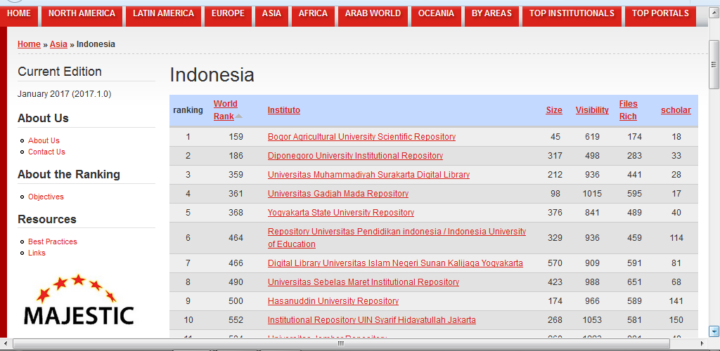
Top Ten Institutional Repositories in Indonesia

Slide 7
UIN Jakarta’s repository ranking
No | Year | Level of Rangking | Area
1 | January 2017 | 10 | Indonesia
2 | January 2017 | 56 | Asia

Slide 8
Short Profile of UIN Jakarta’s Repository
Initiative
Established in 2010
Platform
DSpace
Content
Multidiscipline
Multitype publications (more than 20.000 items available)
Access
Full Open Access
http://repository.uinjkt.ac.id/

Slide 9
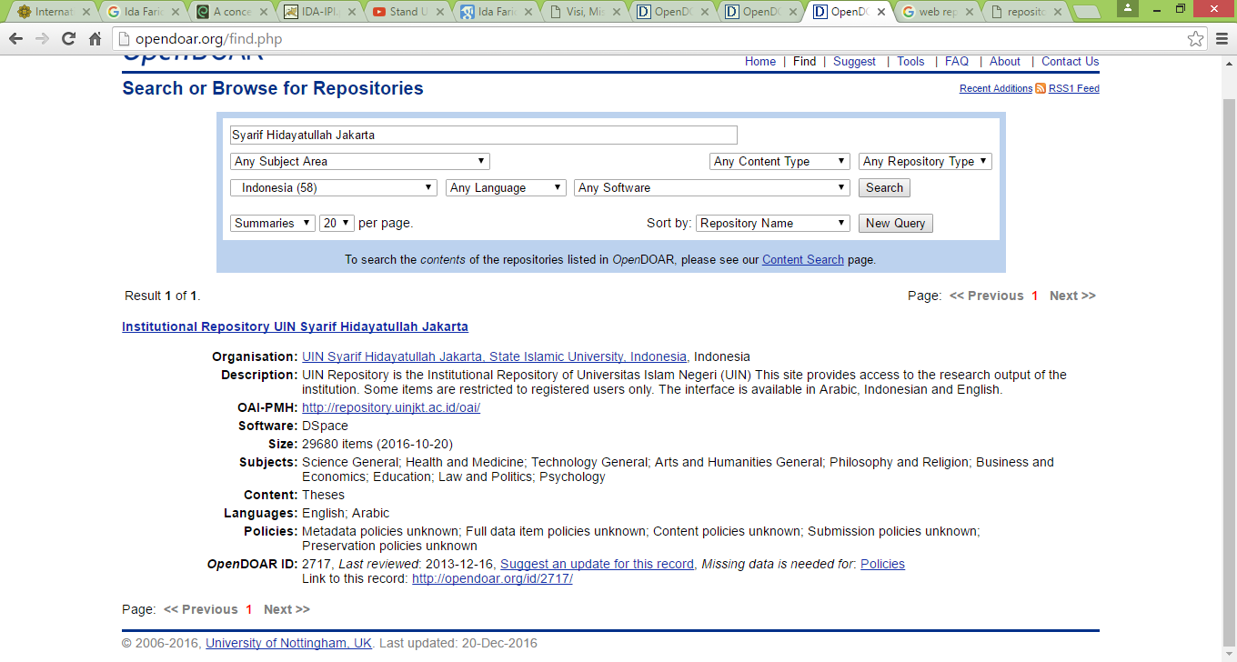
Profile of UIN Jakarta’s Repository on OpenDOAR

Slide 10

Types of the IRs’ Collection

Slide 11
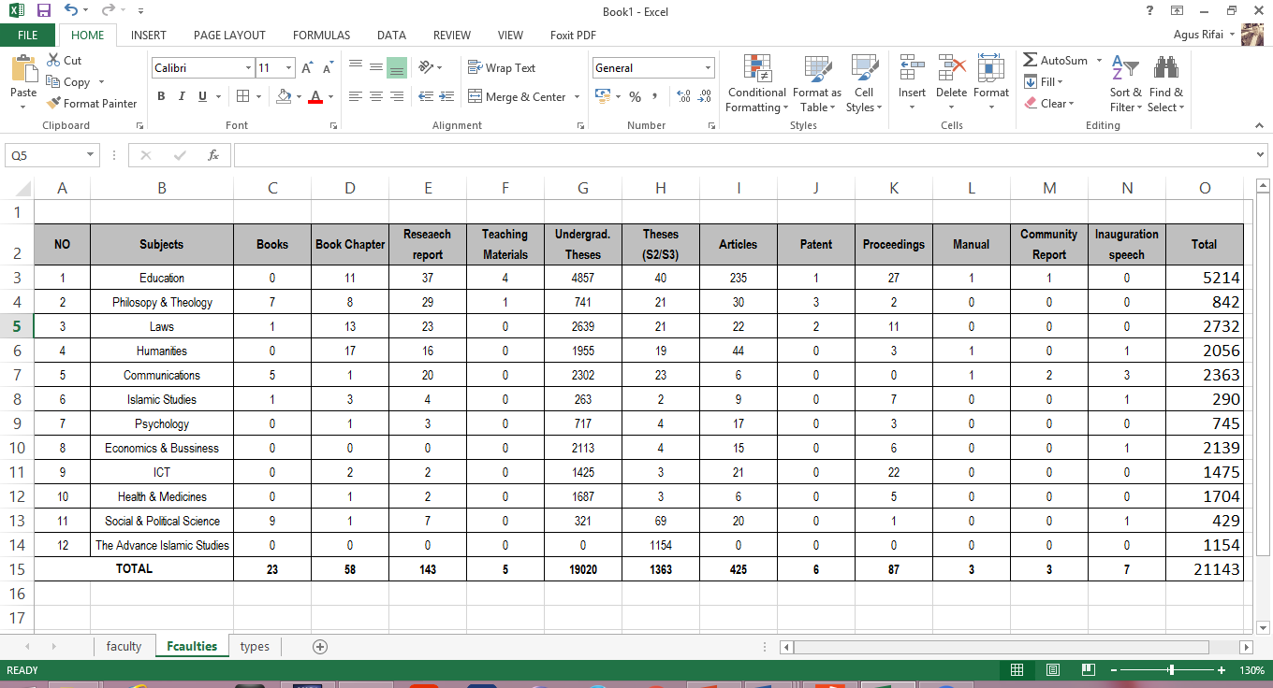
IRs’ Collecetion Based on the Subject

Slide 12
The Development of IRs

Slide 13
Phases of IRs Development
Development of the System
-Preparing the platform for managing the repositories
-Data Migration
Implementation of the system
-Preparation
-Submission
-Publishing
Maintenance of the System
-Upgrading the system
-Content evaluation

Slide 14
IRs Submission Processes
Preparation
Preparing materials ; collecting, digitizing watermarking materials
Submission
Creating metadata
Uploading the files
Publishing
Verifying the accuracy of metadata
Validating the appropriatness of content
Creating username & Password
Approving for publishing

Slide 15
Partnership in the IRs Development

Slide 16
Partnership1 : Pre Implementation Phase
No | Activities | Executors | The Roles
1 | System Development | IT Division Librarians | To design and develop (customize) the system for IRep To analyze the need of the IRep system (such as metadata requirements)
2 | Data Migration | IT Division Librarians | To transfer the data from theses database to Dspace at the initial phase
3 | Infrastructures Preparation & Installation | Administration IT Division | To facilitate the development of repositories such as server installation, networking, Wi-Fi and so on

Slide 17
Partnership 2 : Implementation Phase
No. | Activities | Executors | The Roles
1 | Knowledge Production | Lectures & other universities communities | To produce ideas, innovation, and scholarly works Librarians provide information resources for producing knowledge
2 | Content Recruitment | Faculties Librarians | To search and collect scholarly materials
3 | Content Preparation | Faculties Librarians (if required) | To prepare the materials such as digitizing material, watermarking, protecting files
4 | Submission | Faculties Librarians (if required) | Creating metadata Uploading the files attachment
5 | Publishing | Librarians | Verifying metadata, format, content type Validating the content or files uploaded by lectures Facilitating the digital creative common license Accepting or approving the contents

Slide 18
Partnership 3 : Post Implementation Phase
No | Activities | Executors | The Roles
1 | System Maintenance | IT Division | Maintaining the repository system
2 | System Evaluation | Librarians IT Division | To evaluate the use of the system
3 | Repository training & socialization | Librarians IT Division | Promoting the repositories among academic staffs Conducting training on the IT skills required Operating the repository system
4 | Repository services | Librarians | Providing services pertaining the repositories issues (providing Irep unit)

Slide 19
Conclusion
The collaboration is the key success of IRs development in academic libraries
Faculties and librarian have the important roles in the implementation of IRs in academic libraries

Slide 20
Thank You

