Slide 1
Health Literacy to Empower & Promote Health Care Information amongst the Rural Indigenous People of Northeast India through Public Libraries - A plan
Dr Subhajit Choudhury
CET,IIT Guwahati
subhajit.lib@gmail.com, 9954033145

Slide 2
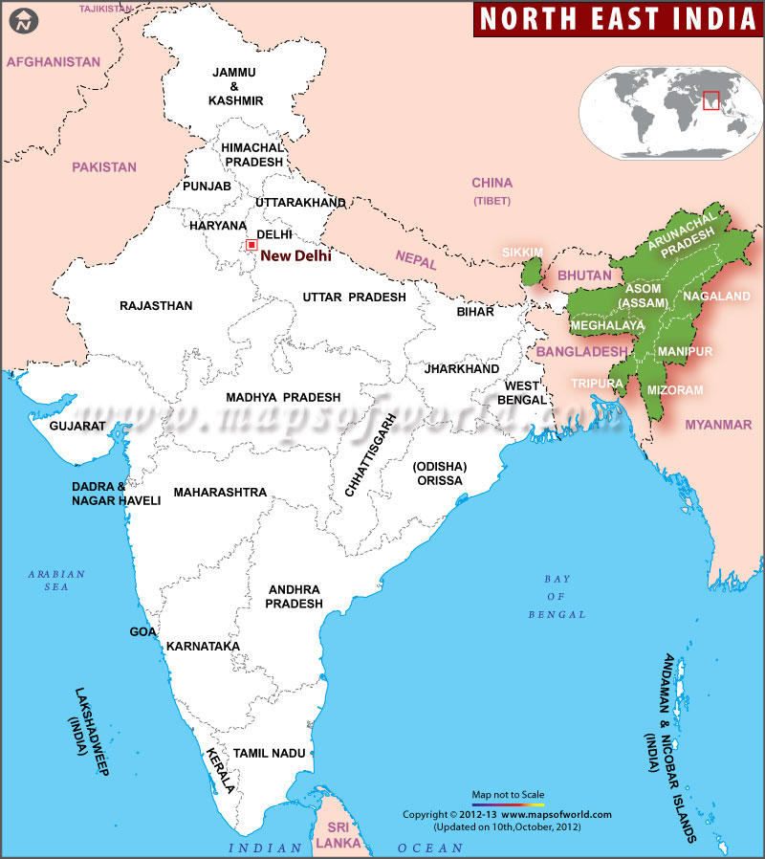
Location of Studied Area: North East India shown
in Green colour

Slide 3
Rural Health Care system in India:
The health care infrastructure in rural areas has been developed as a three tier system as is based on population pattern which is as follows:
Centre | Population Norms
 | Plain Area | Hilly/Tribal/Difficult Area
Sub-Centre | 5000 | 3000
Primary Health Centre | 30,000 | 20,000
Community Health Centre | 1,20,000 | 80,000

Slide 4
Concept of Health and Health Literacy
Health:
Health is the level of functional or metabolic efficiency of a living organism.
Health is a triune of three parts:
Emotional Health
Mental Health
Physical Health

Slide 5
The factors that which are commonly considered cause for illness are – bacteria, viruses, and parasites. What about these? Are they not a major cause of disease? Yes, they are a cause of disease – but not a major one. The ability of these microorganisms to make a person sick relies on two factors:
virulence (quality and quantity)
immunity
Plus there is a third factor that made to say that bacteria, viruses etc. are not a major cause of human sickness:
Social health
If a person gets infected by a potent microbe and has a low immunity against it, then he may fall ill. But bacteria and viruses are not a cause for decreasing health status of our society. Man himself is the cause for it. (Bhatia, Manish, 2013)

Slide 6
Health Literacy
Health literacy empowers a man to live healthily which contributes to make sound decision in every walk of life on health irrespective of place even in case of emergency. Health literacy is the degree to which individuals have the capacity to obtain, process, and understand basic health information and services needed to make appropriate health decisions. Health literacy affects ability of the people in several ways such as navigation of healthcare procedure which even covers filling up of complex form required for treatment and also help to locate service providers and location.

Slide 7
Secondly, it helps to share service provider personal information including history on health etc.
Thirdly, in building block for self-care and management of chronic disease. Fourthly, it helps to understand concept of probability and risk of both disease and treatment.
Health literacy is one of the facets of information literacy which includes numeracy skill as well, e.g. Calculating of blood sugar, measurement of medicine, nutrition and calorie level etc. All these require numerical ability. Further it requires knowledge on health topics and lack of this misinformation about the body as well as nature, causes of disease, relationship between life style, diet and health outcome are not possible.

Slide 8
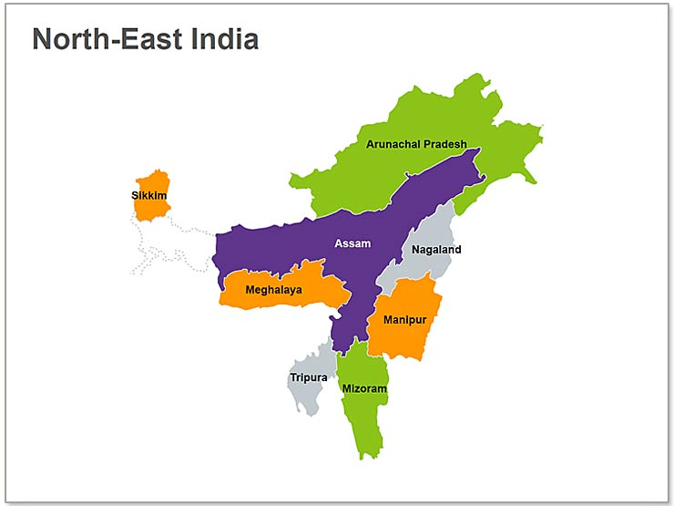
Geographical Area: 262,179 sq. K.Ms
Rural Population: 32, 771,156
Population: 45,486,784
Male:23,212,792
Female:22,273,992
Density:159.375
Literacy: 78.84%
Rural Population:+ 72%

Slide 9
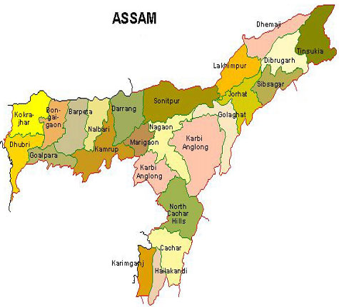
Geographical Area: 10,434 sq. K.Ms
Revenue Circle | No of Villages
Diphu | 875
Donka | 570
Phuloni | 1077
Silonijan | 406
Population- 421,156
Male: 212,996
Female:208,160

Slide 10
HEALTH CARE SYSTEM: TRADITIONAL # Generation after Generation the knowledge of traditional medicine are carried out. # Different plants and their different parts are utilized for different ailments. # Only the required portion is taken, not the misuse of entire plant, as it may be used as a continuous resource of medicine.
Sl. No. | Local name | Consumed for | Method of use and dosage
1 | Chuselok | Cough | Two table spoons of fresh juice, twice daily after meals for six days.
2 | Bapchuki | Stomachache | One table spoon of leaf juice is taken after meals, twice daily for five days.
3 | Jok –an-kelok | Dysentery | Juice of two matured leaves, trice daily before meal for three days.
4 | Phrikangnek | Bronchitis | Half a tea cup of rhizome juice, once daily after meal for ten days.
5 | Raeaba | Skin disease | Fresh leaves paste applied on the affected parts twice daily for eight days.

Slide 11
HEALTH CARE SYSTEM: TRADITIONAL 2
Sl. No. | Local name | Consumed for | Method of use and dosage
6 | Hen saiku | Piles | 100g tuber boiled and taken with rice twice daily for a month.
7 | Ingchum | Apepetizer | Two boiled tender shoots taken with rice, once a day for five days.
8 | Chamua | Piles | 50g tuber boiled and taken with rice, twice daily for a month.
9 | Bengali dido | Jaundice | 50g boiled tender shoots taken once a day with meal for ten days.
10 | Pri | Vitality | 50g boiled tender shoots taken with meal for twenty days.
11 | Bapduli | Jaundice | Five table spoon of leave juice once daily after meal for fifteen days.
12 | Churu | Dysentery | Two table spoon of leave juice thrice daily after meal.

Slide 12
HEALTH CARE SYSTEM: TRADITIONAL 3
Sl. No. | Local name | Consumed for | Method of use and dosage
13 | Lopong brik | Conjunctivitis | One drop of leaf juice applied once daily for three days.
14 | Hewali | Malaria | Half a tea cup of leaf juice once daily after meal for ten days.
15 | Nopak ban | Intestinal worm | Two boiled flowers twice daily after meal for seven days.
16 | Pharchingki | Intestinal worm | Three matured fruits once daily after meal.
17 | Thebongkang | Stomach pain | 25g of boiled tender shoot taken with meal once a day for five days.
18 | Rikang menthu | Gastritis | Four table spoon full of leaf juice, once daily after meal for a week.
19 | Vorke abap | Malaria | 50g leaves boiled in 300ml water till the quantity become half and then taken twice daily after meals for fifteen days.
20 | Parok hanthor | High blood pressure | 225g of boiled shoot taken with meal twice daily for twenty days.
Continued till 27 such vegetables

Slide 13
Health Care System: Karbi
Utilization of locally available fishes by the Karbi people
1
Sl.no. | Local name | Parts used | Disease condition | Application
1. | Nune | Whole fish | Constant spitting or ingthokset | The boiled fish is consumed regularly.
2. | Kumchirui | Whole fish or raw blood | Anaemia | Raw blood taken orally.
 |  | Whole fish/blood | Kalazar | Small sized raw fish is taken orally or fresh blood of the fish is consumed.
 |  | Blood | Entry of leech | Fresh blood is consumed raw as tonic for removal of leech from rectum/anus.
3. | Ok-puthi | Head | Night-blindness | Cooked head is taken regularly.
4. | Nagur | Whole fish | Small pox | Cooked fish is eaten.
5. | Tengera | Whole fish | Small pox | Cooked fish is eaten.

Slide 14
Health Care System: Karbi
Utilization of locally available fishes by the Karbi people
2
6. | Ok-langso | Karbis | Bile | When pricked by thorn | The bile of the fish is applied when pricked by a thorn, it becomes easy to remove.
7. | Manthu | Karbis | Whole fish | Blood purifier | Manthu is cooked with bamboo shoot and taken.
 |  |  |  | Common cold | Manthu is cooked with chilli and taken to cure common cold.
8. | Nujung | Karbis | Fats | Rheumoid-arthritis | The fats is used as a ointment.
9. | Singki | Karbis | Brain | Sting by the fish itself | The brain of the fish is used as an antidote. The brain is consumed raw when stung by the fish itself.
10. | Seketa | Karbis | Head | To maintain health of the liver | Boiled head of the fish is taken regularly.
11. | Notun | Karbis | Flesh of the fish | Weakness after delivery | Boiled fish is taken regularly.
 |  | Karbis | Bile | Stomach ache | Bile of the fish is taken orally.
12. | Ok-meklot/ ok-borok | Karbis | Eyes | Corn or clavus | The eyes of the fish is mixed with common salt applied to the corn affected part of the body.

Slide 15
Some more on traditional …
Similarly all these indigenous communities like Karbi people are using various ethno-medicines and are dependent on them which are self-reliant. These act as alternate living sustainability in terms of medical care system of the indigenous communities since time immemorial. However this healing practice is having enough popularity within the community and more than 80% are still dependent on traditional medicine in remote areas.

Slide 16
Relation: Karbi- North East: India: World
For entire North Eastern Region
India
World
Karbi knowledge on medicine
For the state of Assam

Slide 17
Public Libraries and North East India
State | Central | District | Sub-Division | Block | Circle | Rural | Branch | NGO Library with RRRLF Grant | Total
Assam | 1 | 23 | 14 | - | - | 204* | 04 | 114 | 360
Arunachal Pradesh | 1 | 12 | 13 | 18 | 38 | - | - | 84 | 166
Manipur | 1 | 6 | - | - | - | - | 1 | 120 | 128
Meghalaya | 1 | 7 | - | - | - | - | - | 15 | 23
Mizoram | 1 | 5 | - | - | - | - | - | 410 | 416
Nagaland | 1 | 7 | - | - | - | - | - | 244 | 252
Sikkim | 1 | 3 | - | - | - | - | - | 159 | 163
Tripura | 1 | 3 | 7 | 10 | - | 2 | - | 100 | 123
Total | 8 | 66 | 34 | 28 | 38 | 206 | 95 | 1132 | 1607
Source: (Brahma, Sangrang, 2011) * 200 in plain areas and 04 in hill areas.

Slide 18
Relation Public Libraries and Health vis-à-vis Health Literacy
In Library Manifesto of UNESCO it is further stated that “the primary purposes of the public library are to provide resources and services in a variety of media to meet the needs of individuals and groups for education, information and personal development including recreation and leisure. They have an important role in the development and maintenance of a democratic society by giving the individual access to a wide and varied range of knowledge, ideas and opinions. In the same it is mentioned that in Bolivia, local libraries are venues for a variety of activities, for example health campaigns, classes in hygiene and nutrition, mother and baby clubs and youth clubs.” It also narrated that “the public library can also make a fundamental contribution to daily survival and social and economic development by being directly involved in providing information to people in developing communities; for example, basic life skills, adult basic education and AIDS awareness programmes.

Slide 19
Problem on Health Care system as investigated in North Eastern States
Literacy rate in this area is very low and due to this the health information are not properly understood by the patient. For example the instructions written in English are not understood. Even some school goers cannot understand the writings of medical practitioner.
Due to geographical diversity and non-accessibility by transport the medical care is being disturbed. In addition, people staying in hills are not able to visit Health Centre in emergency.
Out of 44, 996 villages in North eastern states of India (Govt of India, North Eastern Council, Statistical Report,2015), only 206 rural libraries are available. However total libraries together including NGOs run libraries are 1607 only. So maximum villages do not have libraries as well.

Slide 20
Problem on Health Care system as investigated in North Eastern States
During the investigation it is found that two persons had surgical operation for eyes, but they had problem of right eyes but operation was done on left eyes. This error cannot be claimed towards compensation as the records of such proceedings are kept at hospital itself.
The common diseases are Jaundice, Malaria, TB, and recently the tendency towards cancer and kidney diseases are increasing in these areas.
There is a lack of infrastructure in Government run hospitals. CT scan, MRI and even in 90% of places there is no Ultrasonography (USG) facility and 70% primary health centres do not have facility for blood tests etc.
There is shortage of para-medical and medical staff in rural areas. Total number of Government hospitals are 1816 as per NEC statistical report 2015.
Modern concept of sanitation and hygiene amongst the rural mass is negligible. As per the recent report it is revealed that only 1% of village population do have this concept.

Slide 21
Suggestion:
. Centre Level: The Government of India should take due care to open village information kiosk (library) in every village with state of art facility such as pc/laptop internet connectivity etc. to provide information required for community including health information.
a.1: Ministry of Health and Family Welfare should advise to all the state Governments of this region to appoint more medical and para-medical staff in all these health centres.
a.2: The Government of India should provide the mobile medical infrastructure, to enable state governments for medical check-up periodically to minimise the health problem amongst the people.
a.3: The government should make directives to all the Government Medical Centre to archive all the treatment and on request of patients the same to be made available to them.

Slide 22
Suggestion:
b. State Level: State Government should maintain and monitor the service of information kiosk at each and every village. Further it should monitor and provide service for periodic medical check-up along with other awareness programmes to address the day to day medical problems which can be minimised with proper information in time.
c. Staffing: Appointment of library and information staff members has to be made in the village information kiosk. Further, there has to be appointment of health care professionals in these areas as special drive to mitigate the present problem.
d. Database: A central database of all diseases occurred in village areas and information of treatment is also to be stored. This will help to plan national medical care system and policy thereon.

Slide 23
Suggestion:
e. There should be the conversion of medical care information into local languages of the place according to the dialects prevalent in this region (say 220 dialects).
f. Creation of advertisement to promote health awareness such as family planning and to combat various epidemics to be floated in local languages for more effectiveness.
g. The above information including government information to be floated through the Public Libraries and to be launched through village information kiosk through library information professionals.
h. Education:
h1. Library and Information Science courses to be modified with health information as special course to address various health information.
h2. Inclusion of basic health information to be made in the curriculum from the 3rd standard to 10th standard to facilitate and increase preventive medical care amongst the students of rural areas which may be required in urban areas as well.
h3. The higher education as per the directives of UGC under MHRD should give emphasis on study of traditional health care system and this can be well documented as part of natural healing process. This is less expansive and will also act as swadeshi movement for nation building process.

Slide 24
Suggestion:
Creation of toilet in village areas to be taken as special drive as part of the national programme. Further, drainage system to be developed in the villages of this region.
j. The government of India should also take consideration of traditional village worker or healer as one of the informants and include them as one of the resource person to the government health care system. This will not only address the issue at hand but also enrich the national plan to address the local communities. However, this again be routed through the public library system (i.e. village information kiosk/ rural library).
k. Infrastructure upgradation: The public library (District, Block, Rural to be upgraded with modern equipment and communication technologies to equip library staff to provide information on health in particular and other in general. The staff members of library also need to be trained to enable them to cater and disseminate the information on time with accuracy.

Slide 25
Suggestion:
Finally, health literacy to be developed with the followings:
Traditional knowledge to be incorporated into the medical system for better scope of treatment for the region.
Western/modern treatment is costly and not accessible to the poor mass of the region. So this knowledge which is within the same community can be well disseminated for use amongst them as only repackaging of information is to be done through health literacy.
Health Literacy to be developed considering the locally available alternative medicines in the form of flora, fauna, plants shrubs and part of the tress, fish etc.
The Government of India should make Health awareness with inclusion of the traditional knowledge which has been tested since time immemorial.

Slide 26
Conclusion:
The earliest system of health care as evolved on this earth known as Ayurved is traced 6000 years back and it can be revived if proper study is done. The natural system which is also known as traditional health care amongst the indigenous people is less harmful in comparison to the western synthetic medicines. This can deliver far more services than all other systems of medicine which is sustainable & self-reliant form of health care for villages of North East and India as well. Further, folk healers are easily available & affordable and acceptable and existing in all the villages and their services depend upon local resources like flora, fauna, minerals, etc. This region has that much potential to revive Ayurveda.

Slide 27
Conclusion:
In the case of rural communities, the public library may be the sole local information resource for health information provision. The health literacy as suggested above are found to be one of the easiest and accessible options to minimise health problem at-least for the preparedness on health issues to be deployed through public library system. With the proliferation of access to all kinds of health information, public library staff can play a vital role in their communities as information navigators. Further, this will bridge the gap between old and present generations with the use of traditional knowledge base system which will in turn safeguard the cultural identity of the race and will help to preserve the nature.

Slide 28
Conclusion:
Further the services of library and information centres, precisely the village library, acting as information kiosk shall be revived which are in dying condition and also will sustain with importance for many in the society.
Good health will lead to a healthy nation, so health care information has to be given utmost priority by the Government. However effort should be made and the same to be initiated by the various LIS associations to make this as national health policy introducing health literacy in every walk of life including education through library information professionals and centres.

Slide 29
Thank you.
subhajit.lib@gmail.com
+919954033145

