Slide 1
Static Archives Management in Preserving the Historical Values at the Sonobudoyo Museum
Mutia Watul Wardah
Postgraduate Students of Sunan Kalijaga Islamic University Yogyakarta

Slide 2
abstract
Archives is the identity of a nation which must always to be preserved, as of the values of that can be known to the next generations. Archives by its function is divided into two; Dinamis archives and static archives. Static Archives have historical value which must to be preserved. The problem of this research is "how the management of the static archives in preserving the historical values at the sonobudoyo museum”. The purpose of this study was to determine the management of the static archives in preserving the historical values at the sonobudoyo museum. This research is a case study in Sonobudoyo Yogyakarta. The research result showed that the Museum Sonobudoyo was properly managing archives in preserving the historical in accordance with applicable directive. This preserved is done for the preservation contained of historical values as its can be used for the next generations. Archival management in Sonobudoyo has implemented in accordance with the Law of the Republic of Indonesia No. 43 of 2009, such as; the acquisition of archives, static archival processing, static archives preservations and the static access archives.
Keywords: Archives, Static Archives Managements, Historical Archives Preservation

Slide 3
A. Introduction
Archives is the identity of a nation which must always to be preserved as of the values of that can be known to the next generations.
Dynamic archives
Archives by function
Static archives

Slide 4
Static archives has historical values
One of government agency that cares for the archive is Sonobudoyo Museum.
Text of Manuscript
Javanese
Arabic Pegon

Slide 5
The purpose of this study was to determine the management of the static archives in preserving the historical values at the sonobudoyo museum.
Myth
No Archives No History

Slide 6
B. Literature review
Static Archives
Static Archives Management
Basir Bartos, 2013 p.87
Static archives is permanently as of that it can be used
Law of the Republic of Indonesia No. 43, 2009 include the acquisition of static archives, static archival processing, Static archives preservations and archives static access.

Slide 7
c. RESEARCH METHODOLOGY
This study used descriptive qualitative method
This research was conducted at the Museum Sonobudyo Yogyakarta.
Informants in this study was the officer on Sonobudoyo Yogyakarta

Slide 8
d. dISCUSSION
General Description of Sonobudoyo Museum
Sonobudoyo is one of education and culture museum in the city of Yogyakarta, located in Jalan Trikora 6, Yogyakarta North Square.
Collection of Sonobudoyo museum is various diversified among 13 collections of Geologika, 34 collections of Biologika, 8157 collection of Etnografika, 1981 collection Archaeology, 42 collections Historika, 21.914 collections of numismatic, 1240 collection of Filologika manuscript, 384 collections of Keramologika, 9120 collection of Arts, and 384 collection of Technologika. The amount of the total number is 43.235 collections.

Slide 9
The Description of Static Archives Collections in Sonobudoyo Museum
Manuscript Collection based on the type
Static Archival Collection
Collections Based on The Written Media
Collections Based on The Language and script
Collections Based on the Contexts

Slide 10
Static Archives Management in Preserving Historical Values
A. AQUISITION
Compensation
Aquisition
Grants
Consigment Orders
Java Institute, Panti Boedaja and Society

Slide 11
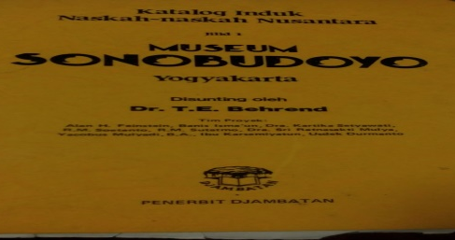
B. PROCESSING
A code based on the origin of the manuscript
Processing
Main Archipelago Manuscript Catalog compused by Sonobudoyo edited by Dr, T.E. Behrend

Slide 12
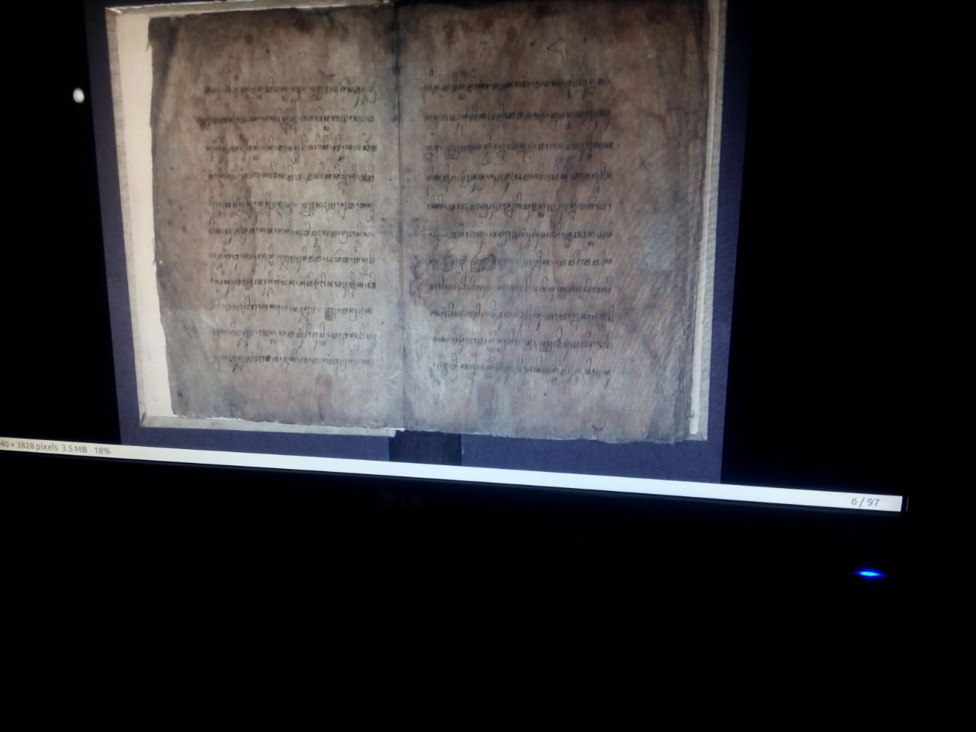
C.preservation
Digitalization
Registering
Process digitizing
Editing
Saving data on the hard drive and computer
Freezing
Collecting the data collections which will be freezing
Insert the ancient manuscripts in plastic and made air-tight
Heat up the Freezing tools in -9⁰C temperatures for one night
Compile the ancient manuscripts Freezing tools for one night with the same temperatures; -9⁰C.
Next, lowered the temperature of Freezing tools to -19⁰C, and left for 18 days.
After 18 days, the ancient manuscripts is taken out and the dust is vacumed
Manuscripts returbed to the storage are in the manuscripts room

Slide 13
D. ACCESS
The manuscript in the Sonobudoyo are not only used by the institution's internal environment, but is also open to the publics, so that people who want to use can apply for permission in advance to the Sonobudoyo museum.
Transcript printed 10% of the total page

Slide 14
conclusion
No Archives No History
One of type archive store information about the historical value is a static archive.
Management of static archive Sonobudoyo museum may apply in accordance with the Law of the Republic of Indonesia No. 43, 2009, such as; the acquisition of static archives, static archival processing, archives static preservation and access to static archives.

