Slide 1

Preserve The Culture Through Workshop and Sinau Batik held in Taman Fatahillah Library
Sofiana Rahmawati
Tamara adriani susetyo-salim
indonesia

Slide 2
Indonesia has diversity of cultural heritage such as :
  Traditional dance
  Traditional music
  Batik
  Art, etc
which needs to be preserved

Slide 3
The Role of Library
Supporting education
Opportunities of mass digital
Preserving cultural heritage

Slide 4
Preserving Culture
To defend the values of art and culture, traditional values by developing a dynamic embodiment, as well as adjusting to the situation and conditions are always changing and evolving.
Preserving Culture (library)
Means the national identity is not lost
Show support for the cultural identity of the public
Helping researchers conduct their studies

Slide 5
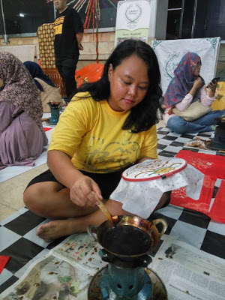
Workshop and
Sinau Batik Program

Slide 6
Workshop and Sinau Batik is a program created in 2012 by Taman Fatahillah library to preserve the culture of batik. The event was held once a month on Saturdays.
The library conduct the preservation of batik culture by introducing the meaning of batik and batik lesson. So batik lesson embeded into the culture and Indonesian assets which could continue to be preserved for future generation.

Slide 7
Activity
Provide the philosophy of batik
Introducing a variety of batik motif
Teaching how to make batik
Discussing more knowledge about batik lesson

Slide 8
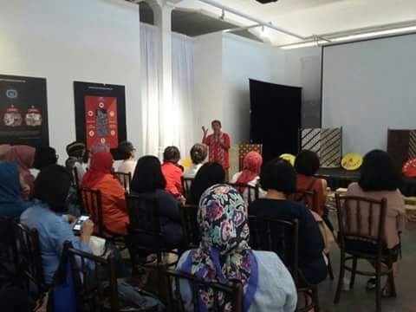
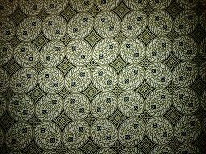
Provide the philosophy of batik
Kawung
The purpose of this activity as a prelude to the introduction of batik and explain about batik the deeper meaning.

Slide 9
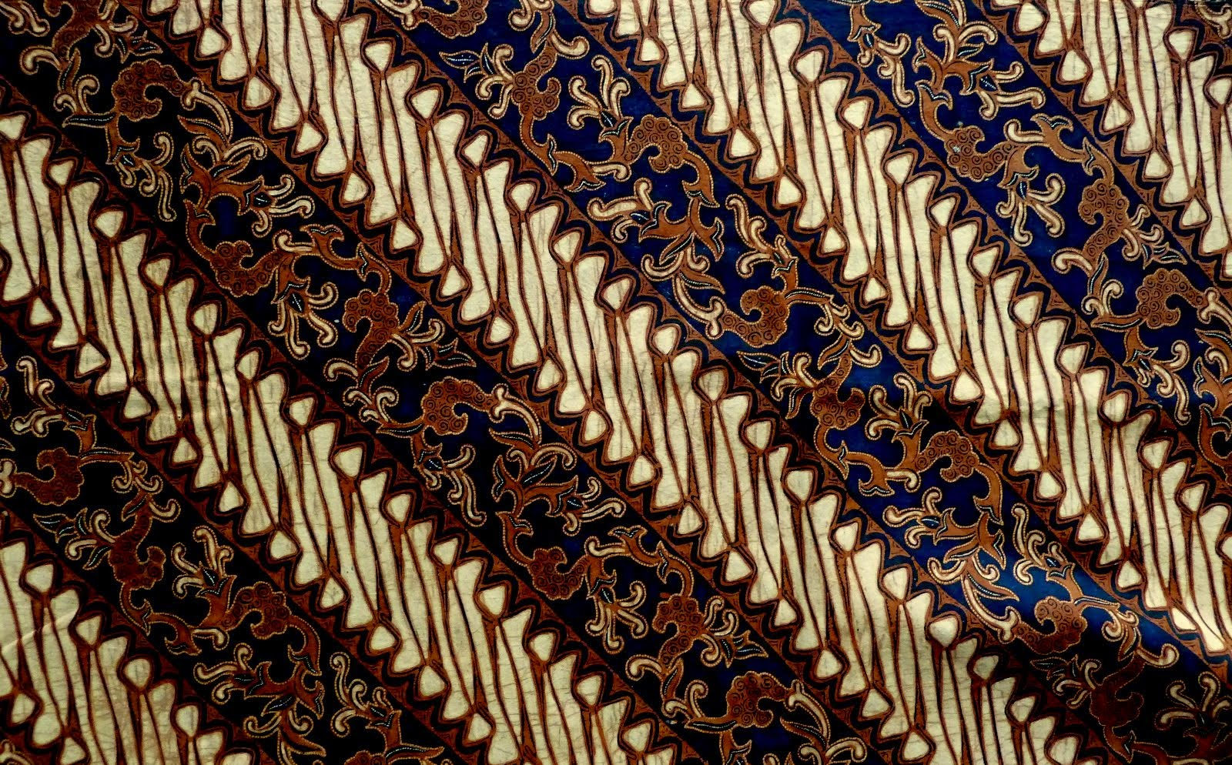
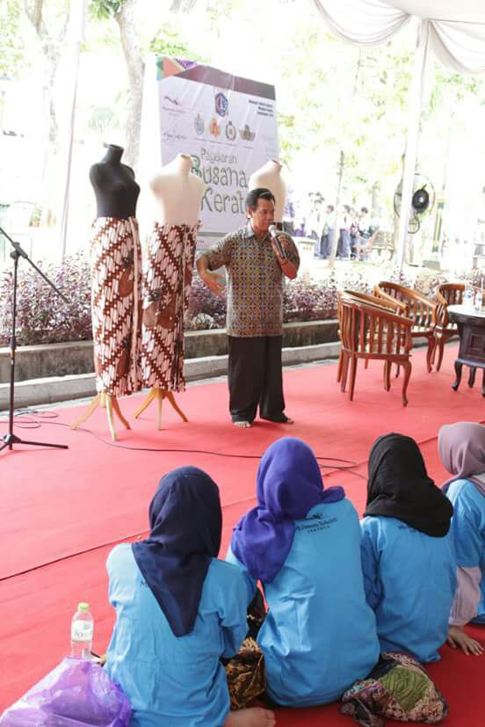
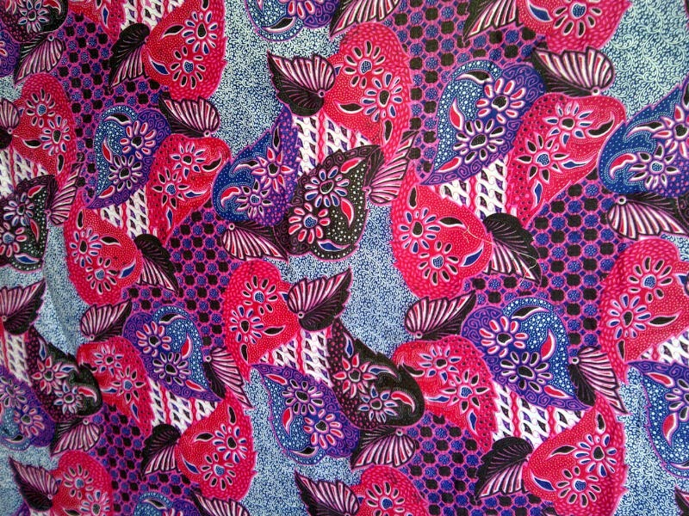
Introducing a variety of batik motif
Batik Solo
Batik Pekalongan

Slide 10
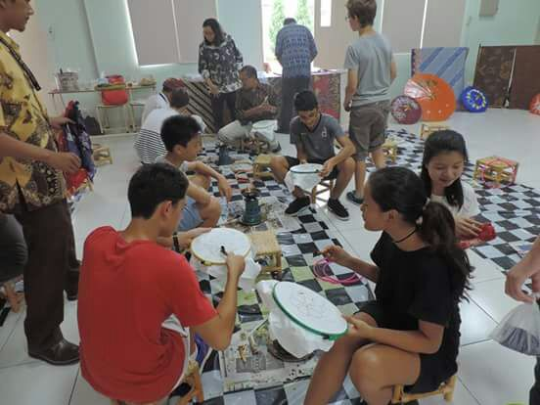
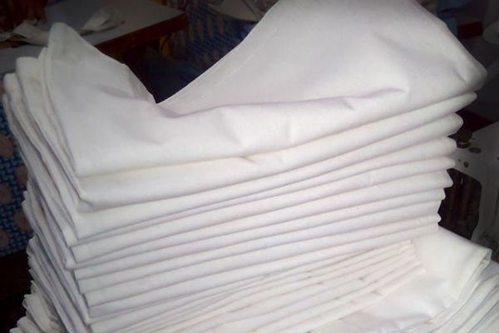
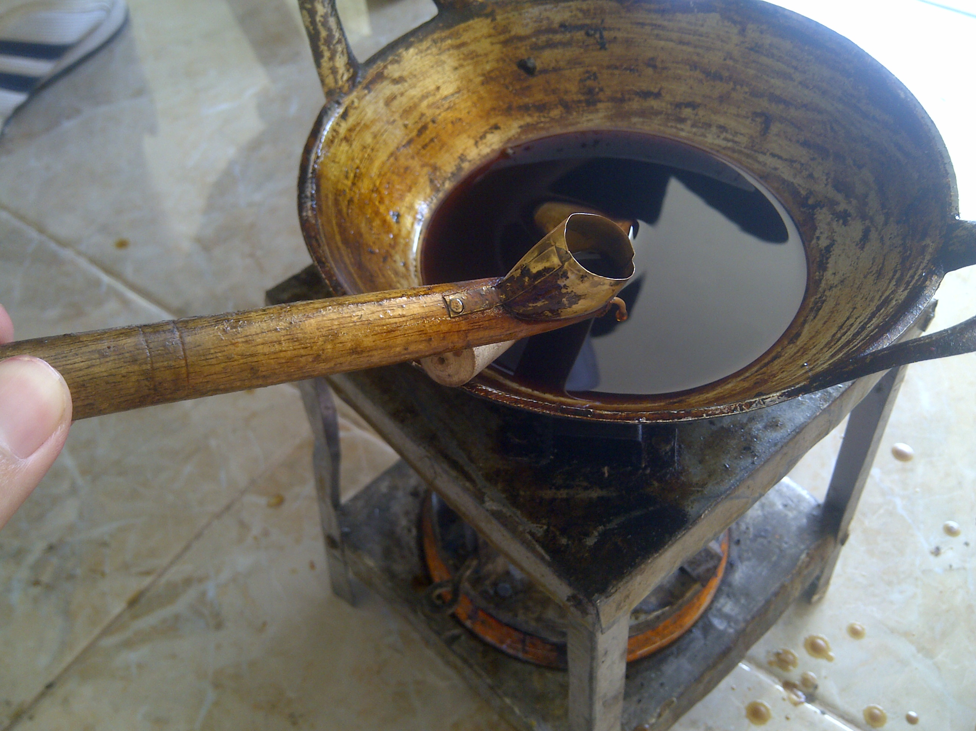
Teaching how to make batik
Mori Cloth
Canting, lilin malam and stain
Nerusi
By knowing how to make batik, in spite of adding to the experience, society could also be the successor in batik those batik will not be lost and can continue to grow.

Slide 11
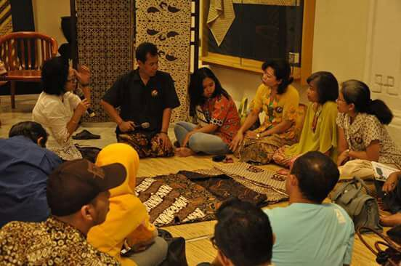
Discussing more knowledge
Discussion about Indonesian culture, especially batik. Here also who will share the knowledge of batik by communities.

Slide 12
Barrier in
Workshop and Sinau Batik
The lack of participation of the public to participate in this program.

Slide 13
Evaluation of
Workshop and Sinau Batik
The price of tickets to attend this program is so expensive
Only few people know about this program

Slide 14
conclusion
Taman Fatahillah Library already do the role of library is preserving cultural heritage with create Workshop and Sinau Batik. This program is very useful to introduce batik (philosophy, motif and how to make it), to preserving batik culture and to make public more loving of batik. However, just a lot of participation in Workshop and Sinau Batik. It should make some kind of fee levels to participate at a low cost and doing a promotion to the maximum. That way, the purpose of this program can be achieved.

Slide 15
source
Book :
Robertson, Deborah A. 2005. Cultural Programming for Libraries: linking libraries, public and culture, Chicago: American Library Association
Word Wide Web :
UNESCO. (2003). Convention for the Safeguarding of the Intagible Cultural Heritage. UNESCO: Paris. http://unesdoc.unesco.org/images/0013/001325/132540e.pdf.
Workshop dan Sinau Batik di Perpustakaan Taman Fatahillah. (2016). Retrieved from Sahabat Budaya Indonesia: http://sahabatbudayaindonesia2.blogspot.co.id/2016/01/test_14.html
Pentingnya Partisipasi Masyarakat Dalam Pembangunan Perpustakaan. (2009). Retrieved from Perpustakaan dan Kearsipan: https://sacafirmansyah.wordpress.com/2009/05/02/pentingnya-partisipasi-masyarakatdalam-pembangunan-perpustakaan-umum/

Slide 16
Thank you

