Slide 1
CONSERVATION AND DISASTER MANAGEMENT OF CULTURAL HERITAGE OBJECTS IN THE CENTER FOR PRESERVATION OF CULTURAL HERITAGE YOGYAKARTA Khusnul Khotimah, Sri Lestari, Ismiyatin
The 5th International Conference of Special Asian Libraries
Curation and Management of Cultural Heritage through
Libraries: Challenges and Opportunities for the Digital Society
May 11, 2017

Slide 2
Background
Historical and archeological heritage are parts of cultural inheritance that should be managed and preserved.As the cultural heritage is irreplaceable by other things, the cultural heritage object needs to be kept its safety

Slide 3
Research Question
How is the implementation of preservation and conservation of cultural heritage in the center for preservation of cultural heritage Yogyakarta?
How is the safety way that is implemented by the center for preservation of cultural heritage Yogyakarta toward all cultural heritage collections in Yogyakarta?
How is the disaster management of the center for preservation of cultural heritage Yogyakarta in protecting cultural heritage?

Slide 4
Theoretical Review PRESERVATION AND CONSERVATION OF CULTURAL HERITAGE
Preservation is an action or a process of steps implementation on supporting the originality shape and the integrity of building material.
Conservation is preventive action taken for maintaining and preserving an object using modern technology as an effort to stop weathering or damage so that age objects can be extended

Slide 5
The Method of Maintenance of Archeological and Historical Heritage
Traditionally maintenance by using hoes, sickles, trowel, broom sticks, ladders, etc.
Maintenance by conservation that is maintenance in order to preserve archeological and historical heritage by using chemical material and special tools for conservation. Application of this method is done by research and experiment in conservation laboratory.
Maintenance the environment and site of archeological and historical heritage by structuring the environment and archeological landscape.

Slide 6
What is Disaster? WHAT IS Disaster MANAGEMENT?
Disaster is an event or series of events that threat and disturb society life that is caused by natural factor and human error and cause fatalities, damage of environment, loss of property, and psychological effect.
Disaster Management is series of efforts that includes the determination of development policies that are at risk of onset of disaster, activity of disaster prevention, response, rehabilitation and reconstruction.
(Act 24/2007)

Slide 7
Kinds of Disaster (Act 24/2007)
Natural
Disaster
Un natural
Social
7

Slide 8
Cycle of Disaster Management
DISASTER
Preparedness
Response
Prevention
And Mitigation
Recovery

Slide 9
Activity of Disaster Management
prevention
mitigation
preparedness
early warning
response
relief
recovery
rehabilitation
reconstruction

Slide 10
Types of Collection
Sites: Prambanan Temple, Queen Boko Temple, Ijo Temple, Water Castle, Sambisari Temple, Kalasan Temple, Kimpulan Temple, Gebang Temple, etsc
Inscription: Rumwiga
Statue made of stone or bronze like Siva Mahadeva, Amitabha, Vajrapani, Bodhisattva, etc
Urn, bowl, cup, plate, clapper, pot, etc
Old money: coins of VOC and Dutch era, notes of Japan invasion era, Chinese currency, silver coins, and gold coins.
Papyrus manuscript of Javanese Middle Ages.
Jewelries: rings, pendants, bracelets, and mirrors.

Slide 11
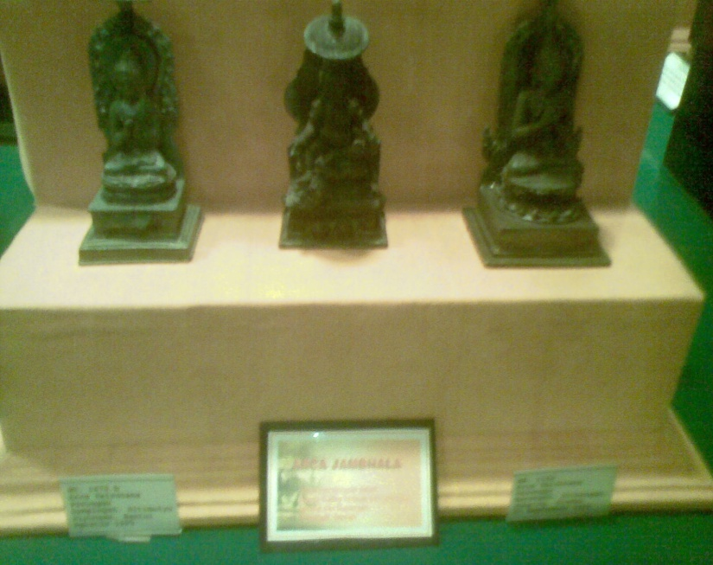
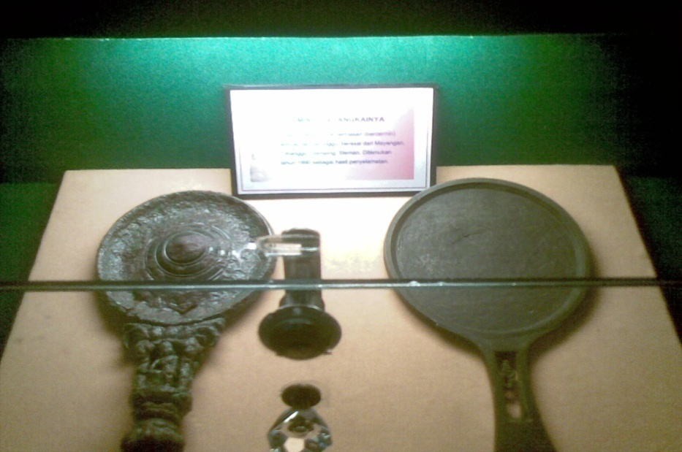
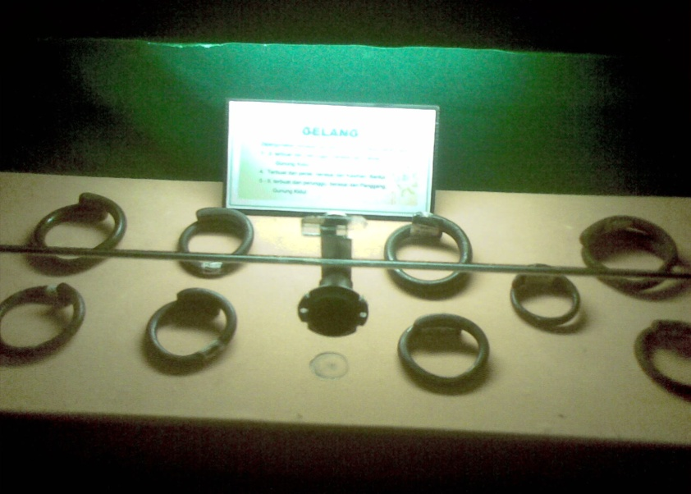
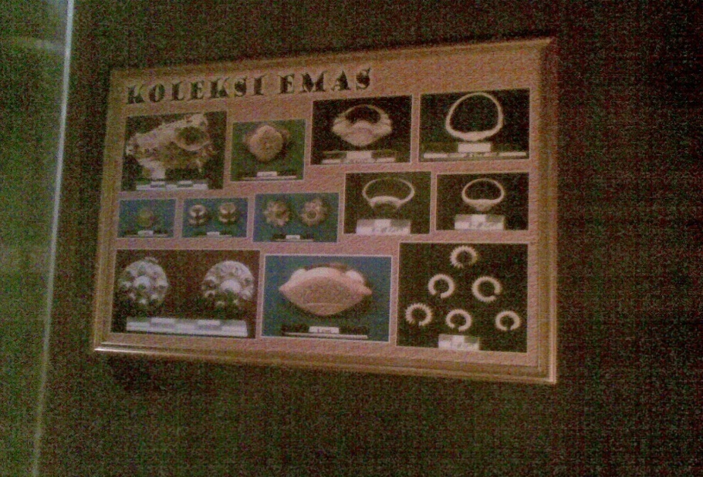

Slide 12
Discussion Preservation and Conservation at Center for Preservation of Cultural Heritage Yogyakarta
installing some instruments
Air Quality Meter is used to measure pollutant index around Prambanan temple which covers measurement of O2, NO2, SO4, CO andH2S.
Portable Climatology Weather Link is used to measure climatology around Prambanan temple that covers measurement of wind direction, rain fall, humidity, and intensity of sunlight.
Digital Stone Temperature Gauge is used to measure stone temperature digitally and remotely (to measure temperature of stone roof of temple).
Steam Cleaner is used to clean microorganism and dust attached on temple mechanically.
Creating replica of cultural heritage objects in exhibition event.

Slide 13
Objects are kept in display cabinet with room temperature and are set its humidity. The maximum temperature is 18° C and the light exposure is low
Consolidation is implemented in some methods, cleaning or incrustation (a layer material that forms on something), desiccation (natural and artificial desiccation), and handling (soaking/lubricating).
Preservation using pesticide is done by doing the cleaning, drying, and handling (brushing, soaking, and spraying of fumigation).

Slide 14
Security at Center for Preservation of Cultural Heritage Yogyakarta
Archeological and administrative data collections in order to investigate to criminal cases based on legislation rules
Actions based on report of crime against historical and archeological heritage
Establishment of Security
Establishment of educational forum and training of Civil Servants Investigator for officials in Directorate of Protection and Enforcement of Historical and Archeological Heritage at the central and local levels.
Building a Guardhouse
Establishment of lighting and other security system on cultural heritage sites
Establishment of information boards about prohibition, appreciation, guidance, and description
Monitoring the flow of traffic both between regions and out of Indonesian territory

Slide 15
Disaster Management at Center for Preservation of Cultural Heritage Yogyakarta
Prevention and Mitigation
Traditional preservation, strengthened by using concrete and sling belt
Preparedness
by installing some tools that can monitor the condition of the temple against the dangers that may threaten : seismograph, instrument for measurement of cracks of the temple that is caused by an earthquake and CCTV

Slide 16
Response
The first action is protecting the cultural heritage by conducting temporary preservation, both handling the objects and protecting it from the environment
Soon after the disaster is happened and it has been conducted security action then officer should report condition to get complete handling.

Slide 17
Recovery
Conduct a survey of objects of cultural heritage by observing directly in the field and recording data of the objects condition and environment.
Identify and analyze the damage and enclose the result of biological and chemical analysis.
Conduct a comparative study, look for appropriate conservation method, test the conservation materials, and conduct chemical test in a laboratory and in a field, finally get a conclusion of the appropriate conservation method.
Applying conservation based on the result of the previous analysis and all of the conservation processes are documented.
Perform cleaning action
Mechanical cleaning : brushing, scratching with/without water
Physical cleaning : vibrating, soaking, absorbing with pulp, water vapor
Chemical cleaning: use lime, ash, and chemical material.
Electrochemical cleaning : chemical material using electricity
Make improvement using steps as follow:
Gluing : joining together the broken fragments
Ordinary splicing and dowelling splicing ( joining together use brass)
Restoring : fixing the damaged parts
Replacing : replacing defective parts use similar quality
Injection : filling defective parts
Camouflage : harmonizing texture and color of the objects

Slide 18
Thank you for the attention

