Slide 1



COLLECTION MANAGEMENT OF PBK LIBRARY
Dr. O. N. Chaubey
Chief Librarian
Pravasi Bhartiya Kendra
Ministry of External Affairs
New Delhi, India
Inaugurated by PM on 2nd October 2016

Slide 2
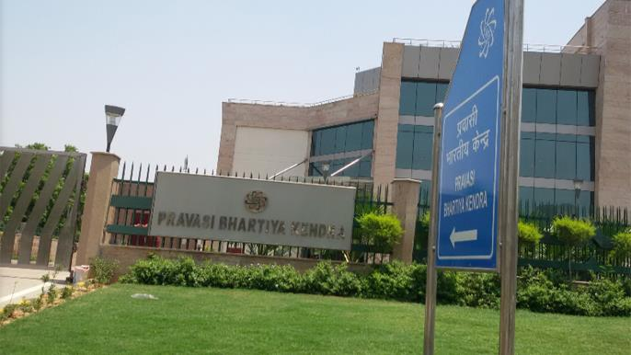
PRAVASI BHARTIYA KENDRA
15 A, Rizal Marg, Chanakyapuri, New Delhi, India

Slide 3
INTRODUCTION
The Indian Diaspora constitutes a significant economic, social and cultural force in the world today. Overseas Indians estimated at over 28 million are spread across the world. Their industry, enterprise, education, expertise and economic success are widely recognized. To strengthen linkages of overseas Indians to their place of origin and with each other, Government of Indian has established The Pravasi Bhartiya Kendra(PBK).
PBK an Overseas Indian Centre under the Ministry of External Affairs, Government of India has set up to emerge as the focal point for networking between India and its overseas Indian community; and as a suitable place which would commemorate the trials, tribulations, the evolution and achievements of the Indian Diaspora. This centre welcome Indian Diaspora living in over 150 countries.

Slide 4
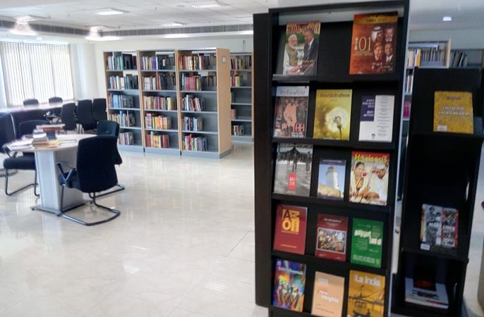
PRAVASI BHARTIYA KENDRA LIBRARY
The Library of PBK is a valuable repository of materials including more than 3000 books collected within month through Indian Embassies / High Commissions about the Indian Diaspora as well as books written by overseas Indians in different languages. PBK Library has been developed as a hybrid library having printed as well as digital resources available for its users. Half of the print materials collected through Mission abroad. The library is fully automated with KOHA open sources software. User can access its resources through Online Public Access Catalogue (OPAC).

Slide 5
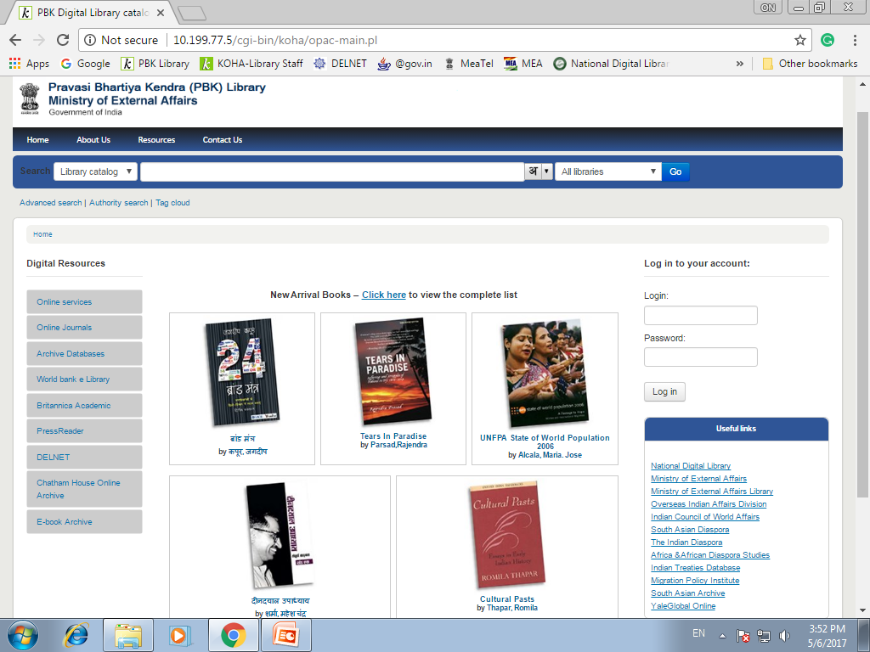

Slide 6

PBK DIGITAL LIBRARY
With an emphasis on digital material,
the library provides access to:
96 Online Periodicals
7 Online Services
7 Online Archival Databases
4 Online Newspapers Databases
Prestigious e-Books Resources

Slide 7

I- ONLINE PERIODICALS
Cambridge Journals-12
Elsevier Journals- 02
John Wiley & Sons Ltd.-02
Sage Journals-15
Taylor &Francis-24
Oxford Journals-13
IP based Access Journal-2
Other Publishers -26

Slide 8

II-ONLINE SERVICES
PBK library also provides several very valuable online full text services regarding independent and rigorous analysis of critical global, regional and country-specific challenges and opportunities; country report, market risk, microeconomics forecast, risk rating, business environment, news, views, and depth data analysis in different languages through different online consortium and archival databases some of them are ....
Africa Confidential
BBC Monitoring
Business Monitor Online
Britannica Academic Edition
Economic Intelligence Unit (EIU)
IHS Jane’s Online Services
MarketLine Advantage

Slide 9
1. Africa Confidential
Africa Confidential is one of the longest-established specialist publications on Africa, with a considerable reputation for being first with in-depth news and analysis on significant political, economic and security developments across the continent.
Agencies of national governments - including defense, national intelligence, foreign affairs and the diplomatic corps.
Risk advisory firms working in areas as varied as political, market & reputational risk, due diligence, anti-corruption (FCPA and UK Anti-Bribery Act) and KYC (Know Your Customer).
Multilateral institutions - including the IMF/World Bank, European Union and African Union.
Universities and other academic institutions, in their departments of African Affairs, International Relations, International Development, and others.
A wide range of international NGOs and think tanks working in the areas of humanitarian affairs, relief aid, anti-corruption/good governance and economic development.
Multinational corporations and companies across a wide variety of commercial sectors, from mining, energy and telecommunications, to financial markets and automotive.

Slide 10
2. BBC Monitoring
BBC Monitoring, a division of the British Broadcasting Corporation, is UK's leading provider of news and information gathered from round-the-clock monitoring of world's media. The news and information offered is based on monitoring of Radio, TV, Press, Internet and News Agency sources around the world. The information is available on a searchable online database – BBC Monitoring Online. The database draws from over 3000 media sources, translated from over 100 languages. About 800 items are added each day, translated into English where necessary.

Slide 11
Business Monitor International(BMI) covers country risk and business forecasts; financial markets; industry research and company intelligence as follows:
3. Business Monitor Online
Country Risk and Business Forecasts: Intra-daily country risk analyses, 5- and 10-year macroeconomic forecasts, sovereign risk ratings and business environment rankings for 175 markets worldwide.
Industry Research: Latest-available research through 130,000 senior executives at 45,000 leading multinational companies, located across emerging markets worldwide.
Financial Markets: BMI's Financial Markets service provides daily analysis, forecasts, and specific trade ideas on global currencies, local and external debt, sovereign credit default swaps, interest rate instruments, equity indices and commodities across global financial markets.

Slide 12
4. Britannica Academic Edition
Britannica Academic delivers fast and easy access to high quality, comprehensive information. The rich combination of the venerable Encyclopaedia Britannica plus Merriam-Webster’s Collegiate Dictionary, magazines and periodicals, and may other research tools provides the variety of reliable sources that students need to consult when conducting research:
In excess of 100,000 new and revised articles, with contributions from more than 100 Nobel laureates, numerous heads of state, Pulitzer Prize winners, leading professors, and experts in all fields of human endeavor.
Integration with Britannica Image Quest, which offers a streamlined ability to explore millions of related images right from the search results page (requires subscriptions to both resources).
A unique “Article History” feature, which allows users to see every update or editorial change in every article.

Slide 13
Britannica Academic Edition continue……….
Biography, subject, and contributor browses; e-books and primary sources; thousands of periodicals.
News feeds from the New York Times and the BBC; editor-selected Web sites; an interactive world atlas; the Merriam-Webster Collegiate Dictionary; and famous quotations.
Updated versions of the World Data Analyst and articles from the Britannica Book of the Year as well as thousands of photographs, videos, graphs, and illustrations.
A fresh and engaging look, with a new user interface; improved search capabilities; and a cleaner overall design.

Slide 14
5. Economic Intelligence Unit (EIU)
The Economist Intelligence Unit (EIU) is the research and analysis division of the Economist Group and the world leader in global business intelligence. EIU’s Electronic services and publications covers over 200 markets, including country analysis and forecasts, risk assessments, economic and market data, daily news analysis, industry trends and management strategies. Followings are main forecast, reports and views at global level:
Country Reports Global
Country Forecast Global
Views Wire Global
Energy Briefing & Forecasts

Slide 15
6. IHS Jane’s Online Services
IHS Jane’s is the premier provider of global market, industry and technical information, analysis and expertise across virtually every level of any operation and enterprise. Its online services have a number of advantages over receiving different information in print. Stay abreast of the latest world and industry developments as they unfold followings:–
Worldwide news and features:
Market forecasts and trends
Country risk assessments
Equipment specifications
Daily news digests from 500+ international sources
Extensive coverage with exceptional usability
Interactive features for enhanced usability include:
At least five years archive, often significantly more analytical tools, graphs and dynamic charting for selected content
Reference content, analysis, images and video
Active interlinking for seamless navigation

Slide 16
6. IHS Jane’s Online Services continue……….
PBK Library Users can start his/her research by entering a keyword search above or by selecting a subject area from Services.
Country Risk Daily Report, Defence Industry, Defence Weekly, Defence: News Module, Intelligence Review, Intelligence Weekly, International Defence Review, Islamic Affairs Analyst
Land Warfare Platforms: Artillery & Air Defence, Missiles and Rockets, Navy International
Security: News Module, Sentinel Security Assessment – China & Northeast Asia, Sentinel Security Assessment – South Asia, Terrorism & Insurgency Monitor, Terrorism Watch Report
World Insurgency & Terrorism information can be search through:-
Janes Defence Weekly
Janes Intelligence Review
Janes Intelligence Weekly
World Insurgency & Terrorism

Slide 17
7. MarketLine Advantage
MarketLine Advantage is an interactive platform, giving users any time access to a unique mix of company, industry, financial and country business data, for every major marketplace in the world. Extensive global coverage of industries with 4000 industry profiles and 30,000+ companies within 215 countries. It covers the following Databases:
Country Statistics
Financial Deals Tracker
Company Prospector
Company Report Generator
Market Data Analytics

Slide 18

III- Online Archival Databases
Chatham House Online Archive1920-2008
JSTOR
Kessing’s : World News Archive
ProQuest ABI/Inform Complete
ProQuest Historical Newspapers-The Wall Street Journal(1889-1995)
ProQuest Historical Newspapers-The Guardian and The Observer (1791-2003)

Slide 19
1. Chatham House Online Archive1920-2008:
Chatham House Online Archive contains the publications and archives for the Royal Institute of International Affairs (Chatham House), the world - leading independent international affairs policy institute founded in 1920 after Paris Peace Conference. The Institute's analysis and research, as well as debates and speeches it has hosted, can be found in this online archive, subject-indexed and fully searchable.
It offers users invaluable insights into the changing dynamics of the 20th century world, including:
The end of colonialism
The development of communism and the Cold War
Post war reconstruction
The rise and collapse of ideologies and dictators

Slide 20
2. JSTOR:
JSTOR is part of ITHAKA , a non-profit organization. It is a digital library of academic journals, books, and primary sources. JSTOR helps people discover, use, and build upon a wide range of content through a powerful research and teaching platform, and preserves this content for future generations.
JSTOR is powerful platform to find the perfect article, explore new topics, and organize your research using JSTOR’s powerful search engine and tools.
Its archival collection is a database containing back issues of more than 2,000 academic and professional journals spanning 50 disciplines and more than 350 years of scholarship including some of the most authoritative and widely read articles in the arts and sciences. The exceptional content has been preserved in its original form and is of the highest-quality digital format.

Slide 21
3. Keesing’s : World News Archive:
Keesing's was founded in 1931 with the intention of creating a lasting archive of original, accurate, and objective articles on the world's political, social, and economic events. Keesings team of news writers and editors (based in Cambridge, UK) create a series of concise, clear articles which are published every month, providing readers with a digestible but detailed summary of global news.
Since 1931 Keesing’s has collected news reports on a daily basis from all over the world in a wide range of languages. These constitute a concise, accurate and unbiased account of important developments in each of the world’s countries, major international organizations and within selected thematic topics.
The Keesing’s archive of over 1 lac articles includes coverage of:-
Elections and changes of government in every country
Social issues such as immigration and asylum
Wars, treatises, and diplomacy
Terrorism and issues of internal security
Legislation, budgets, economic developments, and international agreements
Natural disasters, environmental issues, and scientific discoveries

Slide 22
3. Keesing’s : World News Archive continue ……..
Keesing’s World News Archive also includes useful primary source material such as speeches and UN resolutions.
Some of the special features of Keesing’s archives are:​
A ‘Portfolio’ feature allows users to select and store articles, tag interesting information, and share tags with other users.
‘Breaking History’ articles highlighting major stories worldwide. Coupled with corresponding timelines, these articles highlight connections between current events and modern history
Users can search by date or keyword, and filter results by country or person

Slide 23
4. ProQuest ABI/Inform Complete
ABI/INFORM Complete includes important full‐text journals and much sought‐after titles from the business press as well as key trade publications, dissertations, conference proceedings, and market reports. Through agreements with some of the world’s most prestigious publishers including Cambridge University Press, Dow Jones & Company, Emerald Group Publishing, Palgrave MacMillan, the Financial Times Group, and the Economist Intelligence Unit ProQuest provides access to hundreds of key business titles:-
Key ongoing full-text journals
Key ongoing full-text periodicals
Key ongoing full-text analyses include: Market and industry reports from Economist Intelligence Unit, Oxford Analytica.
Other key full-text non-journal content
Subject coverage

Slide 24
5. ProQuest Historical Newspapers – The Times of India Archive (1838-2006):
This historical newspaper provides genealogists, researchers and scholars with online, easily-searchable first-hand accounts and unparalleled coverage of the politics, society and events of the time. Its coverage are from the year1838 to 2006 and Subject coverage are -Historical local, regional and national news & Multidisciplinary.

Slide 25
6. ProQuest Historical Newspapers-The Wall Street Journal(1889-1995)
The Wall Street Journal provides PDF images of essentially all the content published in The Wall Street Journal from its first issue in 1889 through 1995. It is searchable by keyword, author, article title, and first paragraph as a abstract. It includes editorials, illustrations and advertisements, anything that appeared in the original edition. You can browse issues by clicking Publications at the top of the screen.

Slide 26
7. ProQuest Historical Newspapers-The Guardian and The Observer (1791-2003)
ProQuest UK and Ireland Historical Newspaper Collection (formerly ProQuest Historical Newspapers) is a historical newspaper archive that includes The Guardian 1821-2003 and The Observer 1791-2003, The Irish Times 1859-2011 and The Weekly Irish Times 1876-1958, and The Scotsman 1817-1950 also all leading British and Irish titles of specific interest and relevance to the UK Higher Education community

Slide 27
IV. Online Newspapers Databases
International New York Times
Financial Times
PressReader
Wall Street Journal (WSJ)

Slide 28
1. International New York Times
International New York Times is a leading international source for opinion leaders and decision- makers around the globe. With dedicated newsrooms in Paris, London, Hong Kong and New York, and journalists reporting from all corners of the globe, its informative, inspiring and intelligent coverage of the world makes it required reading in 130 countries around the world.

Slide 29

2. Financial Times(FT)
FT.com provide following tools for corporate subscribers:
Email alerts
Keyword Alerts
Company News & Price Alerts
Email Briefings
Corporate Services

Slide 30
3. PressReader:
PressReader provides unlimited access to more than 6,000 of the world’s premium and trusted same-day newspapers and magazines from over 120 countries in 60 languages under a single subscription.
Key features of PressReader:
Content presented as an exact digital replica (on-screen, same as print)
Read publications and stories just as they appear in print
Personalized user experience on PC, mobile and tablet
Customized news feed with relevant topics and sections of publications to build your own tailored news-feed
Easily discover content searching by keyword or by publication name, country, or language
Saved key-word searching with monitoring alerts

Slide 31
3. PressReader continue……..
Advanced key-word searching with monitoring alerts
Instantly translate stories in up to 18 languages
Saved topics of interest which are integrated into users daily home-feed
Bookmarking into curated collections, which can be accessed at a later date for reference or sharing
Channels – a unique way to share curated content to colleagues, associates or followers
Commenting, opinions and supporting or opposing specific content.
Social integration externally (Facebook, Twitter, etc.) and internally (PressReader)
Download full issues for offline reading
Auto-delivery of content to users mobile or tablet device
Listen to stories with on-demand audio
Synced user profiles across multiple devices
Print full-content pages or articles

Slide 32
3. PressReader continue……..
PressReader has gifted 1 month of access to all attendees of ICoASL.
Visit: http://letstalk.pressreader.com/ICoASL

Slide 33
4. Wall Street Journal (WSJ):
The Wall Street Journal is a business-focused, English-language international daily newspaper based in New York City. The Wall Street Journal is published six days a week, along with its Asian and European editions. The main benefits of Wall Street Journal are as follows:
Financial, business and world news updated 24/7 with 200 new stories added daily
Online personalization tools
30,000+ company profiles and 25 industry-specific sections
Market Data Center "at-a-glance" dashboard

Slide 34


E-Books
The Library of Pravasi Bhartiya Kendra acquired collection of the World Bank Groups eLibrary and Bloomsbury collections of online eBooks.
1. Bloomsbury E-Books Collections:
Bloomsbury collections deliver online access to scholarly books from Bloomsbury’s award-winning Academic division. Spanning the humanities and social sciences, the site features the latest research publications from Bloomsbury, T&T Clark, The Arden Shakespeare and Hart Publishing, alongside scholarship from historic imprints Continuum, Berg and Bristol Classical Press. New collections are added each year.
It provides instant access to quality research and delivers libraries with a flexible way to build e-Book collections across the international relations. It contains over 5,000 titles, featuring content from Bloomsbury’s latest research publications as well as a 100+ year legacy. Options are flexible to help librarians complete their collections by subject, collection year, or selected series.

Slide 35
1. Bloomsbury E-Books Collections: Continue……
Main features and benefits of Bloomsbury collections are as follows:
Instant access to 100s of key works, easily navigable by research topic
Cite, share and personalize content
Search full text of titles; filter by date, series or subject
Browse by subject
Find the most relevant book chapters quickly and intuitively
Hyperlinks: find works in the same subject or by the same author; link between text and endnotes or bibliography
Download and print chapter PDFs without DRM restriction
Use on your tablet or smart phone

Slide 36
2. World Bank eLibrary
The World Bank is the world’s largest source of development assistance. In support of its mission—to end extreme poverty and promote shared prosperity—the World Bank conducts and publishes research on a broad range of global and regional issues affecting developing countries.
The World Bank eLibrary is a subscription-based website for institutions, dedicated to offering researchers quick and easy access to the complete collection of World Bank publications since the 1990s. Built on a state-of-the-art platform, the World Bank eLibrary also offers a variety of added-value functionality to take users to the content they need as efficiently as possible. Content in the eLibrary is carefully curate to meet the highest academic and editorial standards. Users of eLibrary are assured full and immediate access to all academic research and scholarship published by the World Bank.

Slide 37
2. World Bank eLibrary continue……..
The World Bank eLibrary has been serving the unique needs of researchers and librarians since 2003. It offers a variety of tools and enhanced functionality, saving users valuable time. Special features and conveniences include personalization, citation support, MARC records for cataloguing, and indexing in the major library discovery products.
It covers a broad range of global topics and issues that are relevant in today’s increasingly interconnected world – such as climate change, public health, conflict and security, education, jobs, and migration, international economics and finance.

Slide 38
2. World Bank eLibrary continue…..
The World Bank eLibrary contains a wide array of content types including:
All World Bank flagship and annual publications
Regional and thematic series
Training manuals and handbooks
Working papers
Journal articles from The World Bank Research Observer and The World bank Economic Review
Data publications
Top country and regional data from World Development Indicators
The World Development Indicators are the primary World Bank collection of development indicators, compiled from officially recognized international sources, presenting the most

Slide 39
CONCLUSION
Pravasi Bhartiya Kendra Library possesses rich collection in digital format. With all resources collected at PBK library, centralized repository of hybrid library is available to the Indian Diaspora users worldwide. Probably this is going to be the first such library in the Asian continent that aims to fulfill the twin objectives of commemorate the trials and tribulations, as well as the subsequent evolution and achievements of the diverse Indian Diaspora. Digital repository of such material can certainly help towards keeping the cultures alive at least in the virtual sense for posterity. The Government of India under the Ministry of External Affairs is making endless efforts to sustainable, symbiotic and mutually rewarding economic, social and cultural engagement between India and its Diaspora.

Slide 40
Thank you
Mail your suggestions at:
pbklibrary@mea.gov.in
(O): +11-24156444
(M): +91-9868103286

