Slide 1
IcoASL 2017 INFORMATION REPACKAGING IN PRESERVING INDEGENOUS KNOWLEDGE OF MINANGKABAU FOLKLORE
DIAN HASFERA
(UIN IMAM BONJOL PADANG)

Slide 2
INTRODUCTION
Folklore as a local identity
Malin Kundang : West Sumatera
Tangkuban Perahu : West Java
Roro Jongrang, Bondowoso : Yogyakarta
Folklore VS Foreign Fairytale

Slide 3
Interested of Elementary Students Reading Folklore
Indicator Question | SD 04 Tarandam (65 student) | SD 23 Pasir Sebelah (88 student)
The favorite activities Reading Watching TV | 10 studens 55 studens | 22 studens 60 studens
Knowing folklore No Yes | 39 studens 26 studens | 68 studens 14 studens
Parents did storytelling Yes, they did Never | 21 studens 44 studens | 29 studens 53 studens

Slide 4
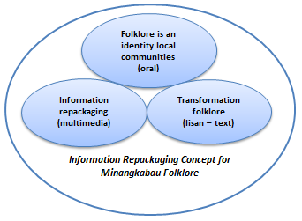
The Information Repackaging Concept of Minangkabau Folklore

Slide 5
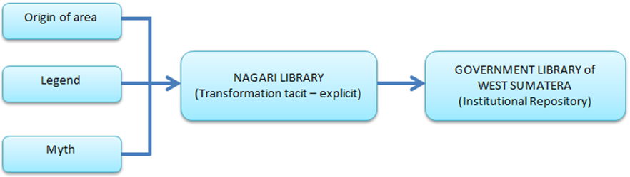
Collecting Minangkabau Folklore by Nagari Library

Slide 6
Minangkabau Folklore
19 District/City
Kab. Agam : ca. 51 folklore
Kab. Dharmasraya : ?
Kab. Kepulauan Mentawai : ?
Kab. 50 Kota : ?
Kab. Padang Pariaman : ?
Kab. Pasaman : ?
Kab. Pasaman Barat : ?
Kab. Pesisir Selatan : ?
Kab. Sijunjung : ?
Kab. Solok : ?
Kab. Solok Selatan : ?
Kab. Tanah Datar : ?
Kota Bukittinggi : ?
Kota Padang : ?
Kota Padang Panjang : ?
Kota Pariaman : ?
Kota Payakumbuh : ?
Kota Sawahlunto : ?
Kota Solok : ?
Total
?
……. Folklore

Slide 7
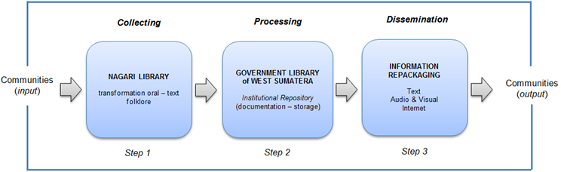
The Stage of Information Repackaging Preserving Indigenous Knowledge Minangkabau Folklore

Slide 8
