Slide 1
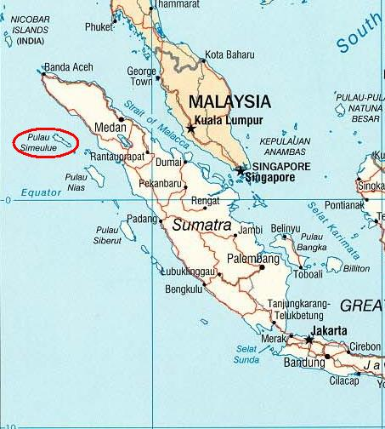


THE ROLE OF LIBRARY
IN MANAGING ORAL DOCUMENT
(LITERATURE STUDIES ON INDIGENOUS KNOWLEDGE FOR DISASTER MANAGEMENT IN SIMEULEU ISLAND)
Dian Novita Fitriani University of Indonesia
Niswa Nabila S.B.A Defense University Indonesian

Slide 2
Introduction
Indonesia is a country with a high potential of disasters caused by the movement of tectonic plates. This is due to Indonesian territory that is located at the confluence of two longest active mountain path in the world (Nugroho, 2015).
PROBLEM
On December 26, 2004 earthquake occurred in a depth of 4 km from the sea and measuring 9.0 SR in the bottom of sea that caused a tsunami. More than 200,000 people died.
A total of 400.000 people were displaced and lived in a refugee camp (Arief, 2010). .
PHENOMENON
But on the Simeuleu Island, which is located just 40 km away from the centre of the earthquake; two tsunamis did not cause many casualties in the areas such as Aceh and Nias Island but only killed seven people from a total of 78,000 population of Simeuleu.
WHY?
they have indigenous knowledge (IK) called Smong. Smong is a poem about the tsunami that happened in 1907. The poem Smong contains characteristics of impending tsunami through the experiences of their ancestors in the past. Smong is an example of IK that serves as mitigation and preparedness when tsunami will happen.
Deborah Turner discovered that IK is one of the oral forms of documents. IK is a unique knowledge in a given society. IK was disseminated orally transformed into oral artefacts that able to convey specific information by passing of information from person to person by oral communication. As one of the documentary institutions, libraries should be sensitive to these changes.

Slide 3
The Evolution of New Documentation Concept
Suzanne Briet defined that the document is things which are concrete or symbolic in a sign that preserved and stored until the completion of representatives, from building back, or providing physically, or intellectual phenomenon.
Buckland’s definition is constructed by Briet and revealed that the documents are all informative things.
Oral Document
Turner understands oral document in the form of a working definition as an oral document artefacts are able to convey evidence or information to a specific content that is delivered via oral. This definition reflects how a document conveys oral evidence or information in two ways, words and actions. The results of Turner's study revealed that the utterance can produce certain kinds of artefacts. Such as the article that is able to contribute to the knowledge, speech can also produce artefacts of information.

Slide 4
From that Point!
The Question are?
1) Is the IK can be recognized as an oral document?
2) Is oral document can be used as a library collection?
3) How is the role of libraries in managing IK "Smong" for disaster management in Simeulue Island

Slide 5
Method
This study used qualitative research methods specifically literature study. Literature study is conducted by the researcher to gather the relevant information and has a correlation with the topic or the problem. Nasution (2003) states that literature study qualitatively can be viewed as a resource same as a person who can answer questions.

Slide 6
Indigenous Knowledge as a Form of
Oral Document
Turner defined oral document as a document that uses oral delivery mechanism. The other forms of oral documents can be clearly understood through the concept of oral history or oral tradition
The characteristic of oral tradition as well as IK is where knowledge or messages transmitted orally from generation by generation
IK contrast with the international knowledge system generated by universities, research institutions and private firms. It is the basis for local level decision making in agriculture, health care, food preparation, education, natural resource management, and a host of activities in rural communities
However, it should be noted that all speech is not an oral document. To analyze whether the speech can be described as an oral document, it must be abide by a factor of four documents that was articulated by Frohman.

Slide 7
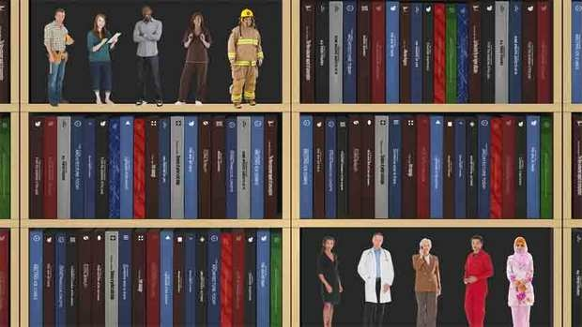
Oral Document as Library Collections
Sulistyo Basuki (1993: 3) library is a room, part of a room, or the building itself used to store books and other publications are usually stored according to specific arrangements to be used by the reader, not for sale.
Law No. 43 In 2007, the library is an institution which manages the collection of books, copies and / or records professionally with a standard system to meet the needs of education, research, preservation, information and recreation of the users.
Law No. 4 of the 1990 about deposit of printed and recorded, records are all kinds of recordings of any intellectual or artistic works are recorded and duplicated in the form of tape, disk and other forms in accordance with technological developments intended for the public.
Library as one of the documentary institutions should be adapting to the development of the new documentation concept which is happening at the moment.
The terminology of document changed rapidly, started from only two and three-dimensional things, then have been changing to include three-dimensional documents and live.

Slide 8




The Role of Library in IK's Managing Disaster Management on Simeulue Island, Aceh
Collecting papers about IK both in analog or digital form
Collecting speech about Smong
Manage and empower the community to be directly involved in managing IK

Slide 9
Conclusion
Based on Turner’s theory, IK is one form of oral document, Smong is one of IK, "Smong" proved to be effective in disaster mitigation on Simeulue Island.
The role of library as a documentary institution to manage IK : by collecting speech, collecting article about IK and doing the action.
The definition of document is changing rapidly. Currently, the definition is different from the previous meaning. Documents are not only limited to two and three-dimensional things, but also grown to include live three-dimensional.

Slide 10


