Slide 1
Revitalization of Ki Hajar Dewantara Theory Through Library Service (A Case Study of the Sarjanawiyata Tamansiswa Library University)
Rosiana Nurwa Indah
Sunan Kalijaga State Islamic University Yogyakarta
Email: rosianaindah7@gmail.com
WhatsApp : 089696970993

Slide 2
TABLE OF CONTENTS
01
Introduction
02
The Goal and Research Methode
03
Literature Review
04
Discussion
05
Conclusions
06
Contact Us

Slide 3
Introduction
Support the education and provide information access and become the culture agents
College libraries as a part of educational institution
The explosion of information
.
Library contribution in collected various information which contains; historical elements, community leaders, society culture, and a variety of information containing a cultural values
a challenge for the library as an institution as an information provider
.
Library is the whole idea of ​​education

Slide 4
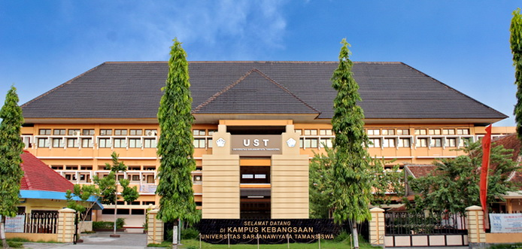
Location Study
The location study that the researcher choose is in the Sarjanawiyata Tamansiswa University because Sarjanawiyata Tamansiswa University is a university which in practice was influenced by the theories of Ki Hajar Dewantara.
4

Slide 5
The Goal
The objective of this study aimed to find out how the efforts and roles of the University Sarjanawiyata Tamansiswa library in introducing and preserving the theory of Ki Hajar Dewantara in the new era through innovation services breakthrough.
Research Methode
This study used qualitative research methods. The approach used is a case study used to describe the condition from the research, surveys, and describ a story from the information. The techniques of data collection in this research are observation, interviews and documents.

Slide 6
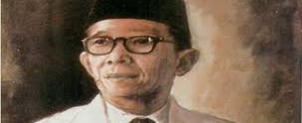

Literature Review
1. Ki Hajar Dewantara Theory
2. Library Services
Various works produced by Ki Hajar Dewantara also contains a lot of inspiration, known as the theory of Ki Hajar Dewantara. This theories used as a guide, especially in the field of education like Tri teachings of the Education Center, the family, school, and community; Among System concept or Tutwuri Handayani; The Leadership trilogy, is “Ing ngarsa sung tulada, Ing madya mangun I karsa, and tutwuri handayani”, and others.
Library services is one of the most important part of the library. according to Kinnell (Judith and Preston, 2000: 155), the library service is something that is offered by the library to the community or the user, as of that the community or the library user can know the existence range of information services and various media resources owned by the library.

Slide 7


Discussion
In order to pursue the revitalization of Ki Hajar Dewantara theories, the library provides two innovative services :
Tamansiswa Service
This service is a borrowed collection services in the form of Tamansiswa special collections and Ki Hajar Dewantara collections which can be used as a means of discussion, workshops and learning activities.
Ki Hajar Dewantara Corner
Ki Hajar Dewantara Corner is the corner exhibition of all collections, stuff and artistical that are owned and associated with Ki Hajar Dewantara.
This corner aims to the library users to know the stuff and artistical of Ki Hajar Dewantara.

Slide 8
The Library Roles of Revitalising The Theories of Ki Hajar Dewantara
01
Helpful in complete the coursework about Ki Hajar Dewantara theories
02
Help to understand the theories of Ki Hajar Dewantara and Tamansiswa
03
To support research about Ki Hajar Dewantara theories
04
Preserving the cultures treasures

Slide 9
Conclusions
In order to pursue the revitalization of Ki Hajar Dewantara theories, the library provides two innovative services, namely Tamansiswa Service, and Ki Hajar Dewantara Corner which reserved for the users. Both library services use multimedia devices; providing room for a means of discussion or learning activities; changing collections in digital form; reprint collections that have not been published; entered into a collaboration with the Taman Siswa Museum; and provide a resources for discussion for researchers.
These efforts aim to create the library's role in realizing the needs of the users in Ki Hajar Dewantara theories and facilitating the users to various collections of Ki Hajar Dewantara theories; and fill the needs of the preservation of cultural treasures.

Slide 10






Revitalization of Ki Hajar Dewantara Theory Through Library Service (A Case Study of the Sarjanawiyata Tamansiswa Library University)
Rosiana Nurwa Indah
Sunan Kalijaga State Islamic University Yogyakarta
facebook
WhattsApp
Email
facebook.com/rosiana nurwa indah
089696970993
rosianaindah7@gmail.com

Slide 11
That’s all. Thank you!

