Slide 1
Digital Transformation of Library to Achieve
Customer Delight
Seema Nair & Sneh Lata Sharma
Tata Consultancy Services, India
ICoASL, Yogyakarta, Indonesia
10-11 May 2017
TCS Public

Slide 2
Customer Satisfaction ➔ Customer Delight
“A satisfied customer is the best business strategy of all”
~ Michael LeBoeuf
It is no longer enough to satisfy your customers. You must delight them
~ Peter Kotler
“Drive customer delight with your content.”
~ Aaron Agius
Customer Delight
“Know what your customers want most and what your company does best. Focus on where those two meet.”
~ Keven Stirtz
"The first step in exceeding your customer's expectations is to know those expectations."
~ Roy H. Williams
Mission of TCS
To help customers achieve their business objectives by providing innovative, best-in-class consulting, IT solutions and services
TCS Public

Slide 3

Digital Transformation of Library
Reference Desk ➔ Online Chat Service
Reprint Service ➔ Electronic Delivery
Print collection ➔ Cloud Computing
Digitization
Real Time Support
Collaboration & Innovation
Align Organizational Goals
TCS Public
Notes:
Most of our customers are tech savvy and working around the globe so need information anywhere, anytimes that makes us to transform
Rapidly changing technologies and changing customer expectation and need to get information prior to their competitors forcing Libraries to transform themselves
Luckily we are working in IT company and which is the first one to embrace digital transformation and so, we are just going with the flow of our company

Slide 4
Challenges During Transformation
Skillsets
Fear to Embrace New Technologies : Apprehensions to accept or deploy new technology or a new software
Financial
Limited Budget
Clear Digital Vision
Forced library to step down in second position within the organization.
Benchmark our processes with organization’s requirements
Limited knowledge on content creation
Forced to optimize Library resources (print or digital)
Role Change
Lack of value added service
Road Ahead to Transformation is Not an Easy Pathway
TCS Public

Slide 5
Components of Digital Transformation
Customer
Competition
Value
Innovation
Data
TECHNOLOGY
Acts
as
Catalyst
Reinvent
Stay Relevant
Engage
Reskill
TCS Public

Slide 6
Strategic Approach to Digital Transformation
TCS Case Study : Value Add Through Digital Transformation
Customer Delight
Credibility
Customized Products
Seamless Service
Subscribed Databases
Security
Knowledge of Organization
Upcoming Deals
Current Projects
Instant Information Delivery
Abreast with User Profile
User Friendly Content Delivery
Authenticated Published Facts
TCS Public

Slide 7



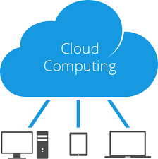
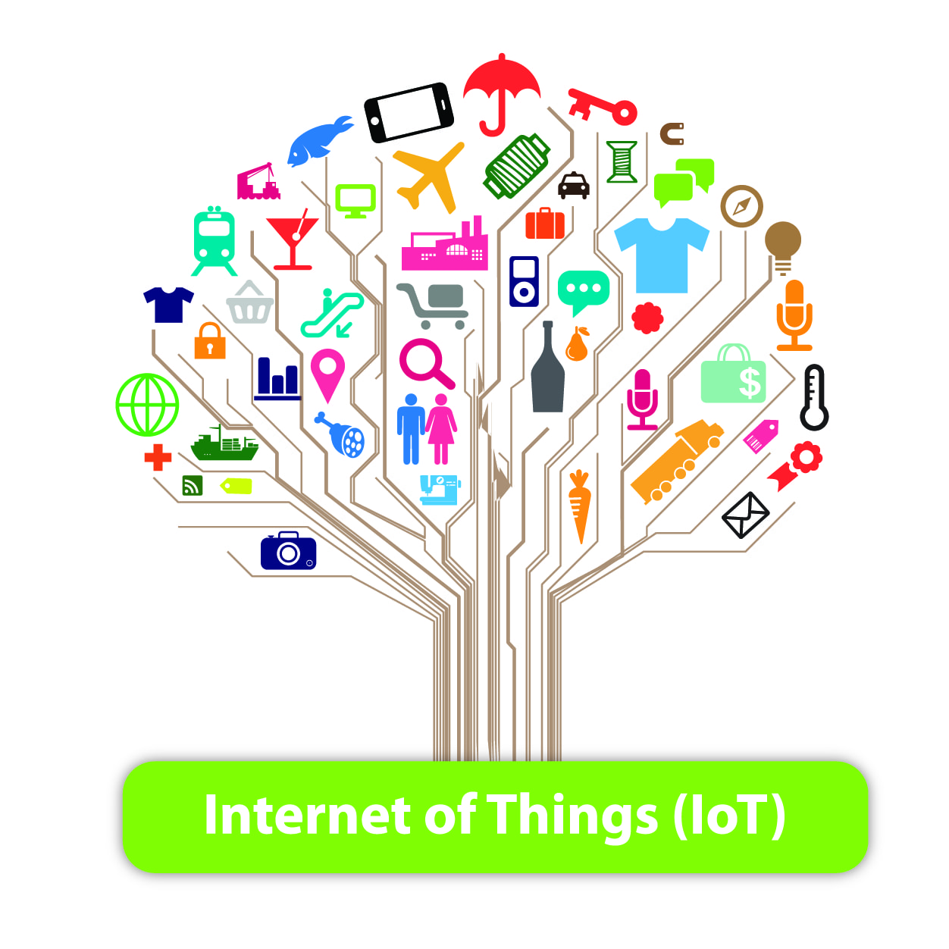
Conclusion
Social Media
Domain knowledge
Two-way communication
Mobile Application
Creating a mobile app for library services
Networking , handheld devices, customized services will act as main differentiator for Libraries to recreate their value
Analytics
Big Data + Predictive Analytics will help to improvise the customer reach and understand the forthcoming challenges + solution
Cloud
Databases such as 24*7, Safari Books Online, OCLC etc. are well supported by cloud system with readily accessible data for the end users.
Internet of Things (IoT)
Smart phones can turn on the application to track the wish list of every patron visiting the library.
Create customer delight by developing vision, new models and experiment ideas for futuristic library!
TCS Public

Slide 8

Thank You !

