Slide 1


Webometrics Study of Top 50 Asian Institutional Repositories
by
Attya Shahid
&
Arshad Mahmood

Slide 2
CONTENTS
Abstract
Introduction
Objectives
Scope
Methodology
Data Analysis
Conclusion

Slide 3
ABSTRACT
This paper highlights the
Present status of open access institutional repositories in Asia.
This paper gives a brief introduction to the Webometrics ranking for world Institutional Repositories especially top 50 Asian repositories. Comparisons by content type, repository by type, by software and by language for the top 50 Asian repositories are made.
This paper also presents and reviews top 50 institutional Repositories performance and position in Webometrics rankings for in the world based on Webometrics data.

Slide 4
Introductions
Technology Revolution
The Directory of Open Access Repositories – OpenDOAR
Institutional Repositories (IRs)
Academic Library Metrics for Web based Study
IR Systems for IRS

Slide 5
Objectives
This is an expository graphic research examine did as a cross-sectional review. The essential goal of this review is to figure the web affect variable of the main 50 Asian storehouses. Particularly the objectives are;
To identify the Repositories in Asia by country
To find out the content type of repositories
To calculate the repositories by type
To find out repositories in Asia by software
To explore repositories by language

Slide 6
Methodology
The sample was consisting of top 50 institutional repositories of Asia in the ranking of repositories based on their activity on the webometrics. The first step of the research was to find out the top 50 repositories of the Asia through repositories.webometrics.info/websites.
The second stage is to collect the applicable data from the Open DOAR website. http://www.opendoar.org/countrylist.php?cContinent=Asia

Slide 7
Data Analysis
1. Growth of Institutional Repositories (2005-2016) World Wide

Slide 8
2. Growth of IRs (2010-2016) in Asia

Slide 9
3. Repository in Asia by Country
Open DOAR shows that most of Institutional repositories available in Japan which are 211. In top 50 ranking Japanese Institutional repository “Kyoto University Research Information Repository” placed on No.1 in top 50 repositories of Asia. 2 Taiwan repositories (National Chenqchi University Repository & National Cheng Kung University Institutional Repository) are placed on 2 & 3 Nos. in ranking. Gadiah Mada State University of Indonesia is placed at last number i.e.50.

Slide 10
4. Content type of repositories
Articles are most common content of Institutional Repositories. 40 IRs has articles followed by 29 has theses, 25 has unpublished and 22 has conference proceedings.

Slide 11
5. Repositories in Asia by Software
DSpace is most common software used to support Institutional Repository. 32 IRs using DSpace software in Asia followed by 16 IRs using Eprints, 4 libraries are using WEKO and other are using Digital Commons, Earmas & XooNlps.

Slide 12
6. Repository in Asia by Language
in Asia by language exposed that Chinese is most common language used in top 50 IRs in Asia followed by English 35, Japanese 22, Indonesian 5, Malay 2 and German, Latin, Multilingual 1.

Slide 13
Conclusion
The conclusion based on both kinds of data obtained is presented to address the research objectives.
RO1 – Repositories in Asia by Country
Research exposed that in top 50 ranking most IRs available in Japan 21 (42%).
RO2 – Content Type of Repositories
Research discovered that most content type is articles, theses & conference proceedings, available in top 50 Asian Institutional Repositories.
RO3 – Repository by Type
This research results shows all top 50 Asian repositories are Institutional by type.
RO4 – Repositories by Software
Data analysis revealed that DSpace is most common software use in top 50 Institutional repositories. Top 32 IRs (64%) are using DSpace Software, 8 IRs (16%) are using Eprints.
RO5 – Repositories by Language
Most common language available in top 50 Asian Repositories is Chinese. 36 IRs contain Chinese material, 35 have English & 22 have Japanese language material.

Slide 14
THANK YOU
TERIMA KASIH

Slide 15

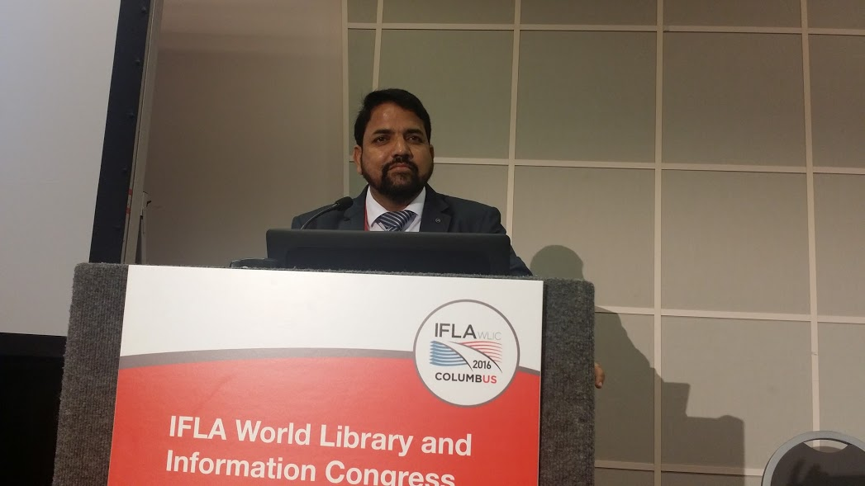
Contact
Ms. Attya Shahid | Mr. Arshad Mahmood
Librarian – FAST National University, Karachi, Pakistan Email: attyashahid@gmail.com | Deputy Director – Library State Bank of Pakistan Email: arshad.sbp@gmail.com

