Slide 1
IcoASL 2017 Role of Library and Archives for Preservation of Indigenious Knowledge in Minangkabau Society “Seni Saluang jo Dendang” (A theorical overview for the future idea)
LAILATUR RAHMI & DIAN HASFERA
UIN IMAM BONJOL PADANG

Slide 2
Introduction
Saluang jo Dendang is the art of music delivery of the (story sing), the which is accompanied by music saluang, usually saluang conjunction with the this can be enjoyed in the traditional events, a wedding procession and events are deliberately created by the surrounding community is a special display of traditional arts (folk festival).

Slide 3
Saluang jo Dendang : part of Indegenous Knowledge ?
Local IK, holistic and integrative because it is rooted in a particular community and experience lies in the broader cultural traditions of the people who live in that place.
IK essentially functional and directed to a practical response and performance.
IK is an experience rather than theory and strengthened through continuous experience, trial and error.
IK learned through repetition that helps retention and reinforcement.
IK constantly changing in ways that are produced and reproduced, found and lost.
IK typical divided to a greater extent than other forms of knowledge, although its distribution is socially distinguished, by gender and age.
Distribution IK always fragmented. It is not in its totality, either in one place or one individual.
IK can not be easily codified.
IK is transmitted orally, or through imitation and demonstration and codification process can cause the loss of some properties.
(Mearns, Du Toit and Mukuka , 2006)

Slide 4
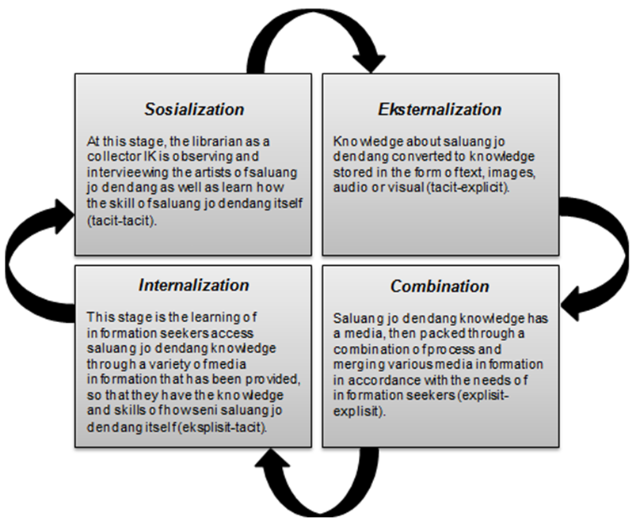
SECI cycle of Seni Saluang jo Dendang

Slide 5
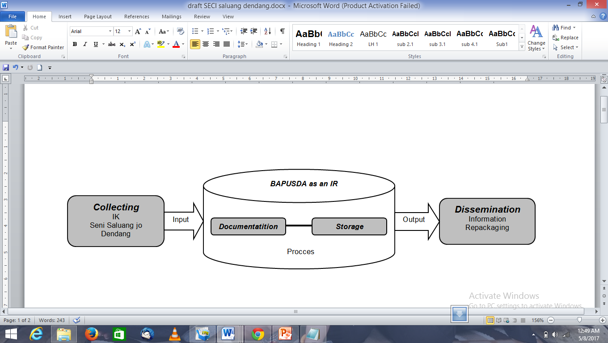
The Government Library as Intsitutional Repository (IR) for Seni Saluang jo Dendang

Slide 6
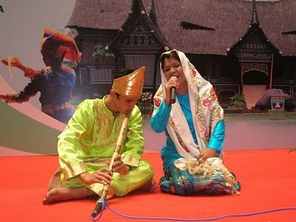

Slide 7
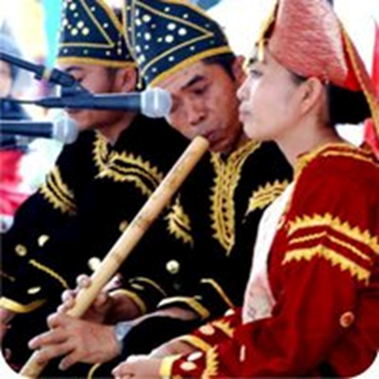

Slide 8
Conclusion
Seni saluang jo dendang has been collected and documented so on are stored in various forms of media that will be utilized for the benefit of society. In accordance with Act No. 4 Year 1990 Deposit Act printed and recorded, that the government library not only save and preserve IK Minangkabau society in its physical form, but the most important is his intellectual value. Efforts should be made to collect/ IK packages and make them available on the Internet to be accessible to a wider public, one of them through the local library's website.

Slide 9
Thank You

