Slide 1
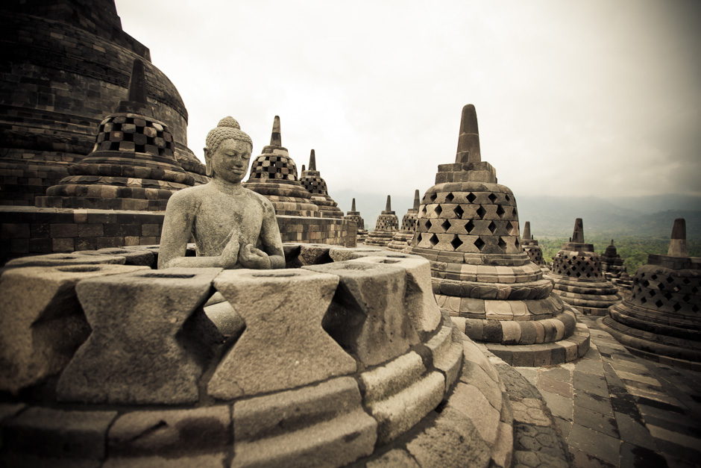
PRESERVATION OF TRADITIONAL KNOWLEDGE
IN THE DIGITAL ERA :
Studies in Conservation Library Of Borobudur
PRESENTED IN ICOASL YOGYAKARTA INDONESIA 2017
Nisa Adelia, S.IIP.,M.Hum nisaadelia7@gmail.com Dina Oktaviana, S.IIP.,M.Hum dinaoktaviana@gmail.com

Slide 2
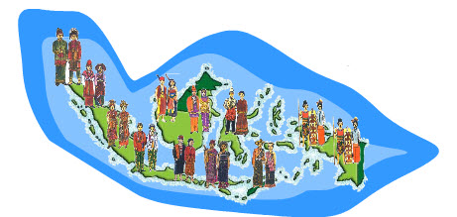

Indonesia is a country rich in culture and traditional knowledge
Today, almost 80% of the world's population still uses indigenous knowledge

Slide 3
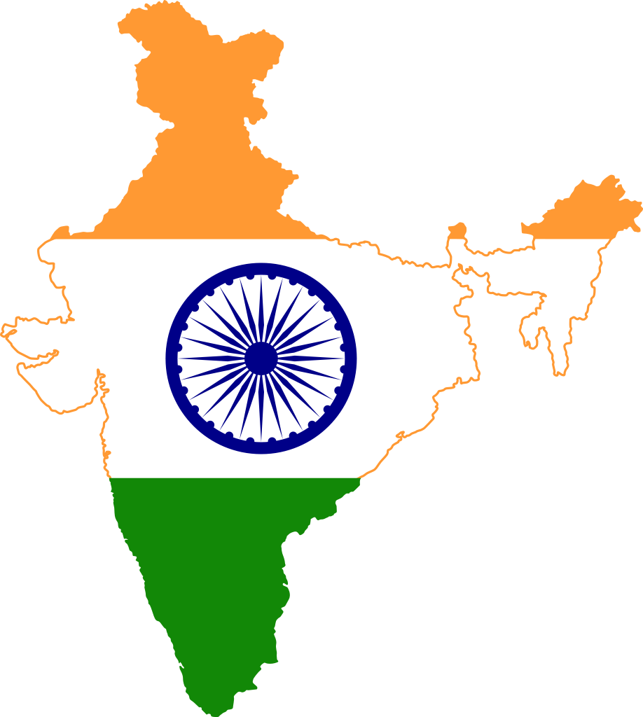
India make library to save 36,000 information turmeric formulation used in Ayurvedic medicine
Ahfad University Library and
Sudan also create and develop a database of associated traditional knowledge

Slide 4


Indigenous knowledge is important to be documented in order to save for and maintain the knowledge contained.
Along with the times, information technology bring a logical consequence to make documentation face the digital era

Slide 5
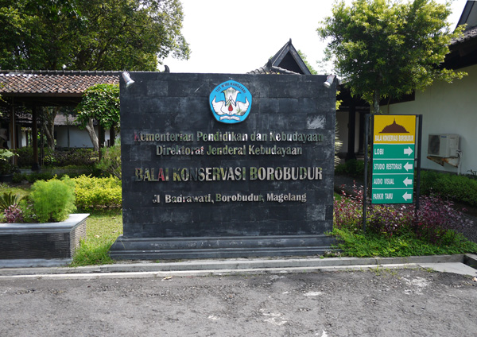
Library Borobudur Conservation has made the documentation of traditional knowledge, but whether it has reached the stage of digital

Slide 6



Some Documents have been digitized
(Photo, Document of Study)
Books have not been digitized yet
(Research)

Slide 7



Preservation in digital era : In Library Conservation Borobudur
Protection Intelectual Property
Limited human resources

Slide 8

Conclution
Related to digitization activities in this global era, in outline, the Borobudur Conservation Office not all perform digitizing yet.
- This is due to lack of human resources.
- Challenge of protection of Intelectual property
as the results of interviews conducted :
The head of the service said that, the collection is still in the documentation ik book form alone. Not to digital, this is because constrained by the lack of human resources. On the other hand, the Head of service sessions have concerns about the information provided if preservation is done digitally. Open information is a form of information that is "sold cheaply", as they called the head of the service who showed concern towards digitization.

