Slide 1
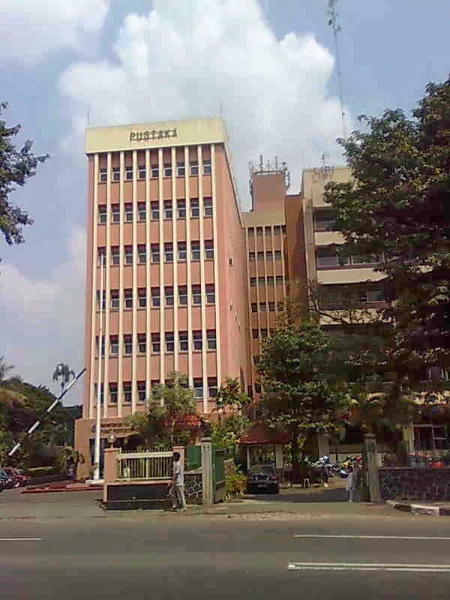
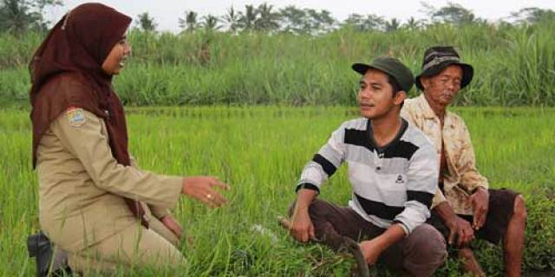
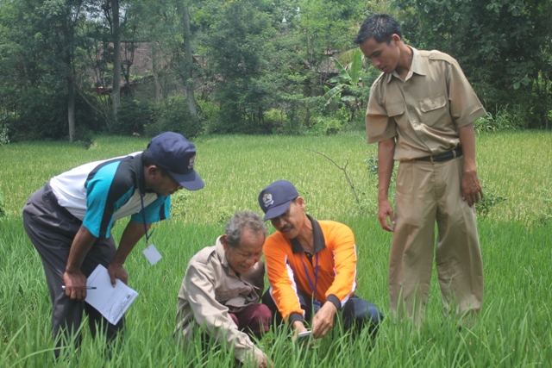
Perception of Bogor District Agricultural Extension Officers Toward the Potencies of Indonesian Center for Agricultural Library and Technology Dissemination
CATUR OKTAVIAN INDRI HASTUTI
octivian.indri@gmail.com
AKHMAD SYAIKHU HS
asyaikhu@pertanian.go.id

Slide 2
Introduction
BACKGROUND
Challenges
The increasing need of extension officers to agricultural information
Availability of agricultural information resources for extension officers
Utilization of Indonesian Center for Agricultural Library and Technology Dissemination (ICALTD) by agricultural extension workers
Aim of Research
Research Question
Analyzing the perception of agricultural extension officers against ICALTD
How the perception of agricultural extension officers to ICALTD?

Slide 3
RESEARCH METHODS
The methodology in this study used descriptive methods approach that describe the data whether from primary and secondary data
Human
Resources
Facilities
Research Variables
Collection
Libraries
Promotion and
strengthening
institutions
cooperation
Libraries
Service
locations

Slide 4
RESUTLS AND DISCUSSION
Characteristics of extension officers
Human resources of ICALTD
Age
Working Period
HR Variables | Precentage of the respondents score
 | 1 | 2 | 3 | 4 | Total
Competency | 0 | 10,34 | 80,46 | 9,20 | 100
Productivity | 0 | 11,49 | 86,21 | 2,30 | 100
Capacity | 0 | 6,90 | 89,66 | 3,45 | 100
Quality | 2,30 | 17,24 | 74,71 | 5,75 | 100
The Collection of ICALTD
Collection Variables | Precentage of the respondents score
 | 1 | 2 | 3 | 4 | Total
Currentness | 2,30 | 10,34 | 75,86 | 11,49 | 100
Completeness | 11,49 | 14,94 | 67,82 | 5,75 | 100
Quality | 2,30 | 8,05 | 85,06 | 4,60 | 100
Quantity | 3,45 | 27,59 | 63,22 | 5,75 | 100
Form | 1,15 | 13,79 | 74,71 | 10,34 | 100
Management | 2,30 | 17,24 | 72,41 | 8,05 | 100
Level of Education
Functional Office
Notes: 1 = not very good; 2= not good; 3 = good; 4 = very good

Slide 5
RESUTLS AND DISCUSSION
The Facilities of ICALTD
The Library Services of ICALTD
Facilities Variables | Precentage of the respondents score
 | 1 | 2 | 3 | 4 | Total
Ease of access to information | 3,45 | 26,44 | 62,07 | 8,05 | 100
Media and communication channels | 1,15 | 10,34 | 79,31 | 9,20 | 100
ICT | 1,15 | 3,45 | 86,21 | 9,20 | 100
Photocopy | 5,75 | 26,44 | 66,67 | 1,15 | 100
Reading room | 0 | 8,05 | 87,36 | 4,60 | 100
Internet service | 3,45 | 5,75 | 78,16 | 12,64 | 100
Lighting | 2,30 | 8,05 | 81,61 | 8,05 | 100
Library Interior | 1,15 | 6,90 | 77,01 | 14,94 | 100
Collection Variables | Precentage of the respondents score
 | 1 | 2 | 3 | 4 | Total
Procedure | 2,30 | 16,09 | 75,86 | 5,75 | 100
Requirement | 3,45 | 8,05 | 80,46 | 8,05 | 100
Transparancy | 1,15 | 5,75 | 83,91 | 9,20 | 100
Discipline | 3,45 | 8,05 | 82,76 | 5,75 | 100
Responsibility | 2,30 | 5,75 | 80,46 | 11,49 | 100
Skill | 2,30 | 3,45 | 83,91 | 10,34 | 100
Speed | 1,1,5 | 8,05 | 82,76 | 8,05 | 100
Access | 1,15 | 6,90 | 81,61 | 10,34 | 100
Quality | 2,30 | 3,45 | 87,36 | 6,90 | 100
Fairness | 1,15 | 6,90 | 81,61 | 10,34 | 100
Courtesy | 0 | 4,60 | 85,06 | 10,34 | 100
Equity | 2,30 | 5,75 | 82,76 | 9,20 | 100
Certainty | 3,45 | 8,05 | 83,91 | 4,60 | 100
Comfortability | 2,30 | 10,34 | 81,61 | 5,75 | 100
Security | 0 | 3,45 | 86,21 | 10,34 | 100
Notes:
1 = not very good; 2= not good; 3 = good;
4 = very good

Slide 6
RESUTLS AND DISCUSSION
The Promotion of ICALTD
The Cooperation of ICALTD
The Location of ICALTD
Cooperation Variables | Precentage of the respondents score
 | 1 | 2 | 3 | 4 | Total
External stakeholder | 2,30 | 31,03 | 60,92 | 5,75 | 100
Internal of Agricultural Ministry | 2,30 | 14,94 | 80,46 | 2,30 | 100
Location Variables | Precentage of the respondents score
 | 1 | 2 | 3 | 4 | Total
Reachable | 1,15 | 40,23 | 52,87 | 5,75 | 100
Ease of transport | 1,15 | 16,09 | 77,01 | 5,75 | 100
Distance locations | 2,30 | 42,53 | 43,68 | 11,49 | 100

Slide 7
CONCLUSSION
CONLUSSION
The perception of Bogor Distric extension officers toward the potency of the ICALTD showed in the varying assessment. Extension officers assess the potencies of the ICALTD with a good score.
This means that the potencies of the ICALTD have important role to support the development of extension officers in Bogor District. By utilizing them, extension officers can obtain information of agricultural technological innovation to meet their needs.
In addition the extension officers can enhance their competencies in disseminating agricultural information to farmers. The establishment of cooperation between the ICALTD and the stakeholder will improve and increase the farming system in Bogor District.

Slide 8
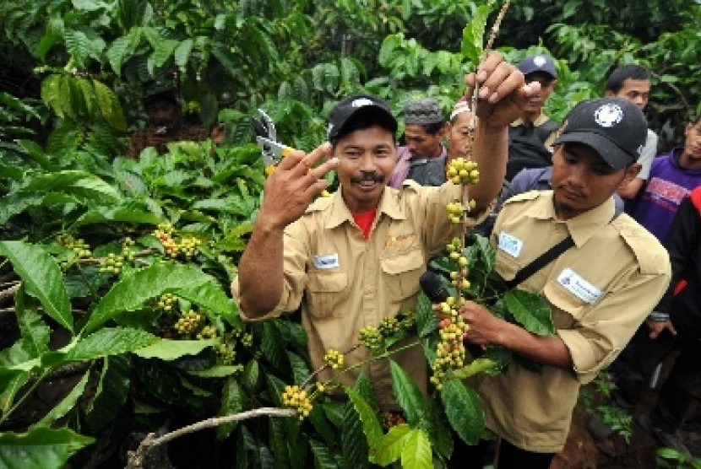
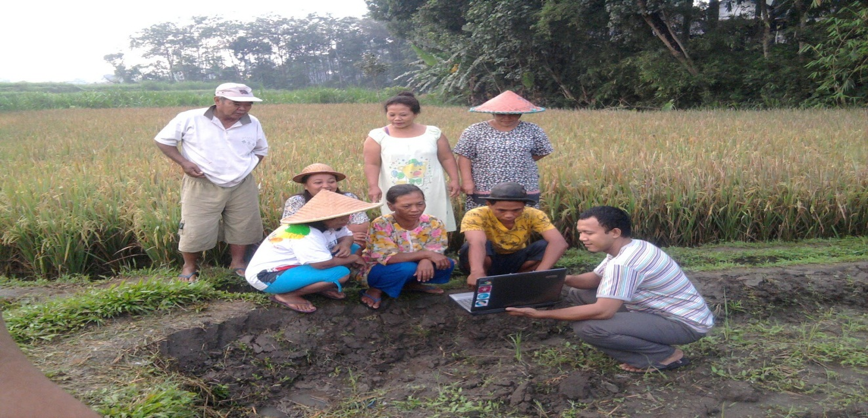
Thank you for your attention
Thank you for Your Attention

