Slide 1
Javanese Manuscripts as Source of Nusantara Islam
Machasin
Sunan Kalijaga State Islamic University

Slide 2
Nusantara Islam: Problem of the Status
- Unity of Islam in diversity
- Great and small traditions of Islam or better written and practiced Islam
- Indonesia the country of diversity
- Islam observed in a pluralistic society
- Originality and genuineness

Slide 3
Nusantara Islam: peculiarities and Problems
politeness,
civility,
appreciation of differences
Volatility:
socialization and internalization
taking care, maintenance, development;
- confidence as to competitors, adversaries

Slide 4
Example: what to reach in child education
سُونْ ميميتي انريك عقلي بوﭼاه # ﭘومنوا لواس۲ بيسا ﭬﭽﺎه
I begin to attract the reasoning capacity of children, in order that it may eventually fully develop
بسا ميكير بسا عراسا بسا ﯕﻨﺎه # عارڤ۲ كابيه ايكو من فضل الله
i.e. that they are able to think, to sense and to act properly; hoping that all be realized by God’s graciousness

Slide 5
Nusantara Islam: Where to Find
in the comportment of the people
not yet written, nor yet formulated
some ingredients to be found in the old local manuscripts
values inherited from pre-Islamic traditions: indigenous, Indian, Persian, Chinese

Slide 6
The Richness of Javanese manuscripts on islam
Script: Javanese, modified Arabic characters (pegon);
Javanese characters: semi syllabic, not developed to transliterate
Arabic words/texts, serving more Javanese pronunciation
Form: tembang (poetic form:
- Javanese Macapat or Arabic qasida/singiran)
- gancaran (prosaic)
Content: piwulang (moral guidance), Islamic history, Islamic theology, Islamic law, fictions, elementary knowledge of Islamic teachings etc.

Slide 7
Examples of theological Manuscripts
Radyapustaka
32645 (280) Buku Ngakaid (J) (articles of belief)
32665 (447) Hikayatul Arwah (J) (story of spirits)
32680 (167) Ilmu Ke-allahan (J) (theology)
32745 (430) Kitab Majemuk (J) (miscellaneous)
Pakualaman
52625 (0131) Serat Hikayat Nawawi (J) (epistle on the story of Nawawi)
52640 (0689) Sipat Kalih Dasa, Sadat (J) (the 20 Attributes of God)
52690 (0379) Kitab Tauchid (J) (Book of God’s Unicity)

Slide 8
Examples …
Surakarta
12810 (96 ha) Kitab Ummul Brahim (J)
12815 (511 ra) Serat Darma Pepeling: a) Kitab Ngakoid (articles of belief)
13037 (214 na(a)) Serat Sitin I (the 60 problems)
13040 (214 na) Serat Sitin II (the 60 problems)
Mangkunegaran
22705 (A 32) Kawruh Usuluddin (knowledge of the foundations of religion)
23115 (A 91) Sifat Kalih Dasa tuwin Primbon (the 20 attributes of God and miscellaneous)

Slide 9
Example …
FSUI (jilid 3-A)
1. Serat Bustam (CI.13; G.32 Rol.99.06) Javanese script.
2. Serat Bustam Salatin (CI.15; NR 264; Rol. 99.07). Javanese
3. Bustam, Maklumat (the knowable), Wirid Hidayat Jati (CI16; NR 376; Rol.99.08). Javanese
4. Kabar Kiyamat (news on the apocalipse) (IS.5; NR 337; Rol.62.04) Arabic script.
5. Cariyosipun Kabar Kiyamat (the so-called news on the apocalipse) (IS 6; B 3.7; Rol. 62.05). Jawa.
6. Kabar Ngakerat (news on the hereafter) (IS.7; NR 99; Rol.62.06). Javanese
7. Aqidah Islam (Islamic belief) (IS.11; KB 2) Arab
8. Ilmu Tauhid (science of God’s Unicity) (IS.12; KB 3). Arab

Slide 10
difficulties
readability of the texts: the character, the language
accessibility of some text; many are still at private collection
Javanese way of presentation/narration
Text edition, transliteration dan translation
Very slow advancement
Philological
Necessity of many branches of knowledge: philology, Islamic tradition, Islamic history, Javanese philosophy

Slide 11
Ingkang dhihin teteping kang ati First the firmness of your heart
Madhep mring Datollahu tangala focusing on God’s person
Kapindho marang sipaté Second, on His qualities
Apengal kang kaping tlu Third, on his actions
Tuwin marang ing Kanjeng Nabi as well as in The Majestic Prophet
Muhamat mustapa Muhammad Mustafa
Panutup[é] Rasul the seal of the messengers
Solalahu alaihi wasallam May God give him blessing and peace
Yaiki tékaté sawiji-wiji That is the determination of any thing
Kang dhingin uluhiyah First, uluhiya
Kapindho[né] budiyah [ka]ping tri Second, [b]udiyah and third
Pan saiyah genepé tiga Saiyah to make them three

Slide 12
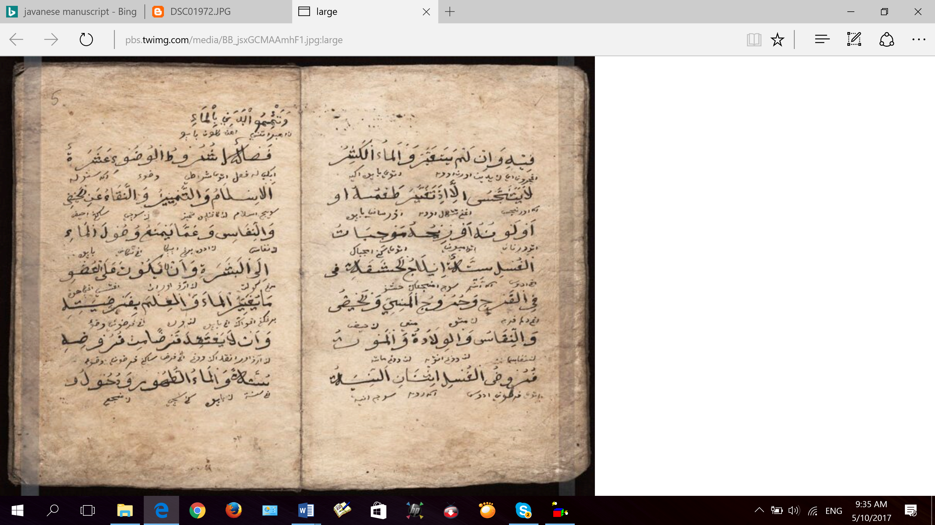

Slide 13
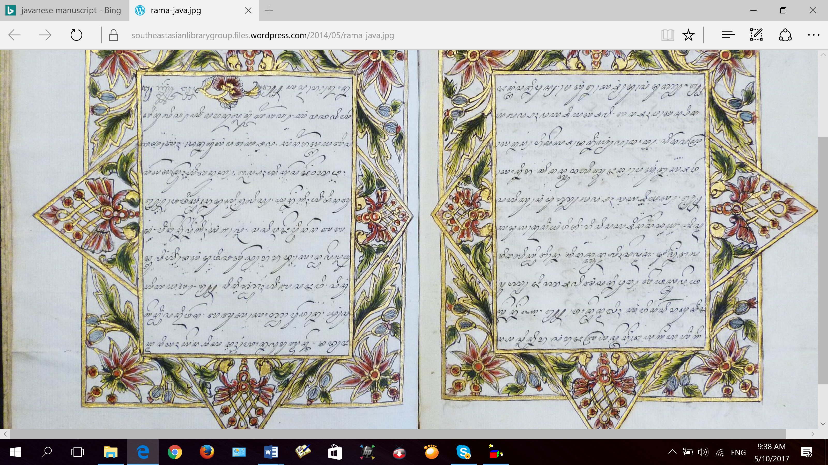
Example: Javanese

Slide 14
The role of Islamic University Library
Hunting and collecting as many as possible of the manuscripts
Preserving them
Making them available through transliteration and translation

Slide 15
conclusion
Uncultivated very rich materials
More students to study the manuscripts: to make them readable not only for the specialists
Inviting scholars of Islamic studies to use them
Enhancing the service capacity of Islamic University Library

