Slide 1

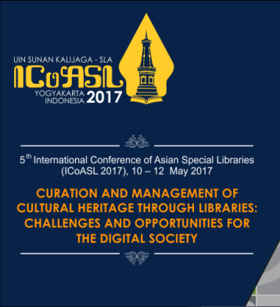
Building a Timeless Audiovisual Collection: Libraries and Archives as Repositories of Oral History
Joseph M. Yap | Agnes S. Barsaga
De La Salle University
Notes:
Good afternoon ladies and gentlemen. My name is Agnes Barsaga, Librarian from DLSU Libraries in the Philippines. With me is my co-author, Mr. Joseph Yap, the Instructional Media Services Coordinator of DLSU Libraries. We are here to present the status of oral history in the Philippines particularly the oral history collection of DLSU Libraries.

Slide 2
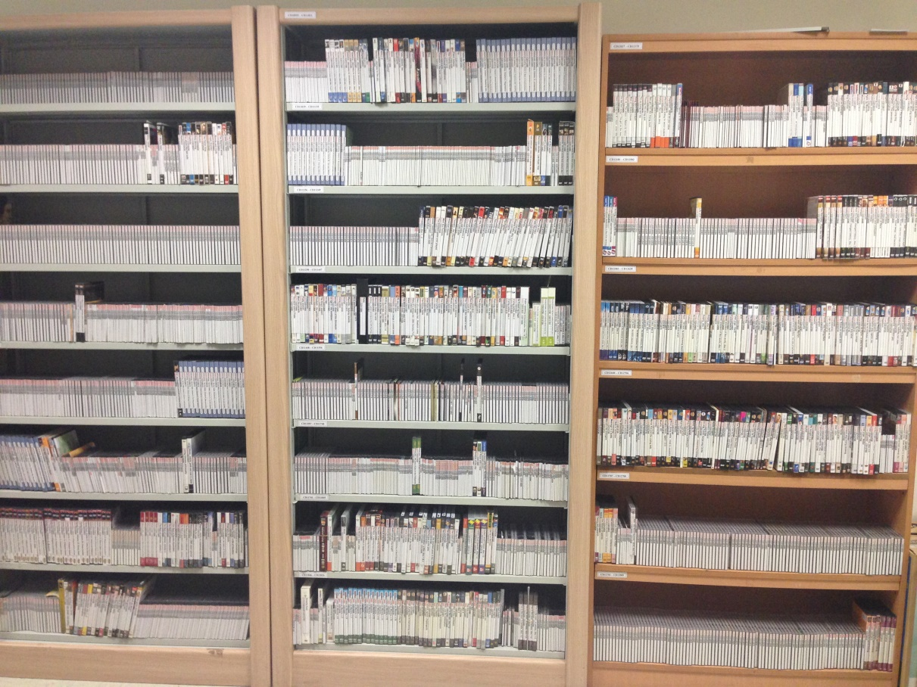
AV resources as sources of information
AV resources are hard to accumulate, maintain and preserve.
Notes:
AV resources are hard to accumulate, maintain and preserve. The photo shows the AV collection of DLSU Libraries. Traditionally, these are the acquired assets of an academic library and its main purpose is to support the academic, research and instructional needs of the academic community. These are more for circulation and does not need archival preservation. However, in an academic setting where archives is present, there is one collection, also an AV resource, which was neglected and needs urgent attention, and the need to preserve. These are the oral history collection.

Slide 3
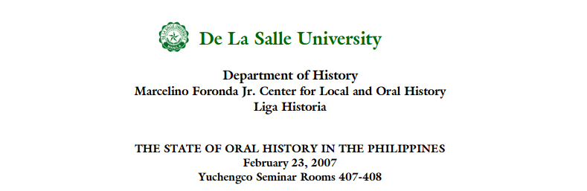
Oral history
Oral histories, as primary sources of information, are used as evidences of the past and inculcate human memory.
Notes:
Oral history is used when you want to get an idea not only of what happened in the past, but how those memories meant to people and how it felt to be integral during those periods. As defined by the Nebraska State Historical Society, oral history is “a primary source document created in an interview setting with a narrator for the purpose of collecting and preserving that person's firsthand information about an event, period of time or way of life and making it available to researchers.

Slide 4
Objectives
Since academic libraries and archives collect oral history projects, this paper would like to answer the following:
What fields of discipline do they have in their collection?
What requirements/strategies do academic libraries need to embark in an oral history project?
Are there new ways or initiatives in capturing oral history other than the traditional and usual process?
Notes:
How do the archives address these questions? In general, this paper will share the challenges and experiences of establishing oral history projects specifically in an academic library and archives. The present state and condition of the oral history collection of DLSU will also be discussed.

Slide 5
Methodology
This study explores the oral history collection of the DLSU Archives.
Data were extracted from the Sierra library system.
Extracted subjects were arranged alphabetically.
2009 Philippine Standard Industrial Classification
Notes:
This study explores the oral history collection of the DLSU Archives. Data were extracted from the Sierra library system. Extracted subjects were arranged alphabetically. Historical data coming from the correspondences kept at the archives were also used to understand how the collection accumulated and how they were being organized, classified and used by the patrons. Literature reviews were also consulted to learn more about the background of oral history in the Philippines. Subjects were also classified based on the 2009 Philippine Standard Industrial Classification. This will give us an idea on the number of existing interviews based on industry. Duplicate subjects were removed from the list.

Slide 6
Results and Discussion
Academic (also called college and university) are archives that preserve materials relating to a specific academic institution. Such archives may also contain a "special collections" division.
Part of the archives collection is a set of audiovisual materials which contain oral histories.

Slide 7
OH is SEA
Lim, Morrison and Kwa (1998), compiled a list of oral history institutions in Southeast Asia. They were able to identify three from Brunei, 11 from Indonesia, 13 from Malaysia, three from Myanmar, six from Philippines, three from Singapore, and 10 from Thailand.

Slide 8
OH in the Philippines
Foronda (1979) traced the oral history in the Philippines in his book entitled, ‘Oral history in the Philippines and other historical essays.” He was able to enumerate oral history projects in Luzon, Visayas and Mindanao.
Notes:
When Foronda wrote about his book in 1979, the National Archives of the Philippines (NAP) and the National Historical Institute (now National Historical Commission of the Philippines) were still planning to initiate their own oral history projects. Dr Marcelino A. Foronda, Jr., historian and pioneer in Philippine OH and former full professor at DLSU (Abrigo & Natividad, 2017).

Slide 9
OH at DLSU Libraries
The Foronda Oral History Project (FOHP) opened its doors at De La Salle College (now University) in 1975.
On August 2-6, 1993, during the celebration of the history week at De La Salle University, it was announced that the collection of the Center for Local and Oral History will be transferred to the University Library.
Notes:
It contains bibliography, appendices, printed materials and bio-data, newspaper and magazine clippings. Reynaldo Palma, a professor of the History Department graciously endorsed the undergraduate oral history project from History Department to the Marcelino Foronda Oral History Collection (Jimenez, 1999).

Slide 10
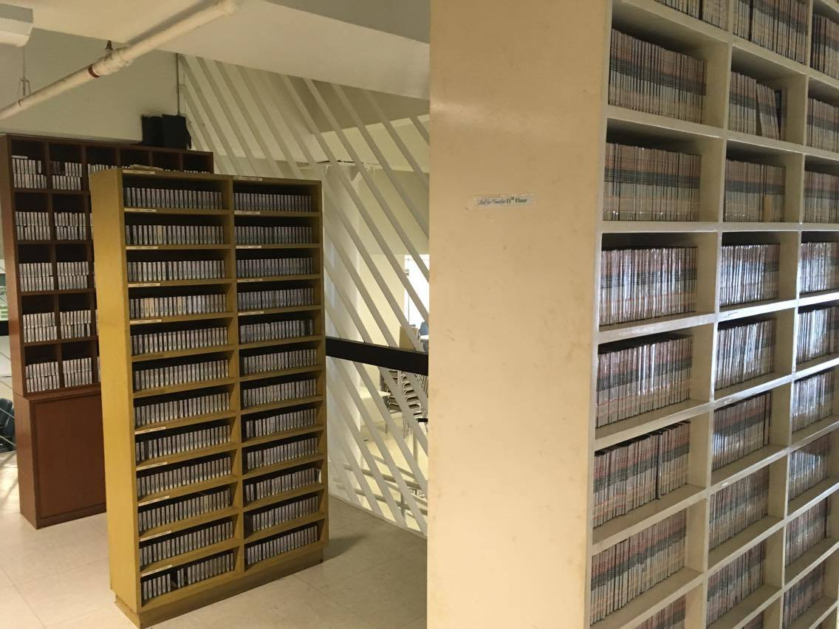

Slide 11
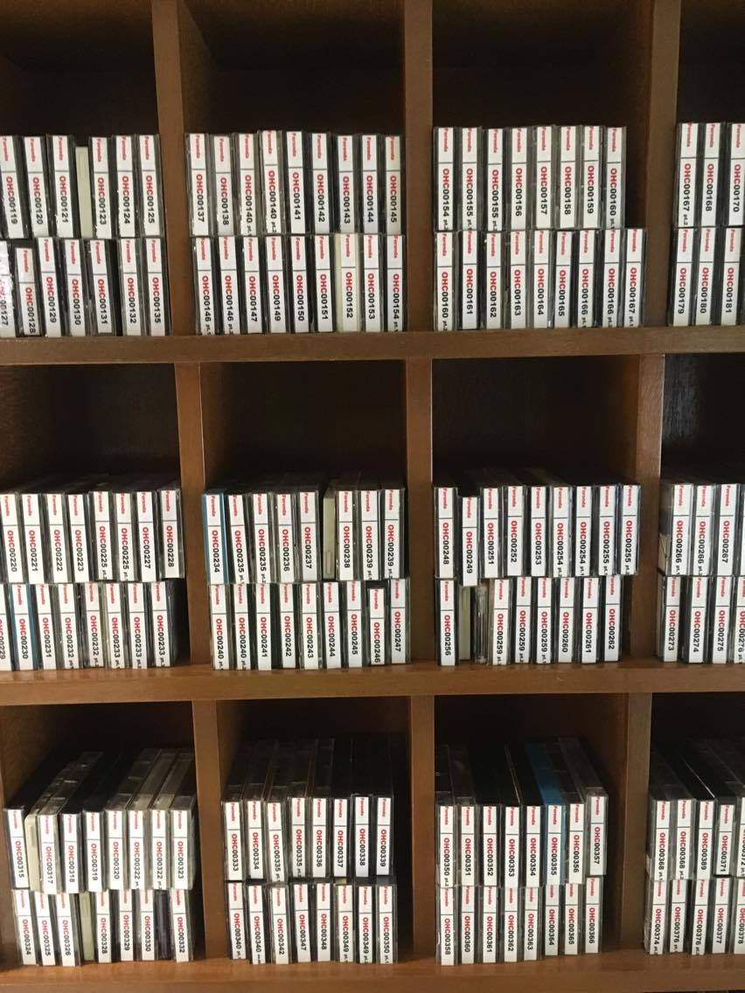
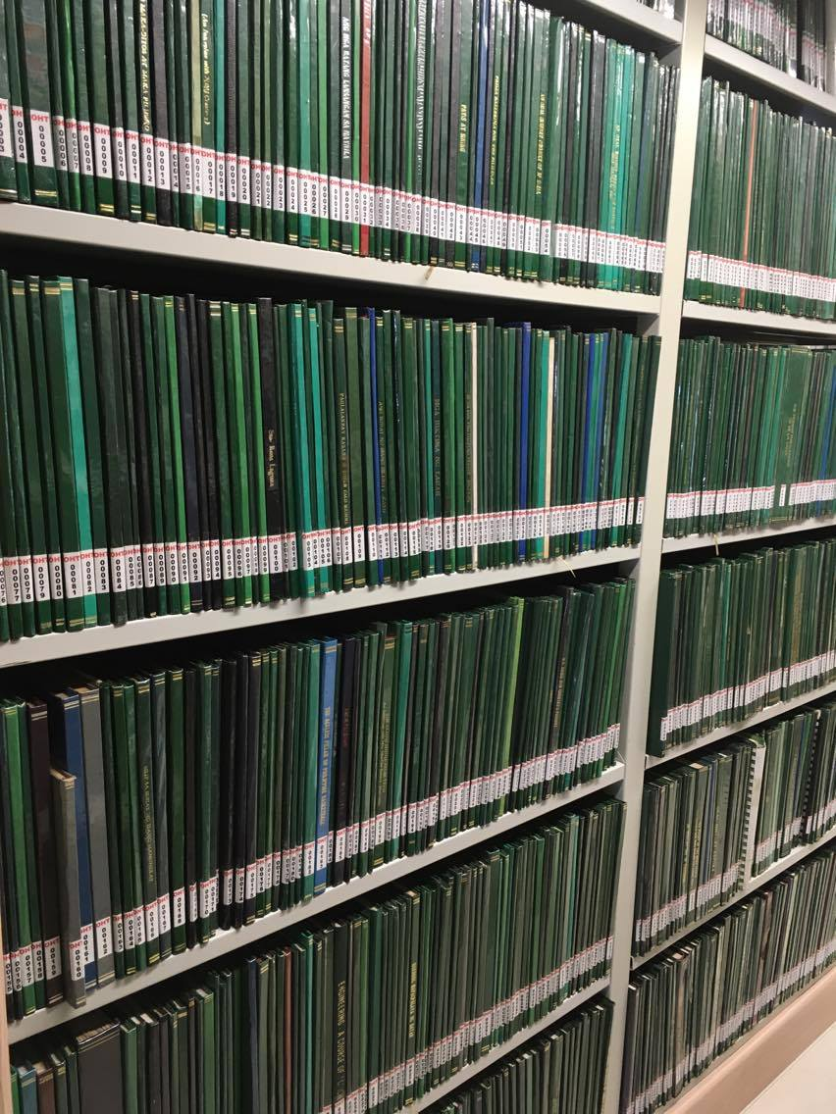

Slide 12
Current Collection (based from Sierra)
324 oral history cassettes (OHC)
341 oral history transcripts (OHT)
There are 179 subjects identified.
353 themes/topics (Abrigo & Natividad, 2017) which covers 1, 011 vol of print transcripts (Foronda family) 1, 009 vol of print transcripts (MFCLOH). 1, 011 audio cassette tapes in pcs (Foronda family) and 749 audio cassette tapes in pcs (MFCLOH).
Notes:
These subjects were based from the Library of Congress Classification Scheme and were re-categorized according to the Philippine Standard Industrial Classification to identify which type of industry does each oral history belong to.

Slide 13
Notes:
Table shows the top three industries with the most number of interviews. Section M (Professional, Scientific and Technical activities) had 30 interviews or 16.95%, next is 15.25% or 27 interviews which comes from the Arts, Entertainment and Recreation and top three is Public Administration and Defense; Compulsory Security with 10.17%.

Slide 14
Challenges in our collection
The oral history collection was not given enough recognition as a collection.
The items are still being sorted. There are some OHTs with the same accession but with different content.
There are two groups of oral histories being kept at the Archives. One is under the Marcelino A. Foronda Collection and the other one came from the History department. This should be merged.
Notes:
1. Due to the large scope of the Archives, this collection has been forgotten and was not widely disseminated and promoted. There was no or little usage of the collection.

Slide 15
There are items not present in the catalog as an item record. Unprocessed.
Some CDs do not have transcripts.
According to a report/letter in the Archives, there are beta tapes included in the collection, where are they?

Slide 16
Initiatives
As shared by Shannon & Bossaller (2015), “non-print collections, such as collections of recorded oral histories, represent less traditional forms of knowledge. Human libraries push the boundaries further in the quest to integrate wisdom and lived experience into library collections.”

Slide 17
Human Library as OH project
Human libraries are “composed of human books that a "reader" can interact with. Human books are people who are subjected to stereotyping and prejudices. They have volunteered to be public representatives of their respective groups so they could share with others their personal stories to break down stereotypes and prejudices (DLSU, 2016).”

Slide 18
It was also mentioned by McCracken (2013) that “the idea that each of these people have stories that are worth sharing can be looked at as a personal history or an oral history. The participants often talk about their personal experiences making their talks snippets of oral histories that they are sharing with others.”

Slide 19

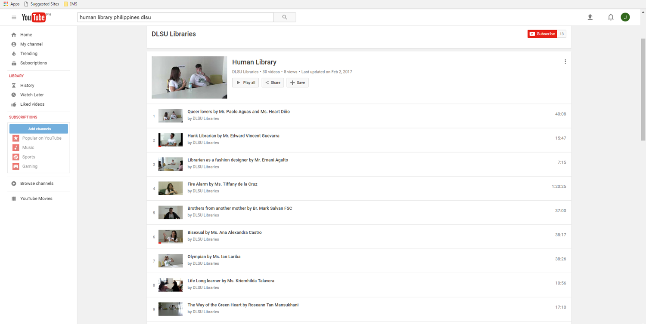

Slide 20
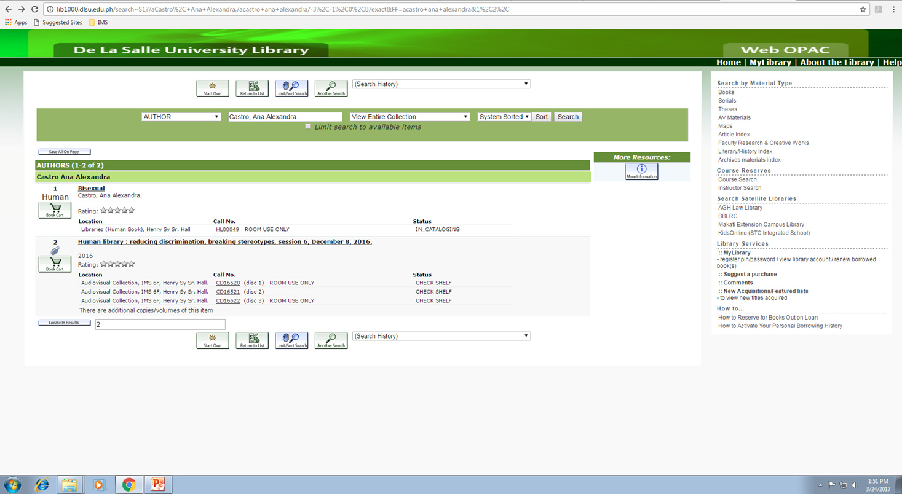

Slide 21
Strategies
Formally establish an OH center which is approved by the institution.
Collaborate with the center and the library/archives may take the initiative in collecting, organizing and preserving the collection.
Establish guidelines in the access and dissemination of the content.
Market the collection and make it an excellent asset for research and publication.

Slide 22
Conclusion
Audiovisual documentation may act as primary sources of intellectual information specifically in the production of oral histories.
Notes:
As stressed by Baum (1996), oral history starts from creation, followed by curation and ends by consuming. Oral histories were created to shed light from the stories of the past. They are archival sources with evidentiary values.

Slide 23
Recommendation
We recommend that academic libraries and archives need to embark in oral history projects so that the general public may have options in finding sources of information.

Slide 24
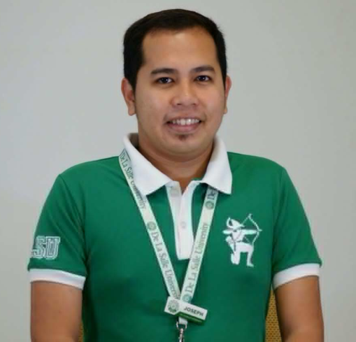
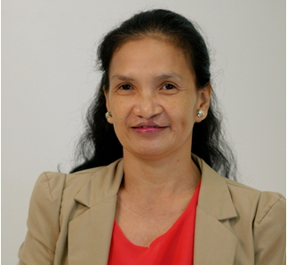
Thank you for listening!
Maraming salamat sa pakikinig!
Terima kasih untuk mendengarkan!
Sunane ke lie dhanyavaad!
joseph.yap@dlsu.edu.ph
agnes.barsaga@dlsu.edu.ph

