Slide 1
https://upload.wikimedia.org/wikipedia/commons/a/a4/Bayanihan_2.JPG

Slide 2
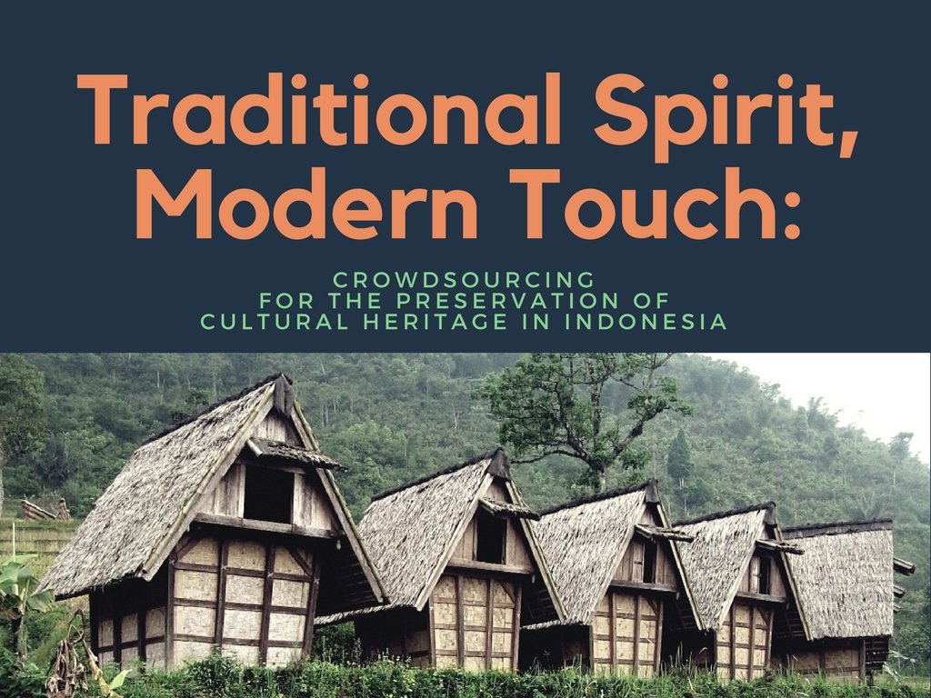
https://www.flickr.com/photos/sobatbudaya/14103544207/in/album-72157644890347004/

Slide 3
About us
Lis Setyowati (Universitas Diponegoro)
Setyowati, L. (2016). Pengajaran literasi informasi dengan konsep gamification di perpustakaan perguruan tinggi . 2nd place winner of Librarian Scientific Writing Competition 2016 held by Universitas Islam Indonesia.
Setyowati, L. (2016). Digital life, digital tattoo and the filter bubble: Raising the awareness and the cautions on online activities through information literacy education. Paper presented at the International Conference on Science Mapping and the Development of Sciences. Graduate School Universitas Gadjah Mada. 20-22 April 2016.
Safirotu Khoir (Universitas Gadjah Mada)
Khoir, S., Du, J. T., Davison, R. M., & Koronios, A. (2017). Contributing to social capital: An investigation of Asian immigrants' use of public library services. Library & Information Science Research, 39(1), 34-45.
Khoir, S., Du, J. T., Koronios, A. (2015). Linking everyday information behaviour and Asian immigrant settlement processes: Towards a conceptual framework. Australian Academic & Research Libraries, 46(2), 86-100.

Slide 4
Today’s discussions
Introduction
Heritage preservation initiatives
Crowdsourcing
Lesson learned
Conclusion

Slide 5
Indonesia
Challenges with cultural heritage:
Cultural extinction
Cultural property disputes
633 ethnic groups
1,331 ethnic subgroups
(Indonesian Bureau of Statistics, 2017)
https://www.dol.gov/sites/default/files/images/ilab/child-labor/images/indonesia.png

Slide 6
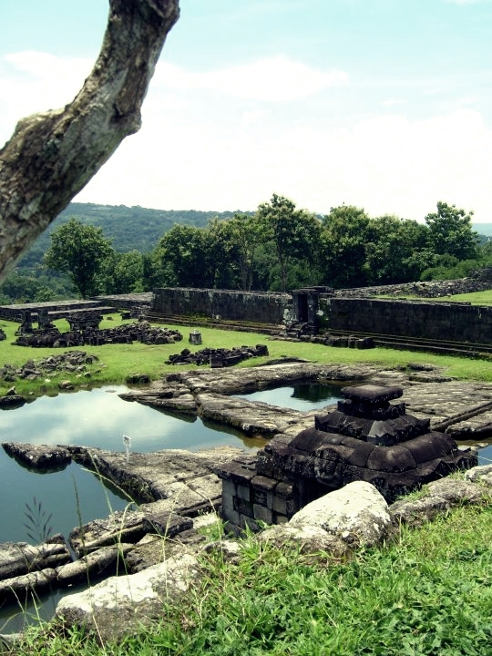
Heritage listing inventory initiatives
Government
Indonesian ministry of Education
and Culture
Data Pokok Kebudayaan
Indonesia
Kebudayaan Indonesia
National Library of Indonesia
Pustaka Indonesia
Pernaskahan Nusantara
Keraton Nusantara
Non-Government Organizations

Slide 7
gotong royong
crowdsourcing
“the act of taking a job traditionally performed by a designated agent (usually an employee) and outsourcing it to an undefined, generally large group of people in the form of an open call (Alam & Campbell, 2012)
https://upload.wikimedia.org/wikipedia/commons/a/a4/Bayanihan_2.JPG

Slide 8
#1
to achieve goals using cheap
resources
#2
Why Crowdsourcing?
to achieve the goals faster
#3
to have supporting virtual
communities and user groups
#4
to get engaged with
community
#5
make use of the knowledge,
expertise and interest of
the community
#6
to improve the quality of
data/resource
#7
to add more value to the data
#8
to improve data
discoverability
#9
to raise a sense of public
ownership and responsibility
towards cultural heritage collections
Holley (2009)

Slide 9
Crowdsourcing initiatives
Yayasan Mitra Netra
providing braille readings for the blind through mass digitalization
Kitabisa.com
raising donations from the public for library developments
Buku Untuk Indonesia raising book donation

Slide 10
Crowdsourcing initiatives
in heritage inventory
#1
#2
Pantau Pustaka Indonesia

Slide 11
Sobat budaya
Since 2008 they’ve collected data on Indonesian culture through Gerakan Sejuta Data Budaya (GSDB) or the million cultural data movement.
The cultural heritage inventory initiative aims :
To collect data on cultural artefacts
33.045 data on Indonesian culture has been collected
To promote the “cultural artefact inventory” itself as a new culture among the community members
http://www.budaya-indonesia.org

Slide 12
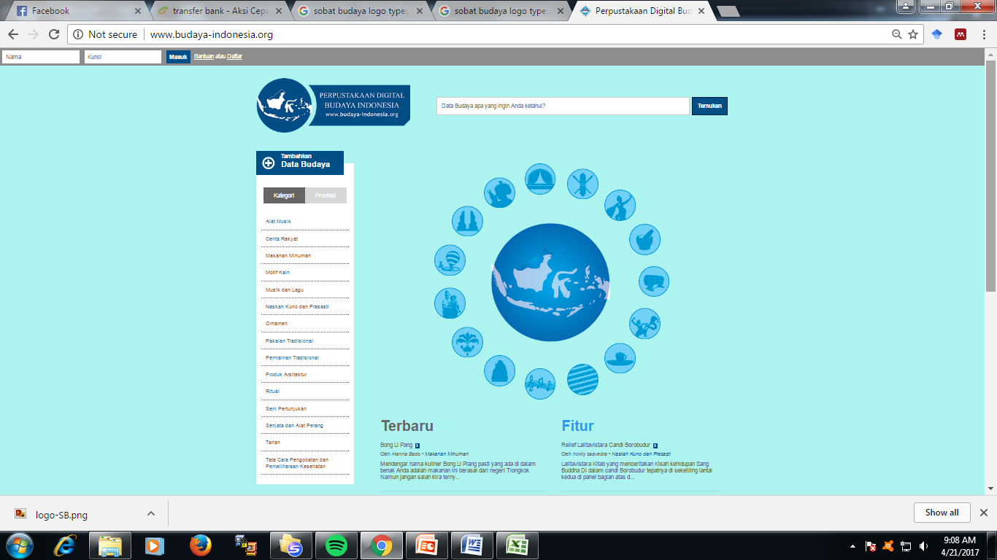
Sobat Budaya

Slide 13
Pantau Pustaka Indonesia
Developed in January 2012 using the Ushaidi platform.
Collected 560 reports
Indonesian Heritage Inventory becomes a database for texts, maps, pictures and videos of Indonesian heritage, including the natural heritage, cultural heritage (tangible and intangible heritage), and cultural landscape heritage
http://heritageinventory.web.id

Slide 14
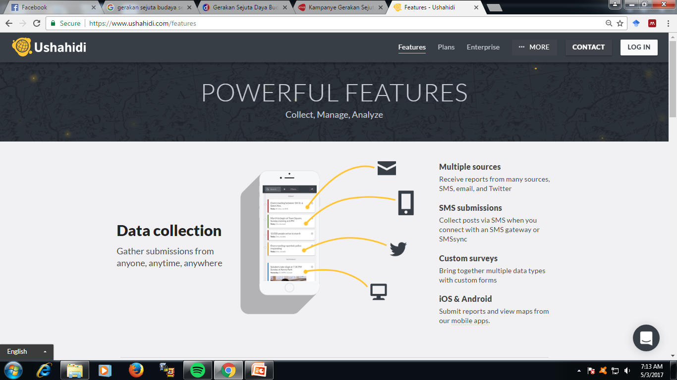
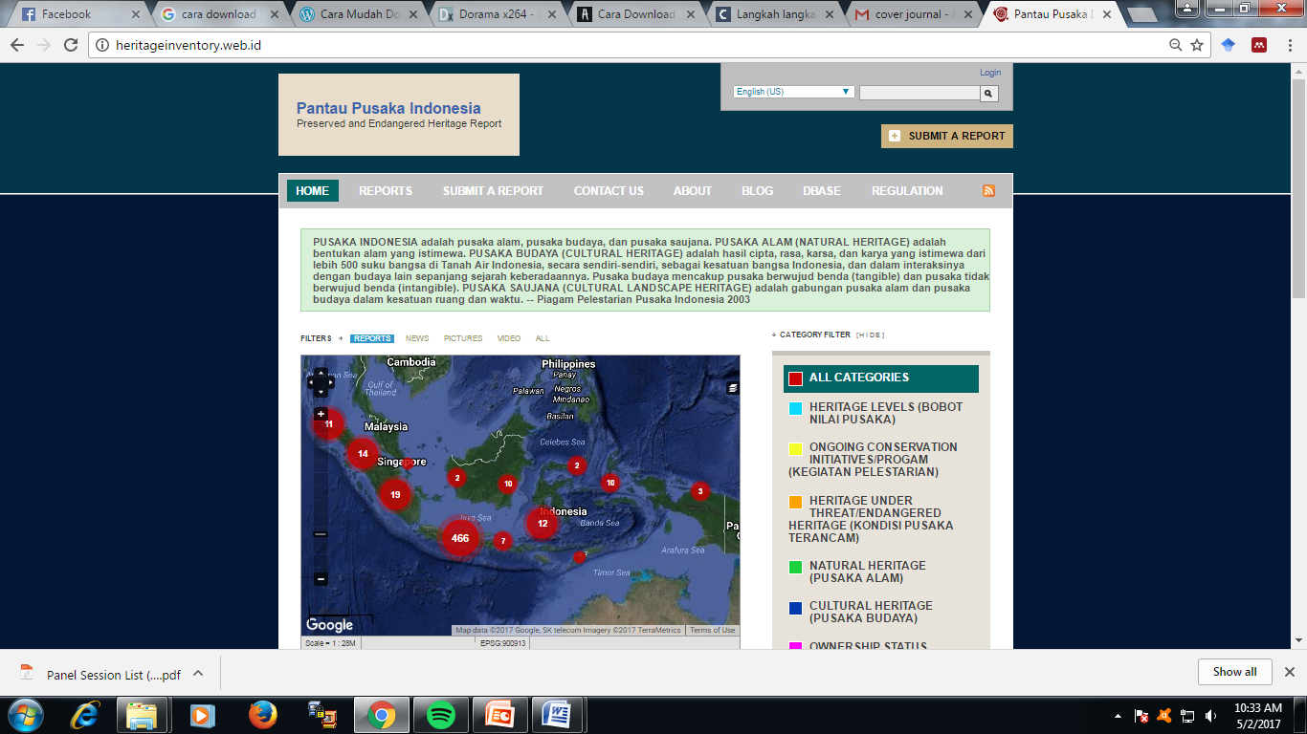
Pantau Pustaka Indonesia

Slide 15
Lesson learned
#1 Easy system
To invite more people to participate in the project, they have developed an easy system
a. Web visit for online data
inputting

Slide 16
Lesson learned
#1 Easy system
b. Simple report and data
inputting via smartphones,
either via short message,
email or tweeting.
The applications are available on play stores

Slide 17
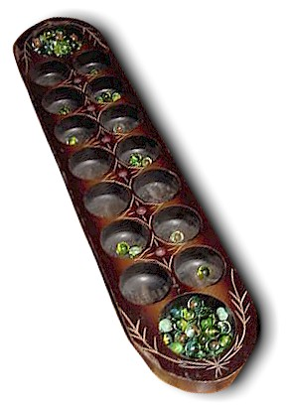
Lesson learned
#2 Gamification
Gamification is “the application of game elements in nongaming situations, often to motivate or influence behavior”
(Educause, 2011)
Gamification “has the ability to get people’s attention and engage them in a target activity as well as influencing their behavior”
(Kim, 2015)
http://budaya-indonesia.org/Congklak/

Slide 18
Lesson learned
Game-based elements
enabling gamification
#2 Gamification
Since 2011, Sobat Budaya has applied incentives for the contributors
(Brigham, 2015)

Slide 19
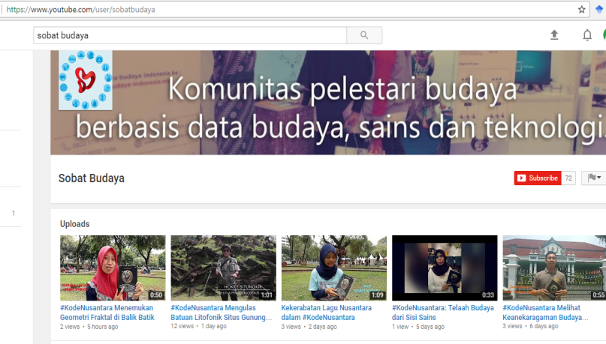
Lesson learned
#3 Engagement Strategy
The Ladder of Engagement
Participation type
Spreaders
Happy bystander
listen
share
Involvement/relationship
(Kanter, 2010)

Slide 20
Lesson learned
#3 Engagement Strategy
The Ladder of Engagement
Donors
Participation type
Spreaders
Happy bystander
listen
share
money
Involvement/relationship
(Kanter, 2010)

Slide 21
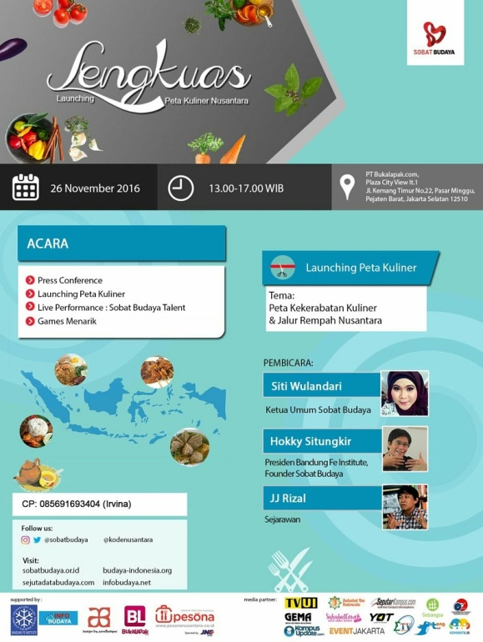
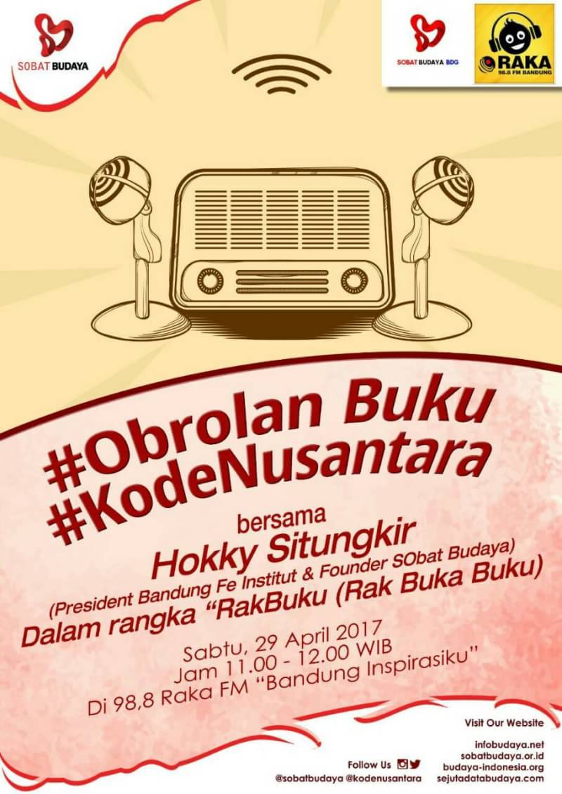
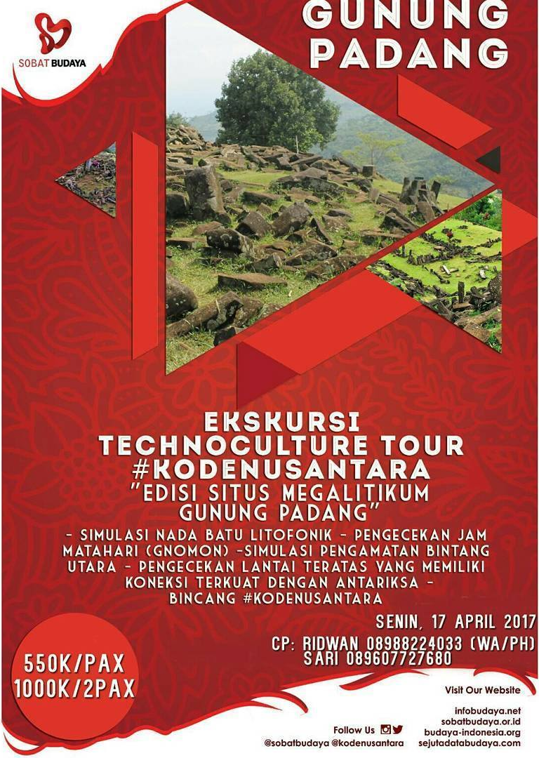
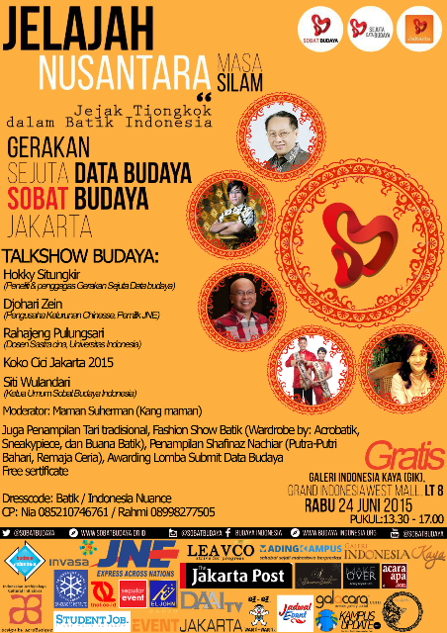
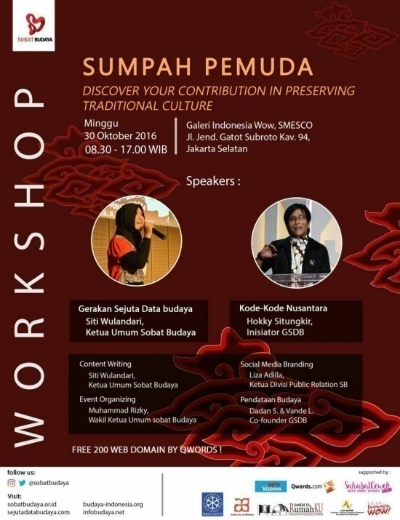
Lesson learned
#3 Engagement Strategy
The Ladder of Engagement
Evangelist
Donors
Participation type
Spreaders
Happy bystander
listen
share
money
ask
Involvement/relationship
(Kanter, 2010)

Slide 22
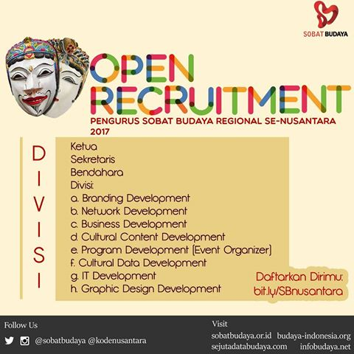
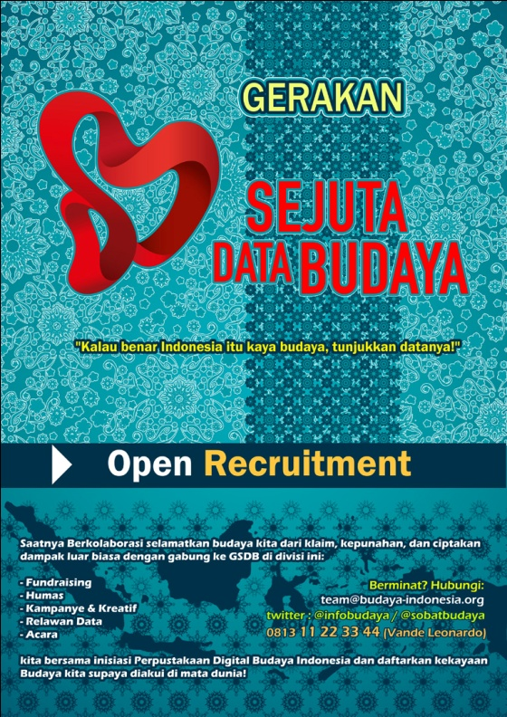
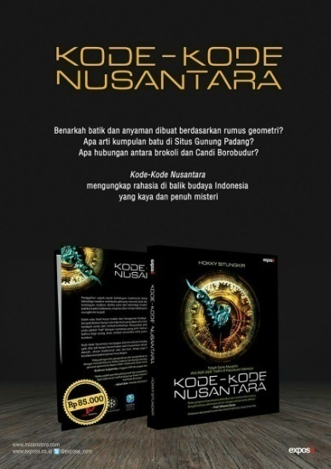
Lesson learned
#3 Engagement Strategy
The Ladder of Engagement
Instigator
Evangelist
Donors
Participation type
Spreaders
Happy bystander
listen
share
money
ask
create
Involvement/relationship
(Kanter, 2010)

Slide 23
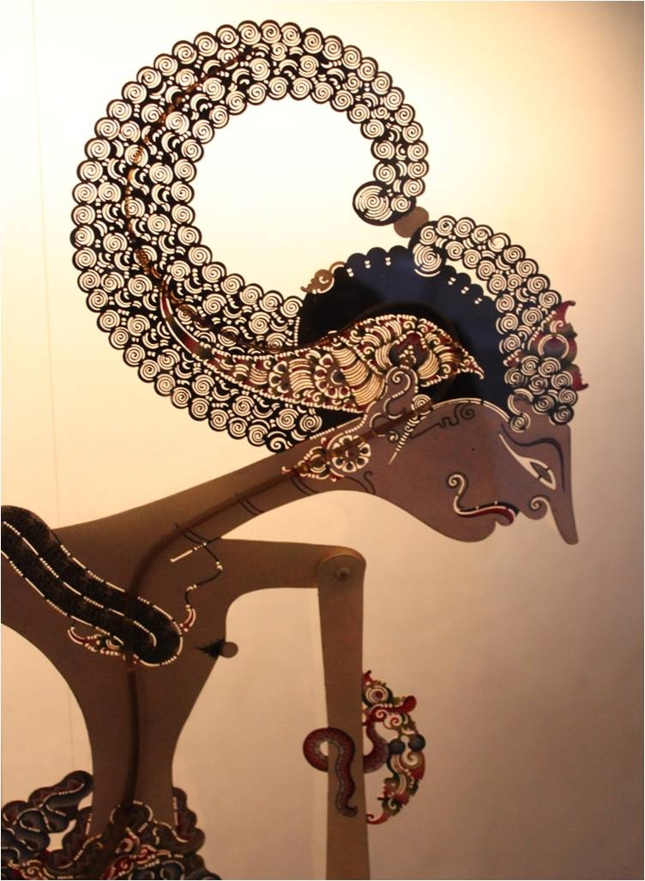
Lesson learned
#4 Quality Control
Controlling quality through game mechanics
Controlling quality through curators
https://upload.wikimedia.org/wikipedia/commons/d/da/Wayang_Kulit_-_Museum_Wayang_02.jpg

Slide 24
Conclusion
Heritage inventory is a project which is considered challenging to manage solely by one institution
Crowdsourcing becomes a great initiatives involving wider community for heritage preservation in Indonesia
Crowdsourcing triggers public awareness in heritage preservation

Slide 25
THANK YOU
Kindly get in touch
to let us know
if you have any questions.
Lis Setyowati
Faculty of Engineering
Diponegoro University lis@ft.undip.ac.id
Safirotu Khoir
Central Library
Universitas Gadjah Mada safirotu@ugm.ac.id

