Slide 1
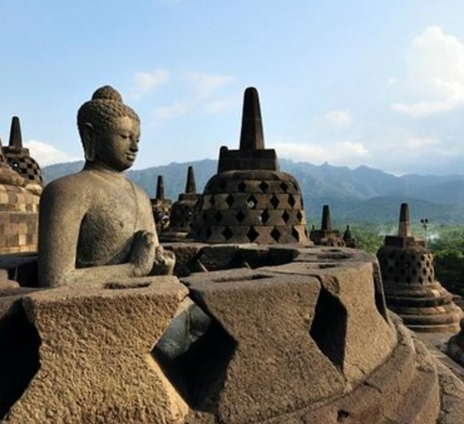
Curtailing the Challenges Faced in Digital Society
A Success Story of Library and Publisher Collaboration for Promoting Electronic Resources
Mr. Iranna Shettar Mr. Dhanukumar Pattanashetti
Asst. Librarian IEEE Client Services Manager
NITK, Surathkal, India IEEE, Bangalore, India

Slide 2
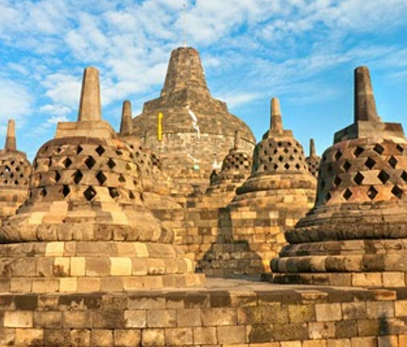
Introduction
Challenges in promoting electronic resources
Adoption of new and innovative activities by libraries
Library+Students+Publisher partnership, a new mantra?
Methodology
Outcome

Slide 3
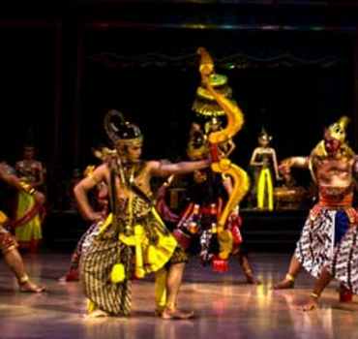
Program Partners
Central Library, NITK
NITK is one of the oldest and most prestigious Centrally Funded Technical Institution in India. 5000+ resident users, 14 engg. depts.
Resources: 2.5L Prints, 14 e-databases, 6,000 eJournals, 5,000 eBooks.
IEEE Xplore Digital Library
A powerful resource for the discovery of and access to scientific and technical content.
Provides web access to more than four million full-text documents
IEEE Student Branch
Basic operating organizational unit of an IEEE Section or Region
At institutes to represent and fulfil the needs of the members and the missions of IEEE

Slide 4
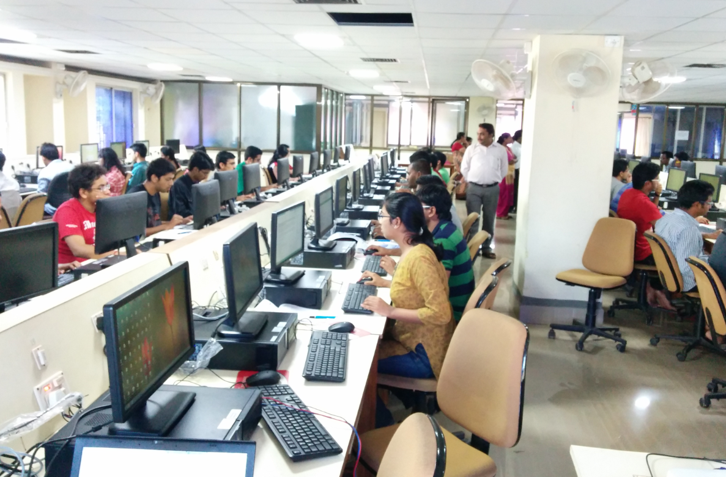
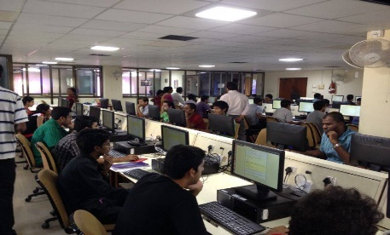
Methodology
Event promotion & Registrations collected
Event promotion through email campaigns, social media pages and regular posters.
120 registered for the event; walk-ins were encouraged.
Two sessions were planned to accommodate the participants’ schedules: 1st was with hands-on session and 2nd was briefing open session. Both the activities were followed by an online quiz, about library, its offerings, IEEE Xplore etc.

Slide 5
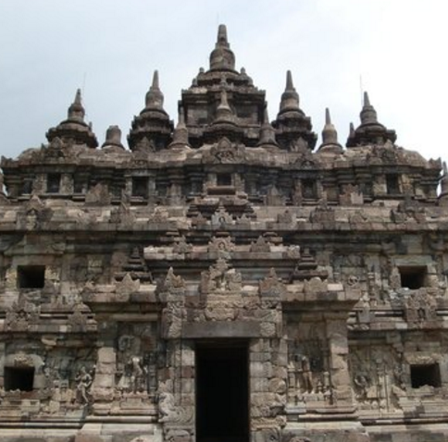
Briefing Sessions
1st Session: With hands-on, 100+ participants.
in-depth training on
how to leverage various features of the IEEE Xplore platform
how to reduce time and frustration finding the right set of articles
how to understand the structure of a scholarly article
easy-to-use discovery and search tools
create and refine search queries etc.
2nd Session: 120+ Participants
During the closing ceremony, Director was briefed on the outcome, prizes/ participation certificates were distributed.

Slide 6
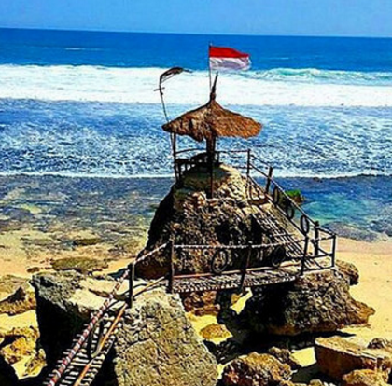
Findings
Table 1. Article downloads
 | Q2-2014 | Q3-2014 (Awareness conducted) | Q3-2013 | QoQ Growth | YoY Growth
Article Downloads | 26564 | 48276 | 29997 | 81.74 % | 60.94 %
Table 2. Other Parameters
 | Q2-2014 | Q3-2014 (Awareness conducted) | Q3-2013 | QoQ Growth | YoY Growth
Page Views | 107753 | 207535 | 160551 | 92.60 % | 29.26 %
Visits | 9334 | 16142 | 10581 | 72.93 % | 52.56 %
Article Request | 32451 | 58403 | 37179 | 79.97 % | 57.09 %
Abstracts | 5695 | 7341 | 7118 | 28.90 % | 3.13 %
Searches Run | 12193 | 28030 | 22435 | 129.89 % | 24.94 %
Abstract Views: Reports the number of requests for an article Abstract. Article Request (PDF): The number of PDF documents requested from the server.
Page Views: The number of pages viewed on a Web site. Searches Run: Reports the number of keyword searches performed.
Visits: Represents the number of individual durations of times visitors were on the site accessing a series of pages without 30 minutes of inactivity.
QoQ – Quarter on Quarter YoY – Year on Year

Slide 7
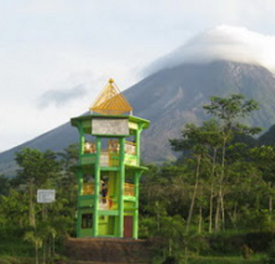
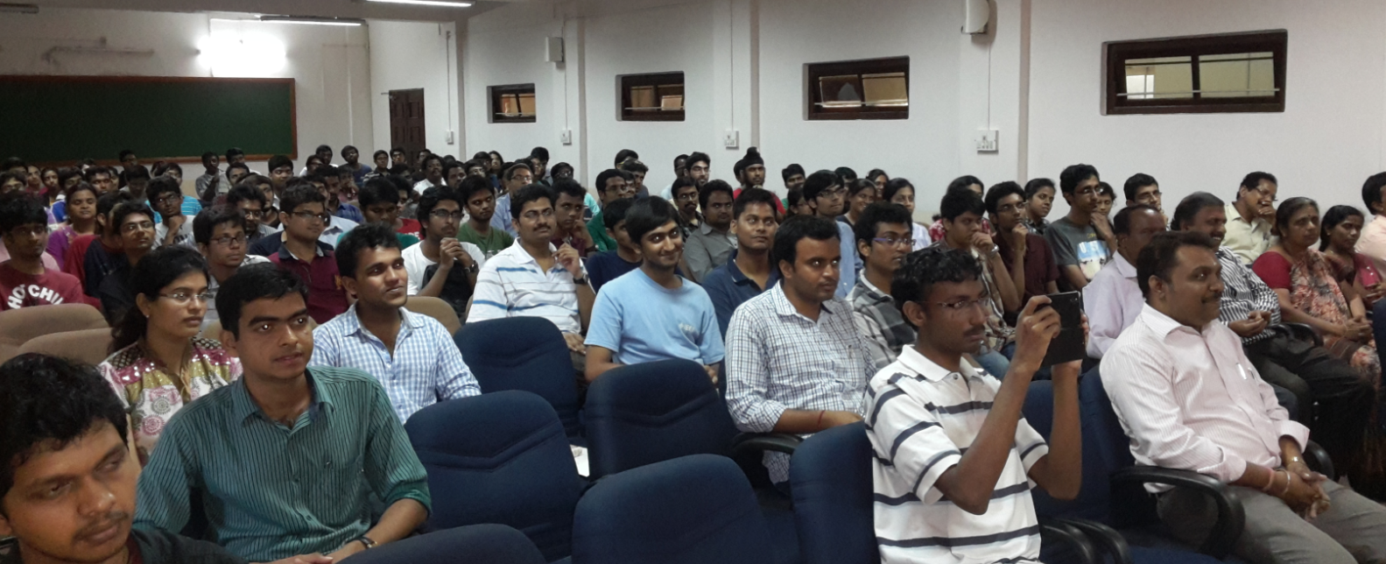
Outcome
30% of the registered members admitted they weren't aware of the availability of the IEEE subscription
Participants learned the various services provided by the library.
Usage of the IEEE Xplore platform went up by 92.60% in September 2014 when compared with September 2013
Usage consistently increased in Q3 2014 when compared with Q4 2013 with a percentage increase of 29.26%.
Articles Downloads went up by 81.74% in Q3 2014 when compared with Q2 2014
Articles Downloads went up by 60.94 % in Q3 2014 when compared with Q3 2013

Slide 8
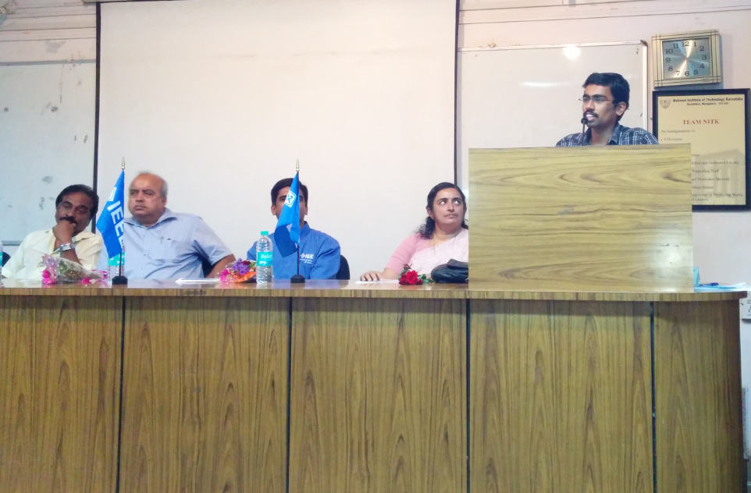
Outcome contd…
Significant increase of usage in terms of page views, abstract views, and the searches run, were observed when compared with the previous year’s statistics.
Number of page visits within IEEE Xplore platform shot up by 72.93% QoQ and YoY doubled with 52.56%
80% increase in Articles request QoQ and 57.09% increase in YoY
Abstract view increased 28.90% and 3.13% respectively, QoQ and YoY
The total searches run for QoQ increased drastically with 129.89%

Slide 9
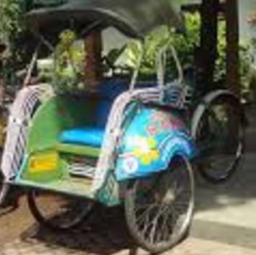
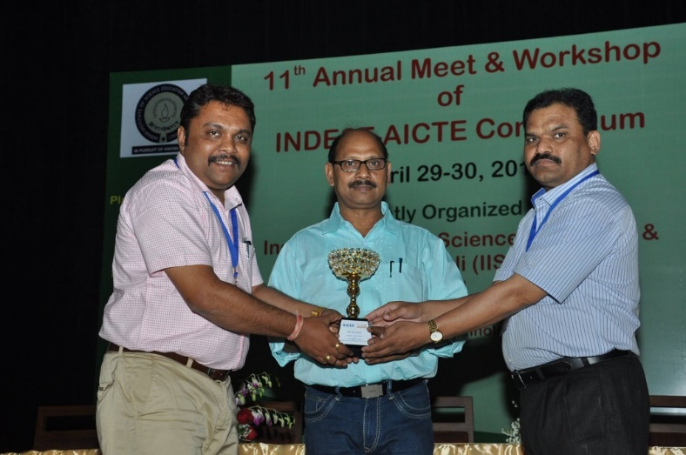
Institute Receives Award
The institute claimed the highest user award in the IEL Level 2 category during the AICTE-INDEST annual event held in Mohali in 2015

Slide 10
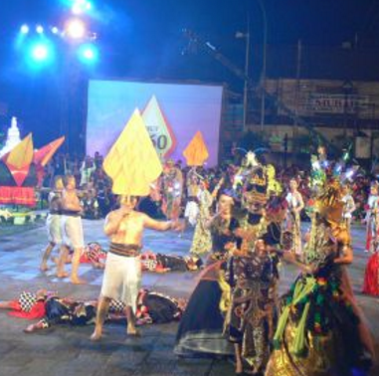
Few more!
Director, NITK appreciated the partnership initiative with IEEE and encouraged the library to continue offering such highly engaging sessions.
The participants provided suggestions on new books for the library, and features for the IEEE Xplore Digital Library.
As suggested by the Director NITK, Central Library continued partnering with publishers to conduct more user awareness sessions of this type.
Till date (2016) conducted more than 18 such events partnering with various publishers.
Usage of the library website and the services offered significantly increased.
The library footfalls increased compared in the past.
User requests for Library assistance for literature searches increased, especially from Research Scholars.

Slide 11
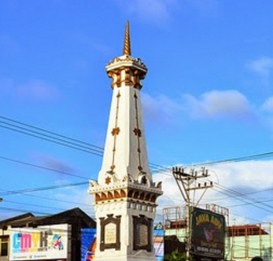
Suggestions
Following are some of the other ways of looking at promoting the resources:
Clubbing such orientation sessions with a paper writing session
Recognizing the top authors of the institution in various streams during such orientation sessions.
Clubbing such orientation sessions with an in house expert talk on a general topic of interest

Slide 12
Conclusion
Technology has changed the way end-users engage with library resources and the information professionals
Library, heart of the institution by making research materials available online, usage statistics and participation in library training sessions
Usage will continue to be a driving factor for libraries
For end users’ attention, new models of engagement are necessary
Effective mechanism: involving the active student groups
Digital society needs more of inclusivity to succeed

Slide 13
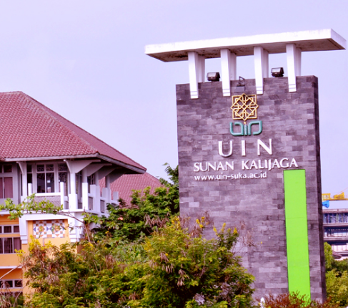
Thank You…!!!
Mr. Dhanukumar Pattanashetti
IEEE Client Services Manager
IEEE, Bangalore, India
Email: dhanu.p@ieee.org
PHONE: +91 80 4944 4366

