Slide 1
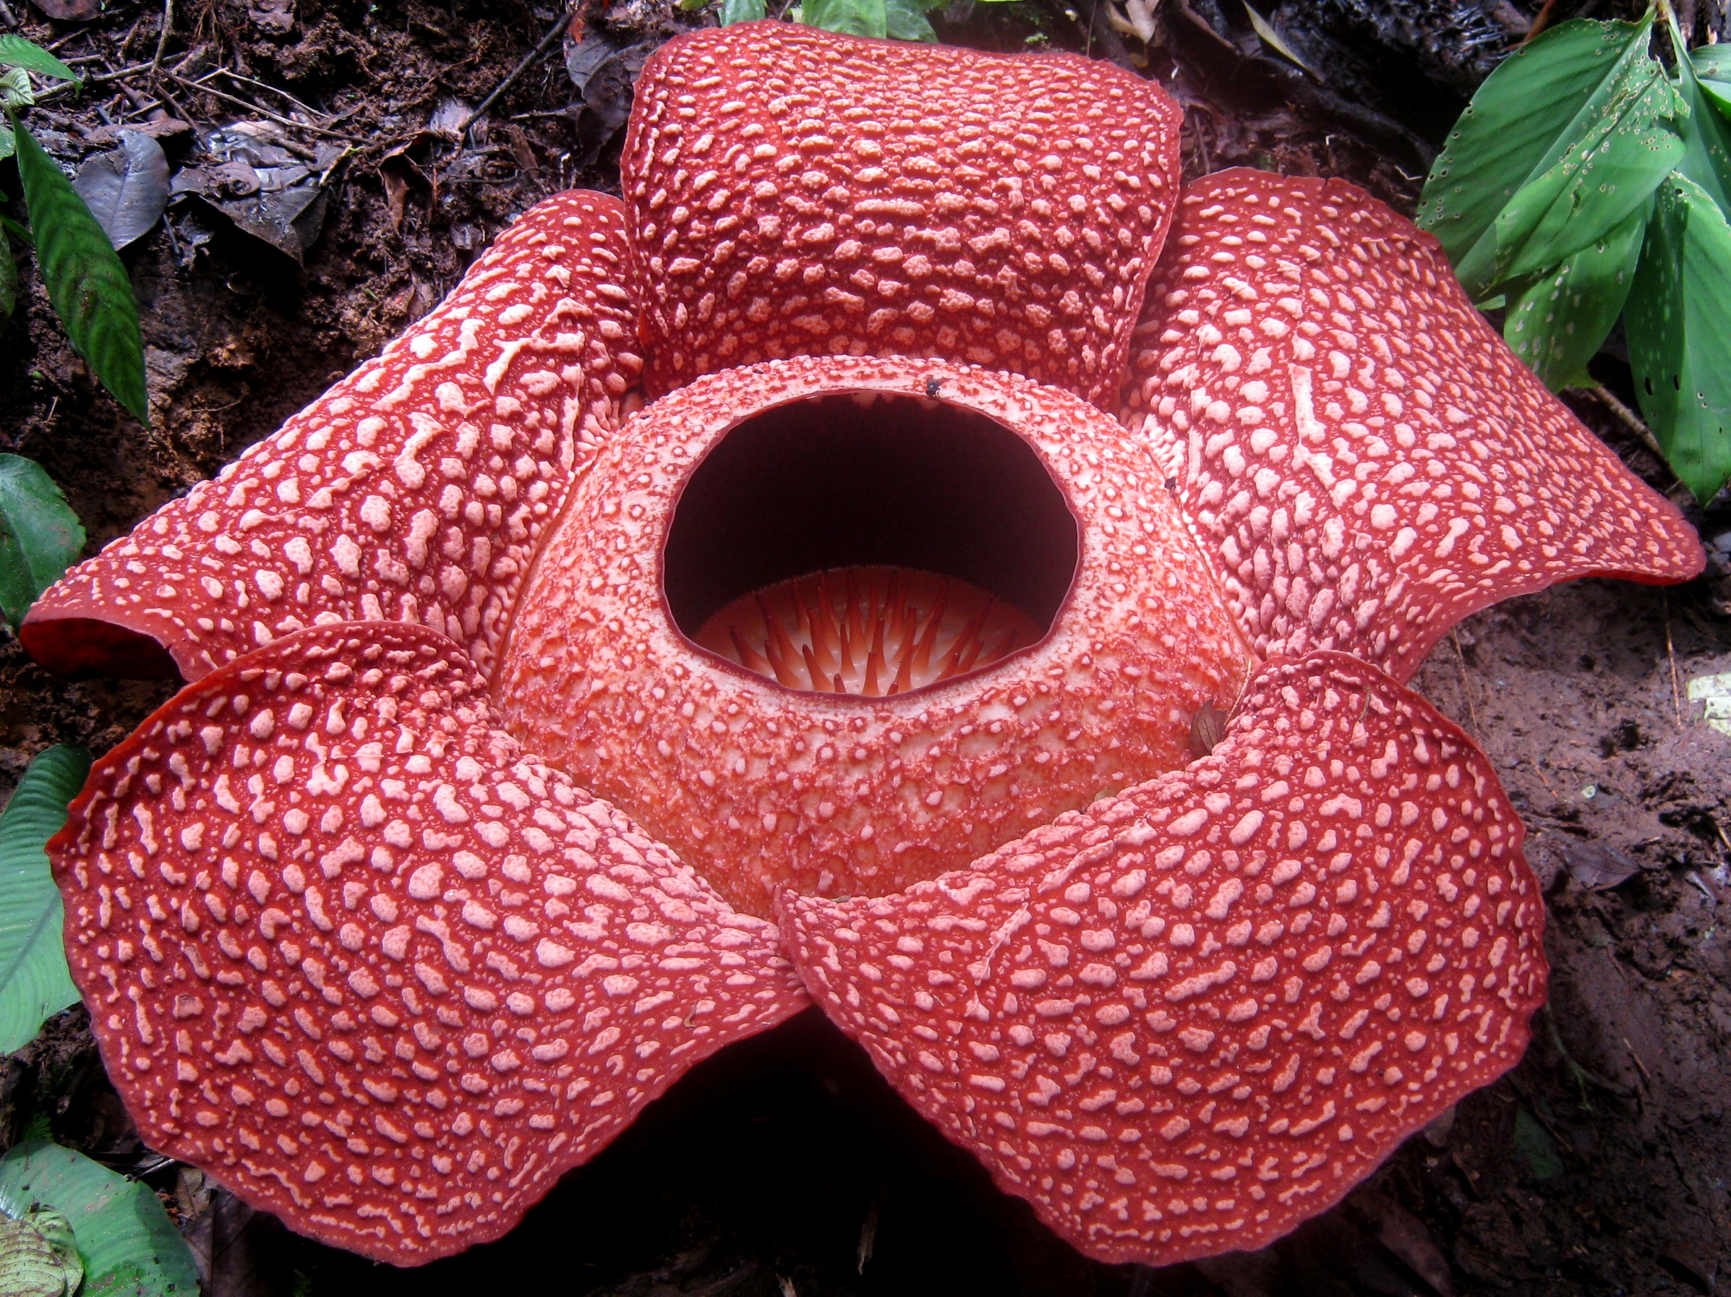
The Role of Bengkulu Corner in Preserving Bengkulu’s Cultural Heritage (the Land Raflesia) Through the Manuscript and Bengkulu’s Collection Increase in Student’s Cultural Literacy (Study in Library Of University of Bengkulu)
Fransiska Timoria Samosir, S.Sos.,M.A University of Bengkulu

Slide 2
Background
Bengkulu is as history city in Indonesia
Bengkulu always call The land of Rafflesia.

Slide 3
Bengkulu in history

Slide 4
The problem
Some of the Young generation in Bengkulu dont know history, culture, norm etc about Bengkulu
In Bengkulu there is not institution give and provide information about culture of Bengkulu
Bengkulu Corner is in response to the social conditions

Slide 5
University of Bengkulu Library
Bengkulu Corner
Preserving cultural heritage
Cultural literacy

Slide 6
Theoretical Overview
(Chibuzor,Dim. L, Ngozi, 2009) Cultural heritage refers to the legacies of physical artifacts and intangible attributes of agroup or society that are inherited from past generations, maintained in the present for the benefit of future generation.
Prott. & O’keefe in (Chibuzor,Dim. L, 2009) cultural heritage includes moveable objects (works of arts)-, immovable cultural objects (monuments and sites), expressive activities (language, music, dance and drama) as well as intangible customs and traditions such as proverbs, rituals and intellectual norms

Slide 7
Laster, Paulsen expanded H.B wilson in (Thayer, 1998) Cultural literacy is being aware your ethnicity and utilizing cross multikultural communication skill.

Slide 8
Methods
Qualitative
Interview/Observation
Head of University of Bengkulu library
Librarian in Bengkulu corner
Students

Slide 9
Discussion and analysis
Glance of Bengkulu
The main tribe is Lebak and Melayu.

Slide 10
Coastal area

Slide 11
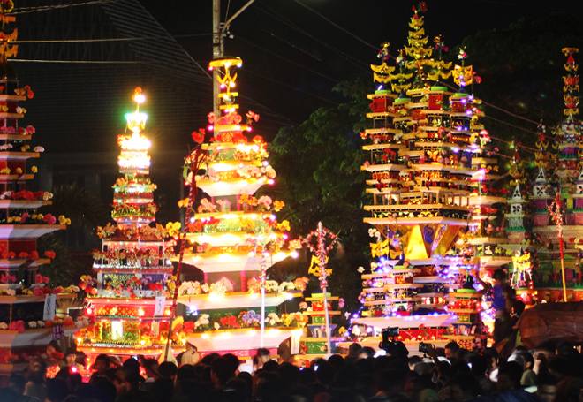
Tabot

Slide 12
Rafflesia Arnoldi

Slide 13
Bengkulu in history

Slide 15
Kain besurek

Slide 16
II. Bengkulu Corner
Bengkulu corner persist in april 2016

Slide 17
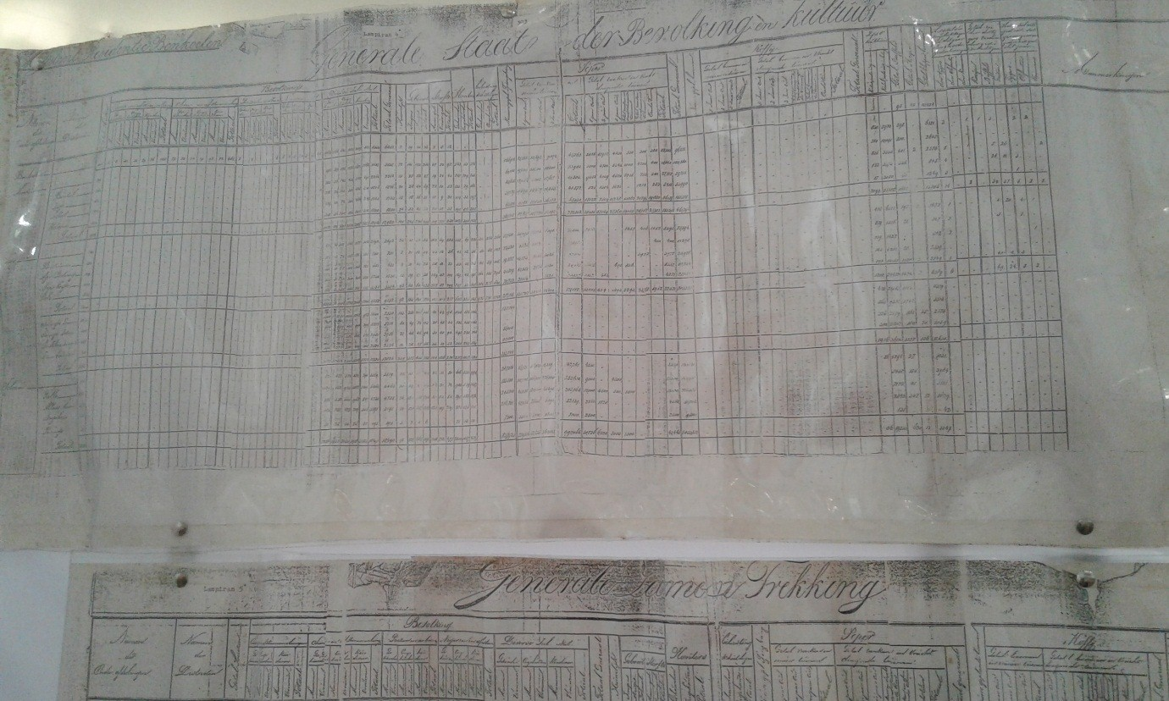
Collection of bengkulu corner
Manuscript

Slide 18
b. Scientific work
Jurnal
Thesis
Disertation
Essay
Research reports

Slide 19
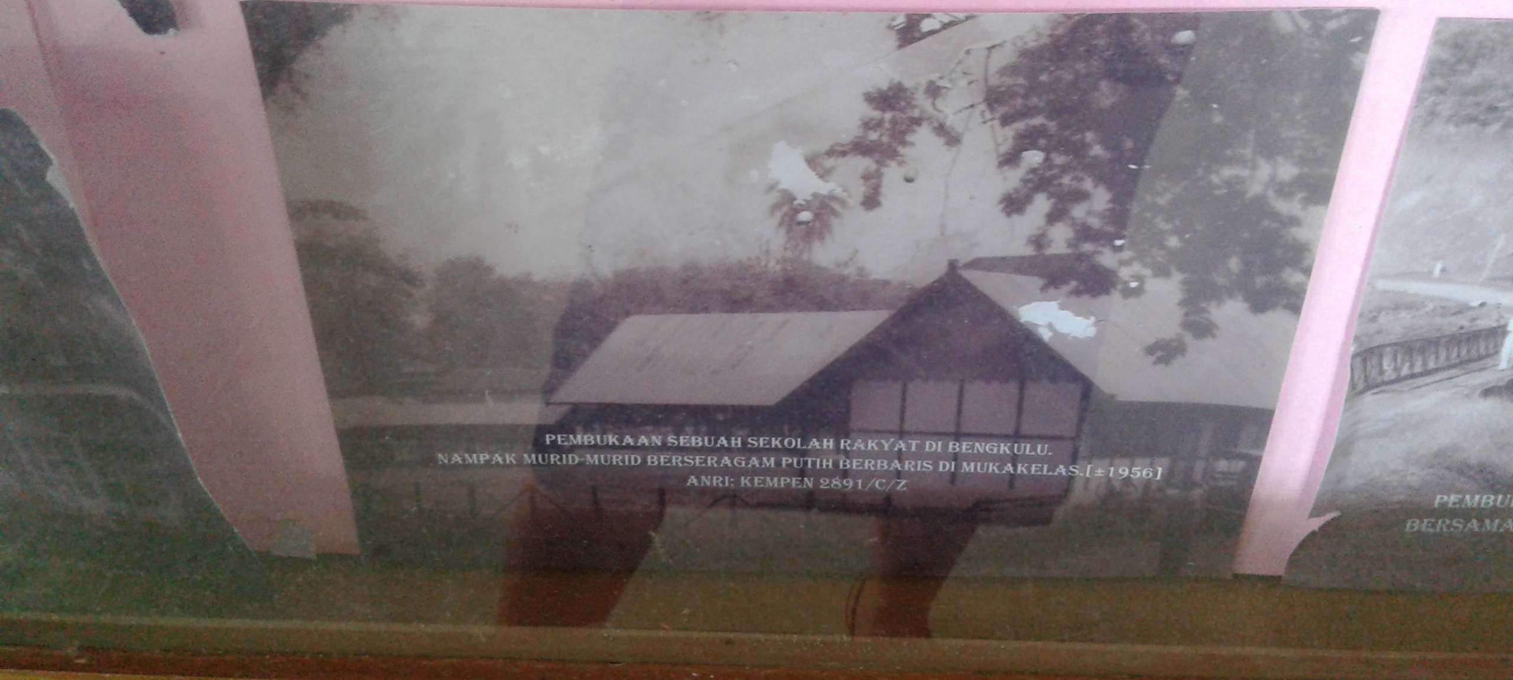
C. Photo

Slide 20
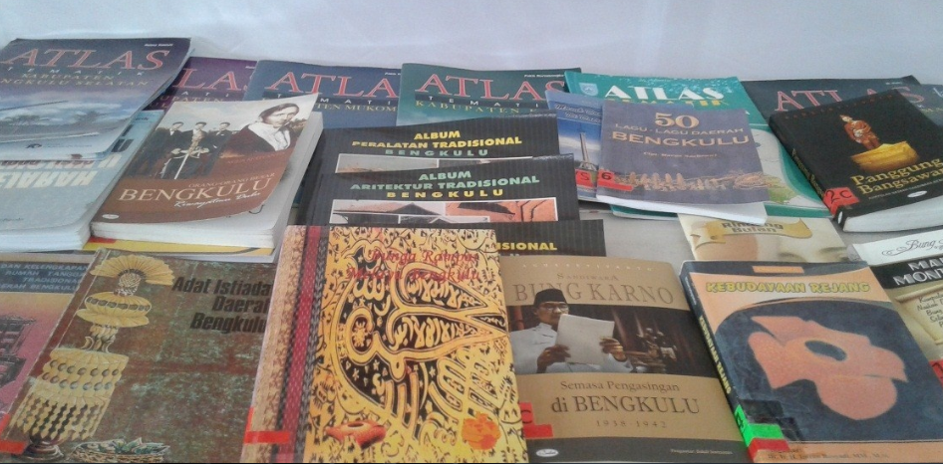
Book

Slide 21
II . User of Bengkulu University
Students from University of Bengkulu
Researches
Student from out university
Community

Slide 22
Cultural Literacy and the Role of Bengkulu Corner's
Cultral literatur to help reader
Bengkulu corner presence have a positive impact to increase cultural literacy

Slide 23
Bengkulu corner do promotion of the service to the academic civitas through
1. the library user education.
2. UNIB Fair

Slide 24
Conclusion
Culture is something becoming important to Need be safeguarded and inherited our generation
Bengkulu corner have big role increase cultural literacy of Bengkulu society except academician Bengkulu University
Bengkulu corner present to present the collection of Bengkulu about history, culture, customs, beliefs, norms and the other

