Slide 1
STRATEGIC LEADERSHIP AND ROLE OF LIBRARY AND INFORMATION CENTRES IN ENVIRONMENTAL SUSTAINABILITY: AN OVERVIEW OF GREEN TECHNOLOGIES Prof. I V Malhan Central University of Himachal Pradesh Dharamshala, H. P., India & Dr. Shivarama Rao K Central University of Kerala Kasaragod, Kerala, India

Slide 2
Introduction
Green is largely becoming a standard term to denote processes, products, services and technologies that in one way or the other integrate with them indicating that their use is in the larger interest of environment care and protection.
The fundamental concern of any green technology is environment sustainability.
Green technologies are thus an approach towards saving earth.

Slide 3
Environmental damage is a worldwide problem
Too many activities for societal modernization ranging from deforestation, increasing volume of e-waste, ruthless use of chemicals in agriculture and household and growing emission of greenhouse gases are leading to environmental damage.

Slide 4
WHY LIBRARIES NEED ATTENTION and INVOLVEMENT?
Libraries are key channels of self education and information.
Libraries are social institutions.
Libraries contribute to the understanding and advancement of human knowledge.
Libraries can contribute their bit by imparting environmental information literacy.
Libraries house a large volume of documents printed on paper.
The pulp and paper industry is the third largest industrial greenhouse gas emitter...

Slide 5
WHY LIBRARIES NEED ATTENTION and Invovement-contd?
Libraries consume enormous quantities of energy for user services and comfort.
Libraries produce considerable waste.
Libraries should set examples for environment friendly practices.
Libraries should be the first institutions to incorporate principles of sustainability and turn themselves into models of green culture

Slide 6
APPROACHES TO GREEN INITIATIVES

Slide 7
Social and cultural
Usage of social media for green campaigns
Virtual meetings – Reduce travel.
Social media and networks make it easier for large numbers to participate in campaigns.
Example:- Nestle was targeted for using Sinar Mas, the offending producer and supplier of palm oil in Indonesia.
Public libraries can also publicize green issues and disseminate information on environmental issues.

Slide 8
Green buildings
Many of modern day construction of buildings are damaging its ecosystem, oceans, lakes, forests and fields. There are plenty of threats to people, animals and plants.
Green building certifications - G-SEED, LEED, BREEAM, CASBEE etc
It is estimated that there are nearly 600 green product certifications in the world

Slide 9
Energy savers and renewable energies
Benchmarking of energy use
Example - ENERGY STAR benchmarking tools.
Exploration of renewable energy technologies - wind, solar, bioenergy.
Use of Day light, turn off the lights when not required.
Installing motion-sensors
More Light from Less Power through CFLs and LEDs

Slide 10
Energy savers and renewable energies
Systems to control high exposure to the sun.
Natural cooling techniques
Full fledged maintenance programme

Slide 11
Green IT, gadgets and apps
Green IT is a set of practical measures designed to ensure that Information Technology is developed, delivered and used in a way that is environmental friendly, sustainable and energy efficient.
Environment compliant purchasing of IT.
Institute purchasing policies that promote resource efficiency and toxic reduction.
Green Computing – by providing responsible and environment sensitive computing solutions

Slide 12
Green IT, gadgets and apps-contd
People around the world rely on laptops, phones and tablets as an essential part of their everyday lives.
Toxic e-waste is predicted to grow to 65.4 million metric tons in 2017 (UN study).
E-Waste - voluntary take-back programmes (buy-back offers).

Slide 13
Green IT, gadgets and apps-cond
Smartphone apps abound! But there some green apps too.
Light bulb finder – to find energy efficient light bulbs
Good Guide - green app that lets you scan a bar code, then informs you about that product's environmental footprint
iRecycle - the app know where you want to recycle or use your current location and iRecycle will tell you what resources are nearby, their hours of operation and driving directions.
Selection and efficient usage of smart apps in libraries green initiatives.

Slide 14
Day light harvesting
Utilizing daylight in libraries is becoming a priority not only for aesthetic reasons, but also with the intent to save energy and costs. apps in libraries green initiatives.
Roof monitors, skylights, and wall apertures are some of the design features used to improve the quality of natural lighting in libraries.
Use of day light sensors will helps in reducing energy consumption and controls the lights in day lit spaces.
Using photo sensors in day lit spaces to control dimmable ballasts will allow a system to work without being actively operated by occupants.

Slide 15
Space management and Alternative transport
Share and ride for library employees and users
Carpool, Bikepool, Public transport
Split cost, Save fuel
Exmaples- UberPOOL, Ola
Use of bicycles and electric car with charging stations
, promotion or subsidy of alternative forms of transportation for employees, such as fuel efficient vehicles, cycling, or mass transit mechanisms will largely help in controlling greenhouse-gas emissions.

Slide 16
Healthy atmosphere through microclimate
Libraries exist and function in a wide range of climatic conditions
Raising the height of ceiling of reading room.
Rain water harvesting tank on roof.
Water bodies in the library premises, landscaped plantation and underground parking.
Vegetated roof

Slide 17
Healthy atmosphere through microclimate-contd
Jaipur city in India is hot, like 45 degrees C or 113 F
Architect Manit Rastogi or Morphogenesis designed the Pearl Academy of Fashion in Jaipur using a number of old technologies to create "an environmentally responsive passive habitat."
A traditional way of cooling in India was the Stepwell, a pond dug into the ground or surrounded by walls above ground so that the air is cooled by evaporating water in an enclosed, shaded zone”.
Buildings are protected by double skin which is derived from a traditional building element called the ‘Jaali’ which is prevalent in Rajasthani architecture. The double skin acts as a thermal buffer between the building and the surroundings.
Notes:
https://www.treehugger.com/sustainable-product-design/learning-from-the-past-designing-for-the-future-how-they-air-conditioned-in-india-400-years-ago.html

Slide 18
Water management and recycling techniques
Besides overall management of resources at the national level, water resources require to be adequately managed at institutional level.
Use technologies or practices to reduce or eliminate the creation of waste materials.
Reusing or recycling waste materials.
Bans on plastic, shifting from paper to digital
3-D printing

Slide 19
ACTION PLANS & STRATEGIES

Slide 20
Environmental Literacy
Awareness is a key to participate in green initiatives. Systematic learning may require becoming a fully green literate individual.
Even many of us on day to day basis informally contribute to green initiatives, but are never aware of our contributions in green initiatives.
We need to analyse environmental issues more closely through the lens of world religions and cultures

Slide 21
Environmental Literacy-contd
Libraries are central to students’ academic investigations; the work of librarians in embedding information literacy across the curriculum is an obvious place to transform the practices of knowledge inquiry.
Using the library as a teaching tool and employing alternative education techniques.
Applying green practices in library and information systems and asking users to practice is not an easy task

Slide 22
Environmental Literacy-contd
Even our ancient scriptures have included practices and values related with ecological and environmental conservation.
Information literacy has close connection with sustainable literacy.
Ultimately, the goal of environmental education is to develop an environmentally literate public.
The issues of sustainability are location-specific, but the aim is to have sustainability of the planet Earth

Slide 23
Environmental Literacy
Introduce a course on vaastu shastra that integrates architecture and Nature while planning library buildings.
The trend of Earth Buildings is growing.
Some of the organizations involved are:
Thannal and Vasthukam in Kerala, Made in Earth in Bengaluru, Auroville Earth Institute in Auroville — and architects such as Dharamsala-based Didi Contractor, Chennai-based Benny Kuriakose, Kerala-based Eugene Pandala and Goa-based Gerard da Cunh.
Create environment-conscious ambassadors.

Slide 24
Environmental values-traditional knowledge
Environmental values are already built in our ethos but we are not behaving in accordance with those environmental values and in fact we seem to be behaving in the exact opposite direction.
We require to preserve our traditional knowledge on environment issue that has helped environmental sustainability century after century.

Slide 25
Digitization and Resource Sharing
Digital resources have larger impact on usage and accessibility of information, but it has negative environmental impacts due to energy use and e-waste.
Encourage positive responsible behaviours to users on consumption of paper, ink and toner
For example, Green Print a software that removes space and unnecessary images.
Eco-Font is a font face for text with tiny holes to reduce ink usage by 20% without much impact to readability

Slide 26
Digitization and Resource Sharing-contd

Slide 27
Simplified in-house operations and processes
Re-design library operations and processes.
Implement Lean – six sigma.
Revamping the library procedures using green concepts and technologies is also desirable

Slide 28
Maintenance of library buildings
Cut down usage of chemicals and poisonous floor cleaners.
Install environment friendly furnitures
For example, WeBike – pedal for library furniture is a new innovation for library furniture, this type of furniture will have a pedal to recharge devices like smart phones in thirty minutes of time.
Education is a key component for LEED understanding.

Slide 29
Collaboration
Library and IT department can work together to test green technology programs in the library .
Duplex printing, loaning i-pads and kindle kinds of devices to library users

Slide 30
Information professionals as change managers
Our inititaitves must link business to the industry, the community and the political, social and economic forces of the nation as a whole.
Create a think tank for green knowledge services.
Outreach activities;
Adopt villages
Enhance community reach programs with green message.

Slide 31
Measure green impact and set benchmarks
Green initiatives of libraries must be measured based on their programs and publish frequent dashboards on energy saving, waste cut down, waste recycling and other indicators related to green compliance.
Amount of water used annually by an average library, amount of solid and hazardous waste generated by a library, cost reduction effected by reducing energy, water, and paper use, percentage of daily library shipments received that end up in garbage bins, percentage of publisher catalogs produced on recycled paper, quantity of computer paper used per library employee and user etc.

Slide 32
Corporate Social Responsibility (CSR)
The survival of the libraries both in the medium and long term depends on its economic feasibility, commitment with the environmental sustainability and socially responsible performance.
We have examples of corporates helping public libraries in reshaping their structures; however, libraries should also revisit their library social responsibility (LSR) by implementing programs like green initiatives for sustainable development and participate in environment protection programs.

Slide 33
Corporate Social Responsibility (CSR)-contd
For example, The Northern Ireland Library Authority (Libraries NI, 2015) has its own statement of corporate social responsibility
CSR must be part and parcel of doing services that contributes to organizations’ long term survival

Slide 34
CONCLUSIONS
Foster a sense of green culture at organizational level
Find out locally suitable ideas with global benchmarks
LIS professionals who are involved in green initiatives should make use of social media to disseminate information
Libraries becoming promoters of sustainability and social responsibility initiatives

Slide 35
CONCLUSIONS-contd
Combine such projects with public education programs to strategically positions libraries to become community models for sustainability.
If librarianship is humanism in practice, any service rendered for environment sustainability is service to the whole gambit of nature.

Slide 36
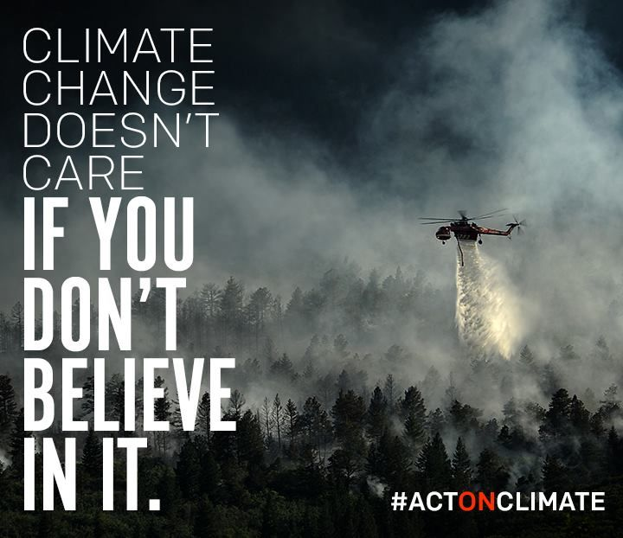
CONCLUSION
Notes:
https://www.pinterest.com/b_litwiler/environment/

Slide 37
Thanks!
ANY QUESTIONS?
Cloud Cloud Cloud
You can find me and my co-author at
imalhan_47@rediffmail.com
shiva@cukerala.ac.in

