Slide 1
A Model of Preservation in Managing Old Collection at the Library of Kolese St. Ignatius Yogyakarta, Indonesia
Melisia Windhi Astuti
Nurdin Laugu

Slide 2
Introduction
According to law no. 43 year 2007 on libraries, a library is an institution responsible for managing a collection of written works, printed works, and/or recorded works in a professional way through standard system, and recreation for library users.
A library has a variety of functions, from education to culture, including collection preservation.

Slide 3
the frame of UNESCO principles on Instruction to Conservation → “conservation” → as a preventive action in order to protect the object of culture through environmental control and protection from damaging factors and mishandling.
Preservation is meant as direct treatment toward objects of collection, library materials, in order that those can be protected from different factors, such as humidity, chemistry, insect, microorganism, etc.

Slide 4
The Library of Kolese St. Ignatius Yogyakarta
establishment in 1923
Have various different functions
One of this functions help empowering the preservation of collection of a variety creations of human culture, both books and archipelago old manuscripts

Slide 5
Method
Use qualitative method
The object of this research is a model of preservation at this library including activities of managing old collection, namely: preventive, curative, and restorative.
The subject of this research consists of the head of the library of Kolese St. Ignatius Yogyakarta and several staffs who are responsible for the department of the library preservation
uses three techniques of data collection: interview, documentation, and observation.

Slide 6
CONSEPTUAL APPARATUS

Slide 7
Management
Management according to Kamus Bahasa Indonesia (2006) is meant as a use of resources effectively to achieve objective.
Lasa Hs. (2009) in his book Kamus Kepustakawanan Indonesia explained that management is a process of planning, organizing, directing, and controlling members’ activities of certain institution and/or organization and uses of organizational resources in order to achieve the purposes of the institution.

Slide 8
Preservation
According to Martoatmojo (2010), the preservation of library materials has several purposes are, amongst them:
to save the values of information of the library material;
to save the physical aspect of document;
to overcome the barriers of limited number of room for library;
to accelerate the process of acquisition of information.

Slide 9
In general, it seems that the damage of collection is caused by internal and external factors.

Slide 10
The paper materials still contain acid and lignin compounds which can accelerate the process of weathering and alteration on the paper.
Paper with low quality
Paper with good quality
Internal
Factor
Usually contains a lot of acid and lignin compounds
The paper is free from the effect of acid and lignin compounds.

Slide 11
External factor can be seen from three forms.
First is the physics associated with the temperature, humidity, and light.
Second is the biology which constitutes fungus, insects, rodents, etc.
Third is other form of factor that includes, such as disaster and human (Made, 2013).
External
Factor

Slide 12
There are several ways done by a library in order to protect collection from damage. The way can be seen in three parts, namely:
Preventive
Curative
Restorative

Slide 13
PREVENTIVE
Preventive according to Martoatmojo (2010) is the activities that have been done since the collection belongs to the library.

Slide 14
There are various different approaches to prevent the damage of library materials from physical factor.
LIGHT
The light for instance is used when it is needed.
The use of fabric curtains needs to be considered associated to the hot sunlight entering the room.
The position of the books should not be too close to the window to avoid ultraviolet radiation.
Meanwhile, aspects of air and dust can be considered through the clean of the library room, book storage in protector boxes, the use of air conditioner (AC), and cleaning air through air cleaner.

Slide 15
TEMPERATURE & HUMIDITY
Avoiding humidity sources.
The temperature should be arranged to between 20-24°c or humidity between 45-60% RH.
The use of air conditioner should be used in 24 hours/day and 7 day/week.
The condition of room should also be maintained through good ventilation, installation of blower or dehumidifier, the use of silica gel, etc.
In order to monitor the temperature and humidity, there are used a variety of tools, such as thermohygrometer, psychoeter, dan thermohygrogaph. Besides, library materials also need to be stored in filing cabinets and the like (Made, 2013; Martoatmodjo, 2010).

Slide 16
In terms of biological factor, there are several points that should be payed attention.
Place for restoring library materials must be clean and dry as well as controlled periodically.
Air humidity should be decreased and the holes that enable insects to enter must be prevented.

Slide 17
Besides, the other factor can be seen from two elements, human and nature.
In referred to human element, there are several things that need to be considered. One of them is training how to handle and treat library materials in a good way. It is also important to consider about the security, arrangement, equipment, and environment when they are exhibited. Food and drink should not be brought into reading rooms so that the rooms always remain clean. The understanding and the awareness of users should be improved.
Furthermore, the natural factor pays attention for all equipments concerning on their capabilities to be fireproof and fire resistant should be always available. Banning smoking in the library should be made of signs, the use of electrical equipment must be carefully (Martoatmodjo, 2010).

Slide 18
CURATIVE
This can be understood as activities that are particularly maintaining library materials which begin to damage. The curative treatment is used to make collection to be long-life in physical forms.

Slide 19
Curative
The curative preservation can be seen from several activities, such as:
Fumigation
De-acidification
Lamination

Slide 20
RESTORATIVE
As for the restorative, it means an activity done in order to improve damaged collection through several ways, such as patching and bleaching the paper, the replacement of damaged pages, and tightening the thread binding.

Slide 21
Management of Preservation
The management of preservation can be concluded as an effort to organize and manage all forms of preservation and conservation of library materials due to the optimalization of function of collection. Also, they can be used for a long time.

Slide 22
Model of Preservation
According Oxford Advanced Learners’ Dictionary, it is a representation of something; it is a simple description of a system used for explaining, calculating something, etc. or it is a person or thing regarded as an excellent example to copy.

Slide 23
DISCUSSION

Slide 24
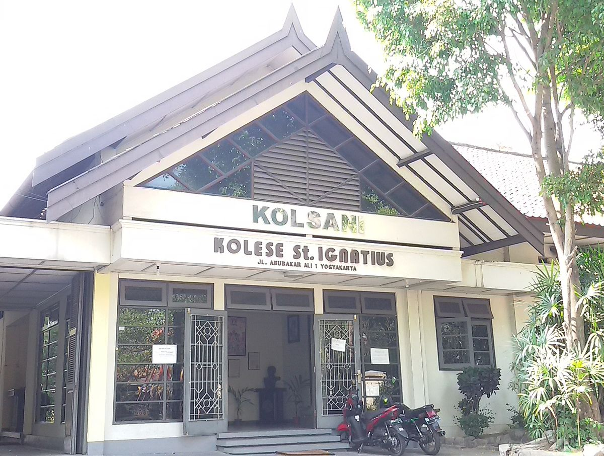
A Glance of Library
The library of St. Ignatius of Yogyakarta which is commonly abbreviated with the Library of Kolsani. It is the library of the monastery, a friar and brother of the society of Jesus, studying Theology.
The library is one of library the private non-university in the Province of D. I. Yogyakarta that is located at Jl. Abu Bakr Ali No. 1, Kotabaru, Gondokusuman, Yogyakarta, D. I. Yogyakarta. The position is located at the edge of the road, on the east side of the Toko Puskat.

Slide 25
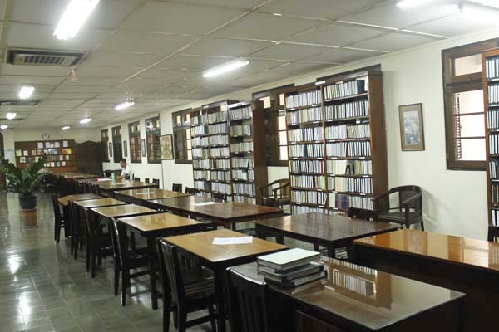
Collection and Managemenet Preservation
Library Collection
Library of St. Ignatius provides 250,000 copies of library materials in printed form, journal by 130 titles, and seminary around 100,000 copies.

Slide 26
Management of Collection Preservation
Basically, the management of the existing collection at the Library of Kolsani has no planning or organization that regularly from the library. The library of Kolsani gives special attention to 4 things:
Material collection in the library should be maintained in accordance with its place (continuously controlled, including on the part of the circulation);
The damage occurs in the material collection (binding loose, paper tears, etc.) are directly corrected or repared;
The cleanliness of the materials collection should always be maintained;
Temperature and humidity should be always controlled.

Slide 27
Preventive Preservation
Cleaning books periodically using a small broom specialized to clean book.
The temperature of the library room is set to 26 degrees celsius and room humidity are set according to the proper humidity, i.e. 62 Hg.
Lighting in the library of Kolsani is not from light only, but also utilizing a window - a large window that was there. This library maximizes the use of sunlight.
In order to reduce the radiation of the ultraviolet rays of books, this library use curtains, as well as do not put library materials close to the window.

Slide 28
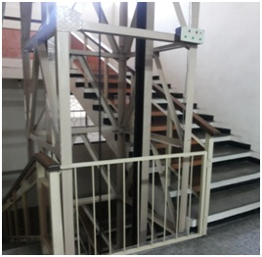
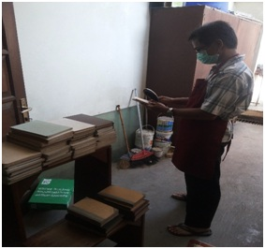

Slide 29
Currative Preservation
In this library, the activities of curative preservation done are to do fumigation regularly to its library materials.

Slide 30
Restorative Preservation
In the library, collections that are damaged will be directly carried out the repair, while the repair itself can not be ascertained will end how long because there is not a special officer who is responsible for the repairment of library materials.

Slide 31
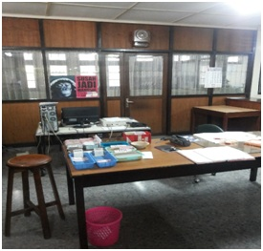
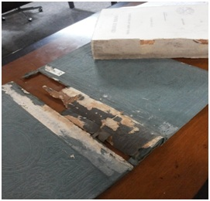

Slide 32
THANK YOU

