Slide 1
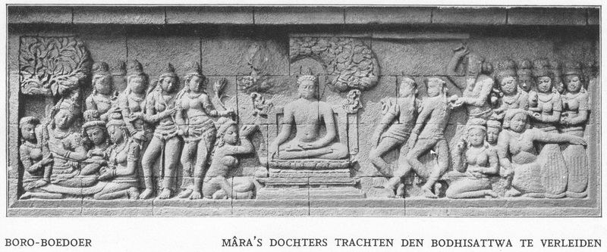
The Role of Borobudur Conservation Center Library in Providing References for Composing Cultural Objects Studies Results
Atin Istiarni & Rizki Shofak Isnaini
Librarians at University of Muhammadiyah Magelang

Slide 2
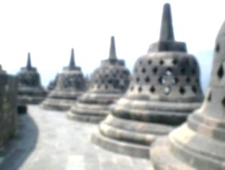
Cultural Heritage In Indonesian
Identity
Identity → Culture
Indonesia → constructions, dances, manuscript, etc.

Slide 3
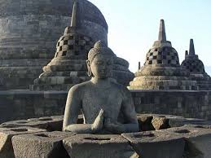
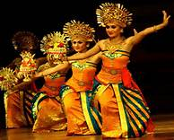
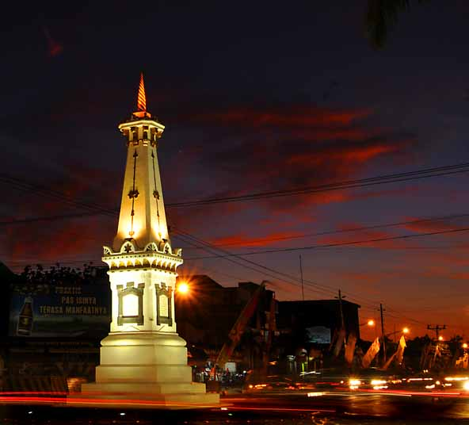
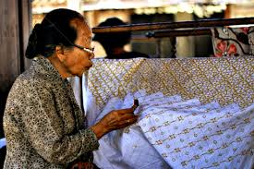
Kinds of Cultural Heritage In Indonesian
Cultural Heritage Objects
Customs
Environment

Slide 4
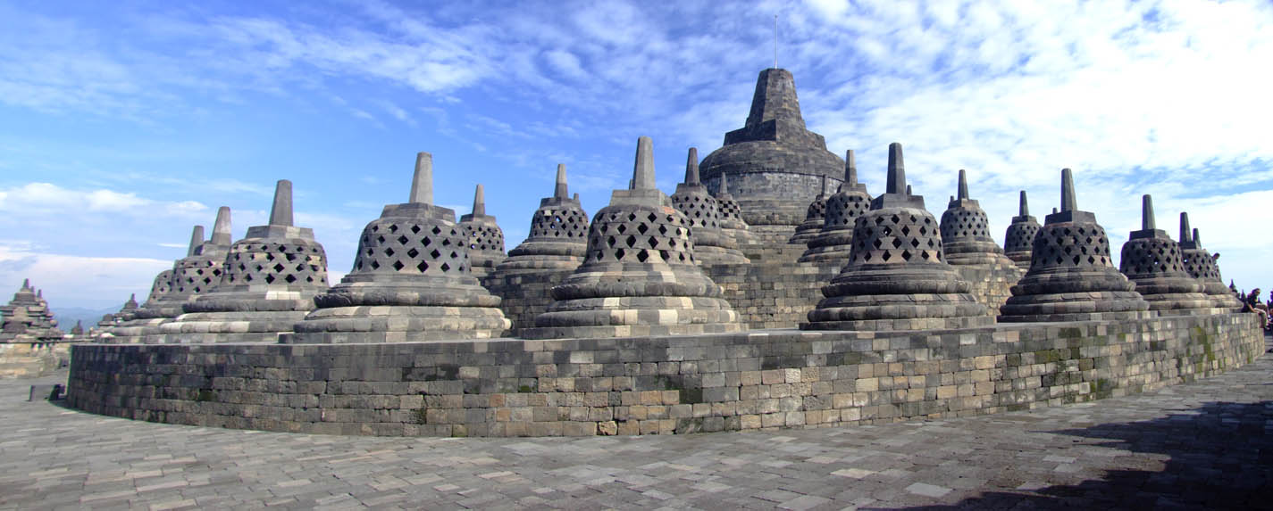
Conservation & Cultural Heritage
Cultural Heritage:
Damage = maintenance for sustainability
Conservation:
Maintenance & Protection

Slide 5
Borobudur Conservation Center
Govermental Institution
Borobudur Tempel Conservation Center
Indonesian Cultural Heritage Object Conservation Center

Slide 6
What are the roles of Library in research result report?

Slide 7
Studies Result Report
Observation
Laboratory Test
Studies result reports
Final test
Sample Test
Supporting theories
Object
Samples
Conservation method determination
Information deal with conservation
LIBRARY
Prior research

Slide 8
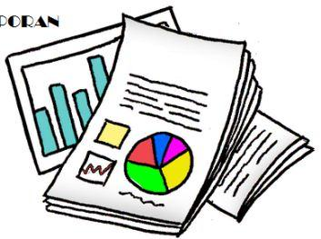
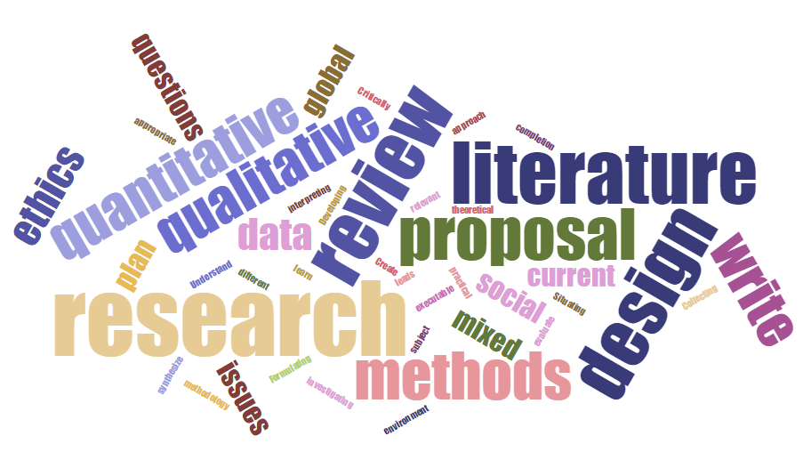
Research Method
Validity & Reliability
Type
Triangulation by combining interviewing and observation techniques
Qualitative Research
Data Collection
Data Analysis
Observation and Interview
Data Analisis from the reduction of interview and observation result

Slide 9
Borobudur Conservation Center Library
Collection
3690 copies with 2594 titles
Duties
Supporting the implementation of the implementation of the tasks of their parent institutions
Function
Information center

Slide 10
Roles of Library for Studies Result Report
1
3
Information Laboratory
Heritage Information Management
2
4
Information References Source
Information Services

Slide 11
Roles of Library for Research Result Report
Information Laboratory
Various kind of information dealing with conservation and cultural heritage object can be found in Borobudur Conservation Center Library.
Free access information
To create heritage information → Studies result Reports.

Slide 12
Roles of Library for Research Result Report
Information References Source
Borobudur Conservation Center Library has:
Information on cultural heritage object.
Always updated information.
Local content collection that become references.

Slide 13
Roles of Library for Research Result Report
Heritage Information Management
Researchers must submit the document of the research result to the library.
“special” book published by Borobudur Conservation Center is managed only by the library.
Library is the colection circulation controler.

Slide 14
Roles of Library for Research Result Report
Information Services
Open Acces
Borrowing= the intern of Borobudur Conservation Center
Reference service
Information on the availability of collection needed by the researchers
Information dissemination through various kind of promotion

Slide 15
Conclusion
Conservation research activities obtain document of research result report.
Research result report is one of heritage information forms.
Borobudur Conservation Center Library is the studies result report center.
Through Borobudur conservation center library, heritage information will always be protected and updated.
Management of Studies Result Reports through information services and dissemination is one of the roles of library in keeping the sustainability of cultural heritage objects.

Slide 16
Sugesstion
The library should be neater so that visitors feel comfortable in the library
Technology supports such as computers, Wi-Fi, informative screens are also required to support library services
Adequate place becomes an important thing that must be realized immediately
The library manager must be more than one
The information re-packaging is also required as a preservation step
Reports in the form of library collection access statistics should be displayed

Slide 17
Thank for your attention

