Slide 1
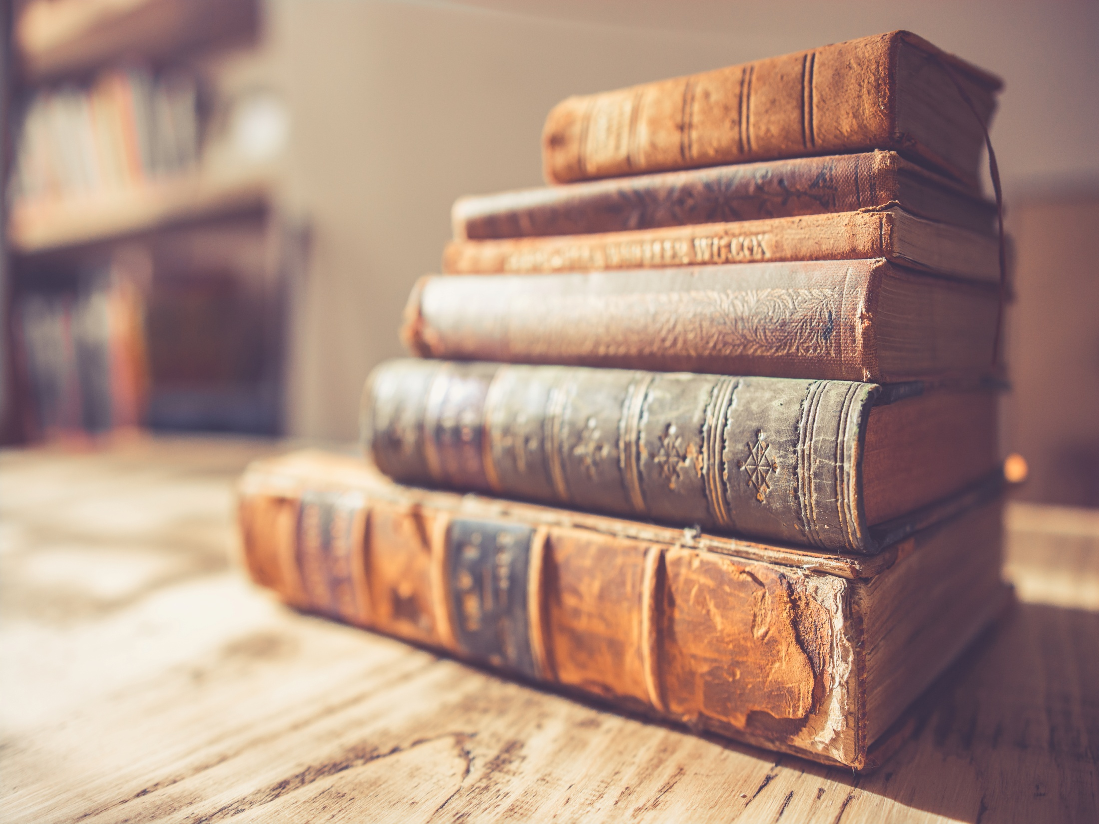
Martalia Arimbi and Labibah Zain
ICoASL 2017
Yogyakarta, May 10 2017
Table of contents
Introduction
Research methods
Discussion
Preservation and Conservation of Collections
The efforts were conducted in the prevention of damage to the collection
The equipment used in the process of preservation and conservation of the collections
Conclusions
Preservation and Conservation of Collections in the
Grhatama Pustaka Library Yogyakarta, Indonesia

Slide 2
Introduction
The library is one of the important components in the community.
As a source of information, the library has the goal to manage, organize, collect and present library materials to be used by user effectively and efficiently.
From this, it can be concluded that the most important element of the library is the collections.
Grhatama Pustaka Library is a public library in Yogyakarta. The library has a variety of collections that need their efforts to preserve library materials so, that the information content is maintained.

Slide 3
Research methods
The method using the techniques of collecting data through observation and interviews.

Slide 4
In the interview, the purpose of the preservation and conservation of library materials has several functions:
1. Protection Function
2. Preserving Function
3. The function of beauty

Slide 5

Discussion
Preservation and Conservation of Collections
The equipment used in the process of preservation and conservation of the collections
The efforts were conducted in the prevention of damage to the collection

Slide 6
The activity preservation in the condition physics of the collection, views from 3 levels, among other things:
a. Low Damage
b. Medium Damage
c. High Damage

Slide 7
Preservation and Conservation
Collection
Figure 1. Collections
Figure 2. Collections

Slide 8
The efforts were conducted in the prevention of damage to the collection:
1. Cleaning against Stain
2. Fumigation
3. Eliminating Acidity on Paper
4. Laminates
5. Transfer to the Collections to the Media

Slide 9
The equipment used in the process of preservation and conservation of the collections are:
Figure 1. Big Cutter
Figure 2. Glue
Figure 3. Scanner
Figure 4. Japanese paper

Slide 10
Figure 5. Drill
Figure 6. Yarn
Figure 7. Brush
Figure 8. Plastic Cover

Slide 11
Figure 9. Big Stapler
Figure 12. Raffia Fibre
Figure 11. Cutters
Figure 10. Book Cover

Slide 12
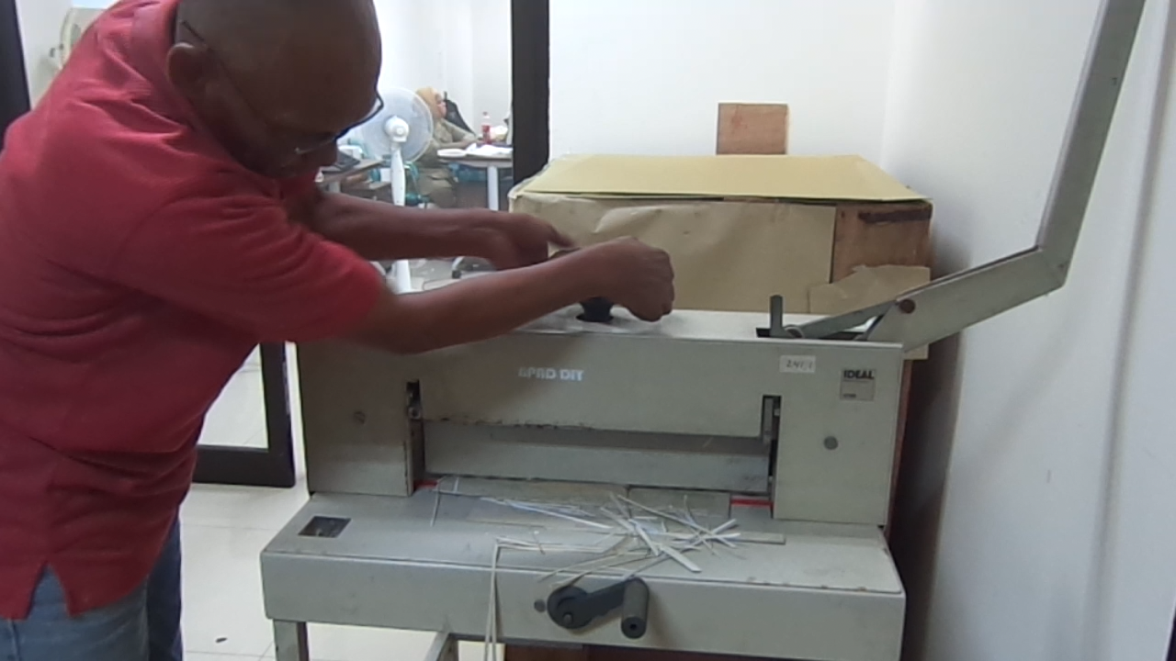

Slide 13
Conclusions
Activities of preservation and conservation of the collections in the Library of Grhatama Pustaka done by seeing from:
the level of the physical condition of the collections :
which consists of three levels are:
a. the rate of low damage,
b. the rate of medium damage,
c. the rate of high damage and efforts
efforts to prevent damage to the collections in the Library of Grhatama Pustaka done with :
cleaning of the stains in the material library, fumigation, eliminating the acidity in the paper, laminate and transfer the forms to the collections.
Preservation and conservation activity was conditioned very well because of the equipment facilities adequate.

Slide 14
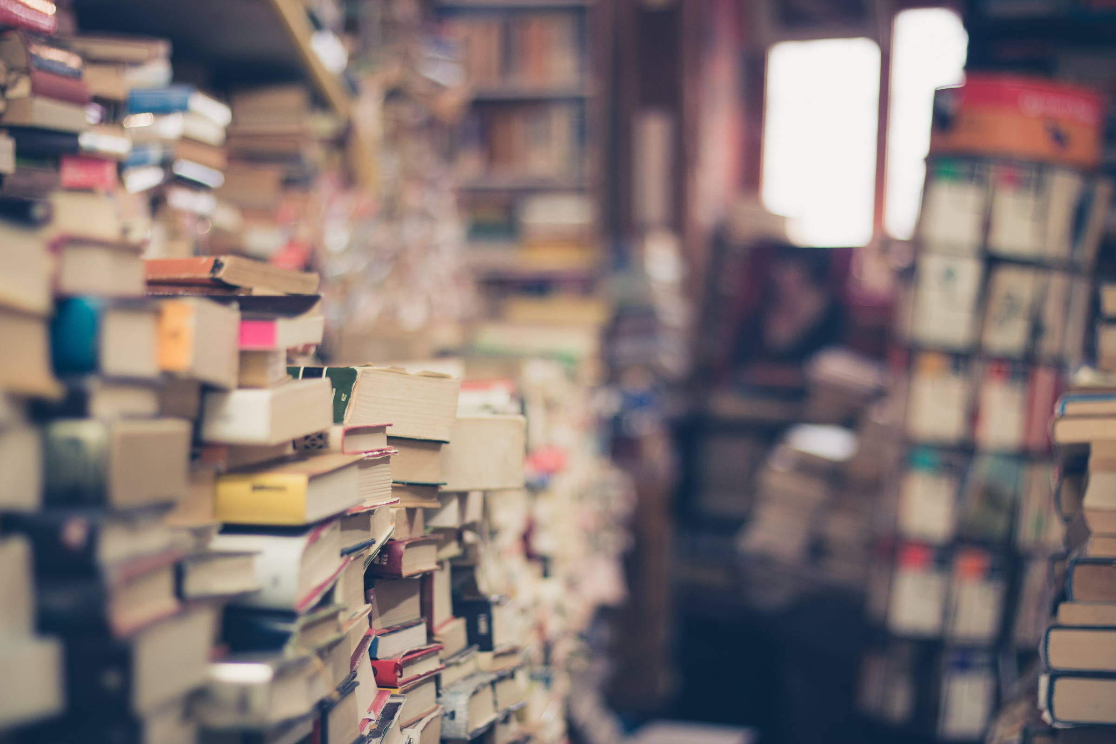
THANK YOU

