Slide 1
The Lecturers’ Personal Information Management in The Faculty of Vocational Education Universitas Airlangga
ICoASL 2017
Yogyakarata, 10 May 2017
Dyah Puspitasari Srirahayu, S.Kom., M.Hum
The Study Program of Library Technician, Faculty of Vocational Education Universitas Airlangga, Jl. Srikana 65 Surabaya, dyahpuspitasari2012@gmail.com

Slide 2
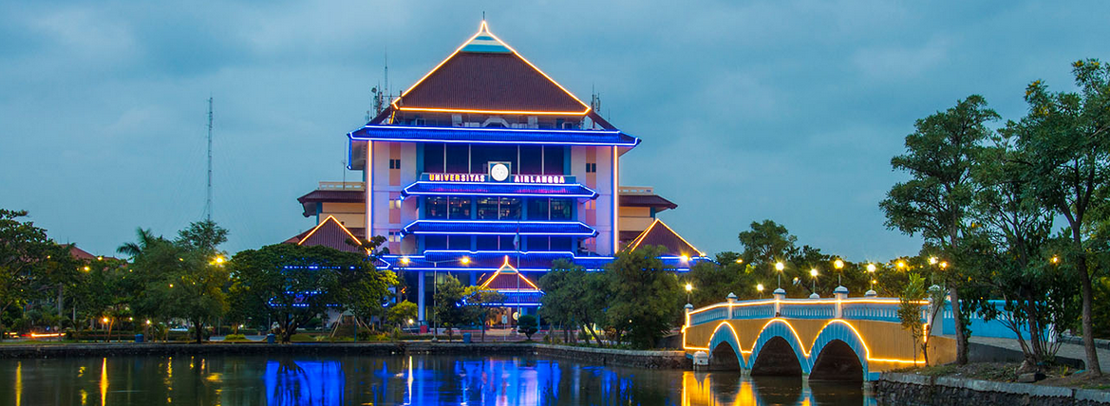
Airlangga University Jl. Mulyorejo Surabaya www.unair.ac.id

Slide 3
Programs in Airlangga University
Bachelor Degree
Master Degree
Doctoral Degree
Specialist/Subspecialist Medical Degree
Vocational Degree
Professional Degree
International Classes & Double Degree Program

Slide 4
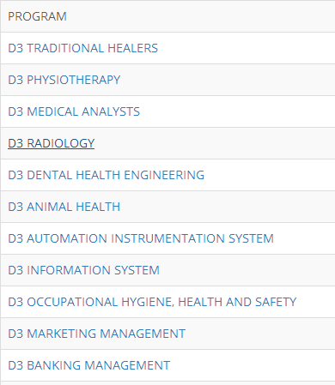
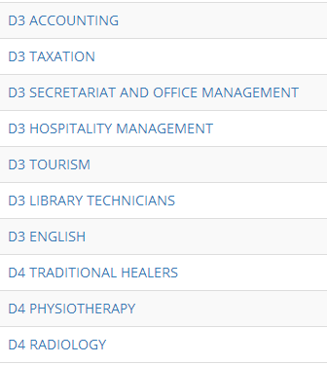
Vocational Degree

Slide 5
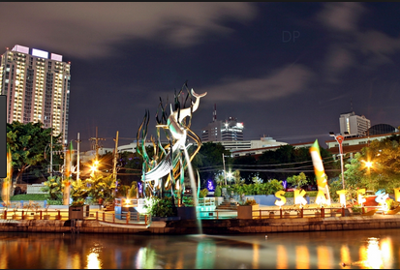
Surabaya

Slide 6
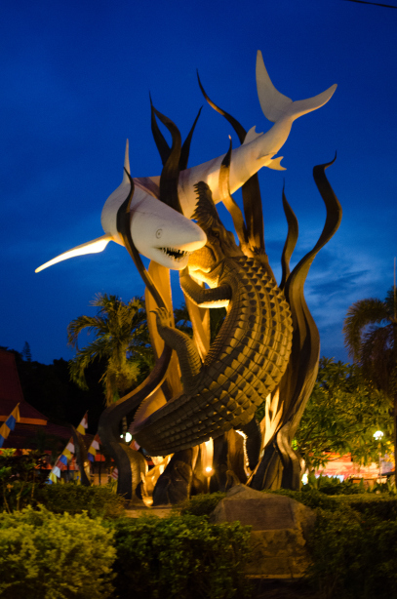
Sura and Baya Simbols

Slide 7
Suramadu Bridge (Surabaya-Madura)

Slide 8
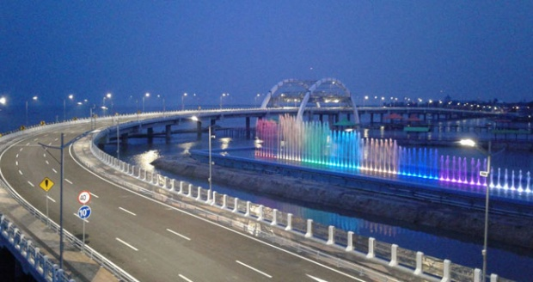
Surabaya Bridge with water fountain

Slide 9
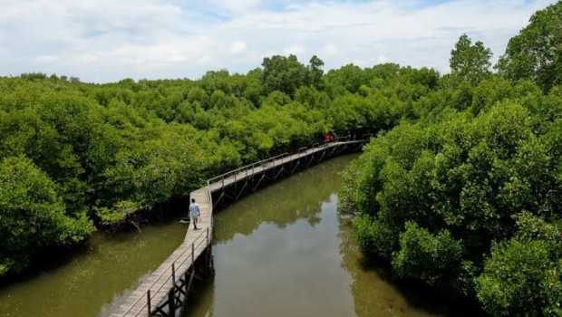
Mangrove Florest

Slide 10
The Lecturers’ Personal Information Management in The Faculty of Vocational Education Universitas Airlangga
ICoASL 2017
Yogyakarata, 10 May 2017
Dyah Puspitasari Srirahayu, S.Kom., M.Hum
The Study Program of Library Technician, Faculty of Vocational Education Universitas Airlangga, Jl. Srikana 65 Surabaya, dyahpuspitasari2012@gmail.com

Slide 11
Introduction
The development of information technology makes information to be distributed without any control, thus, it causes the information become overloaded.
A lecturer will always need information to carry out his role and give that information to his students, colleagues, and society
The phenomena above indicated that a personal information management strategy to help the lecturers deal with excessive information must be developed
Personal Information Management does not only help people in a retrieval information process, but it also trains them to manage, select, and organize their personal information well.

Slide 12
The Purpose of The Study
The purpose of the present study is to discover the illustration of personal information management in easing the information rediscovering process to carry out their roles as lecturers in not only doing teaching and learning activities, but also applying the university three-responsibilities (tri-dharma); those are becoming an academician, a researcher, and doing public service.

Slide 13
Methods of The Study
a quantitative approach with a descriptive method
Population are lecturers in Faculty of Vocational Education, Universitas Airlangga, Surabaya, in 2015
Sampling technique applied in this study was total sampling, 37 responden

Slide 14
Findings and Discussions

Slide 15
Finding Information
Question | Answer | Amount | % | Description | Amount | %
What information needs are you looking for frequently? | Research | 34 | 91,89
 | Course Materials | 27 | 72,97
 | Community Service | 8 | 21,62
 | Hobbies | 11 | 29,73
 | Entertainment | 16 | 43,24
 | Health | 11 | 29,73
 | other | 1 | 2,7 | Tiket | 1 | 100

Slide 16
Keeping and Organizing Information
Question | Answer | Amount | % | Descripton | Amount | %
What electronic media do you use most often to store your information | Laptop | 32 | 86,49
 | PC | 1 | 2,7
 | Email | 7 | 18,92
 | Flash disk | 5 | 13,51
 | Google drive | 3 | 8,1
 | Social Media | 2 | 5,4
 | Other | 2 | 5,4 | Drop box | 1 | 50
 |  | 32 | 86,49 | HP | 1 | 50
 | No Information | 1 | 2,7

Slide 17
Maintaining Information
activity | Answers | Amount | %
Back up data | Schedule | 5 | 13.5
 | Incidental | 32 | 86.5
Transfer file to another format | Yes | 29 | 78,38
 | No | 8 | 21.62
Upgrade file to new software | Yes | 19 | 51.35
 | No | 18 | 48.65

Slide 18
Managing The Flow of Information
Question | Answer | Amount | %
How do you manage the incoming information in your life | Keeps all the information coming | 2 | 5,4
 | Focus on information that suits your needs | 24 | 64,86
 | Respond only without saving | 0 | 0
 | Sort out the appropriate information only | 11 | 29,73
 | other | 0 | 0

Slide 19
conclusion
The conclusion of this study is information needed by the lecturers of the Vocational Education Faculty was mostly related to their three-responsibility activities; those were research (91.89%), and teaching materials (72.9%). To fulfill the information needs, they used various information sources such as google (97.3%), and library (21.62%) in which 83.78% of the lecturers would directly searched the information when they needed it. Then, 83.78% of the lecturers also did a selection process to the information that they would save if it was suitable with their needs.
In managing the information, the lecturers grouped the information according to its content (67.57%), and renamed the files according to its content (64.86%). In maintaining the information, the lecturers backed up the data, but it was done incidentally (86.5%), moved the data to a new HD (78.38%), upgraded the files to a new software (51.35%), and printed the information if they wanted to understand the information better (40.54).

