Slide 1
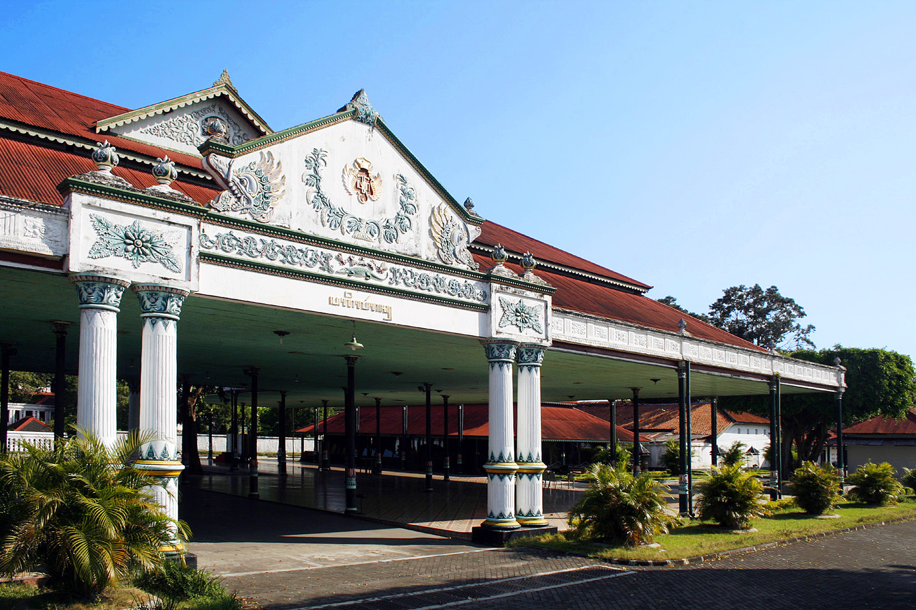
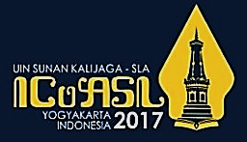
Kraton Yogyakarta Museum Roles in Preserving the Cultural Heritage
(Disaster Planning Approach)
Presented by:
Thoriq T. Prabowo (UIN Sunan Kalijaga)
Budhi Santoso (Universitas Gadjah Mada)
Moh. Mursyid (EAN Library)
T. T. Prabowo, B. Santoso, & M. Mursyid
5th ICoASL, Yogyakarta, Indonesia 10 May 2017

Slide 2
Table of Content
Introduction
(Background and Problem formulation)
Methods
Conclution and Recommendation
T. T. Prabowo, B. Santoso, & M. Mursyid
5th ICoASL, Yogyakarta, Indonesia 10 May 2017

Slide 3
Background
Museum as one of the learning spaces
Because of the important function of museum, so it has to be preserved
One of historical museum is Kraton (Palace) Yogyakarta Museum, which was built on 1755
It has so many cultural heritage which were legacies from Sri Sultan HB-I until HB-X as the King
T. T. Prabowo, B. Santoso, & M. Mursyid
5th ICoASL, Yogyakarta, Indonesia 10 May 2017

Slide 4
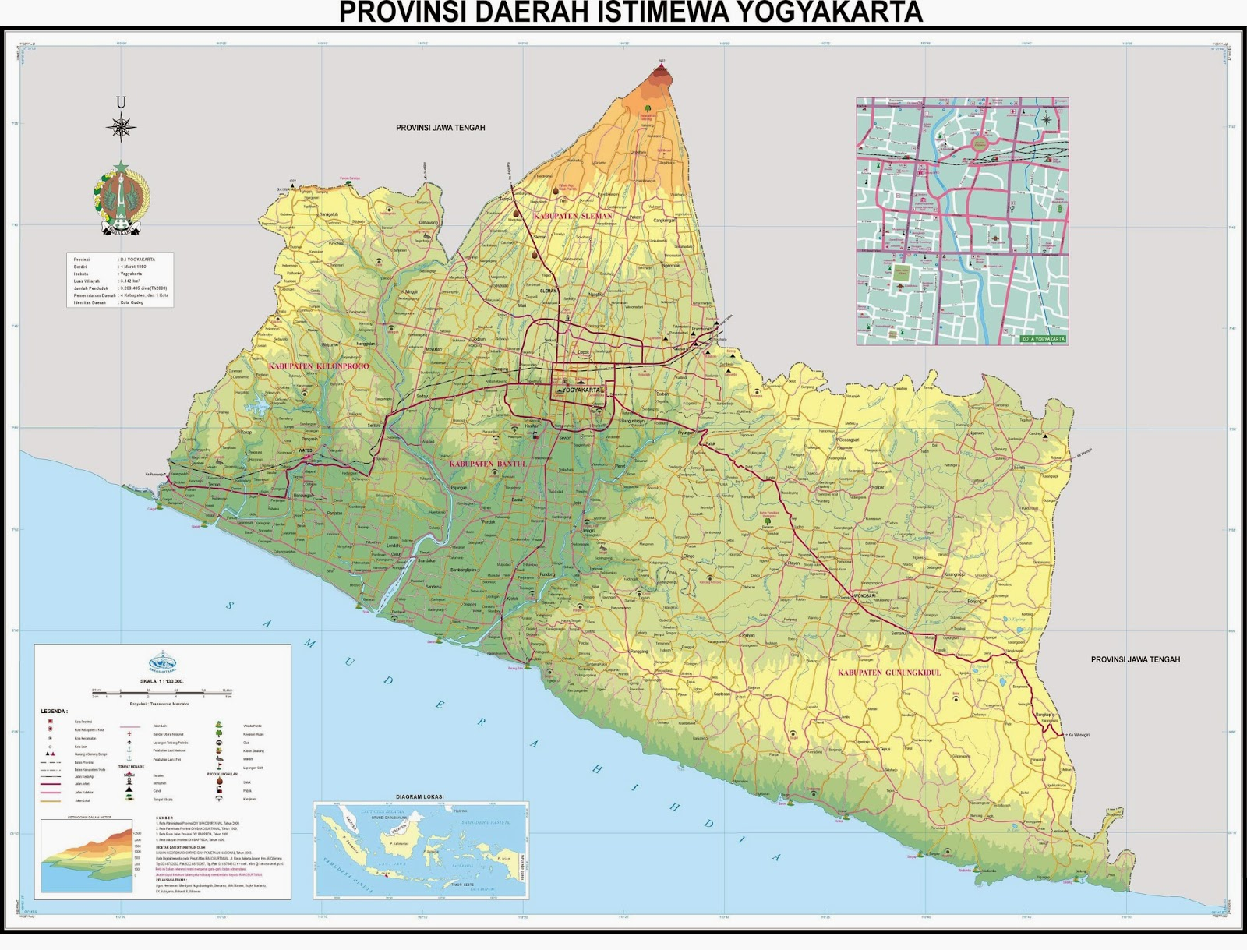

Slide 5
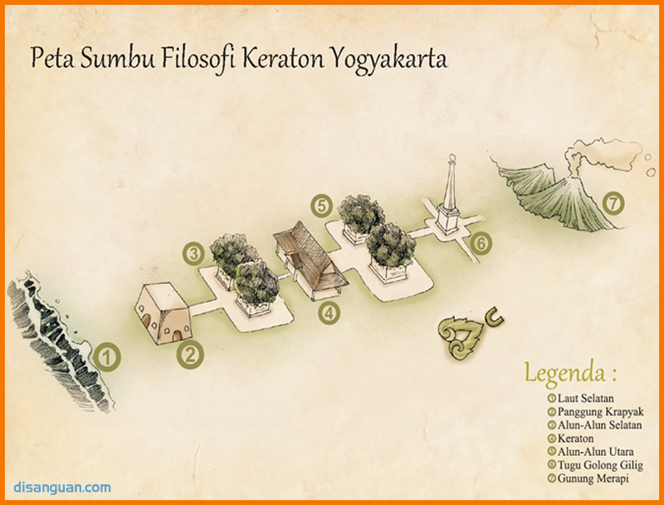

Slide 6
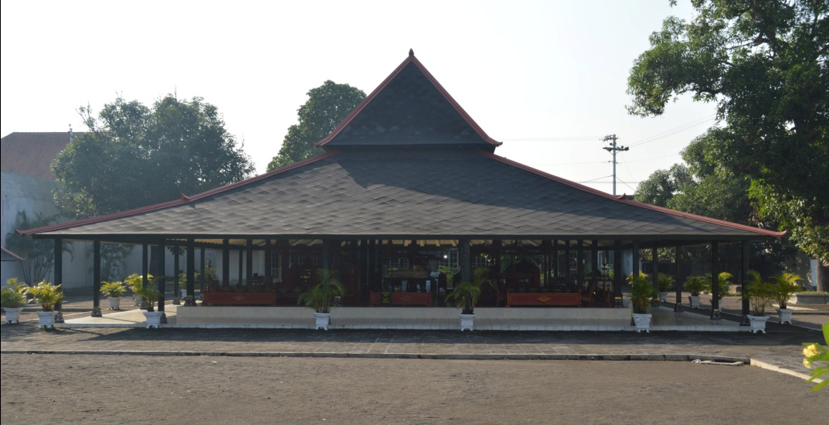
One of building named Bangsal Trajumas in ruins caused by Earthquake on 2006
BEFORE
AFTER
T. T. Prabowo, B. Santoso, & M. Mursyid
5th ICoASL, Yogyakarta, Indonesia 10 May 2017

Slide 7
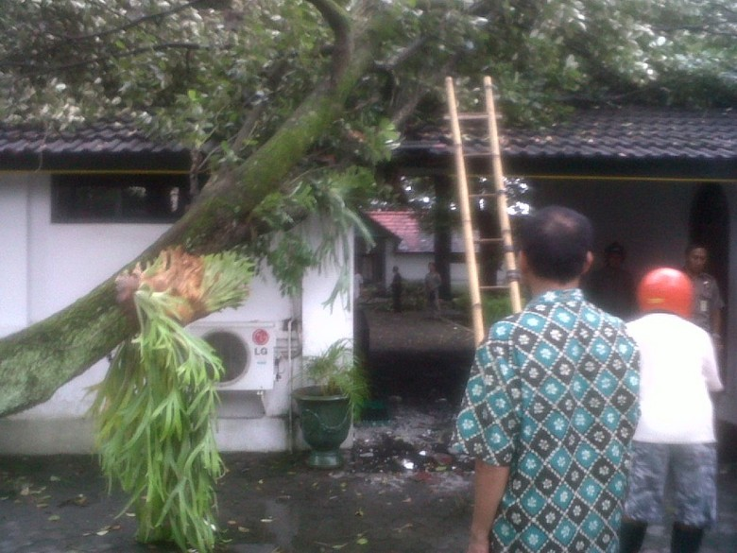
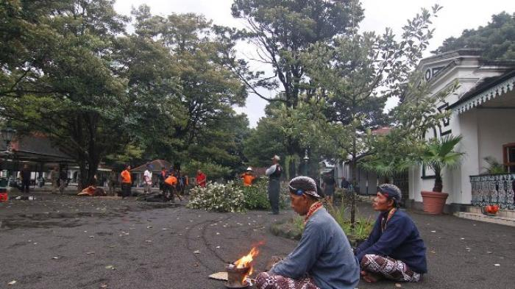
The trees were fell down by the winds on 2014
T. T. Prabowo, B. Santoso, & M. Mursyid
5th ICoASL, Yogyakarta, Indonesia 10 May 2017

Slide 8
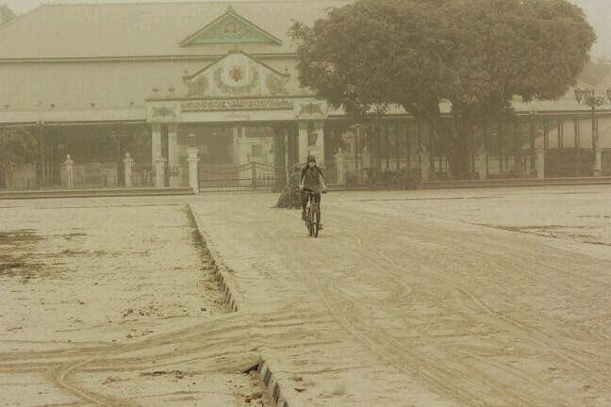
Some of Museum’s Collections were covered by Mt. Kelud vulcanic dust on 2014
T. T. Prabowo, B. Santoso, & M. Mursyid
5th ICoASL, Yogyakarta, Indonesia 10 May 2017

Slide 9
Problem Formulation
How are the roles of Kraton Yogyakarta Museum in preserving the cultural heritage by disaster planning approach?
T. T. Prabowo, B. Santoso, & M. Mursyid
5th ICoASL, Yogyakarta, Indonesia 10 May 2017

Slide 10
Methods
A field research with qualitative approach
Data collected by interview with the Museum Officers and observation
T. T. Prabowo, B. Santoso, & M. Mursyid
5th ICoASL, Yogyakarta, Indonesia 10 May 2017

Slide 11
Disaster Planning
Disaster planning at Kraton Yogyakarta Museum include: Flood, Fire, Winds and Earthquake
There is no a written disaster planning policies
T. T. Prabowo, B. Santoso, & M. Mursyid
5th ICoASL, Yogyakarta, Indonesia 10 May 2017

Slide 12
Flood Anticipation
Sultan HB-I choose the strategic place which was save from flood. The complex of the museum was look like a turtle shell.
There were two rivers as the watercourse named Code and Winanga Rivers
T. T. Prabowo, B. Santoso, & M. Mursyid
5th ICoASL, Yogyakarta, Indonesia 10 May 2017

Slide 13
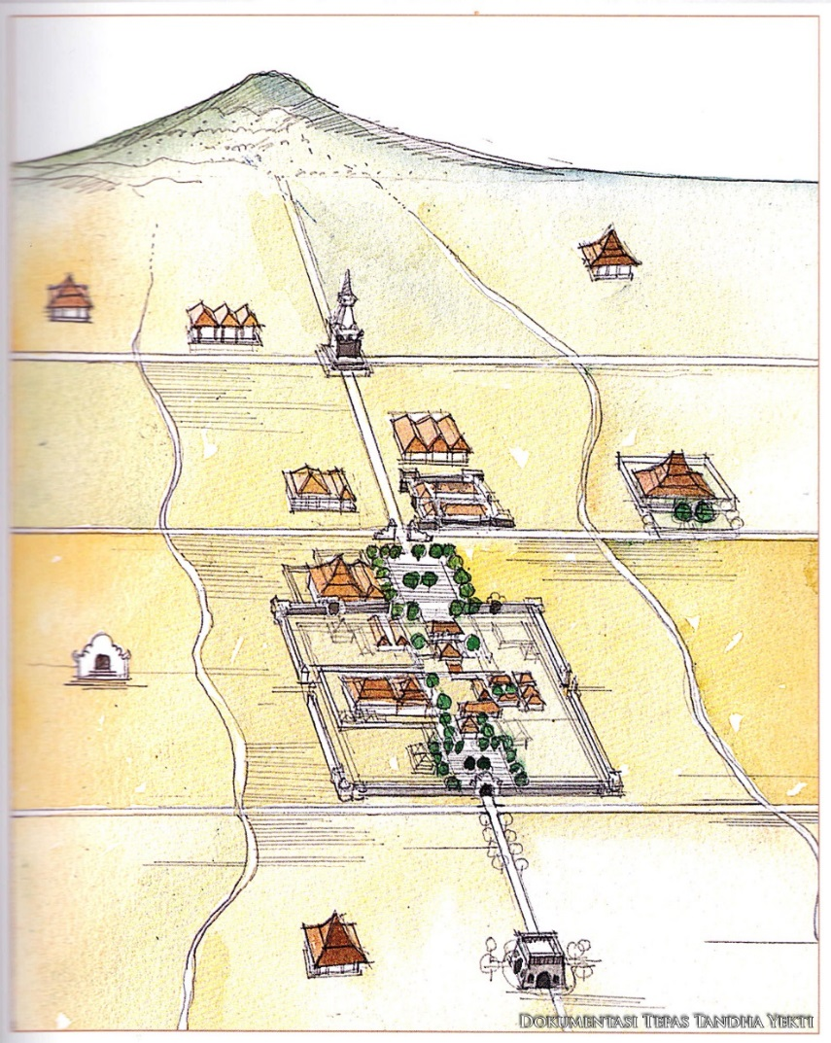
Illustration of water installation
T. T. Prabowo, B. Santoso, & M. Mursyid
5th ICoASL, Yogyakarta, Indonesia 10 May 2017

Slide 14
Earthquake Anticipation
To make the building stronger, so the wood poles were combined with iron poles
Some of museum collections were saved in the wood boxes, so when the earthquake comes they will keep safe
T. T. Prabowo, B. Santoso, & M. Mursyid
5th ICoASL, Yogyakarta, Indonesia 10 May 2017

Slide 15
Iron poles
T. T. Prabowo, B. Santoso, & M. Mursyid
5th ICoASL, Yogyakarta, Indonesia 10 May 2017

Slide 16
Disaster Planning for Human Error
To make the collections keep safe from human touch, so they were located in glass boxes.
Glass boxes also protect the collections from the dust.
T. T. Prabowo, B. Santoso, & M. Mursyid
5th ICoASL, Yogyakarta, Indonesia 10 May 2017

Slide 17
Glass boxes to protect the museum collections from the dust
T. T. Prabowo, B. Santoso, & M. Mursyid
5th ICoASL, Yogyakarta, Indonesia 10 May 2017

Slide 18
The traditional lamp was covered by the cloth to protect from the dust
T. T. Prabowo, B. Santoso, & M. Mursyid
5th ICoASL, Yogyakarta, Indonesia 10 May 2017

Slide 19
Fire Anticipation
There were some advices to do not smoking in the museum areas.
Hydrants were provide to anticipate the fire. They also used to clean the vulcanic dust.
T. T. Prabowo, B. Santoso, & M. Mursyid
5th ICoASL, Yogyakarta, Indonesia 10 May 2017

Slide 20
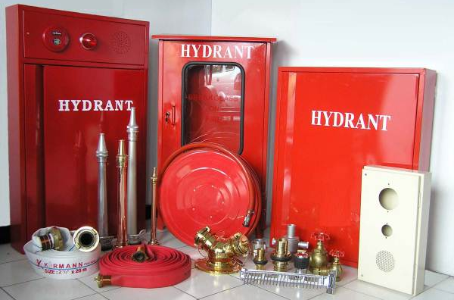
Hydrant
T. T. Prabowo, B. Santoso, & M. Mursyid
5th ICoASL, Yogyakarta, Indonesia 10 May 2017

Slide 21
Winds Anticipation
Cutting the tree branches gradually
T. T. Prabowo, B. Santoso, & M. Mursyid
5th ICoASL, Yogyakarta, Indonesia 10 May 2017

Slide 22
Disaster Plan Funding
Kraton Yogyakarta Museum has a museum maintenance guarantee funding from special funding named Danais (Dana Kestimewaan).
Some of Yogyakarta Palace families also support the maintenance of the museum
T. T. Prabowo, B. Santoso, & M. Mursyid
5th ICoASL, Yogyakarta, Indonesia 10 May 2017

Slide 23
Website http://kratonjogja.id as a digital preservation
T. T. Prabowo, B. Santoso, & M. Mursyid
5th ICoASL, Yogyakarta, Indonesia 10 May 2017

Slide 24
Conclusion
Kraton Yogyakarta Museum has done some preventive activities to face the disaster
The disaster planning are include: flood anticipation, wind anticipation, fire anticipation, vulcanic dust anticipation, human error anticipation
The disaster planning was not created in disaster planning policies
T. T. Prabowo, B. Santoso, & M. Mursyid
5th ICoASL, Yogyakarta, Indonesia 10 May 2017

Slide 25
Recommendation
The Museum needs to create the disaster planning into written policies
The Museum needs to arrange the disaster planning team which has full responsibilities
The Museum needs to more active to digitizing its collections, because it is an effective disaster planning effort
T. T. Prabowo, B. Santoso, & M. Mursyid
5th ICoASL, Yogyakarta, Indonesia 10 May 2017

Slide 26
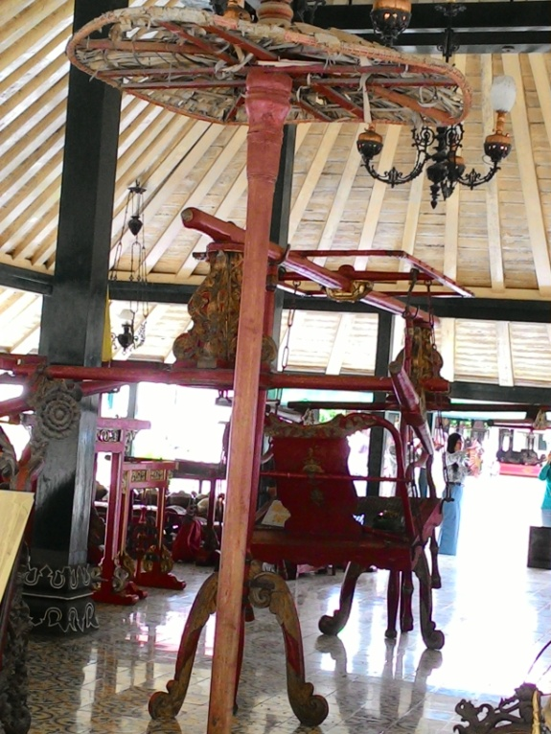
Photos
T. T. Prabowo, B. Santoso, & M. Mursyid
5th ICoASL, Yogyakarta, Indonesia 10 May 2017

Slide 27
Photos
T. T. Prabowo, B. Santoso, & M. Mursyid
5th ICoASL, Yogyakarta, Indonesia 10 May 2017

Slide 28
References
Adrisijanti (ed.), I. (2010). Lindhu Ageng Ngayogyakarta: Warisan Budaya Pascagempa Bumi 27 Mei 2006. Yogyakarta: Balai Pelestarian Peninggalan Purbakala Yogyakarta.
Badan Nasional Penanggulangan Bencana RI. (2008). Peraturan Kepala Badan Nasional Penanggulangan Bencana Nomor 4 Tahun 2008 Tentang Pedoman Penyusunan Rencana Penanggulangan Bencana. Jakarta: Badan Nasional Penanggulangan Bencana Republik Indonesia.
Bain, J. R. (2009). Museum Emergency Plan. Missoula: Historical Museum at Fort Missoula.
T. T. Prabowo, B. Santoso, & M. Mursyid
5th ICoASL, Yogyakarta, Indonesia 10 May 2017

Slide 29
References
Direktorat Museum Departemen Kebudayaan dan Pariwisata RI. (2007). Pengelolaan Koleksi Museum. Jakarta: Departemen Kebudayaan dan Pariwisata Republik Indonesia.
Dorge, V., & Jones, S. L. (1999). Building an Emergency Plan: A Guide for Museums and Other Cultural Institutions. Los Angeles: The Getty Conservation Institute.
Kaur, T. (2009). Disaster Planning in University Libraries in India: A Neglected Area. New Library World, Vol.110 No.3/4, 175-187.
Martoatmodjo, K. (1993). Materi Pokok Pelestarian Bahan Pustaka. Jakarta: Universitas Terbuka.
T. T. Prabowo, B. Santoso, & M. Mursyid
5th ICoASL, Yogyakarta, Indonesia 10 May 2017

Slide 30
References
Momani, N. M. (2011). Integrated Framework for Earthquake Consequences Management. Disaster Prevention and Management: An International Journal, Vol. 20 Iss. 3, 314-333.
Dorge, V., & Jones, S. L. (1999). Building an Emergency Plan: A Guide for Museums and Other Cultural Institutions. Los Angeles: The Getty Conservation Institute.
Smith, K. (2008). Hydrological Hazards: Floods. In K. Smith, Environmental Hazards: Assessing Risk and Recuing Disaster (pp. 232-261). London: Routeledge Tailor and Francis.
Soneye, A. (2014). An Overview of Humanitarian Relief Supply Chains for Victims of Perennial Flood Disasters in Lagos, Nigeria (2010-2012). Journal of Humanitarian Logistics and Supply Chain Management Vol. 4 Iss. 2, 179-197.
T. T. Prabowo, B. Santoso, & M. Mursyid
5th ICoASL, Yogyakarta, Indonesia 10 May 2017

Slide 31
References
Spence, R. (2007). Saving Lives in Earthquakes: Successes and Failures in Seismic Protection Since 1960. Bulletin of Earthquake Engineering, Vol. 5 No. 2, 139-251.
Stevenson, J., & Collins, P. H. (2006). Dictionary of Information and Library Management Second Edition. London: A & C Black Publisher.
Sulistyo-Basuki. (1991). Pengantar Ilmu Perpustakaan. Jakarta: Gramedia Pustaka Utama.
Tamura, Y. (2009). WInd-Induce Damage to Buildings and Disaster Risk Reduction. The Seventh Asia-Pacific Conference on Wind Engineering (pp. 1-22). Taipei, Taiwan: APCWE VII.
Vassiliadis, Z. M. (2011). Mega Fires: Can They be Managed Effectively? Disaster Prevention and Management: An International Journal Vol. 20 Iss. 1, 41-52.
T. T. Prabowo, B. Santoso, & M. Mursyid
5th ICoASL, Yogyakarta, Indonesia 10 May 2017

Slide 32
Thoriq T. Prabowo (thoriqtriprabowo@gmail.com)
Budhi Santoso (kangbudhi@ugm.ac.id)
Moh. Mursyid (mohmusryid@gmail.com)
5th ICoASL, Yogyakarta, Indonesia 10 May 2017

