Slide 1
Comparative Study on the Library Leadership between UIN Sunan Kalijaga and UII
(A Search for Human Resources, Financial Issues, and Collection Development)
Rusmiatiningsih & Nurdin Laugu
rusmiatiningsih38@yahoo.com, n.laugu@gmail.com
Sunan Kalijaga Yogyakarta, Indonesia
The Power of PowerPoint | thepopp.com

Slide 2
background
Foucault -> position of power on everywhere on structure of invisible life
The history on the birth of Islamic Institutions in Indonesia
UIN Sunan Kalijaga and UII libaries => As under Islamic Institutions => are believed involve the practice of power

Slide 3
What purpose?
Is to find out a leadership comparation between two libraries of Islamic Universities, UIN Sunan Kalijaga and Indonesia Islamic University (UII)

Slide 4
Conceptual Apparatus
01
Leadership
Wirawann => a process wich mutually influences to realize the vision
Aunur Rohim & Fakih => is a social interaction to achieve a common goal .
Kumaran => leaders can be found at all levels of organizations.
01
02
Library as a power field of universities
Mary & Haris => library as a manager of knowledge and information, => as a symbol of intellectual power and politics.
Goulding => library is an indicator of cultural capital, suggesting that libraries for production, dissemination, and appropriation of cultural capital.
Laugu => library is an arena of representation of power which is seen in the activities of the library.
03
The scope of leadership in libraries
Henri Fayol => 3 elements of management are; Man, Money, Material, and Method
Luther Gulick => POSDCORB (Planning, Organizing, Staffing, Drecting, Coordinating, Reporting, and Budgeting.
In the managemen activities, power is believed to be pevasive into the library elements, Man (human resources), Money (Budget), and Material (collections)

Slide 5
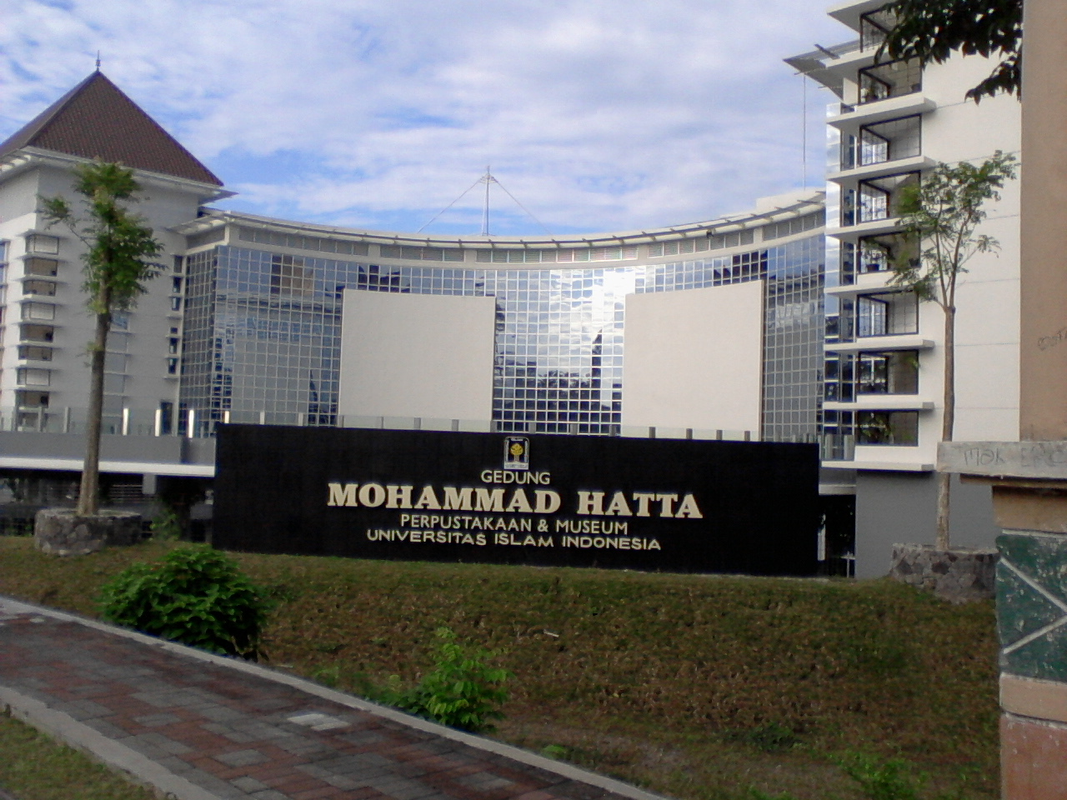
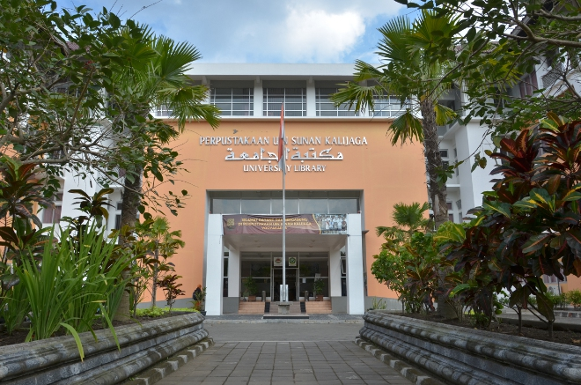
UII Vs UIN Sunan Kalijaga Libraries
Under Private Institution
Human Resources => viewed from hierarchical structure, recruitment culture, and professional authority
Financial => private management. RKAT (Work Plan for Annual Budget). Decided by rector but library is given authorithy spend the budget it self. => income from tuition fee, business development, endowment, government grants, and cooperation.
Collection => the acquisition collection from RKAT => for ebook & ejournal
Under State Institution
Human Resources => viewed from religious group (ideology power of NU & Muhammadiyah)
Financial => dependent on government. APBN (State Revenue and Expenditure Budget)
Collection => Auction process.

Slide 6
Differences
Human resources (successions and recruitment culture).
Financial (UII from privat management, meanwhile UIN Sunan kalijaga from APBN).
Collection Development (UII it self, meanwhile UIN Sunan Kalijaga use auction process.
Similarities
Human resource element (relationship including seniority, employment status, gender, and professional authority).
Similarities & Differences

Slide 7
conclusion
=>Power relations have been pervasive into library elements, such as in the human resources, financial issues, and collection development.
=> UII library more professional, meanwhile UIN Sunan Kalijaga influenced of religious ideology.
=> Finally, such situation produces an image that libraries under private institution become more dynamic than those under state institutions.

Slide 8


Thank You.
Contact Us !
Rusmiatiningsih
Nurdin Laugu
Fb : Rusmiatiningsih
Email : rusmiatiningsih38@yahoo.com
WhatsApp : 085287334239
Fb : Nurdin Laugu
Email : n.laugu@gmail.com
WhatsApp : 081328559993

