Slide 1

THE ROLE OF GRHATAMA PUSTAKA LIBRARY YOGYAKARTA INDONESIA
IN THE PRESERVATION OF LOCAL CULTURE
Endah Dwi Susanti
Lathifatun Nafi’ah
Marwiyah, MLIS

Slide 2
INTRODUCTION
Yogyakarta as a culture city has a very broad sense that is the area that has a cultural treasure and local wisdom.
Yogyakarta is an area that has the privilege or special autonomy status.
It is written in the Law Numb. 13 Year 2012 on Regional specialty of Yogyakarta, the specialty of Yogyakarta has several important goals one of which is to maintain and develop the culture of Yogyakarta, the cultural heritage of the nation.
One of the efforts to preserve the local culture in the Special Region Yogyakarta is establishment of a public library Grhatama Pustaka.
The IFLA / UNESCO Public Library Manifesto explains that one of the functions of public libraries is to develop a culture in the community, especially the local culture in the community surrounding the library.

Slide 3
How the role of Grhatama Pustaka as a public library in the culture city Special Region of Yogyakarta to perform its role in preserving the local culture?

Slide 4
SCOPE
Definitions
Grhatama Pustaka
Yogyakarta
Use the Cultural Symbol in the Library Bulding
Library Collection
Activities Related to Cultural Promotion
Cooperation in Preservation
Documentary Movie in Audiovisual Room
Efforts to Preserve
Local Culture
Obstacles in Preservasion
of Local Culture
The process of preservation of rare collections
The process of cultural preservation
The obstacles experienced by Grhatama Pustaka
Polices in the Preservation of Local Culture

Slide 5
Definitions
Preservation of cultural heritage can be defined as an ongoing activity in maintaining a collection of the wealth of reason, knowledge, and culture to survive and benefit the present and the future.
The library has a role as a vehicle for the preservation of the cultural wealth of the nation to promote national culture either through the provision of various collections and other credible form related to cultural preservation.

Slide 6
Grhatama Pustaka Yogyakarta
Grhatama Pustaka is one of the services unit of Library and Regional Archives (BPAD) Special Region of Yogyakarta, which is located at Janti Street, Banguntapan, Bantul, Yogyakarta. Grhatama Pustaka inaugurated by Yogyakarta Governor Sultan Hamengkubuwana X on December 21, 2015.
Grhatama Pustaka means a place which save library collection, because there are many collection of new books to the collection of rare books which are out of print, either in book form or digital form.

Slide 7
1. Efforts to Preserve Local Culture
Use the Cultural Symbol in the Library Bulding
Library Collection
Activities Related to Cultural Promotion
Cooperation in Preservation
Documentary Movie in Audiovisual Room

Slide 8
Use the Cultural Symbol in the Library Bulding
Proverb or Java aphorisms that decorate each pole of Grhatama Pustaka
Grhatama Pustaka uses ornaments and decorations with nuance of Javanese culture, such as the presence of batik ornaments that decorate the walls of the library building and the ornaments inscribed with a saying or proverb Java that adorn each pole of Grhatama Pustaka.

Slide 9
Grhatama Pustaka Library building with the four pillars
The fourth pillar that is called the Four Pillars Minaret Grhatama Pustaka perfection implies four Javanese people, namely Prakoso meaning mighty, Wulung which means eagle, Wangi which means fragrant scent and the Agung which means big.
Of the four pillars of meaning, Grhatama Pustaka is expected to be a gateway for people to achieve the highest degree through the knowledge stored in various collections in the Grhatama Pustaka.

Slide 10

Use of symbols Si Yokca in every room
In the Javanese language, Yokca can also be an invitation "Yok Cah" which means getting young people to read.
Si Yokca is illustrated as a butterfly which wearing traditional Javanese cloth. Butterfly characters selected for taking the philosophy of metamorphosis as an embodiment of a learning community character and cultured. Parang batik motifs on the wings of a butterfly and batik kawung on slempang to show identity and privilege of Yogyakarta. This icon is used as a mascot of the library that also can be found on key chains or direction to locker rooms in Grhatama Pustaka.

Slide 11
Library Collection
Collection of Center of Excellence
  Center of Excellence Javanese culture is a library services and information about the local culture that aims to meet the needs of user for the information related to the culture in Indonesia, especially cultures of the people residing in the area of Java.
  Documents events and articles also published on the website, called Center of Excellence of Library and Regional Archives Special Region of Yogyakarta which can be accessed at http://bpad.jogjaprov.go.id/coe/.

Slide 12
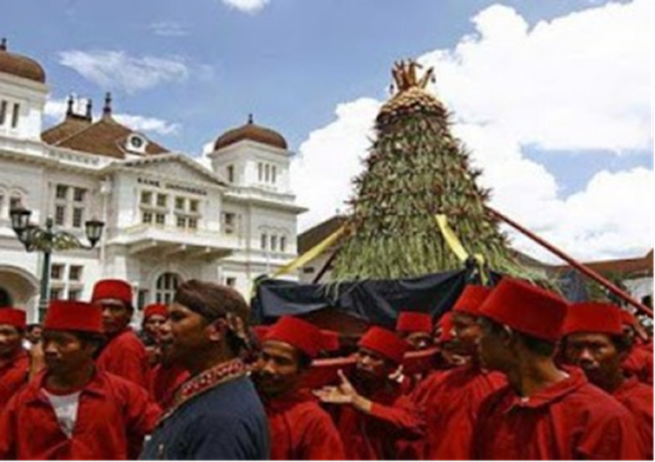
The articles and news related to the local culture of an area, especially Java cultures such as:
Sekaten
The traditional celebration of Sekaten

Slide 13
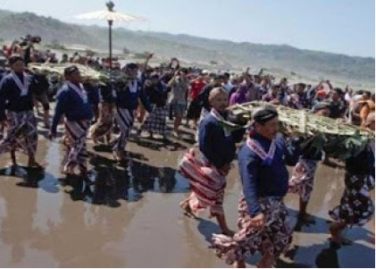
Labuhan
The traditional celebration
of Labuhan

Slide 14
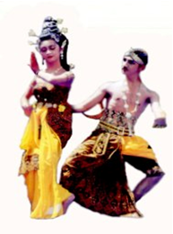
Prastowo Roro Kuning Dance from Nganjuk
  .
The Prastowo Roro Kuning Dance

Slide 15
b. Rare Book Collections
  In rare collection rooms, there are about 10.000 copies rare collection consists of various fields of science.
  Generally, the subject contains about cultures in Indonesia.
  In the room also found a rare collection of books by Javanese language and script, a book with Dutch, English, Persian and other languages.
  The books in the rare collection rooms be obtained from gifts or donations.

Slide 16
Activities Related to Cultural Promotion
Grhatama Pustaka also participated in one of the traditional ceremony organized by the Palace of Yogyakarta is Sekaten.
In the event, Grhatama Pustaka set up a booth to exhibit and socialization
In the exhibition and socialization, Grhatama Pustaka show collections such as mysticism, a collection of books about the keris, batik, Yogyakarta, and also playback video profiles Library Service Center.

Slide 17
Next..
Library through the Center of Excellence also held the popularization of Javanese culture through activities such as:
  Maca geguritan amrih dadi tontonan.
  Discussion of Javanese culture with the theme “Ethics Java”.
  Book Review “Garingsing Pepesthen”
  Correctional Javanese culture with the theme “Pigunane Tembang Jawa ana ing masyarakat”.
  Correction of Javanese culture with the theme “Penulisan cerita berbahasa Jawa”, that present by Drs. Dhanu Priyo Prabowo, M.Hum of Balai Bahasa Yogyakarta.
  Seminar on Batik and Wayang.

Slide 18
Cooperation in Preservation
Grhatama Pustaka in cooperation with several parties such as the palace of Yogyakarta, Pakualaman, Taman Siswa, Sonobudoyo, Yogyakarta Department of Culture, and Language Center.
Cooperation done in terms of documenting local culture as their traditional ceremonies at the palace and in the society, arts and local arts.
In the preservation of rare collections, in addition performed by the preservation, Grhatama Pustaka is also working with several agencies to carry out over the media, transliteration and translation.

Slide 19
Documentary Movie in Audiovisual Room
The results of documentation in the form of movies and videos made by Grhatama Pustaka will be screened in the audiovisual room.
Some films has cultural themed that played in the audiovisual room is a film that tells the Sultan Hamengkubuwana IX, ceremonies, traditional ceremonies, as well as the arts in Yogyakarta.

Slide 20
3. Obstacles in Preservasion of Local Culture
The process of preservation of rare collections
The process of cultural preservation
The obstacles experienced by Grhatama Pustaka

Slide 21
The process of preservation of rare collections
  Select a document or old manuscripts to be digitized, in terms of its content, its culture, history and other aspects.
  Seeing the condition of the old manuscripts, still good or not. If it is too difficult to be digitized, then look for another way of preservation, should not be imposed, for example in a photo or scan.
  Referring to people who have an understanding or knowledge of preservation, which did not consider the same codex with general books while doing the digitization process.
  Conducting the process of digitization.
  Save the results of digitization as a duplicate, copy or as a backup.
  When the shelving on the shelf, the collection has been increasingly fragile condition or should be saved, and then stored in a separate place. Because already have a copy, the original script is rolled into the limited book, special and very important.

Slide 22
The process of cultural preservation
The process of cultural preservation is done by documenting cultures in society such as folklore, traditional ceremonies, arts and local arts.
Form of documentation that can be done in the form of writing, video, or movie.
The result of cultural documentation in the form of written stored in the Center of Exellence room, in the form of video stored in the digital collection room, and in the form of movies done screening on the audiovisual room.

Slide 23
The obstacles experienced by Grhatama Pustaka
Insecurity of the librarian and user to understand the text written partly in a foreign language.
Cooperation that sometimes only benefit one side.
In terms of culture, sometimes there are traditions that are beyond human reason.
In the process of digitizing ever there was one instance that must be understood in the culture, because it is difficult to accept logic.

Slide 24
3. Polices in the Preservation of Local Culture
In terms of preservation of local culture, Grhatama Pustaka yet have rules and regulations that govern the policy.
In general, is already outlined in the rules wider, in the Rule of Law specialty of Yogyakarta.
Appointment Grhatama Pustaka as a place of cultural preservation be some sort of rules or some sort of decree.

Slide 25
CONCLUSSION
One form of cultural preservation in Yogyakarta is founding a public library Grhatama Pustaka. In carrying out its role as a local public library that serves as a cultural agent, Grhatama Pustaka has a few attempts. Among these efforts is use the cultural symbol in the library buliding, library collection such as collection CoE (Center of Excellence) and rare book collections, activities related to culture promotion such ac discussion and book review, cooperation in preservation, and documentary movie in the audiovisual room.
The process of preservation in the Grhatama Pustaka divided into two, namely the preservation of rare collections and preservation of culture. Some of the obstacles experienced by Grhatama Pustaka in cultural preservation among others, from the librarian who lacks experience on rare collections and sometimes beneficial cooperation of the parties. There are no written policy that describes the preservation of local culture in Grhatama Pustaka.

Slide 26
THANK YOU

