Slide 1
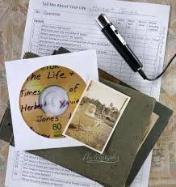
Efforts Conducted by the National Library of Indonesia to Preserve Local Knowledge Through Oral History Program
Aji Subekti
Tamara Adriani Susetyo-Salim

Slide 2
OUTLINE OF PRESENTATION
BACKGROUND OF RESEARCH
PROBLEM OF RESEARCH
LITERATURE REVIEW
EXISTING CONDITION
RESULT & DISCUSSION
CONCLUSION

Slide 3
Background
Oral history : first developed by Allan Nevin from Columbia University in approximately 1940
every people has memories and memories of historical value, therefore it must be preserved by doing a systematic interview techniques
Among librarians, oral history techniques are still rarely done in an effort to preserve knowledge, because:
the librarians only manage the explicit knowledge
Tacit knowledge
not readily seen and expressed.
It is rooted in action and personal experience.
can be in the community or communities

Slide 4
Background (2)
In the tradition of growing in Africa, it is often said "if there is an elder dies, a library has been lost".
Indonesia has various tribes and customs, but
written language was rare, the only way to preserve tribal laws was to orally transmit them to the next generation
oral traditions in indigenous communities in Indonesia is very strong
It becomes a challenge for librarian in preserving Tacit knowledge
The Systematic technique to capture that knowledge is Oral History

Slide 5
Problems
How are the effort and role of national library in preserving local knowledge?
How to capture local knowledge with oral history method?

Slide 6
LITERATURE REVIEW
Library Preserving the Local Knowledge
local knowledge is the basis for agriculture, health care, food preparation, education, environmental conservation and other activities. Much of such knowledge is passed down from generation to generation, usually verbally
IFLA (The International Federation of Library Associations and Institutions) recommends that libraries and archives should implement programs to collect, preserve and disseminate indigenous and local traditional knowledge resources
include selection, collection, production, documentation, organization, preservation, dissemination and exchange
maintaining equipment needed to retrieve information stored on a compact disc;
providing physical storage space to house books, magazines, and newspapers;
using special handling techniques to access information made available from photographs, diaries, letters, or other memorabilia;
adhering to certain design specifications to ensure a website’s usability; and
creating citations or descriptions of artifacts, for use in bibliographic databases

Slide 7
EXISTING CONDITION (1)
Library Preserving the Local Knowledge
National library has responsible to develop a national collection to preserve the nation's cultural
the points of oral history is still not a priority in Collection Development policy, because oral history program is not easy, especially for librarians
Necessary trainings or workshops that emphasize on:
How to organize and arrange oral history projects. Especially regarding foster cooperation with local communities and formulate clear goals and objectives.
How is the procedure to conduct interviews and capture data such as photos, video. Also how to use the equipment to record it all.
How do I create an oral history material that has been completed to be accessible and useful to the community, such as publish it in a book or videotape
How to preserve oral histories for future generations
librarian is an active member of the historical society

Slide 8
EXISTING CONDITION (2)
Capturing Local Knowledge With Oral History Method
Oral history: witness of historical events, life history, songs, rituals, and ceremonies
Oral History Program For National Library of Indonesia
three factors influenced:
Funding available
Leadership
the sponsoring institution's

Slide 9
RESULT & DISCUSSION (1)
Conceptual effort of National Library of Indonesia to conduct the Oral History Program
Step 1: Set Parameters
Suggestions researcher for coverage field is the field of culture and national history
Priority to capture :
Chief of tribals
Veterans
2 million eldery
Base on Statistics Indonesia (2013), there are 633 ethnic groups in Indonesia

Slide 10
RESULT & DISCUSSION (2)
Step 2: Locating Interviewees
started from the closest locations
teamed up with Yayasan PETA Indonesia to record veterans
If chief of tribal, started from Betawi
Step 3: Selecting Interviewers
experts that can be a bridge of knowledge comfortable and continue to drain the new information: librarian, historian, sociologist, etc.

Slide 11
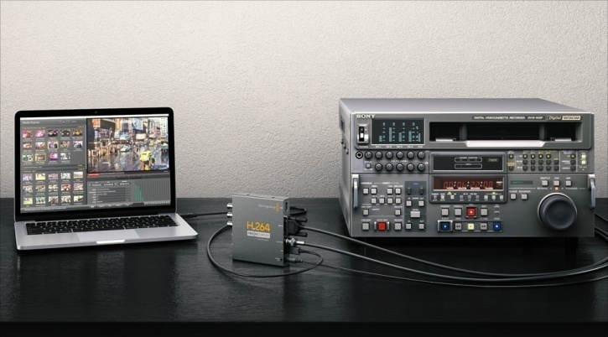
RESULT & DISCUSSION (3)
Step 4: Choosing Recording Equipment
Use a quality recording device
Step 5 : Conducting Interviews
Let them choose the place, and homes
make contact with subjects through a personal meeting
Give trust

Slide 12
RESULT & DISCUSSION (4)
Capturing Local Knowledge With Oral History Method
Step 6 : Processing The Interviews
the work of preservation begins: back up data
Full transcripts involve the verbatim transcription — both questions and answers — of the entire interview
Step 7 : Understanding Ethical And Legal Considerations
sign a release form

Slide 13
RESULT & DISCUSSION (5)
Step 8 : Disseminating
accessible to potential users, both the physical tape or transcript, and its contents
Bibliographic controll
Step 9 : Preserving And Continuously Updating
preserving the recorded evidence for future use of researchers
Creating Oral History collections

Slide 14
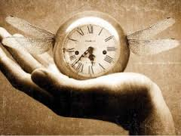
Conclusion
Times was running out. The number of people who had first hand knowledge of this era was declining
Oral history is also useful to save and preserve local knowledge, as well as those owned by individuals or indigenous peoples
Do an oral history program is not easy, especially for librarians, so:
Training of Oral History Program as part of collection development
Coloborating with other related professions
Funds
Leadership
the sponsoring institution's

Slide 15
Thank you

