Slide 1
Designing Strategy Map Indonesian Center for Agricultural Library and Technology Dissemination Using Library Balanced Scorecard
International Conference of Asian Special Libraries (ICoASL 2017)
UIN Sunan Kalijaga Yogyakarta, 10-12 May 2017
AKHMAD SYAIKHU HS
Indonesian Center for Agricultural Library and Technology Dissemination
asyaikhu@pertanian.go.id

Slide 2
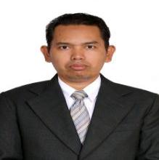
About me
Name | Akhmad Syaikhu HS, S.Sos, MT
Affiliation | Indonesian Center for Agriculture and Technology Dissemination (ICALTD)
Address | Jl. Ir. H. Juanda No. 20 Bogor 16122
Position | Head of Library Resources Management Subdivision
email | asyaikhu@pertanian.go.id
HP | 0817 – 102974
Education | S2 – Magister of Informatics Chief Information Officer Programm Institut of Technology Bandung
 | S1 – Bachelor of Library Science University of Padjadjaran Bandung

Slide 3
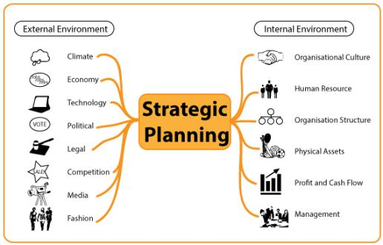
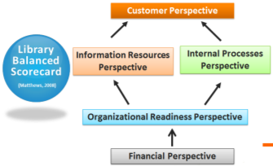
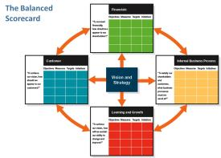
Introduction
A special library is a library that provides specialized information resources on a particular subject, serves a specialized and limited clientele, and delivers specialized services to that clientele.
(Shumaker, David. "Special Libraries." In Encyclopedia of Library and Information Sciences, third edition, 4966-4974. New York: Taylor and Francis, 2011).
STRATEGY
MAP
Introduction
Joseph Matthews
to help the library in desigining of the strategic management of the library.
Kaplan and Norton
can be one framework to build the strategy of the organization.

Slide 4
Methodology
The methodology in this study will use descriptive methods approach that describe the data whether from primary and secondary data
The research stage
Library BSC
CUSTOMER
Strategy Map of
the ICALTD
INFORMATION
RESOURCES
ICALTD’s Profile
INTERNAL
PROCESS
IDENTIFICATION
ORGANIZATIONAL
READINESS
FINANCIAL

Slide 5
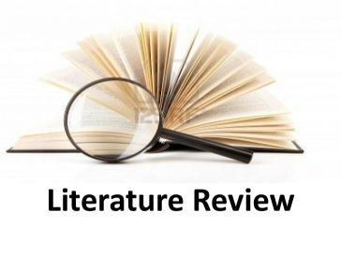
The implement of BSC in library assessment can help the library solve many management problems (Huang and Song, 2010)
Poll (2001) gave an example that a German Project, sponsored by The German Research Council, uses the Balanced Scorecard as a concept for an integrated quality management system.
Michele M. Reid (2011) consider the potential utility for higher educational institutions, and in particular libraries, of the balanced scorecard (BSC) performance measurement tool, originally developed by Kaplan and Norton for use in businesses and since adapted for the public and non-profit sectors
Matthews (2008) explained that because a libary is not like other organizations in many ways, it may be appropriate for it to utilisize one or more additional perspectives as it develops its own library balanced scorecard.

Slide 6
Literature Review
Customer Perspective
Library Balanced Scorecard
Information Resources Perspective
Internal Processes Perspective
(Matthews, 2008)
Organizational Readiness Perspective
Financial Perspective

Slide 7
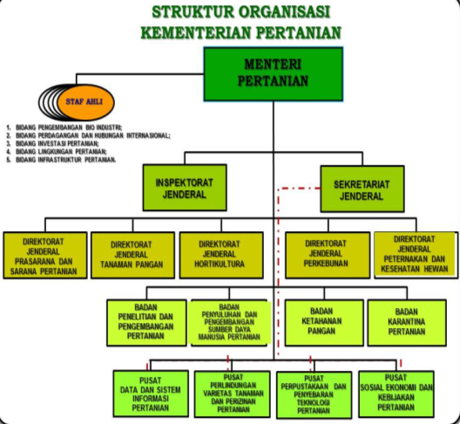
Identification of ICALTD’s Profile
The ICALTD is supporting elements of the Ministry of Agriculture under and are accountable to the Minister through the Secretary-General. The ICALTD has the task on the management of library and information of agricultural science and technology.
In carrying out the tasks, the ICALTD held a function:
scheming of the program, budget and evaluation of the library and information of agricultural science and technology;
managing of library resources and services;
developing of library resources the Ministry of Agriculture
developing and managing of the publication of agricultural research results;
disseminating of information agricultural science and technology through information technology governance and promotion;
managing the instrumnet of information technology and library materials; and
implementation of the ICLATD’s organization affairs
Result and Discuusion
Peraturan Menteri Pertanian No. 43/Permentan/OT.010/8/2015
Tentang Organisasi dan Tata Kerja Kementerian Pertanian

Slide 8
THE MISSION : ... provide and disseminate information of agricultural science and technology. ... improve the capacity of agricultural science and information technology resource management to realize the scientific recognition at national and international level. ... develop a network of national and international cooperation in agricultural science and technology information resource management.
VISION of ICALTD
“ Being a trusted institution of information resources of agricultural science and technology in supporting the achievement of bio-industrial agricultural system in the tropical sustainable ”

Slide 9
The objectives of ICALTD
Policy of the ICALTD Development
General purpose of the ICALTD is providing the excellent information service of agricultural science and technology with ease of access to information.
Development of agricultural library
Development of the dissemination of agricultural innovations
Budgeting of the ICALTD
Human resources development strategy
SPECIFIC GOALS :
developing digital libraries in all Ministry of Agriculture unit;
managing electronic information resources and printed in a systematic, integrated and sustainable;
establish cooperation with scientific institutions of national and international scope in order to expand the sources of information and increase competence;
publication of scientific research results and development as well as bibliographical publications in printed and electronic form;
develop integrated information systems into or outside agencies;
disseminate of agricultural technology innovation through a variety of methods and media;
increase the capacity and professionalism of the IT managers, librarians, and the publication Manager;
improve the skills of the user in finding, accessing, and managing information.

Slide 10
Identification result
Based on the qualitative interpretation against the profile of the ICALTD showed that the strategy of the ICALTD
Perspective | ICALTD’s strategies
Financial | Financial Management
Customer | Information service of agricultural science and technology
 | Providing information access to agricultural science and technology
 | Improvement the quality of publication
Internal Business Process | Development of agricultural library
 | Development of agricultural information dissemination
Learning and Growth | Human resources development
 | Dvelopment of IT insfrastructure
 | Organization management

Slide 11
ANALYSIS of the Results to Library Balanced Scorecard
Perspective | ICALTD’s strategies
Financial | Financial Management
Customer | Information service of agricultural science and technology
 | Providing information access to agricultural science and technology
 | Improvement the quality of publication
Internal Business Process | Development of agricultural library
 | Development of agricultural innovation diisemination
Learning and Growth | Human resources development
 | Dvelopment of IT insfrastructure
 | Organization management
Library BSC
CUSTOMER
INFORMATION
RESOURCES
INTERNAL
PROCESS
ORGANIZATIONAL
READINESS
FINANCIAL
Financial management
Library services
Management of information resources
Policy of library development
Human resources development
Development of library service system
Development of infrastructure
Development of library sistem

Slide 12
STRATEGY MAP of ICALTD
Vision: “ Being a trusted institution of information resources of agricultural science and technology in supporting the achievement of bio-industrial agricultural system in the tropical sustainable ”
Customer
Financial
Providing information access to agricultural science and technology
Financial management
Information service of agricultural science and technology
Improvement
the quality of
publication
Internal Business Process
Agricultural Library
Agricultural Dissemination
Development of agricultural library
Development of agricultural information Dissemination
Learning and Growth
Human Capital
Information Capital
Organization Capital
Human resources development
Development of IT infrastructure
Oragnization
management

Slide 13
STRATEGY MAP of ICALTD’s LIBRARY DEVELOPMENT
Customer
Financial
Library Services
Financial
Management
Information Resources
Internal Processes
Management of Information Resources
Management of library service system
Policy of library development
Organizational Readiness
Human Capital
Information Capital
Human resources development
Development of infrastructure
Development of library system

Slide 14
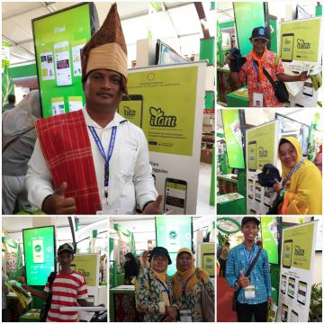
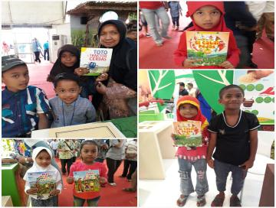
Conlussion
The main conclusions of the study on the designing strategy map of ICALTD using Library BSC were:
the balanced scorecard and Library BSC can be applied as a framework for research in designing strategy map of library;
the design of strategy map of ICALTD can be a policy for the achievement of operational and development of library in the future.

Slide 15
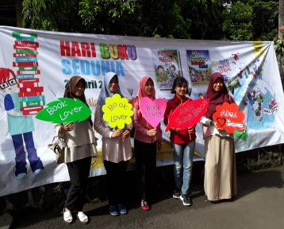
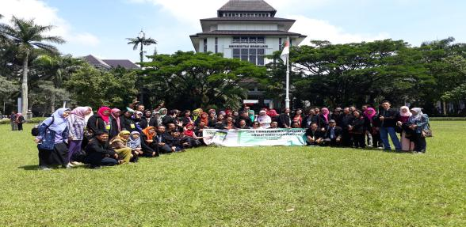
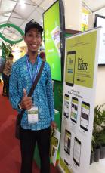
Thank you for your attention
Thank you for Your Attention

