Slide 1
Member of the Asscoiated Press . Aenean commodo ligula eget dolor. Aenean. Aenean commodo ligula eget dolor. Aenhswse. Cejhciebce fcdcdcd.
ILLUSTRATED WEEKLY NEWSPAPER
West. 1869
Friday, May 12, 2017
Price 6d
Preservation Risk Assessment Survey in Collection:
A Case Study of Newspaper Damage at National Library of Indonesia
By
Aris Riyadi
Conservator National Library of Indonesia
Notes:
Assalamu alaikum wr wb, good afternoon
Thank u for opportunity given
On this occasion I will present my research
Preservation Risk Assessment Survey In Collection: A Case Study Of Newspaper Damage At National Library Of Indonesia
According to Law no. 43 on 2007 concerning about mission of the library that is to collect, manage, disseminate information and preserve knowledge as a human cultural heritage that can be used from one generation to next generation. The process of preservation itself is not only in form intellectual or information content but also physical or artefact medium where the information is stored.
Library materials are some documents that containing scientific knowledge information with purpose of its creation for cultural and educational activities.
Along with technological developments, information explosions and more efficient ways, preservation management undergoes a transformation not only applying basic principles of prolonging life, choosing choice, quality, integrity and access but further to meet the needs of the users and provide a social role to the community.

Slide 2
BACKGROUND
FACTS | PROBLEMS
Almost all National libraries organize Preservation activities | Human resource, infrastructure and limited budget
Lack of knowledge about preservation | How it works based on experience
Lack of coordination and cooperation between and inter parts | The complexity of analog preservation work and digitization
Job priority is uncertain | Number and type of damage full of variations
Storage environment fluctuates | Damage to the collection of newspapers getting faster
Do not have a preservation policy yet | Less innovation preservation strategy
Notes:
background of this research can be illustrated by the existence of facts and problems table
Firstly, almost all national libraries in each country hold Preservation activities, but the problem is not comparable between human resources, infrastructure and budget
Lack of knowledge about preservation cause practice doing by trial and errors
Furthermore, lack of coordination and cooperation between library section raises complexity of analog preservation work and digitization
Then there is a fact that uncertain job priority causes variation number and types of damage
It is a facts that storage environment tends to fluctuate and doesn't meet good quality storage standards it is causing Damage to collection more quickly occur
And absence of preservation policies can lead less innovation in development of preservation strategies

Slide 3
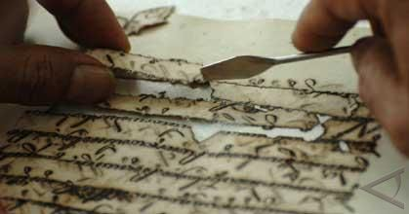
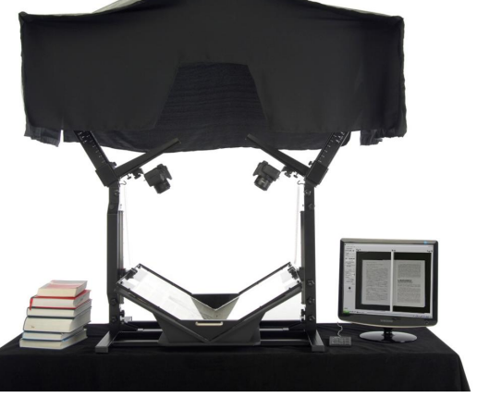
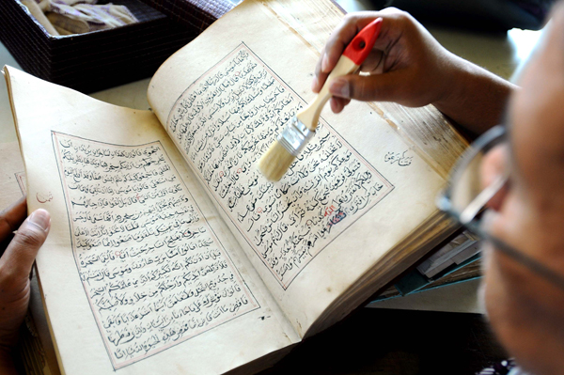
Benefit of Research
V shaved Book Scaner
Conservation and restoration
Notes:
There are several benefits that I can take from this research such as
To identify risk and quantity of damage to obtain an appropriate assessment method
Analyze characteristics of damage so that there is a priority on conservation and digitalization
Establish preservation risk assessment models and strategies that can be used by other libraries

Slide 4
Efforts of National Library to Preserve Newspapers
No. | Preservation Activities | Amount
1. | Restoration | 4.000 copies
2. | Fumigation | 10.200 copies
3. | Care and handling | 11.900 copies
4. | Binding | 1.000 copies
5. | Portepel | 1.200 copies
6. | Boxes making | 750 copies
7. | Microfilm | 750 copies
8. | Digital convertion | 60 rolls
Notes:
Due to uniqueness and high historical value in recording all events in update society, NLI make an efforts to preserve by conservation, restoration, analog microfilm and digitazing with fifty two persons of conservators. Based on Accountability Performance Report 2015 Library Materials Preservation Centre, preservation activities have been carried out :
Restoration four thousand copies
Fumigation ten thousand two hundred copies
Care and handling eleven thousand and nine hundred copies
Binding one thousand copies
Portepel one thousand and two hundred copies
Boxes making seven hundred and fifty copies
Microfilm seven hundred and fifty copies
Digital conversion sixty copies

Slide 5
Setting goals
Sampling determination
Implementation of survey
Data analysis
Interpretation
Quantitative Research Stages
Solution
Notes:
Methodology in this study use quantitative methods of empirical study to collect, analyze, and display data in numerical or statistical form, and to show relationship between dependent and independent variables as general representatives. This surveys conducted to look backward or retro-spective of variables. Data collection is derived from phenomena as a result or a real impact that occurs.

Slide 6
Survey Research
Survey
Collection documentation
Sampling
Collecting data
Data analysis
Conducting survey
Surveyor training
Notes:
The survey was conducted in six stages: first stage, documentation and data collection through all units and its collection room, second stage, determine collection that will be assessed by each copies with systematic cluster sampling method. Third stage, involves surveillance training for conservators and librarians, fourth stage, implementation of survey. Fifth stage, data collection and information entry into a computer database. Last stage is the data processing then results analysis of the survey.
It is very difficult to give an understanding to the surveyor how to assess damage conditions that happen in collection therefore I make a dictionary of damage and train how to fill the form so that there an equation on perception

Slide 7
Quantitative Research
Pilot reserach
Determining survey form
Validity
Survey
Documentation, Sampling, Training, Survey, Tabulation and Data Analysis
Storage survey
Data logger
Recommendation
Pyramidal damage and preservation solutions (conservation, restoration and digitization)
Notes:
In broad outline this study covers stages with formulating goals, pilot study, sampling, collecting data, analyzing and interpreting data then provide development solutions from results obtained

Slide 8
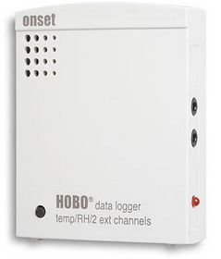
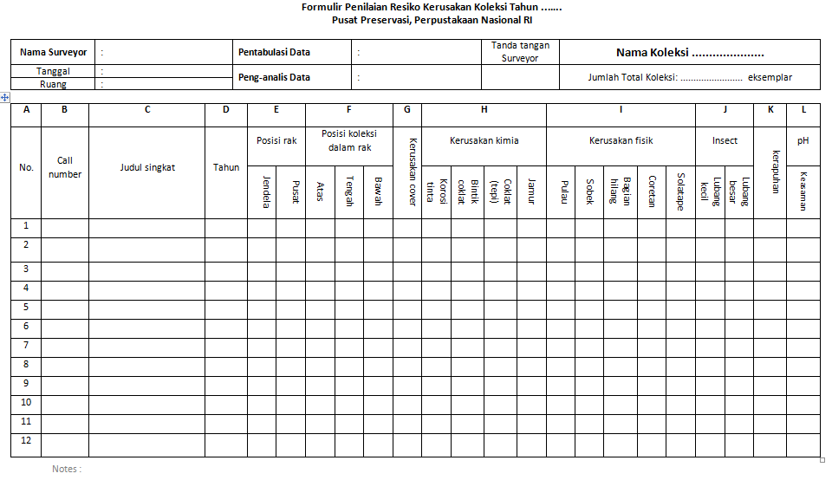
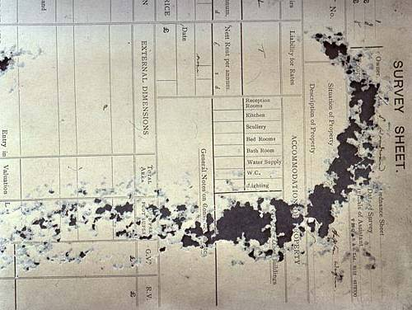
Instruments
Hobo data logger
Survey form
pH pen
Damage dictionary
Notes:
There are several survey instruments that can be used such as survey form, hobo data logger, damage dictionary and Abbey pH pen

Slide 9
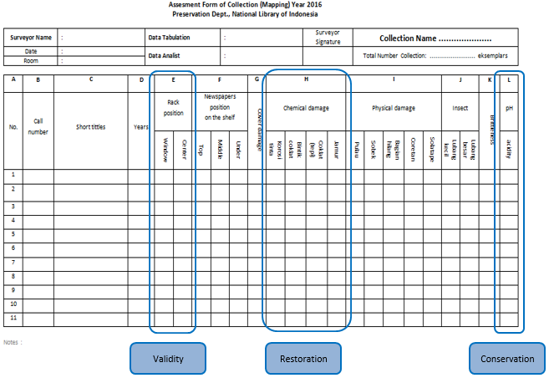
Vertical Sums
Notes:
After collecting the survey form, then the analyst tabulates all existing data into one and fill it in excel
The process of calculating data obtained by summing vertically every variables checked from top to down so that obtained a result analysis

Slide 10
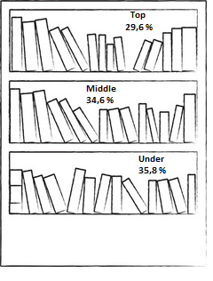
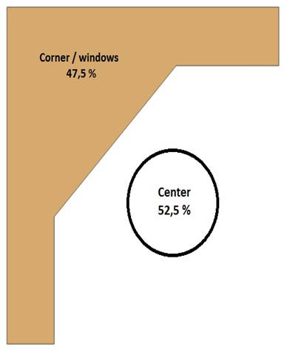
Sampling Validity
Notes:
Percentage of collection positions on storage shelves indicates nearly uniformity of surveyed collection or close to the 30%
Then Percentage position of collection location in the storage space is also close to 50%
It means that almost all collection which in sampling Evenly distributed

Slide 11
Cover damage
Notes:
If survey has been estimate valid then data show one by one damage results, first that cover damage shows no trend relationship beetwen publication year with number of cover damage because damage occur by librarian and user access to open and close the cover frequently.
The highest number of cover damage occurred in time spans from year nineteen ninety eight to two thousand reach 63%. This can be happen because newspapers in that publication are heavily used by users seeking information about political turmoil in nineteen ninety eight

Slide 12
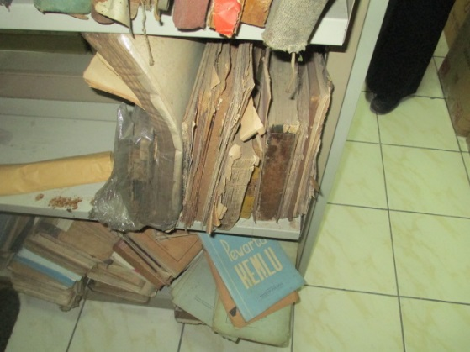
Cover damage
Notes:
This one is an example of damage in cover collection

Slide 13
Chemical Damage
Publish Year | Kinds of stain on paper
 | Ink corrotion | Foxing | Tanned | Mold | Tears
s/d 80 | 31 | 3118 | 2209 | 2690 | 650
81-85 | 3 | 51 | 57 | 37 | 3
86- 90 | 1 | 60 | 51 | 29 | 9
91-95 | 3 | 71 | 114 | 23 | 1
96-00 | 6 | 66 | 105 | 31 | 3
01-'05 | 0 | 91 | 145 | 37 | 0
06-'10 | 6 | 40 | 105 | 11 | 3
Percentage | 1% | 46% | 37% | 38% | 9%
Notes:
By looking above table, very small ink corrosion occurs, this is because pigment in newspapers offset do not use iron gall but oil-based pigments.
The appearance of spots (foxing) occurs in the largest amount of fourth six percent due to oxidation of ferric to ferro iron which catalyzed by poor storage environment.
Mushroom phenomenon occupy second position that is thirty seven percent

Slide 14
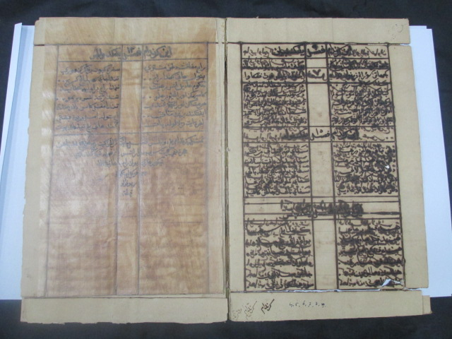
Original Gurindam 12 Ink corrotion
Notes:
As mr reinhard said yesterday that ink in Indonesian collection specially to manuscripts is more dangerous than in german, I will give another reason that Indonesia is a tropical country whose environment temperature and humidity are fluctuate more, so it make damage reaction accelerate, this is just an example a form of ink corrosion on our collection but for newspaper collections its very rare happen ink corrosion.
If you have ever hear Poetry Gurindam 12, then this is the original manuscript Gurindam 12 (Raja Ali) stored in NLI

Slide 15
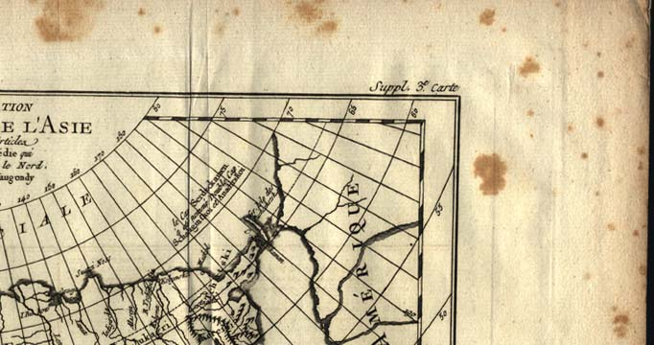
Foxing
Notes:
This damage is what usually conservator called foxing

Slide 16
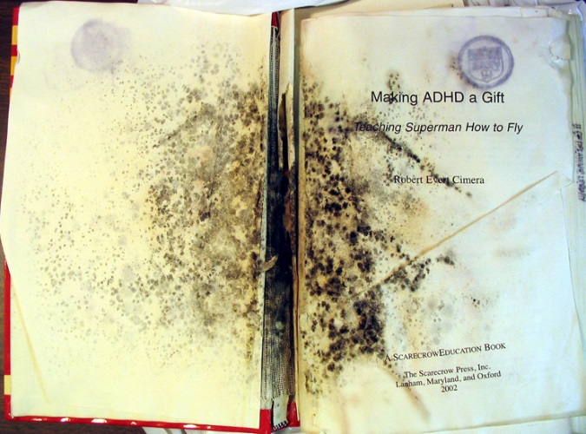
Mold
Notes:
Great fungal attack would make paper become greenish, brown into black. One interesting thing is when fungus has been growing spread on paper it will usually also found insects who depend on these mold.

Slide 17
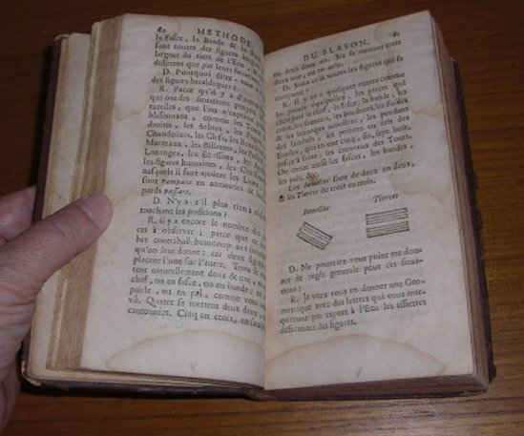
Tear
Notes:
Tears, this stain is because of high humidity collection space then making area with a more contrasting color than surrounding area

Slide 18
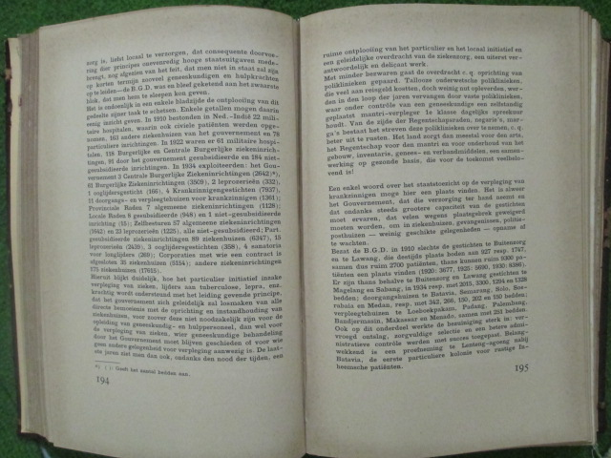
Tanned
Notes:
Picture of tanned

Slide 19
Tanned
Notes:
Tanned damage happen because photochemical reaction of exposure to light over 200 lux so that lignin chromophores decomposes into a quinone which is become yellowish color
Therefore it is important for library to keep collection dark, using LED lights, curtains and ribbenic glass

Slide 20
Physical Damage
Publish Year | Kinds physical damage on paper
 | Torn | Missing part | Scratch | Solatape
s/d 80 | 2240 | 795 | 105 | 316
81-85 | 11 | 17 | 6 | 3
86- 90 | 31 | 17 | 6 | 1
91-95 | 26 | 17 | 14 | 6
96-00 | 43 | 9 | 6 | 11
01-'05 | 48 | 11 | 20 | 3
06-'10 | 26 | 17 | 20 | 11
TOTAL | 2425 | 884 | 177 | 352
Percentage | 32% | 12% | 2% | 5%
Notes:
Damage on newspapers occur physically in form of torn paper, missing parts, scratch and solatape.
this condition occurs because act of vandalism or fragility so resulting torn pieces on papers

Slide 21
Biota Damage
Notes:
To determine damage caused biota is done by recognizing presence of marked damage from their eating activity or metabolism
It is very easy to know their existence by looking the sign in paper hole so that we know what kind of biota causing damage
Total damage because biota present 43% with collections under the year One thousand eight hundred
as much as 47%.

Slide 22
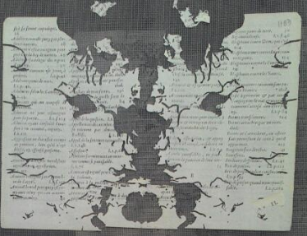
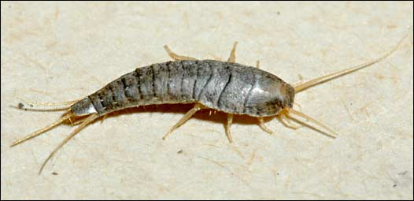
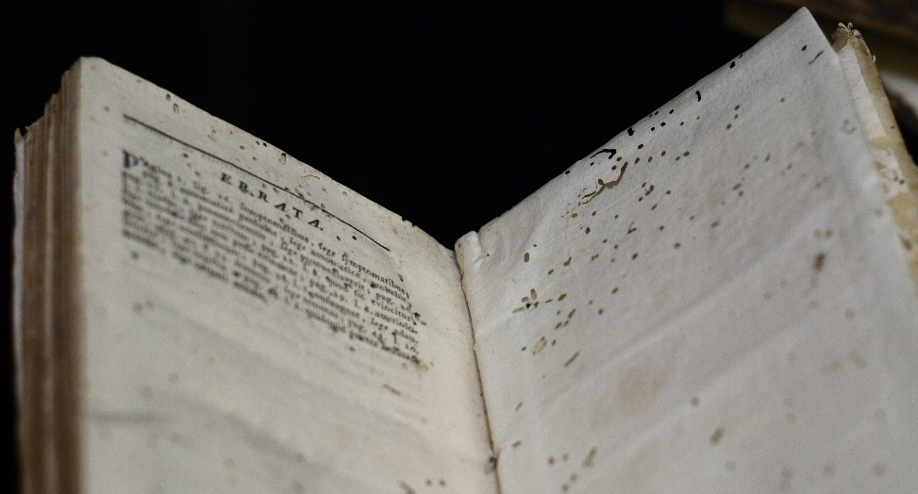
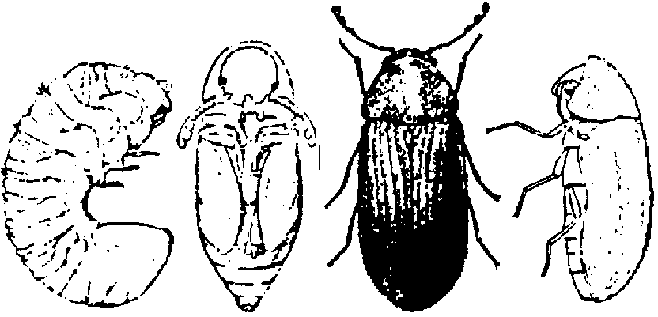
Silverfish
Bookworm
Notes:
Damage collections that occur because of insects can be said damage which is well done it means we can not be restored again because part of collection lost due to their activities. It is very easy to know the damage caused insects by just looking at curve of the missing hole

Slide 23
Fragility
Notes:
Fragility of newspapers mostly occurred in collections under year One thousand eight hundred as much as 71%
While for the above year only an average of 10% - 30% and is heading towards increased fargility
Fragility itself is caused by accumulation of many damage such as pollution, biota, acidity and a bad environment that causes cellulose degradation

Slide 24
Acidity
Notes:
It is unfortunate that unsuitable environmental conditions again greatly affect acidity in paper pH.
There are three factors causes of high percentage acidity firstly because raw material newspaper, which many use of lignin
Secondly because of air pollution, it is marked by amount of dust attached to surface collection
And third handling or hand sweating process that transmitted directly to collection during use

Slide 25
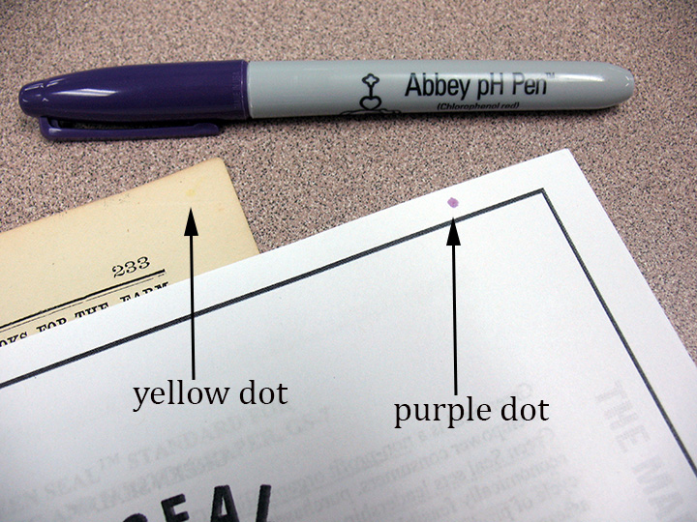
pH pen
Notes:
To know that collection is acid or not, we using pH pen to know it, when collection already acidic mark will be red but if it not it will show blue color indicating collection neutral or slightly alkaline

Slide 26
Variety and Amount of Damage
Notes:
If I make comparison between amount of damage variation and year it will be obtained graph above that will be explained significantly in conclusion

Slide 27
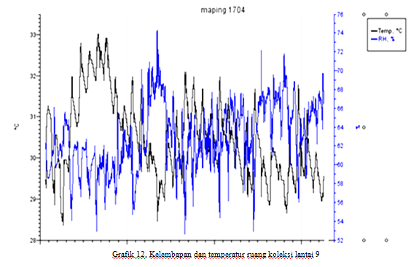
Humidity and Temperature
Notes:
Based on data logger that temperature Max 33 degree and Min 28 degree with average 30 degree
Max humidity is 74% to Min 52% with an average 62%
The fluctuating rate of humidity and temperature is too large and uneven so that it can cause rapid contraction and relaxation for cellulose until the carbon chain breakdown.
Decrease in humidity occurred at 3 PM as the hottest condition then dropped after next hour

Slide 28
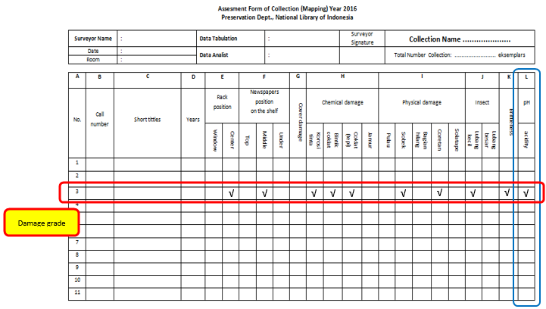
Horizontal sum
Categories (Level) | Description
Good | If there is a collection with a column marked0 – 2
Moderate | If there is a collection with a column marked 3 – 5
Bad | If there is a collection with a column marked 6 – 8
Very bad | If there is a collection with fragille column markedor sum reach9 – 13
Notes:
In determining category of damage, calculation done by horizontal addition to predefined sign

Slide 29
Category of damage
Categories (Level) | Description
Good | If there is a collection with a column marked 0 – 2
Moderate | If there is a collection with a column marked 3 – 5
Bad | If there is a collection with a column marked 6 – 8
Very bad | If there is a collection with fragille column markedor sum reach9 – 13
Notes:
I create my own category of damage grade that depend on the goals library want to get

Slide 30
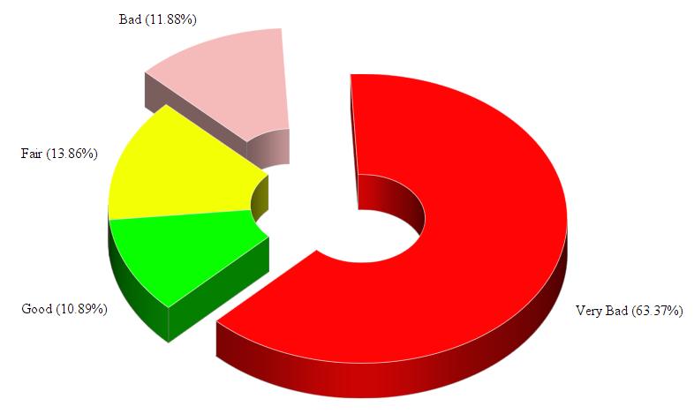
Categories of Damage
Notes:
It is obtained that damage of very bad Grade reaching 63%. This happens because in year under One thousand eight hundred collection has experienced fragility other than the most surveyed collection.
The contribution of good, medium and bad damage is mostly dominated by collections with a young age.

Slide 31
Pyramid of Preservation Strategy
Notes:
Having studied from damage variation, I make a Pyramid of Preservation Strategy that can be formulated directly related to types of damage, what solution can even determine and how much acceleration an institution needs to overcome their preservation activities each year

Slide 32
Conclusion
Method can be use on large library for preservation activities
Objective and easier
Can be use for almost paper base library collection
Determine strategy of preservation
Notes:
This method is ideally can be use on large library especially those willing to try and already implementing preservation programs because comprehensively cover all-risk and damage conditions to collection. This assessment method have some advantages that any other surveying method like its objectivity in appraise damage and easiness with just write a check in blank column. Validity and margin of error may determine from each library by doing pilot studies in advance.
For NLI itself which have so many collections, located in a tropical country, limited budgeting system, human resources, and infrastructure should perform accelerated steps and work priority. So I suggest that when you want to do preservation activities then you should do a survey first so you will get the right strategy planning for preservation.

Slide 33
Member of the Asscoiated Press . Aenean commodo ligula eget dolor. Aenean. Aenean commodo ligula eget dolor. Aenhswse. Cejhciebce fcdcdcd.
ILLUSTRATED WEEKLY NEWSPAPER
West. 1869
Wednesday, December 27, 2016
Price 6d
Thank you
WASSALAM
Notes:
Well, that’s all my presentations thanks you for your attention. Wassalam

