Slide 1
The Comparison Study Of Three Indonesian Manuscripts As World Documentary Heritage
Yogyakarta, May 11th 2017
Oleh:
ENDANG SRI RUSMIYATI RAHAYU
CENTRE FOR SCIENTIFIC DOCUMENTATION AND INFORMATION
INDONESIAN INSTITUTE OF SCIENCES (PDII – LIPI)
Notes:
This template can be used as a starter file to give updates for project milestones.
Sections
Right-click on a slide to add sections. Sections can help to organize your slides or facilitate collaboration between multiple authors.
Notes
Use the Notes section for delivery notes or to provide additional details for the audience. View these notes in Presentation View during your presentation.
Keep in mind the font size (important for accessibility, visibility, videotaping, and online production)
Coordinated colors
Pay particular attention to the graphs, charts, and text boxes.
Consider that attendees will print in black and white or grayscale. Run a test print to make sure your colors work when printed in pure black and white and grayscale.
Graphics, tables, and graphs
Keep it simple: If possible, use consistent, non-distracting styles and colors.
Label all graphs and tables.

Slide 2
AUTHOR’S PROFILE
Name : Endang Sri Rusmiyati Rahayu
Proffesion : Librarian
Affiliation : Centre for Scientific Documentation and Information Indonesian Institute of Sciences (PDII– LIPI)
Education :
Bachelor Degree (S-1) at INSTIPER Yogyakarta majoring Agriculture
Master’s Degree (S-2) at Universitas Indonesia majoring Library and Infromation Science
Notes:
What is the project about?
Define the goal of this project
Is it similar to projects in the past or is it a new effort?
Define the scope of this project
Is it an independent project or is it related to other projects?
* Note that this slide is not necessary for weekly status meetings

Slide 3
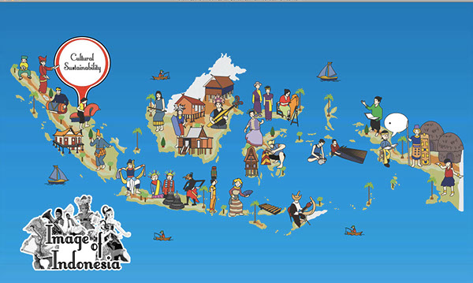
CULTURE AND ITS VALUE
Culture can give people a connection to certain social values, beliefs, religions and customs.
It allows them to identify others of similar mindsets and backgrounds.
Cultural heritage can provide an automatic sense of unity and belonging within a group and allows us to better understand previous generations and the history of where we come from.
Notes:
* If any of these issues caused a schedule delay or need to be discussed further, include details in next slide.

Slide 4
DOCUMENTARY HERITAGE AND ITS ISSUES
The documentary heritage residing in libraries and archives constitutes a major part of that memory and reflects the diversity of peoples, languages and cultures.
A considerable proportion of the world documentary heritage disappears through "natural" causes: acidified paper that crumbles to dust, leather, parchment, film and magnetic tape attacked by light, heat, humidity or dust.
Several Indonesian manuscripts and archives have been registered as Memory of the World. Those are Nāgarakrĕtāgama, I La Galigo, Autobiographical Chronicle of Prince Dipanegara (Babad Dipanegara), and Asian African Conference Archives.
Notes:
Duplicate this slide as necessary if there is more than one issue.
This and related slides can be moved to the appendix or hidden if necessary.

Slide 5
OBJECTIVE
The objective of this paper is to describe the difference of manuscripts of Nāgarakrĕtāgama, I La Galigo and Babad Dipanegara (autobiographical chronicle of Prince Diponegoro) based on criteria of Memory of the World

Slide 6
METHODOLOGY
The descriptive study through the documents analysis is conducted as the main method presented in the paper
The parameters which are observed from these documentary heritage are consist of media, character, year of written, and length.
Content or information of these documentary heritage were analized based on criteria indicator of world significance, time, place, people, form and style, and subject and theme.
Evaluation of criteria indicator were following:
Criteria of world significance
Criteria of time: absolute age
Criteria of place
Criteria of people
Criteria of subject and the
Criteria of form and style

Slide 7
Stages of Analysis
1
Nomination form
2
3
Analized based on world significance indicators : time, place,people, form & style, subject and theme
4
Table Presentation
Comparison of the result
NK
ILG
BD
Notes:
The following slides show several examples of timelines using SmartArt graphics.
Include a timeline for the project, clearly marking milestones, important dates, and highlight where the project is now.

Slide 8
Nāgarakrĕtāgama
The panegyrical poem written between 1350-1365 AD in old Javanese language & characters on lontar leave by Rahawi Prapanca during the reign of Hayam Wuruk, King of Majapahit
Describing the King’s journey through the kingdom in an attempt to know the country and his people and to comprehend their aspiration and needs.
It gives testimony to the reign of a king in fourteenth century Indonesia in which the modern ideas of social justice, freedom of religion, and personal safety and welfare of the people were held in high regard.
It also testifies to the democratic attitude and openness of authority before the people in an era that still adhered to the absolute rights of kingship.
Gives an accurate description of the land and its countryside.
Through the poem, the modern reader perceives a complete and close picture of a community in fourteenth century Indonesia with the political background of the state and its government.
Figure 1. Nāgarakrĕtāgama Manuscripts
(source: collection of National Library of RI, accession number Br. 493 NB 9)

Slide 9
I LA GALIGO
The manuscript dimension is 18 (width) x 22 (height) cm, It has 217 pages and is written on paper (no watermark) with black ink in the Bugis script.
Each page contains 16 lines with a pallawa written after every five letters. The writing is neat and regular and a bit “flattened”.
Manuscript NBG-Boeg 188 consists of 12 folio-sized volumes, each volume measuring 21 (width) x 34 (height) cm with a total number of 2.851 pages.
Its preservation condition is diverse: about 10% of the paper is in bad condition, 60% is normal, 20% is good, and 10% very good. However, all bindings are in very bad shape resulting in many loose pages
Figure 2. I La Galigo Manuscripts
(source: collection of National Library of RI, plate 248)
Manuscript Description
Manuscript 2610/07.114, Collection Museum La Galigo, Benteng Fort Rotterdam, Makassar, Indonesia. Title: Sawérigading dan La Galigo ke Senrijawa.
Manuscript NBG-Boeg 188. Collection Leiden University Library, Witte Singel 27, 2311 BG Leiden, the Netherlands. Title: “La Galigo”. Resubmit on March 2010

Slide 10
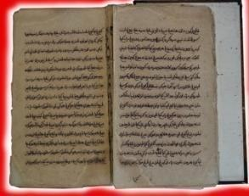
BABAD DIPONEGORO
The manuscript, which is currently deposited in the Indonesian National Library (Accession number KBG282), was copied from the original held by Dipanagara’s surviving family in Makassar which was written between 20 May 1831 and 5 February 1832.
This copy runs to 1,151 manuscript pages in pégon script (Javanese written in Arabic characters) and text in the Javanese tembang macapat (verse) literary genre.
The pégon script text of Dipanagara’s chronicle, constitutes the sole version of this manuscript which survives in the original script in which it was written in 1831-1832.
Figure 3. Autobiographical Chronicle of Prince Diponegoro
(source: collection of National Library of RI, Accession number KBG282)

Slide 11
BABAD DIPONEGORO
The autobiographical chronicle of the Javanese nobleman and Indonesian national hero, Prince Dipanagara (1785-1855) of Yogyakarta.
The Babad Dipanagara (‘The Chronicle of Dipanagara’) - written in exile in North Sulawesi (Celebes) in 1831-1832 - is the personal record of a key figure in modern Indonesian history.
Figure 4. Illustration of Babad Dipanegara
(source: Peter Carey, 2008)

Slide 12
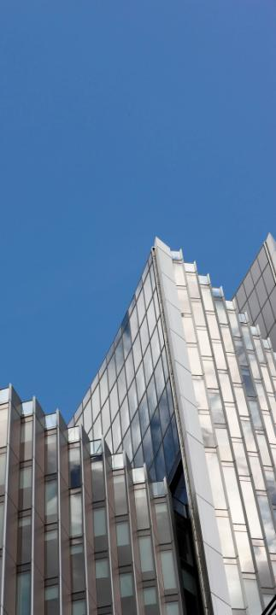
Result
Description of the manuscript
Criteria assesment of documentary heritage

Slide 14
CRITERIA ASSESMENT OF DOCUMENTARY HERITAGE
NO | Criteria indicator | Nāgarakrĕtāgama | I La Galigo | Autobiographical Chronicle of Prince Diponegoro
1 | World significance | Personal safety The rule of law guaranteed peace in the kingdom. Freedom and peace among religions, Social justice, Basic ideas of good governance that are still valid in today’s modern world. | a. Social justice | a. Social justice b. good governance c. leadership
2 | Time | 1350-1365 AD | 14th century | between 20 May 1831 and 5 February 1832
3 | People | Javanese | Indigineous Bugis | The Javanese of south-central Java.

Slide 15
CRITERIA ASSESMENT OF DOCUMENTARY HERITAGE
NO | Criteria indicator | Nāgarakrĕtāgama | I La Galigo | Autobiographical Chronicle of Prince Diponegoro
4 | Place | along the routes of the king’s journey (a large area of Java) | South Sulawesi | south-central Java (the sultanate of Yogyakarta), a large number of Central and East Java
5 | Subject and theme | kakawin, a formal kind of poetry which is essentially a Sanskrit poetic form of king’s journey | literary and mythological unique story for early Bugis society | values, traditions, historical record and culture
6 | Form and style | the kakawin form of prosody of Sanskrit origin | Bugis script | Modern Javanese macapat (autobiography)

Slide 16
Conclusion
The collective memory of the peoples of the world is vital importance in preserving cultural identities in bridging the past and the present and in shaping the future. The Memory of the World is the documented, collective memory of the peoples of the world (documentary heritage) which in represents a large proportion of the world’s cultural heritage. Several Indonesian documentary heritage have been registered as Unesco Memory of the World.
The comparison of three Indonesian manuscripts as Unesco Memory of the World have different character, criteria of time, place, people, subject and theme, and also form and style. The same world significance of their contents is social justice.
Based on the indicator of criteria assesment of documentary heritage for Memory of the World register, Nāgarakrĕtāgama and autobiographical chronicle of Prince Diponegoro have the same uniqueness in guiding principle the basic ideas of good governance that are still valid in the today’s modern world.

Slide 17
Conclusion
The main threat for these documentary heritage are improper storage under tropical climate conditions. This improper storage has among others the effect that the paper becomes mildewed or is damaged irreparably. Most manuscripts are in danger of being lost forever by the deteriorating effect of lack of preservation measures in a hot and humid tropical climate.
Another main threat seems to be the disappearing knowledge of both the Bugis and pegon script and the language in which these manuscripts have been composed.

Slide 18
Title Layout
Subtitle

