Slide 1
Preservation and Visualization of intellectual heritage: an Overview on Bequest of Internet Archive
Dr. Akash Singh, Assistant Librarian, NLU, Delhi
Dr. Priya Rai, Deputy Librarian, NLU, Delhi
&
Dr. Praveen Kumar Jain, IEG, New Delhi

Slide 2
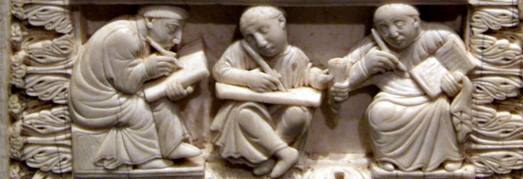
Intellectual Heritage
Source: http://www.byui.edu/Images/humanities-philosophy/Intellectual.jpg

Slide 3
Players Stepping in Preserving Intellectual Heritage
Alexa Internet
An Atlas of Cyberspaces
National Technical Information Service (NTIS), U.S. Department of Commerce, Technology Administration
Peacock
Project Gutenberg
Revival of the Library of Alexandria
The Association for Computing Machinery
The Australian National Library

Slide 4
Players Stepping in Preserving Intellectual Heritage
The Carnegie Mellon University Informedia Digital Video Library Project
The Council on Library and Information Resources
The Digital Library Forum (D-Lib)
The Intermammary Project
The Internet Mapping Project
The Internet Public Library site
The Library of Congress
The Matrix Information Directory Service
The Museum Digital Library

Slide 5
Players Stepping in Preserving Intellectual Heritage
The National Archives and Records Administration
The National Institute of Standards and Technology
The National Science Foundation Digital Library Program
The Radio and Television Archive
The Royal Institute of Technology Library in Sweden
The Society of American Archivists
The United States Government Printing Office
The University of Virginia
WebReference

Slide 6
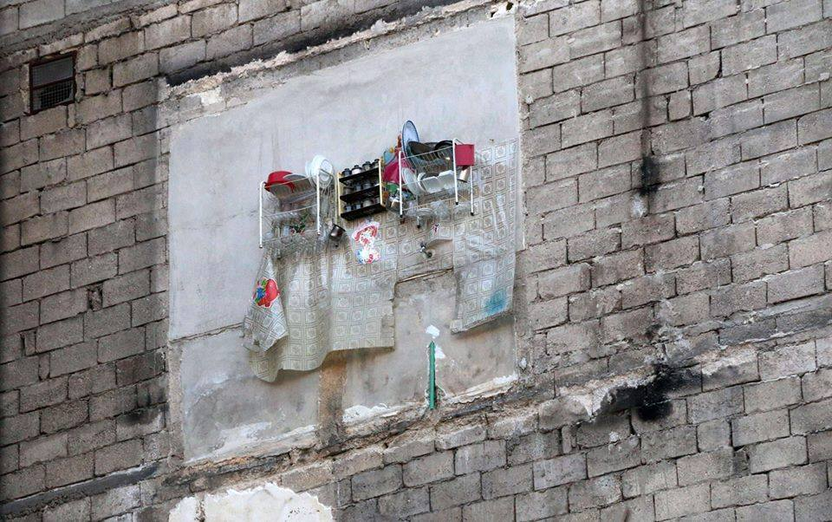
Internet Archive
Image Source: https://i1.wp.com/bellacaledonia.org.uk/wp-content/uploads/2016/12/Czjb7lBWEAAa5Vf.jpg-large.jpg

Slide 7
Internet Archive
‘The Internet Archive’ is a non-profit making organization which was formed to build an Internet library with a purpose offering permanent access for researchers, historians, scholars, people with disabilities, and the general public to historical collections that exist in digital format.
It was founded in 1996 in San Francisco.
Archive has been receiving data donations from Alexa Internet and others.
In late 1999, the organization started to grow to include more well-rounded collections.
Now the Internet Archive includes: texts, audio, moving images, and software as well as archived web pages in collections, and provides specialized services for adaptive reading and information access for the blind and other persons with disabilities.

Slide 8
What kinds of Resources Internet Archive preserved

Slide 9
Books
Moving Images
Audio
News clips
Web pages
Software
Still Images
Music Concerts

Slide 10
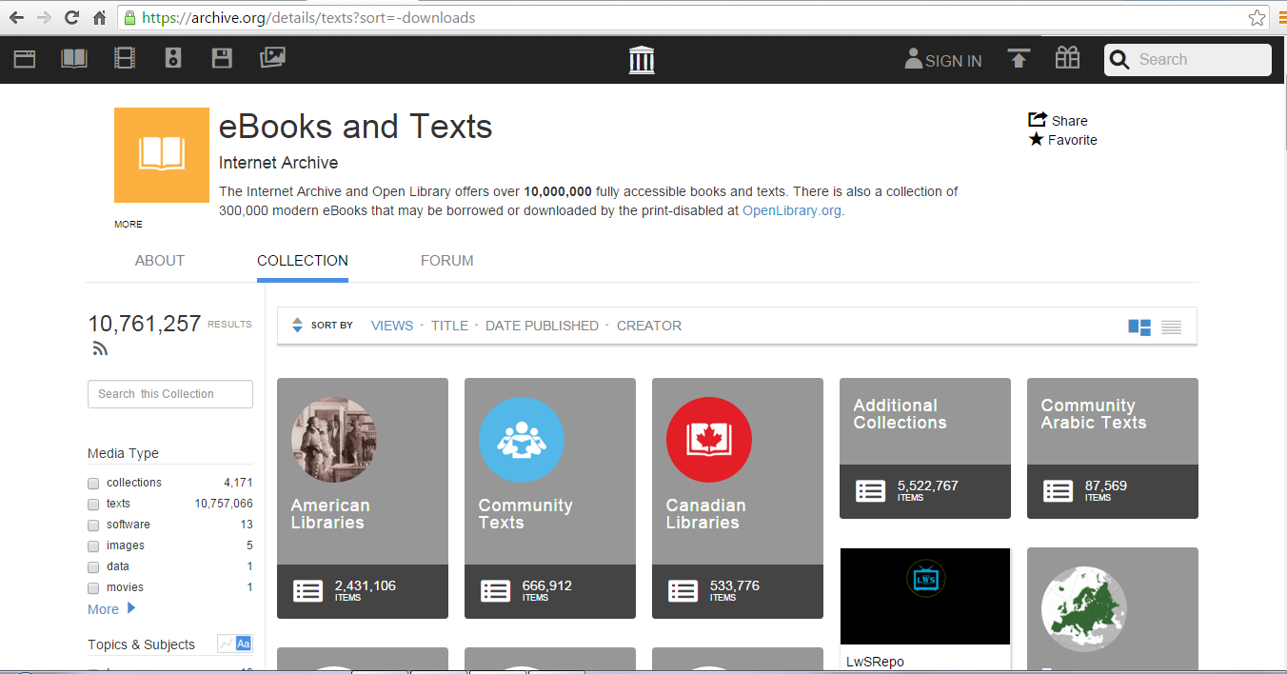
E-BOOKS@ Internet Archive
Internet Archive contains more than 10,000,000 fully accessible books

Slide 11
Books @ Internet Archives (Libraries involved)
Collections | Numbers
American Libraries | 2431106
Community Texts | 666912
Canadian Libraries | 533776
Journals | 957793
Library of Congress Text | 148893
JSTOR Early Contents | 452028
Archiv.org | 782695
National Security Internet Archive | 1152030
European Libraries | 567814
Additional Collections | 5522767

Slide 12
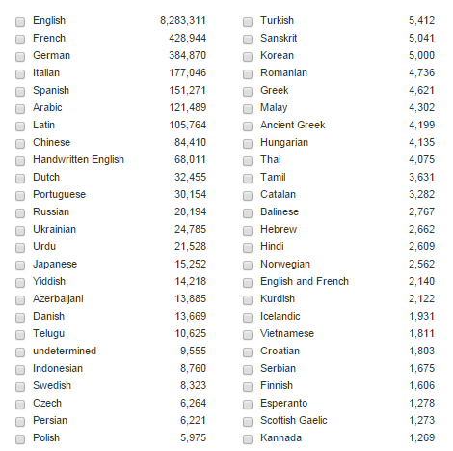
Books @ Internet Archives (More than 50 Languages)

Slide 13
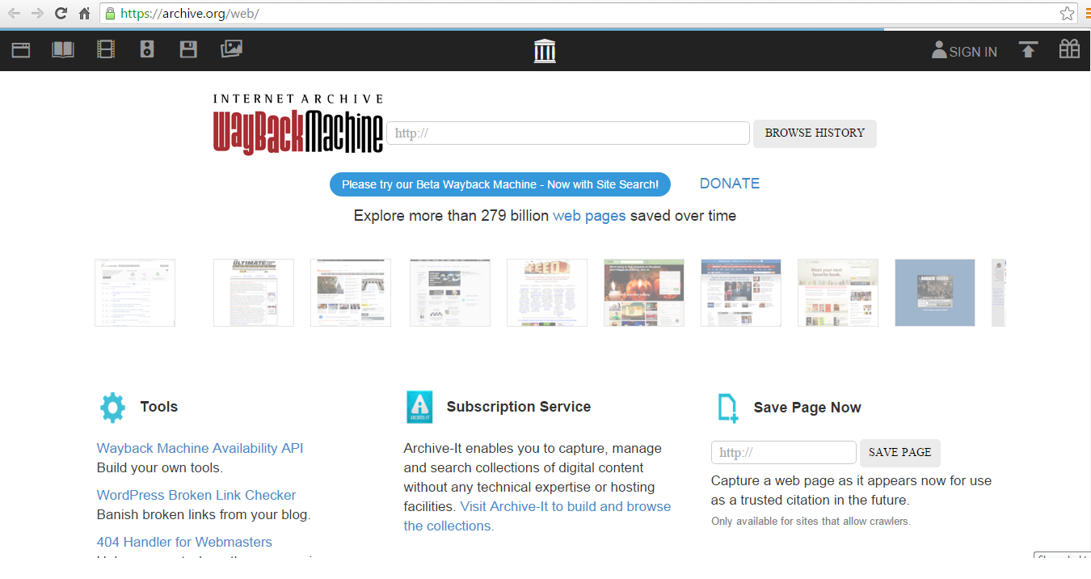
Web pages @ Internet Archives
Internet Archive facilitates access or browsing more than 279 billion webpage. Contents of all web pages can be accessed supported by wayback machine software. Under this page, Internet Archive facilitates provision to search relevant web pages. It also provides option to include or suggest page which should be included.

Slide 14
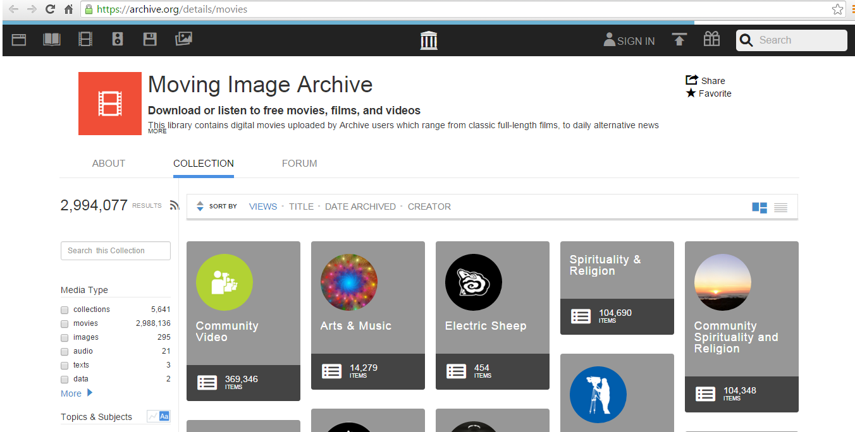
Moving Image @ Internet Archive
Under the head moving image, Internet Archive provides access of more than 2994077 moving images. Free movies, films and videos are available to access under this module. 5641 collections of other virtual movie libraries are included in moving image module. This library contains digital movies uploaded by Archive users which range from classic full-length films, to daily alternative news broadcasts, to cartoons and concerts. Many of these videos are available for free download

Slide 15
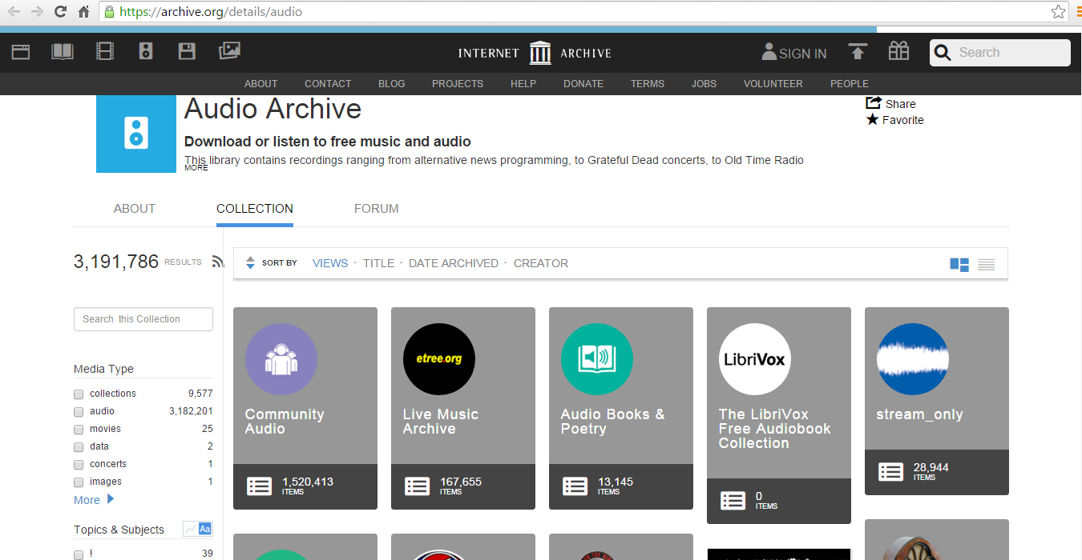
Audio Archive @ Internet Archives
This library contains recordings ranging from alternative news programming, to Grateful Dead concerts, to Old Time Radio shows, to book and poetry readings, to original music uploaded by users. Many of these audios and MP3s are available for free download. This module facilitates access of 3191786 audios of news programming, radio, concerts and other programme from 5641 collections.

Slide 16
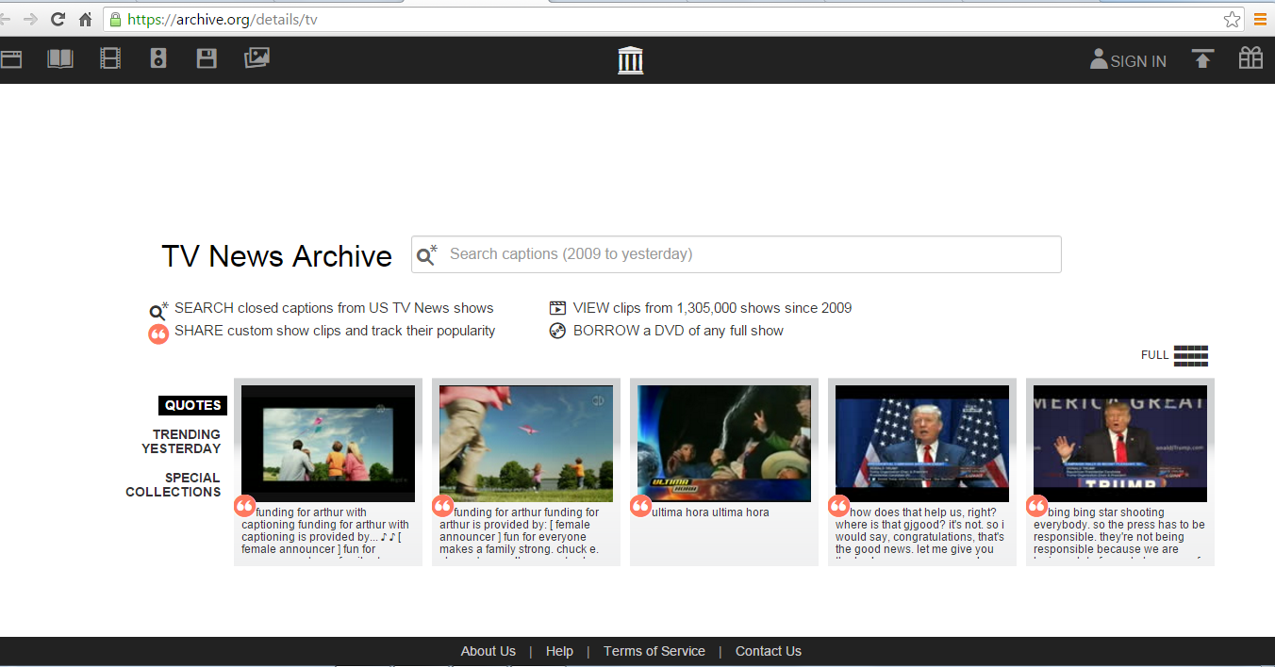
TV News Archive @ Internet Archive
TV News Archive@ Internet Archives
Launched in September 2012, this research library service is intended to enhance the capabilities of journalists, scholars, teachers, librarians, civic organizations and other engaged citizens. It repurposes closed captioning to enable users to search, quote and borrow U.S. TV news programs. Available at no charge, the public can use the index of searchable text and short streamed clips to explore TV news, discover important resources, understand context, evaluate assertions of fact, engage with others and share insights

Slide 17
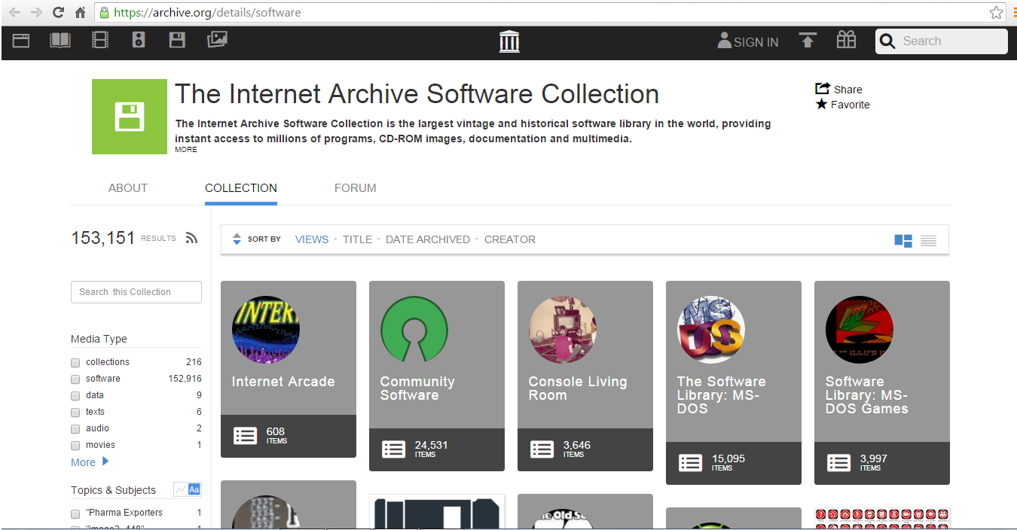
The Internet Archive Software Collection @ Internet Archive
The Internet Archive Software Collection is the largest vintage and historical software library in the world, providing instant access to millions of programs, CD-ROM images, documentation and multimedia. The collection includes a broad range of software related materials including shareware, freeware, video news releases about software titles, speed runs of actual software game play, previews and promos for software games, high-score and skill replays of various game genres, and the art of filmmaking with real-time computer game engines. Under this module 153151 software are available to access various programmes, games and other software

Slide 18
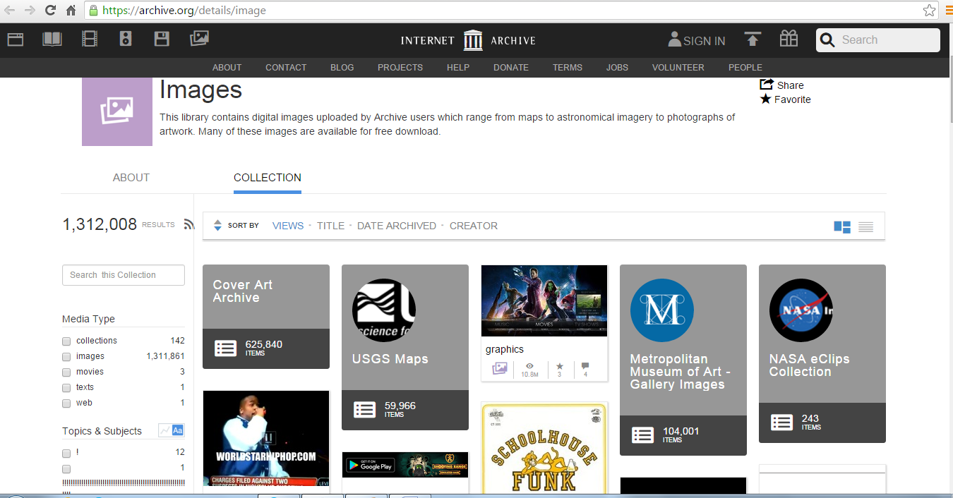
Images @ Internet Archive
This library contains digital images uploaded by Archive users which range from maps to astronomical imagery to photographs of artwork. Many of these images are available for free download. Around 1312008 images are available for free downloads from 142 collections

Slide 19
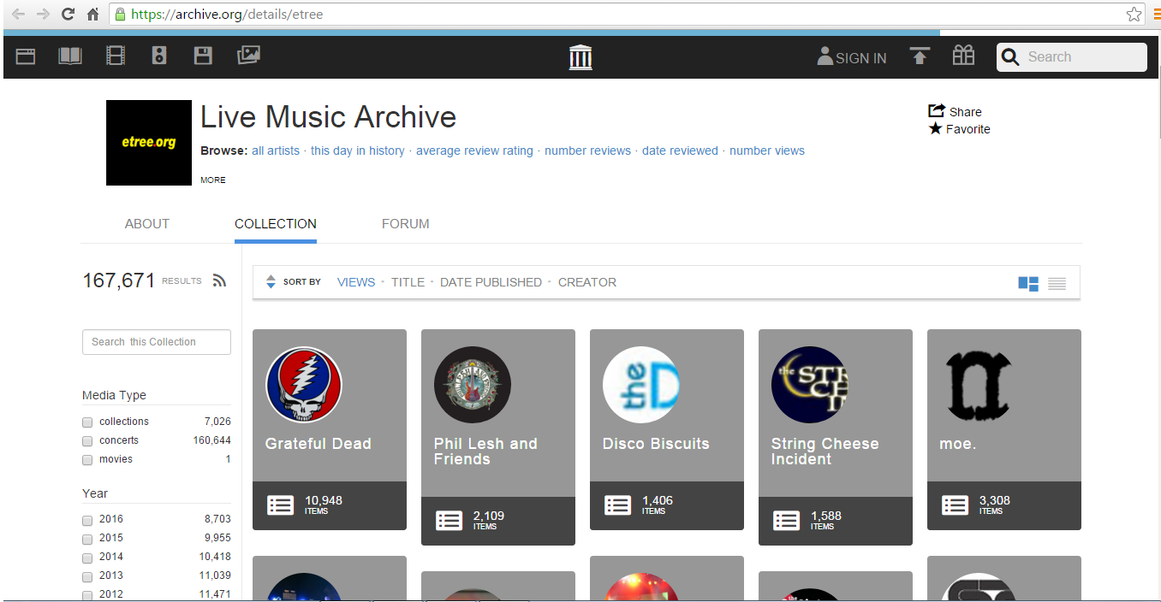
Music @ Internet Archive
The Internet Archive has teamed up with etree.org to preserve and archive as many live concerts as possible for current and future generations to enjoy. All music in this Collection is from trade-friendly artists and is strictly non-commercial, both for access here and for any further distribution. Artists' commercial releases are off-limits. This collection is maintained by the etree.org community. Currently 167671 music files are available for access through module

Slide 20
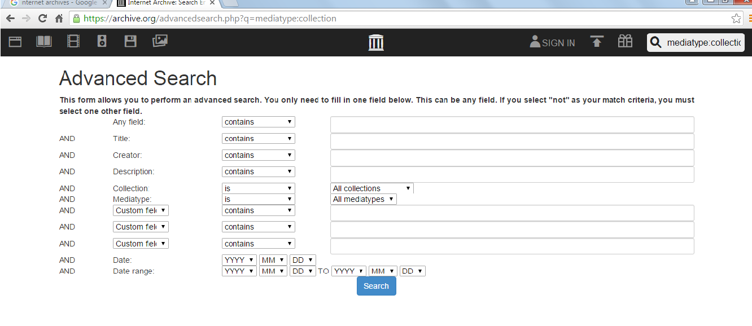
Search Options & Internet Archive
Internet Archive provides simple search like google search. Apart from simple search, it also provides advanced search option. Under advance search, a number of search field are provided for search accurate information e.g. any field search, title search, creator or author search, description, types or format of collection and customization of search. It also provide date search and range of date search for limiting the search

Slide 21
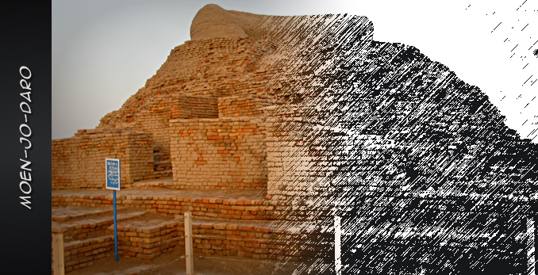
Conclusion
Preservation of intellectual heritage reflects on future generation.
Information and communication technologies have become very big players for preserving historical and current intellectual heritage around the world.
On the other side, library professionals have greater role to inform their end users about existence of such information resources useful for current and future research

