Slide 1
The ROLE OF FARMERS in supplying FOOD AND SOCIAL WELFARE (Case In Indonesia)
ISTININGSIH

Slide 2
INTRODUCTION
WHY FARMERS?
WHY FOOD?
Food is a mojor requirement of human being.
When Indonesian people can not produce enough food, how is the fate of the population?
The total amount of Indonesian population always increases every year.
Will Indonesia people always import food from other countries?
WHY SOCIAL WELFARE?
In this section will be discussed the relationship between farmers and social welfare.

Slide 3
Population increase in Indonesia
3 Millions/Year
2015 - 254,9 Millions
2035 – 305,6 Millions

Slide 4
Social welfare
Social welfare is the condition which is the fulfill of humans need such like material, spiritual, and social for proper life to do the social function.
In Indonesia, there are some groups of farmers.
There are very dinamic interaction among them.
Governmental and nongovernmental organizations can take benefit from farmer’s groups for various interests.

Slide 5
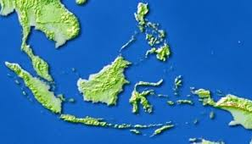
Indonesia
Indonesia region tataled 5.193.252 km2 , consist of 1.890.754 km2 mainland and 3.302.498 km2 sea. Based on natural potential, Indonesia is agricultural country.
The agriculture covers livestock, crops, fisheryies.

Slide 8
WETLAND

Slide 9
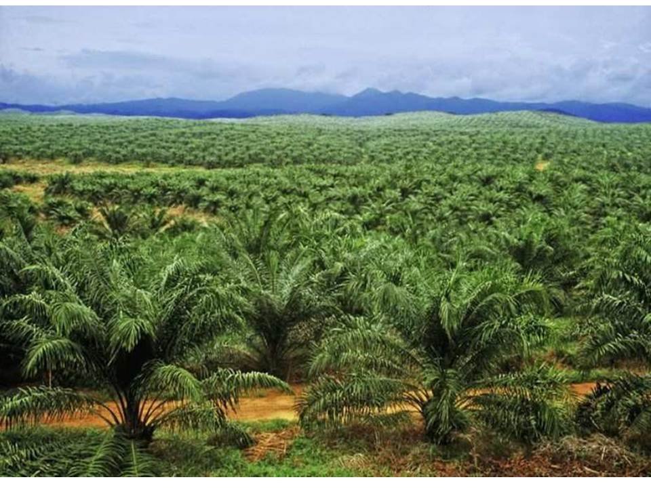
plantation

Slide 10
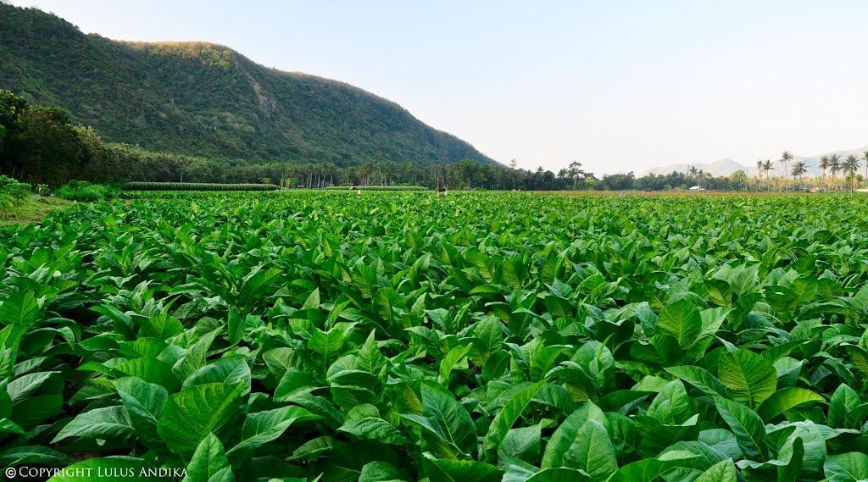
Field / ladang

Slide 11
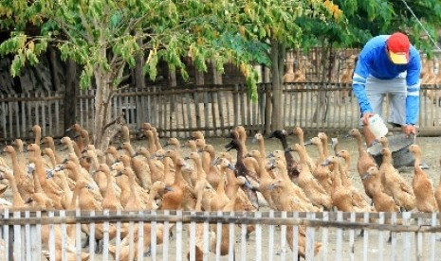
livestock

Slide 12
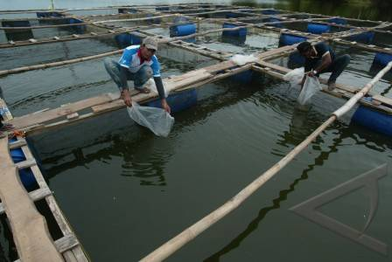
fishery

Slide 13
Agriculture in indonesia - crop
Producers of grain, no. 6 in the world
Rice, no. 3 after China and India
Coffee, no. 4
Chocolate, no 2
White pepper, no. 3
Rubber, nomor 4
Clove, 1
Palm oil, no 2

Slide 14
Import:
Rice, Sugar, Soy, wheat.
Corn, Beef, Milk powder.
Prosessed food, Cassava, and Peanuts.

Slide 17
KEGIATAN UPAYA KHUSUS (UPSUS) PERCEPATAN SWASEMBADA PADI, JAGUNG, DAN KEDELAI (rencana tahun 2015-2019)
Rehabilitasi Jaringan irigasi tersier
Percepatan Optimasi Lahan
Bantuan Benih
Bantuan Pupuk
Bantuan Alsintan
Pendampingan Penyuluh

Slide 18
PLAN AND POLICY OF MINISTRY OF AGRICULTURE IN INDONESIA 2015 - 2019
Kementerian Pertanian
18
www.pertanian.go.id

Slide 19
Realize economic independence by moving the strategic sectors of the domestic economy
Enhancement The Sovereignty of Food.
Food sovereignty is reflected on the power on independently regulate food problems. The concrete reflections are:
1. Enough Food supplies for Indonesian people which are produced by domestic farmers.
2. The Policy of food that is made by Ministry of Agriculture must not be interveted by other country.
3. The power of government in protecting the farmers.
4. The power of government in order to make prosperous to farmers
19

Slide 20
DUKUNGAN SINERGI LINTAS SEKTOR UNTUK PENCAPAIAN SWASEMBADA PADI,
JAGUNG & KEDELAI MELALUI PERBAIKAN JARINGAN IRIGASI
Revitalisasi jaringan irigasi primer dan sekunder
KEMEN. P U
Sinergi pemahaman program produksi (perluasan lahan, budidaya, pascapanen, dan konsumsi)
Akurasi data
BPS
Penyediaan benih unggul padi, jagung dan kedelai
PT SHS, PT PERTANI, PENANGKAR
KEMENTERIAN PERTANIAN
PUPUK INDONESIA HOLDING COMPANY (PIHC)
KEMEN PERINDUSTRIAN
Penyediaan pupuk
Revitalisasi penggilingan padi, penguatan industri pakan
Penyerapan produksi kedelai untuk tahu dan tempe
KOPTI
KEMENDAG
Penetapan harga dan kelancaran distribusi beras jagung dan kedelai
Pengaturan importasi sapi bakalan dan daging
BULOG
Penyediaan beras dalam negeri

Slide 21
SYNERGISTIC SUPPORTING FROM OTHER SECTORS FOR THE ACHIEVMENT OF FOOD SELF SUFFICIENCY OF RICE, CORN, SOY
Revitalization of irrigation
MINISTRY OF PUBLIC WORK
Understanding of the production program (expansion of land, cultivation, post-harvest, consumption)
Accuracy of datas
CENTRAL BEUREU OF STATISTICS
(bps)
Supplying seeds
LIMITED LIABILITY COMPANY: (pertani, penangkar)
MINISTRY OF AGRICULTURE
PUPUK INDONESIA HOLDING COMPANY (PIHC)
MINISTRY OF INDUSTRY
Fertilizer Supply
Revitalization of Rice Mill
Production Apsorbtion
KOPTI
MINISTRY OF TRADE
Price fixing
Regulation of import
BULOG
Rice Supply from Indonesia

Slide 22
The Goals of Food Sovereignty
The increase of food supply from Indonesian farmers:
Rice
Soy
Corn
Beef
Sugar
The increase of Distribution of food:
Controlling of food distribution
Developing of logistic system
The increase of food quality
Irrigation infrastucture is available:
Irrigation networking
Rehabilition for networking
New building of reservoir
22

Slide 23
Problem
Farming system is still traditional and conventional.
Farming technology has not been modern yet. It makes young people are not interested in farming
Agriculture is assumed as dirty, hot, rough, not pretentious.
Farmer: traditional mind set, high resistency to change into modern system.
Petani: Mind set tradisional, konvensional.
62% of farmers is above 55 years old, young farmers are only 12% (data January 2016)
In villages, most young people like working for companies, department stores, hotels, restaurant, offices.
The emplyess at farming sector is less and less . It causes the cost for farming production to increase.
Value added / Rate of Return iwill be lower. It means Indonesia farmers are still poor.

Slide 24
Most of parents do not want that their children will be farmers.
Alignment
The trend of government in protecting the products of farming is still weak.
Such as: Harvest is bought by traders. There is no price standar.
Most young people of Indonesian are not interested in Agriculture education , especilly in studying formal education.
There is only a few agriculture education for high school students.
The department of vocational schools such as automatic, hotels, IT, are more interesting.
Agriculture scientists are less and less.
There are only a few innovative agriculture scientist in Indonesia.

Slide 25
Agriculture sector is the last choice of young people in finding the job.
Farmers are not serious in doing their farming work. It is becaused their primary works are in other sector.
In this case, the result of farming job is not iptimal.
Government policy is not supporting: the price of fertilizer, sed, pestizide and so on.
Organic system of agriculture (that is environmentally friendly) is not fully implemented.
There is only a little of agriculture industrialization.

Slide 26
Recommendation
Giving appreciation to students who wants to study at agriculture departement
Government provides some more modern equipment to school laboratory
Government provides some more modern equipmnet to farmers
Subsidy is increased to farmers.
The budget of agriculture sector should be increased, such like Education Ministry is until 20% from total budget of Indonesian income.
Empowerement to farmers is increased through Agriculture extension.

Slide 27
The assistance to farmers is one of programs that is designed by ministry of agriculture.
The approach of the assistance is group model.
Group approach has some benefits.
The benefits are: means of communication among farmers, build togetherness, take and give, help each other, etc.
The groups of farmer are function as conflict resolution.

Slide 28
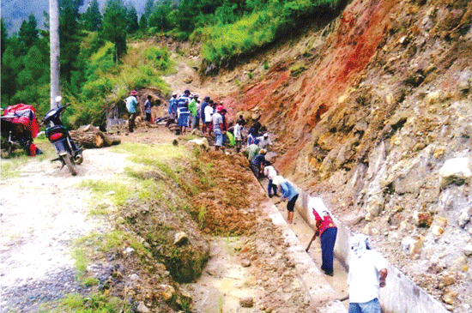
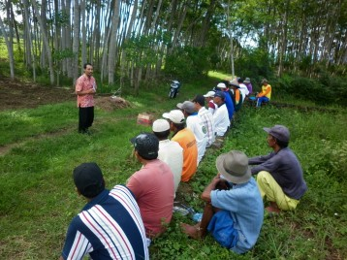
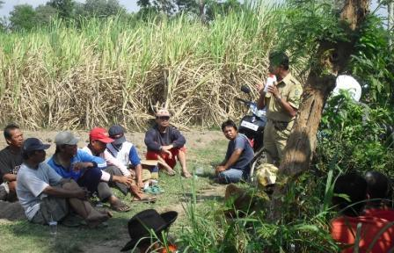
Problem solving
MUTUAL COOPERATION
Asssitance from Agriculture Extension Worker

Slide 29
Steps of Conflict Resolution
Informal conflict resolution that is done by others
Conflict resolution that is done by one who has authority
Informal problem solving that is done by themselves
Conflict resolution that is done by law regulation
To avoid the conflicts
Negotiation
Compulsion
There is a little bit of compulsion

Slide 30
Thank you

