Slide 1
MORAL REVOLUTION AS A STRATEGY TO DEVELOP A SOCIETY’S LIFE TOWARDS A HEALTHY MORAL QUALITY
ISTININGSIH
STATE ISLAMIC UNIVERSITY ‘SUNAN KALIJAGA’ YOGYAKARTA
NOVEMBER 2016

Slide 2
INTRODUCTION
Why Moral Revolution? It is a question proposed here. Why not mental revolution, like what Indonesia president Djoko Widodo’s program. It must be differed between mental and moral.
The purposes of mental revolution is an heart. The riil problem of Indonesian nation is not heart or feeling. If the treatment is feeling or heart, so the final aim is spiritual defend. If it is happen, so the action that is hold is more stationer. So to build the mental of the Indonesian nation is not the right time for now. The purposes of moral revolution is a behavior.
Nowdays, the riil problem of the Indonesian nation is behavior, such like corruption, narcotics, conflict, cruel each others, and so on. It is happen on the nations who are willing about it. The right time now, the most important of the program is find out the strategic for solving the problem. The program is called “The Moral Revolution”.
Indonesia is a multicultural country with various society. The quality of the society is very various, the quality of human resources, character quality, and moral quality. The results of international survey done by mental revolution team showed that in good thing, score of Indonesia has low trend, but in bad thing, the score trend is high. Example, data Tranparency International showed “perception about corruption in public sector of 177 countries, Indonesia in 114 rank.

Slide 3
Based on the data above, a lot of corruptor as a figure whom able to be examples on attitude, character and behavior by society. But there are only a figure as an example who gives bad example for society. Society feel unconvinient to see the bad phenomenon such like quarreled, don’t want to queue, don’t resepect each other. This is the indication moral Indonesian society must be revolusionized. Moral revolution is as a strategy to develop Indonesian society’s life in order to be humane who has healthy moral quality.
Focus Group Discussion happens in Jakarta, Aceh, and Papua were done by Team of working “Mental Revolution” transisition house showed about the public unrest of character. The FGD involved 300 humanist, artists, women, youth, businessman, birokrat, religious leaders, academis staff, and so on. The conclusion is, it is needed mental and moral revolution, because (1) there is character crisis; (2) govermental crisis: there is government but not riil; and (3) crisis of social relation: intolerancy.
Society unrest must be answered and be solved before far running. If since independence day, we are busy with physical building, so it is right time to develop the mental and moral. The development of mental and moral will be done with togetherness movement, colaboration between society and private that is suppoted by government. The movement is startednow from ourselves, do together for improving Indonesia.

Slide 4
MENTAL AND MORAL
Mental is the way and the ability to think, therefore, questioned the mental involve ourselves in the ability to think.
Morale is a value that is owned by a person to consider the person in choosing and doing good / bad, honest / dishonest, etc.
So the moral revolution is more dynamic than the mental revolution.

Slide 5
In Indonesia since the government of President Jokowi peal movement or moral revolution.
Funds are needed by the Indonesian state to implement a very large mental revolution (Trillions).
But whether it was necessary for Indonesia?
Problems that occur in Indonesia is a moral problem that is increasing, such as corruption, conflict, rape, murder, etc.

Slide 6
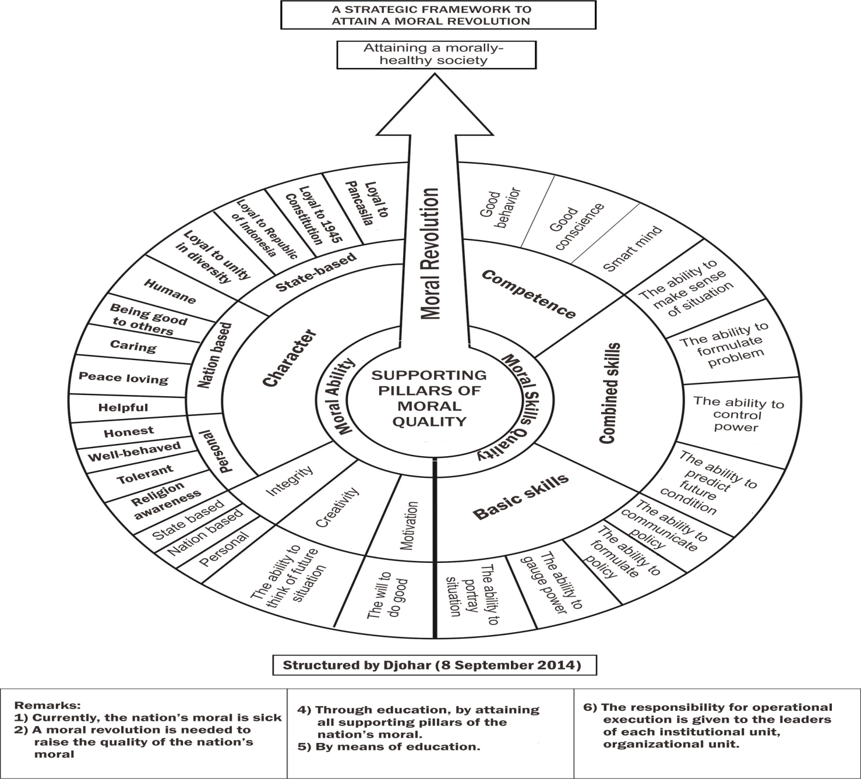

Slide 7
PILLARS OF MORAL
Based on slide 6 above, it can be described that:
There are two main pillars of moral revolution:
Moral Ability
Moral Skill Quality

Slide 8
MORAL ABILITY
There are 4 sub pillars
Motivation
The will to do good
Creativity
The ability to think of future situation
Integrity
Personal
State based
Nation based
Character
Peronal: Religious, well behave, tolerant, honest.
Nation based: helpful, peace loving, caring, being good to others, humane.
State based: loyal to unity in diversity, Republic of Indonesia, 1745 constitution, Pancasila.

Slide 9
MORAL SKILL QUALITY
There are 3 sub pillars
Basic Skill: the ability to portrait situation, gauge power, formulate policy, communicate policy.
Integrated Skill: predict future situation, control power, formulate problem, make sense of situation.
Competence: good behavior, good conscience, smart mind.

Slide 10
STRATEGY AND MECHANISM
Moral revolution can be achieved by formal, non formal, informal education.
Monitoring the success of the program carried out by the government. Therefore, the monitoring model of program ‘Moral Revolution' could follow the model of the structure of government.
From its structure that will define the smallest namely Neighborhood, Community, Hamlet, Village, Sub-District, District, Province.
This moral revolution is the form of a national movement involving all citizens of the nation.

Slide 11
INDICATORS OF A HEALTHY MORAL QUALITY
Objectives to be achieved is the realization of
A SOCIETY’S LIFE TOWARDS A HEALTHY MORAL QUALITY.
There is no corruption, conflict, robbery, theft, rape.
The split unitary state of Indonesia
Peace
Cooperate
friendly
Tolerance
Mutual help

Slide 12
THANK YOU

Slide 13
ADDITIONAL
The Model was found by Theoritical Research
Pillars of Moral Revolution were found from literature / references.
Validating by experts: Educational expert, Sociology Expert, Pakar Kewarganegaraan, Pakar Psikologi.

