Slide 1
ACTUALIZATION OF
LEARNING PROCESS
ON COVID PANDEMIC
(School in Yogyakarta-Indonesia)
ISTININGSIH
STATE ISLAMIC UNIVERSITY “SUNAN KALIJAGA”

Slide 3
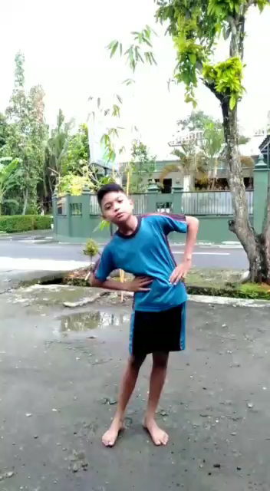

Slide 4
1. Under the COVID-19 pandemic, what is happening with school education in your city or community? (e.g. all schools are closed, and students are learning at home, through online lectures, or doing homework given to them via email or SNS, or no school work at all, or…etc.)
Interview with Vocational Teacher (senior high school-17-19 years)
Schools are closed,; Instruction from Education Authority Yogyakarta Province
Students are laearning from home. Schools arrange New schedule (pandemic Covid19 Schedule)
Teachers follow the school regulation, a day there are 2-3 subject matters
Students star to join the learning process at 07.00 – 11.30 a.m, used end at 4.30 p.m (if off line)
Teachers give tasks to students until do assessment/evaluation
There are difficulties for practice subject.
  Limit time - It makes the students do practice carelessly, improvise
  Monitoring the process – It needs good network of internet and more quota (Rp50.000/week)
Product of students’ work are collected by email, Instagram, photos

Slide 5
....next
All teachers at vocational schools have a relative good skill in IT
Another difficulty: parents cannot facilitate the equipment fully needs of their children
For example: saws, bricks and soon
Examination: for cognitive only, skill is difficult using on line

Slide 6
General High School
Learning process use Whatsapp, Zoom, Webex
Students do their task in groups, hopes teacher get ease in doing correction of students’ work
Difficulties: networks are unstable, the quota is up

Slide 7
Elementary School
(7 – 15 years)
Observasi di rumah siswa Sekolah Dasar
TV Education
Fully use Whatsapp
Parents accompany fully their children

Slide 8
2. How is this alternative mode of education and learning going for students, teachers and their families? What are some of the difficulties and challenges that you observe in their experiences? What are some of the positive sides to it that you observe?
Parents fully accompany students in learning process
Since 2016 Vocational school ask students use lap top; however genaral high school, elementary school is different
Most of students at high school have smart phone, so it is not difficult for them to do learning process on line
However for elementary school and junior high school is different; school never instruct them to use it, so Whatsapps as an alternative.
At elementary school. Parents have a huge role in learning process at home. They carry on teacher’s task to children
It has a very good impact because the interaction between schools and parents is increased
On the other side , the task of the parents is increased. Not only carry on the message from the teachers but also accompany their children in learning
The challenge of teacher: as fasilitator, motivator
Positive aspects: Students are more independent; Responsible to do snd finish their task
Educating children is a shared task between schools, parents and the community

Slide 9
3. All of us are keenly aware now that crises can come to us anytime, and that what worked yesterday does not always work tomorrow. With this awareness, what are some of the roles that education should play in the future for the sustainable development of humanity? What are some of the features that you expect from future education? What will be the role of teachers in that future education?
The role of on line is increasing
The teacher’s physical presence is reduced
The teacher is no longer the person who provides the subject matter, the material can be sought by students, therefore the teacher's role tends to be greater in terms of as facilitator, motivator.
Motto in Indonesia (Jawa) – Teacher as an example – as a question mark nowdays., in on line era.
A great question is – How to build attitude, character of students
Schools no longer play a single role in this matter
The main role in building the character of students is the community and home / family

Slide 10
FUTURE EDUCATION
Education that is able to build students who have the ability to anticipate changes that are fast, creative, innovative, and flexible
Indicators of all the components that need to be found, broken down
Then a solution about "learning strategy" which is oriented to the abilities above isshould be sought.

Slide 11
4. Towards the future of education and teachers that you envision above, how would you change your own teacher education practices?
The teachers are prepared to:
Mastering the most up-to-date IT
Having the ability: anticipatory, creative, innovative, flexible in thinking and acting
Able to motivate students
Able to prepare and do on line learning process
The government empowers parents to accompany their children's learning
Teachers and parents accompany their children
Teachers 'abilities must be more comprehensive: material skills according to subjects, communication with up-to-date IT, interacting with students' parents

Slide 12
THANK YOU

