Slide 1
Layanan perpustakaan university of south australia (UniSA)
Fuad arif fudiyartanto

Slide 2
Di mana UniSA?
Adelaide, South Australia

Slide 3
Adelaide
State: South Australia
Capital city: Adelaide
Premier: Steven Marshall (2018-current)
Liberal party

Slide 4
Demografi sa
Jumlah penduduk:
> 1.7 juta jiwa (sekitar 7.14% penduduk Australia).
> 1.2 juta jiwa tinggal di kota Adelaide.
49.3% laki-laki, 50.7% perempuan.
Luas wilayah: 983,482 km²
12.7% dari seluruh Australia.
Panjang batas wilayah SA: 3,185 km.
http://www.population.net.au/population-of-south-australia/

Slide 5
Universitas negeri (public)
Nama Uni | Tahun berdiri | Jumlah mahasiswa (2018)
Flinders University | 1966 (anggota IRU) | 25.802 (20rb-D, 5rb-I)
The University of Adelaide | 1874 (anggota Go8) | 26.954 (19rb-D, 7rb-I)
University of South Australia | 1991 (anggota ATN) | 32.955 (27rb-D, 5rb-I)
https://docs.education.gov.au/system/files/doc/other/2018_section_2_-_all_students.pdf

Slide 6
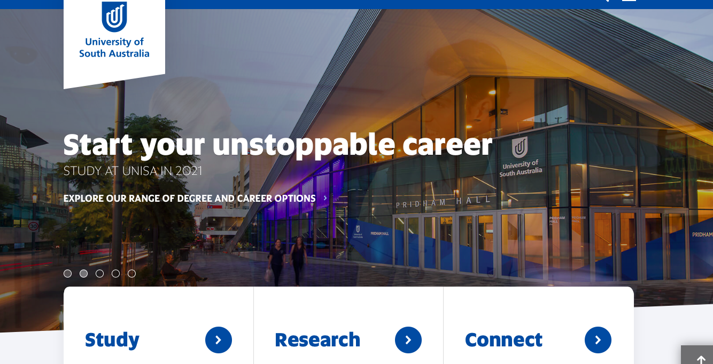
University of south australia
https://www.unisa.edu.au

Slide 7
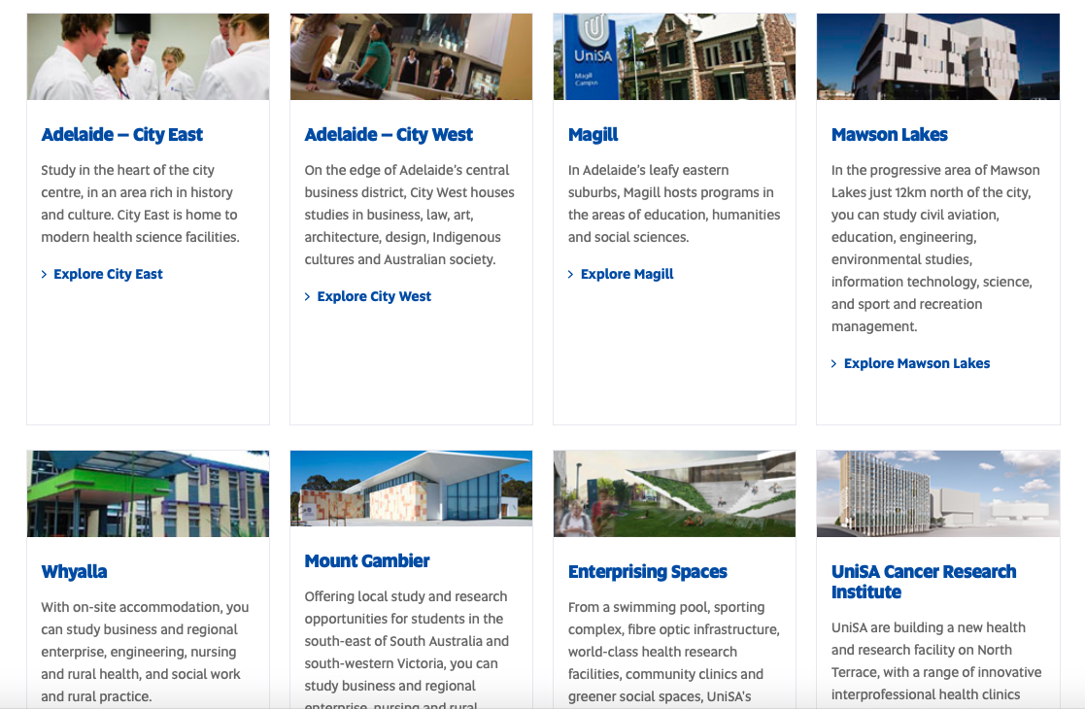
Kampus
Metropolitan:
City west
City east
Magill
Mawson Lakes
Regional:
Whyalla
Mt Gambier

Slide 8
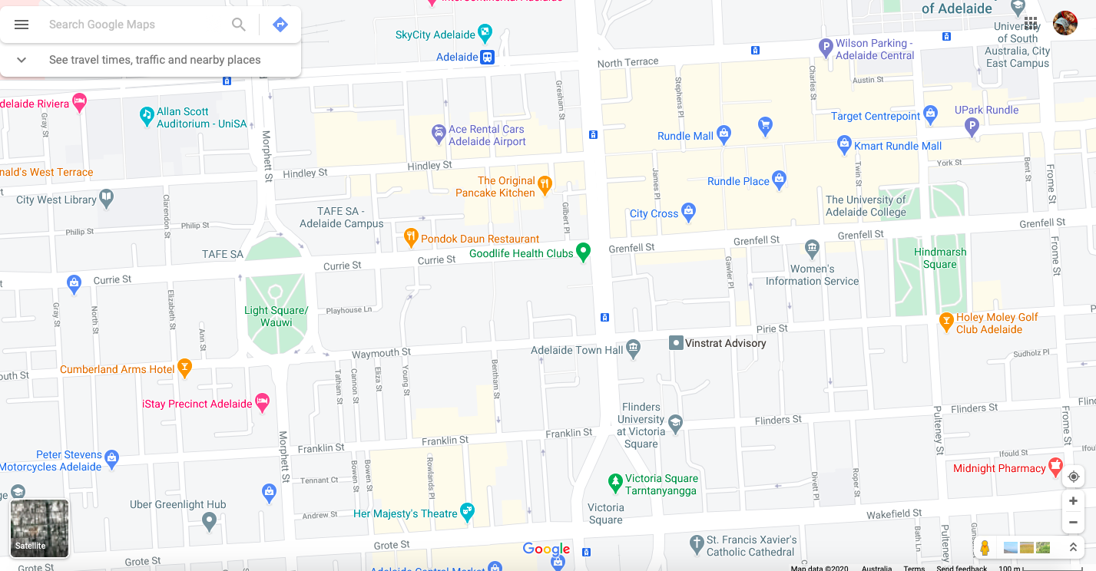

Slide 9
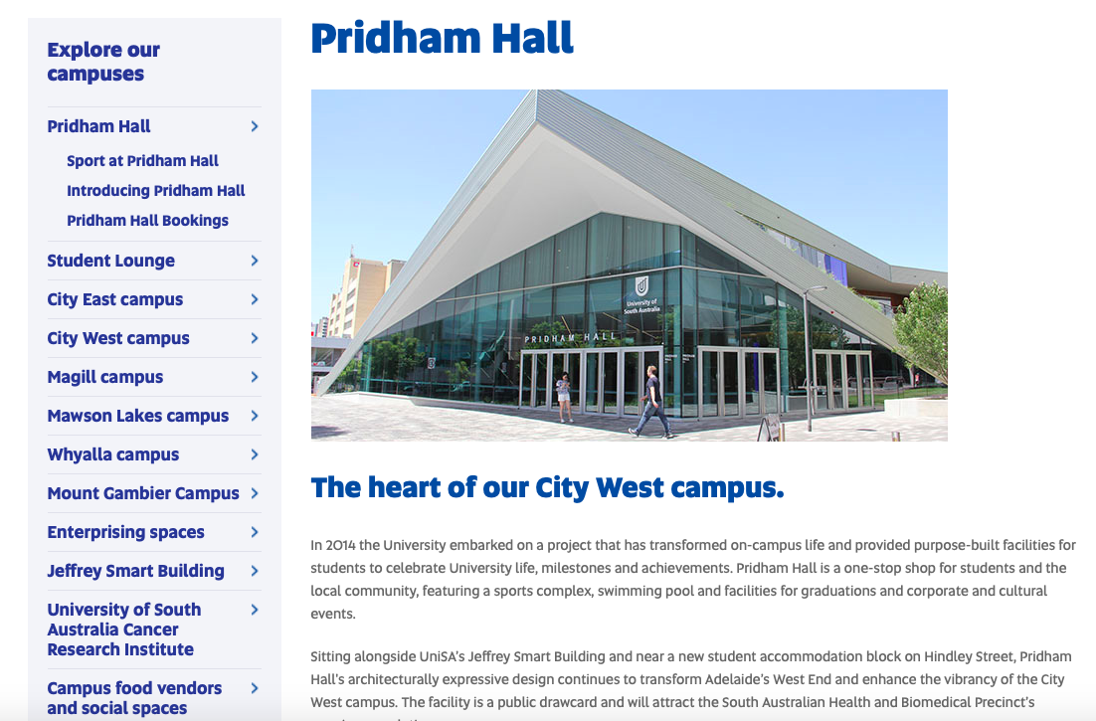
City west

Slide 10
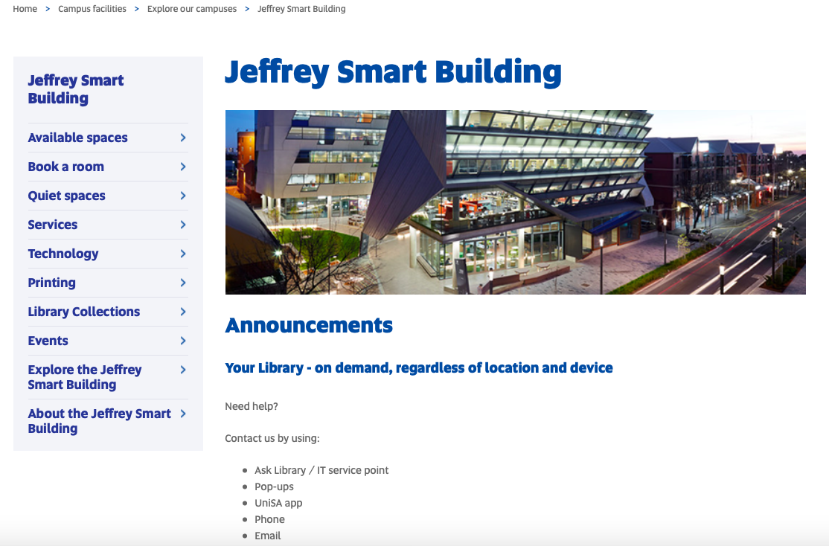
Perpustakaan
Pusat di city west
Jeffrey Smart Building
Setiap kampus juga ada
(lebih kecil)

Slide 11
Video tur
https://www.youtube.com/watch?time_continue=4&v=shRncVrLrnE&feature=emb_logo

Slide 13
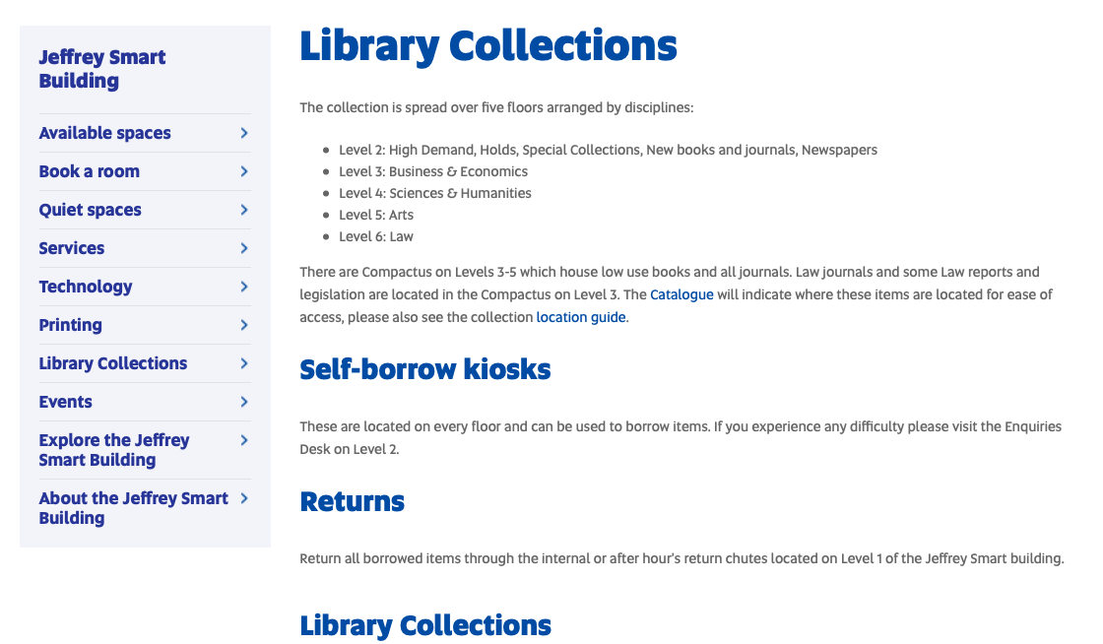

Slide 15
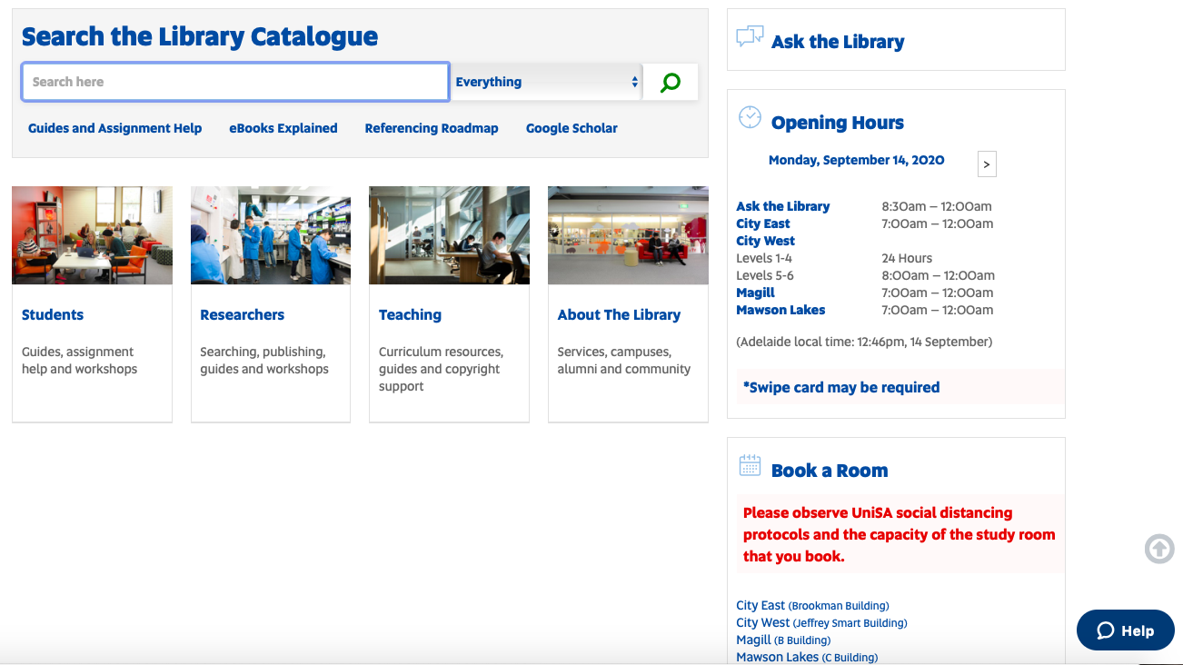
https://www.library.unisa.edu.au

Slide 16
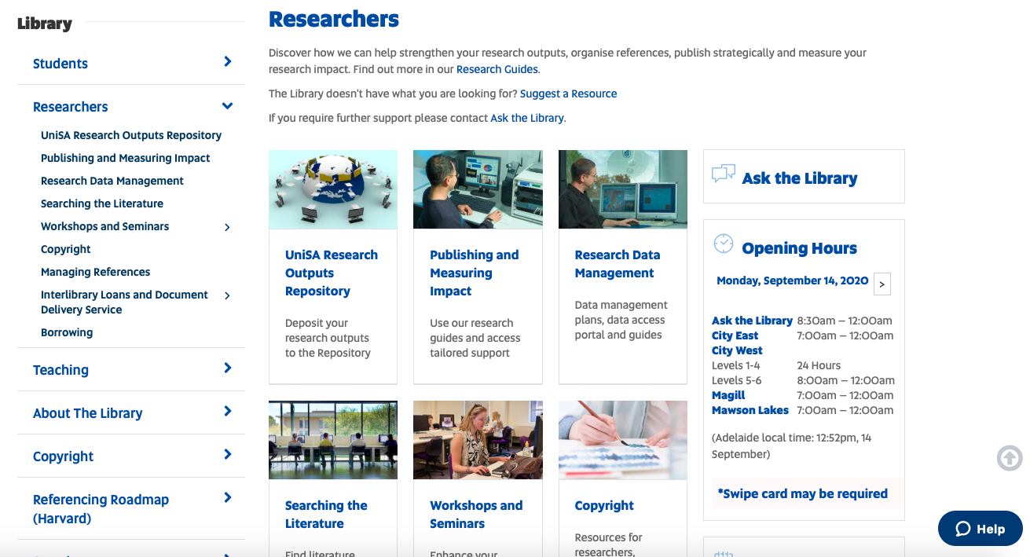

Slide 17
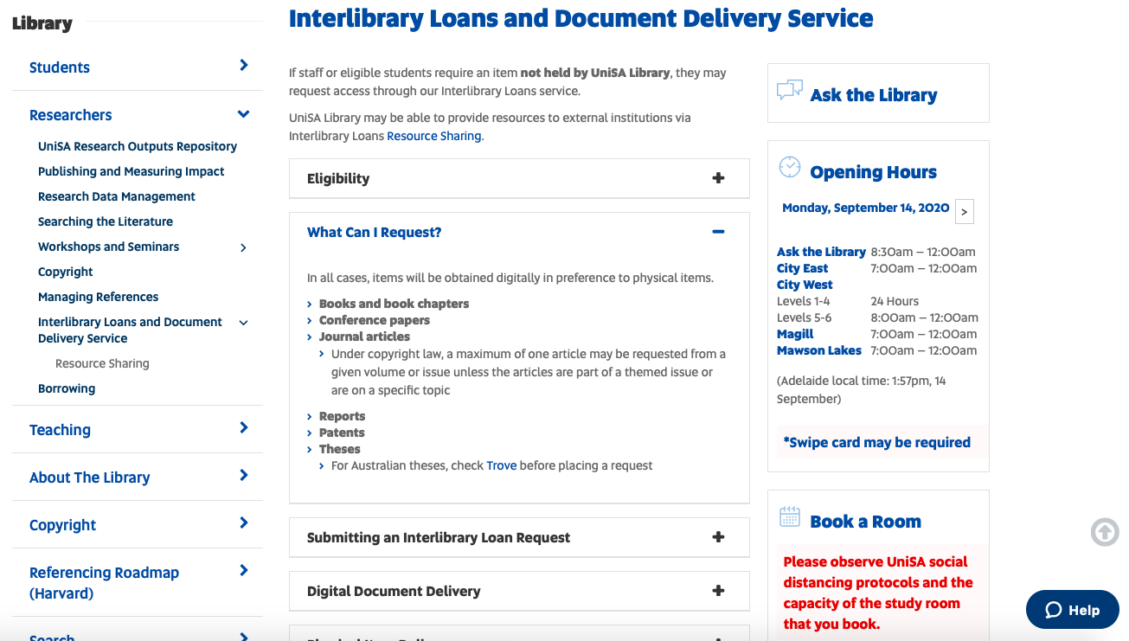

Slide 19
Ilustrasi di Unisa library
https://www.library.unisa.edu.au/researchers/

