Slide 1
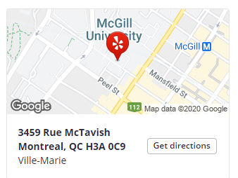
WISATA ke PERPUSTAKAAN McGILL UNIVERSITY
Muhammad Izzul haq
Dosen Prodi Ilmu Kesejahteraan Sosial Fakultas Dakwah & Komunikasi UIN Sunan Kalijaga Yogyakarta/
Awardee Beasiswa 5000 Doktor LN Kementerian Agama/
Ph.D Candidate School of Social Work McGill University Canada

Slide 2
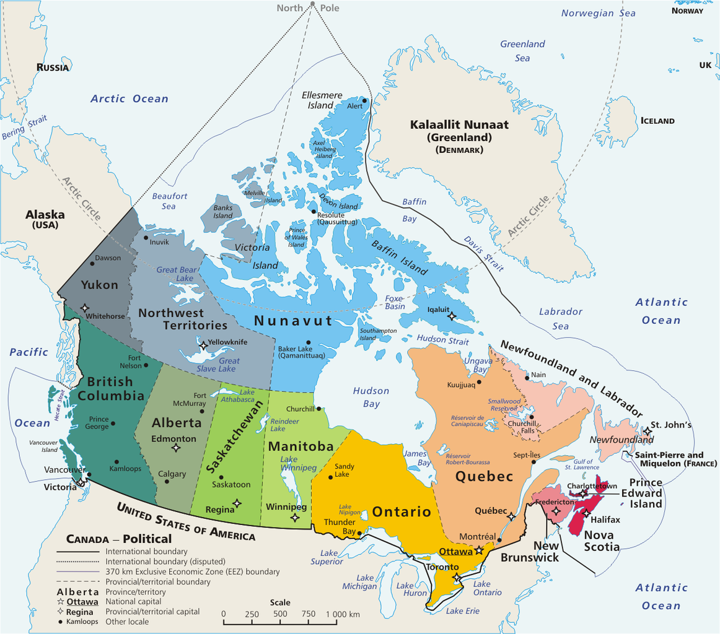
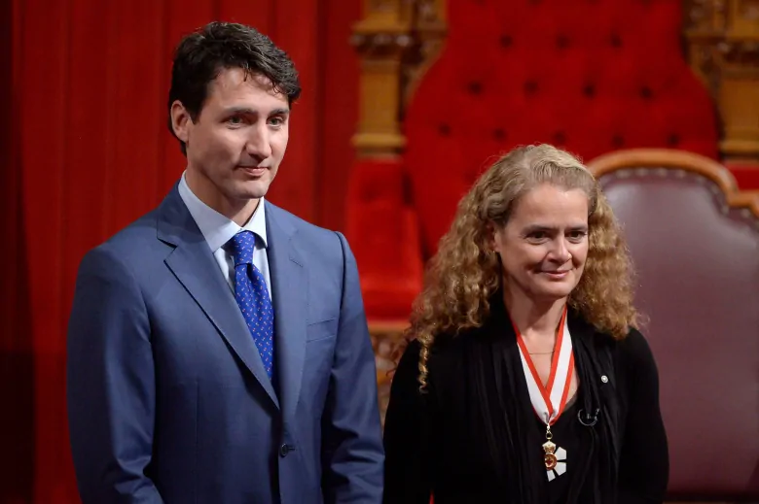
SEKILAS
KANADA

Slide 3
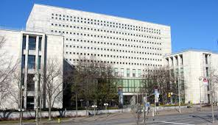
MENENGOK PERPUSTAKAAN DI KANADA
library and archives canada

Slide 4
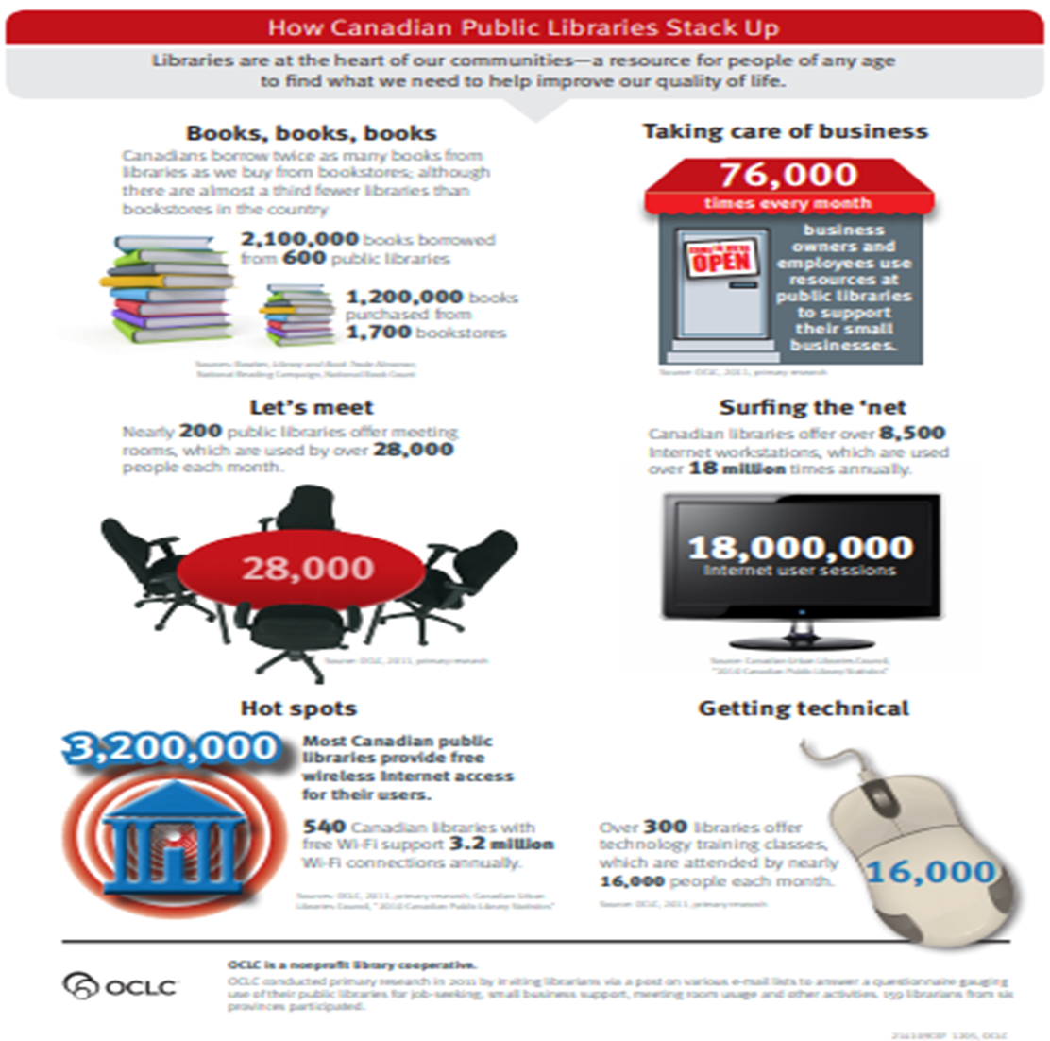

Slide 5
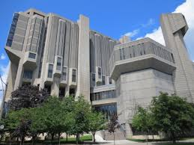
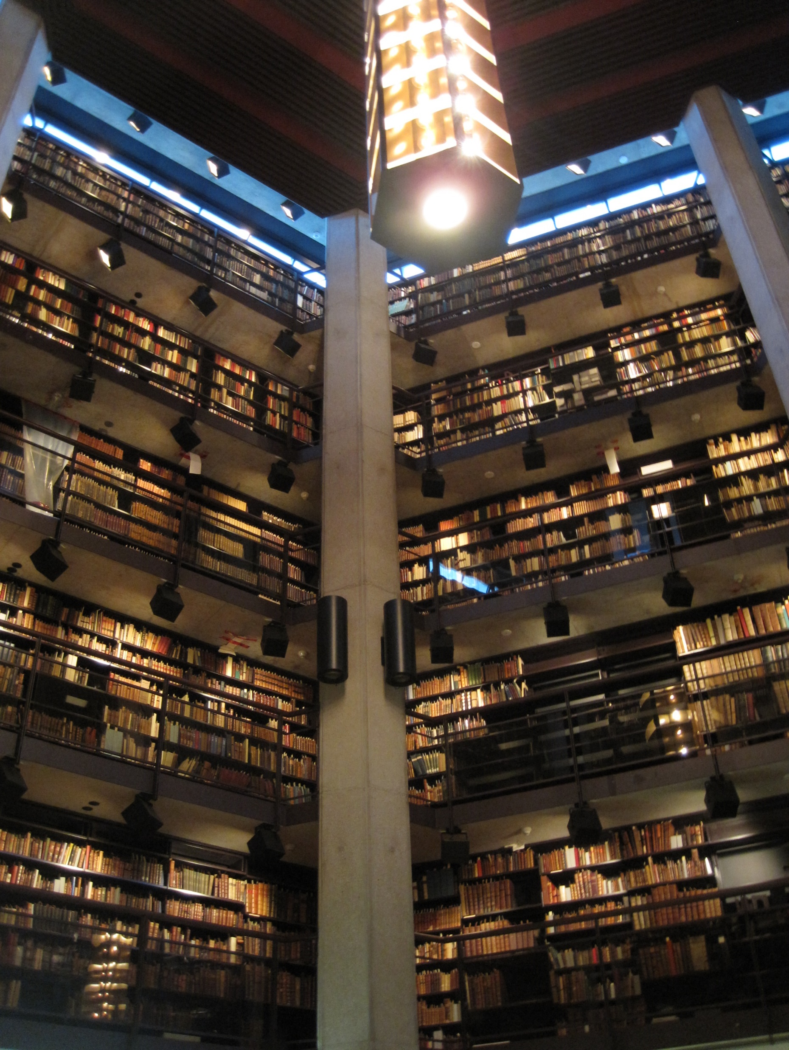
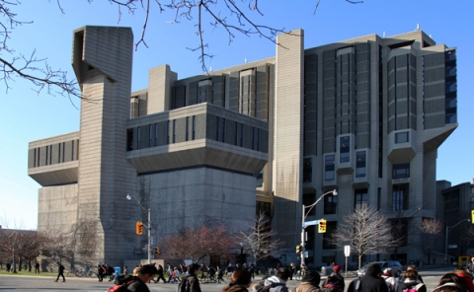
John Robarts Library - University of Toronto Libraries

Slide 6
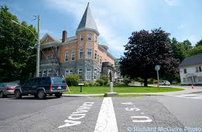
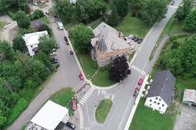
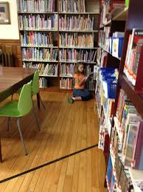
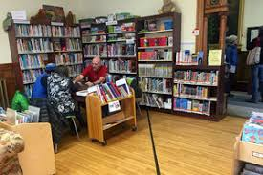
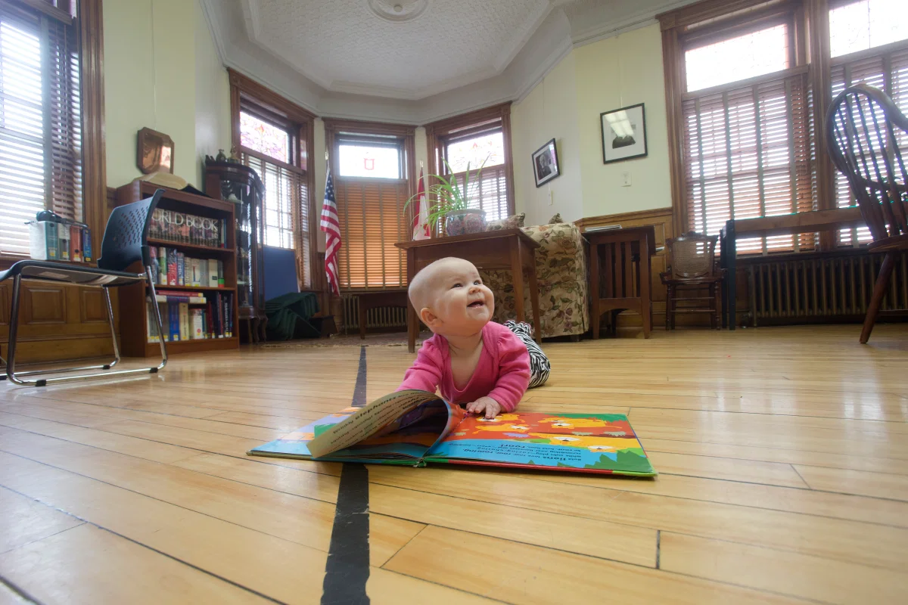
Haskell Public Library Quebec, Canada – Vermont, US

Slide 7
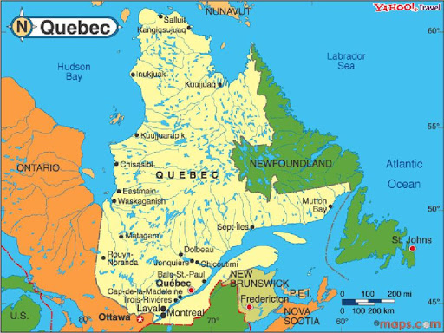
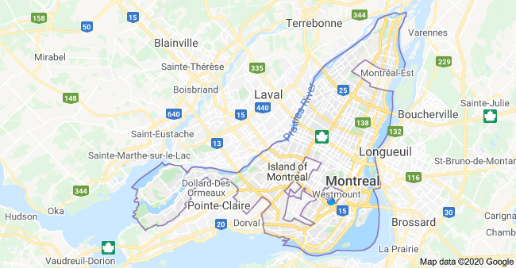
MONTREAL

Slide 8
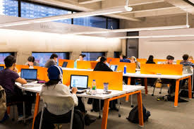
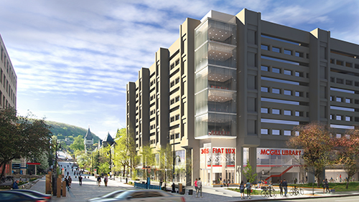
PERPUSTAKAAN McGILL UNIVERSITY MONTREAL

Slide 9
MASUK KE DALAM PERPUSTAKAAN McGILL UNIVERSITY
MacLennan
Koleksi Buku

Slide 10
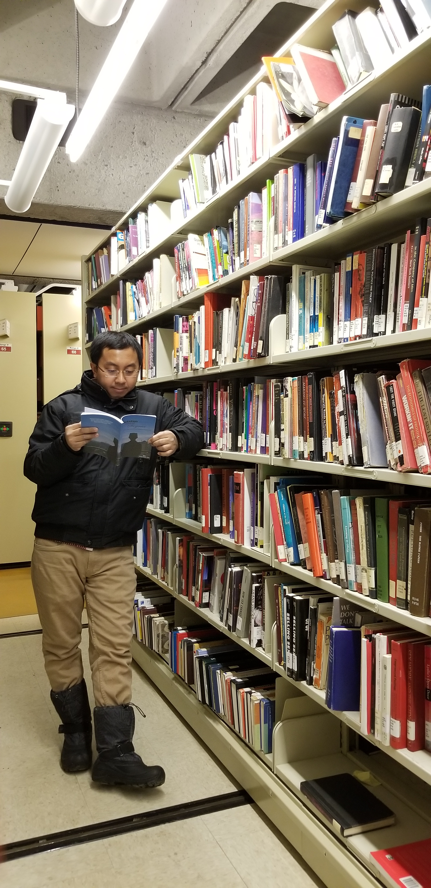

Slide 11
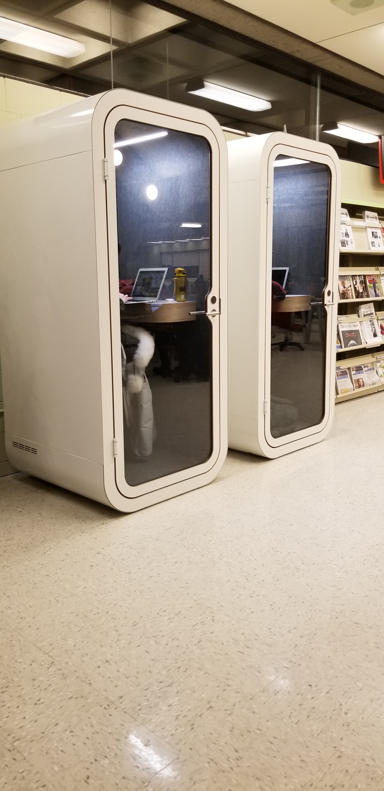

Slide 12
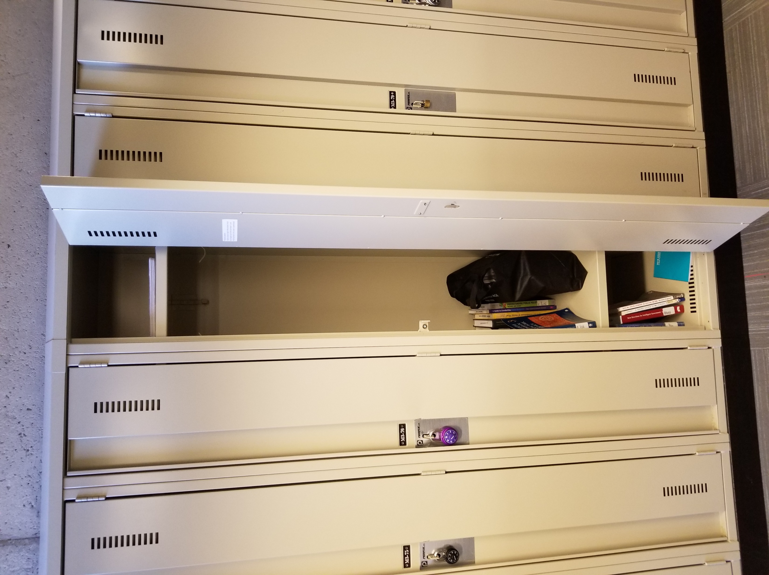
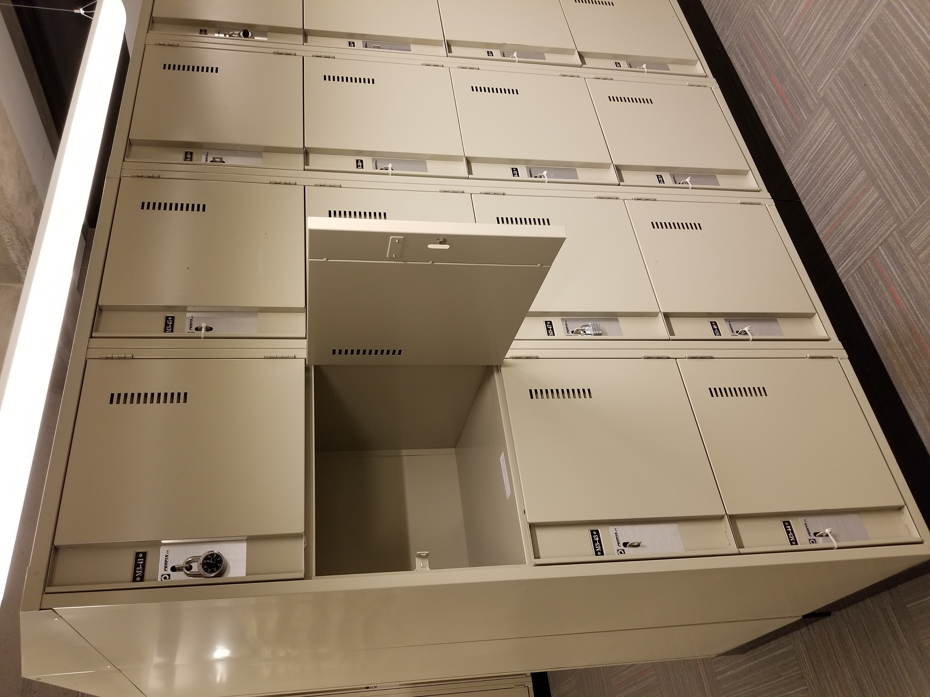

Slide 13
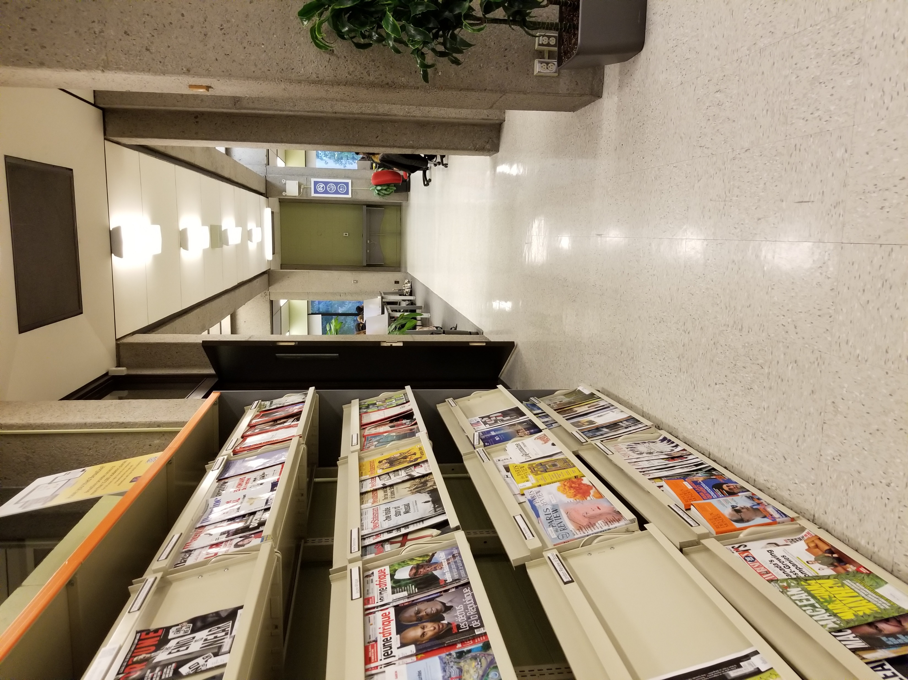

Slide 16
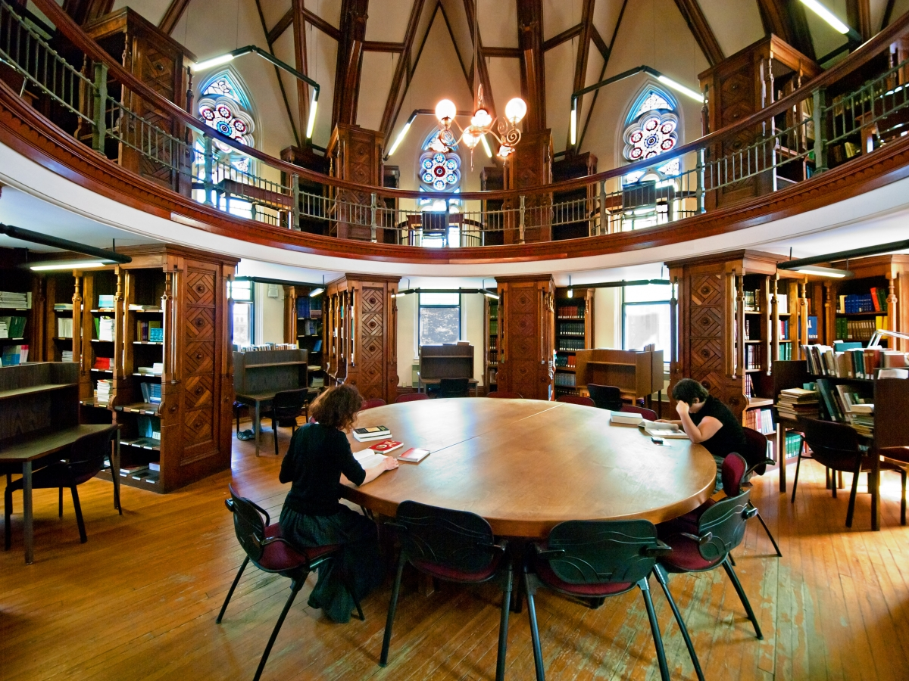
ISLAMIC STUDIES

Slide 17
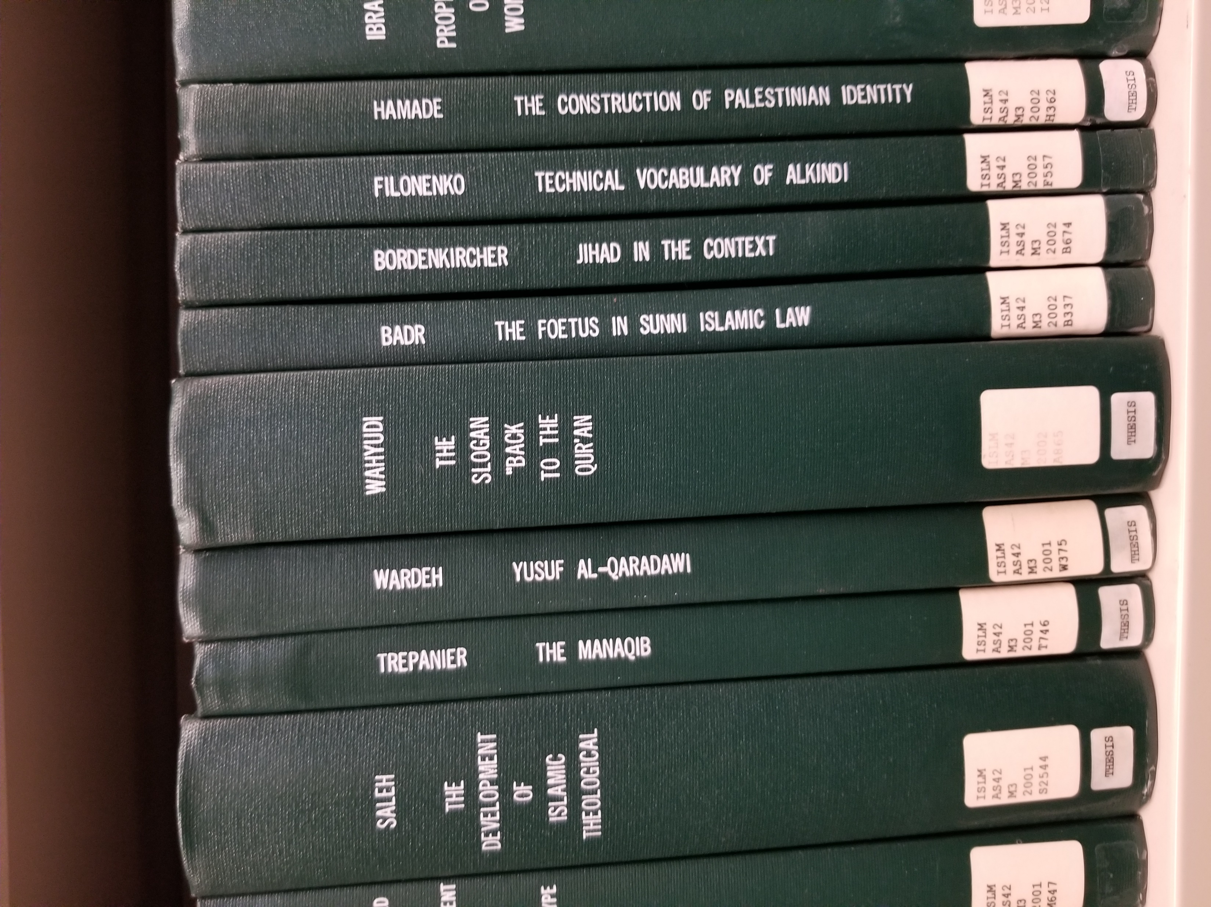

Slide 18
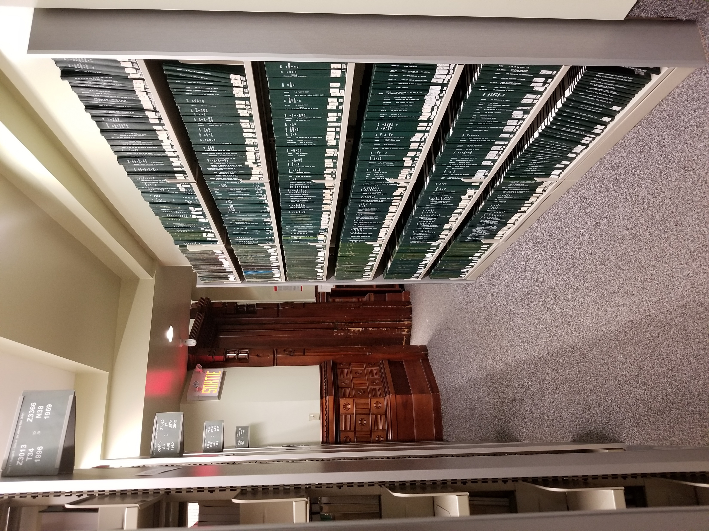

Slide 19
LAYANAN WORKSHOP
https://www.mcgill.ca/library/services/workshops

Slide 20
LAYANAN AKADEMIK
Course Reserve
Liaison Librarian

Slide 21
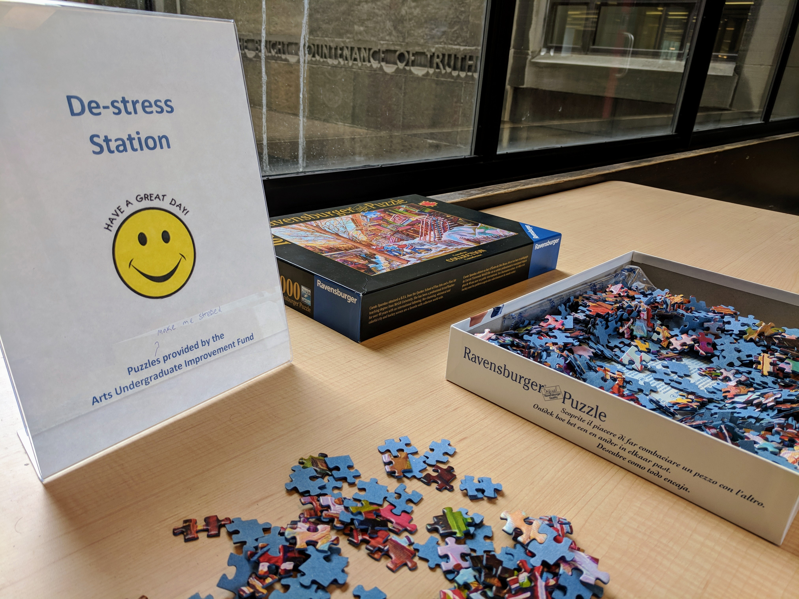
LAYANAN DE-STRESS

Slide 22
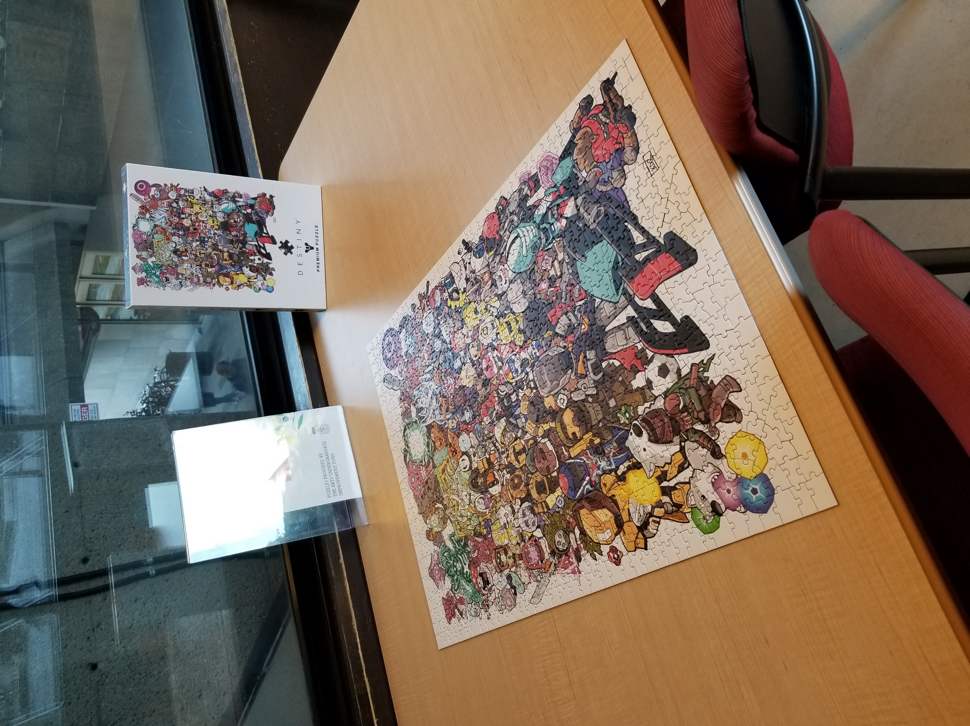

Slide 23
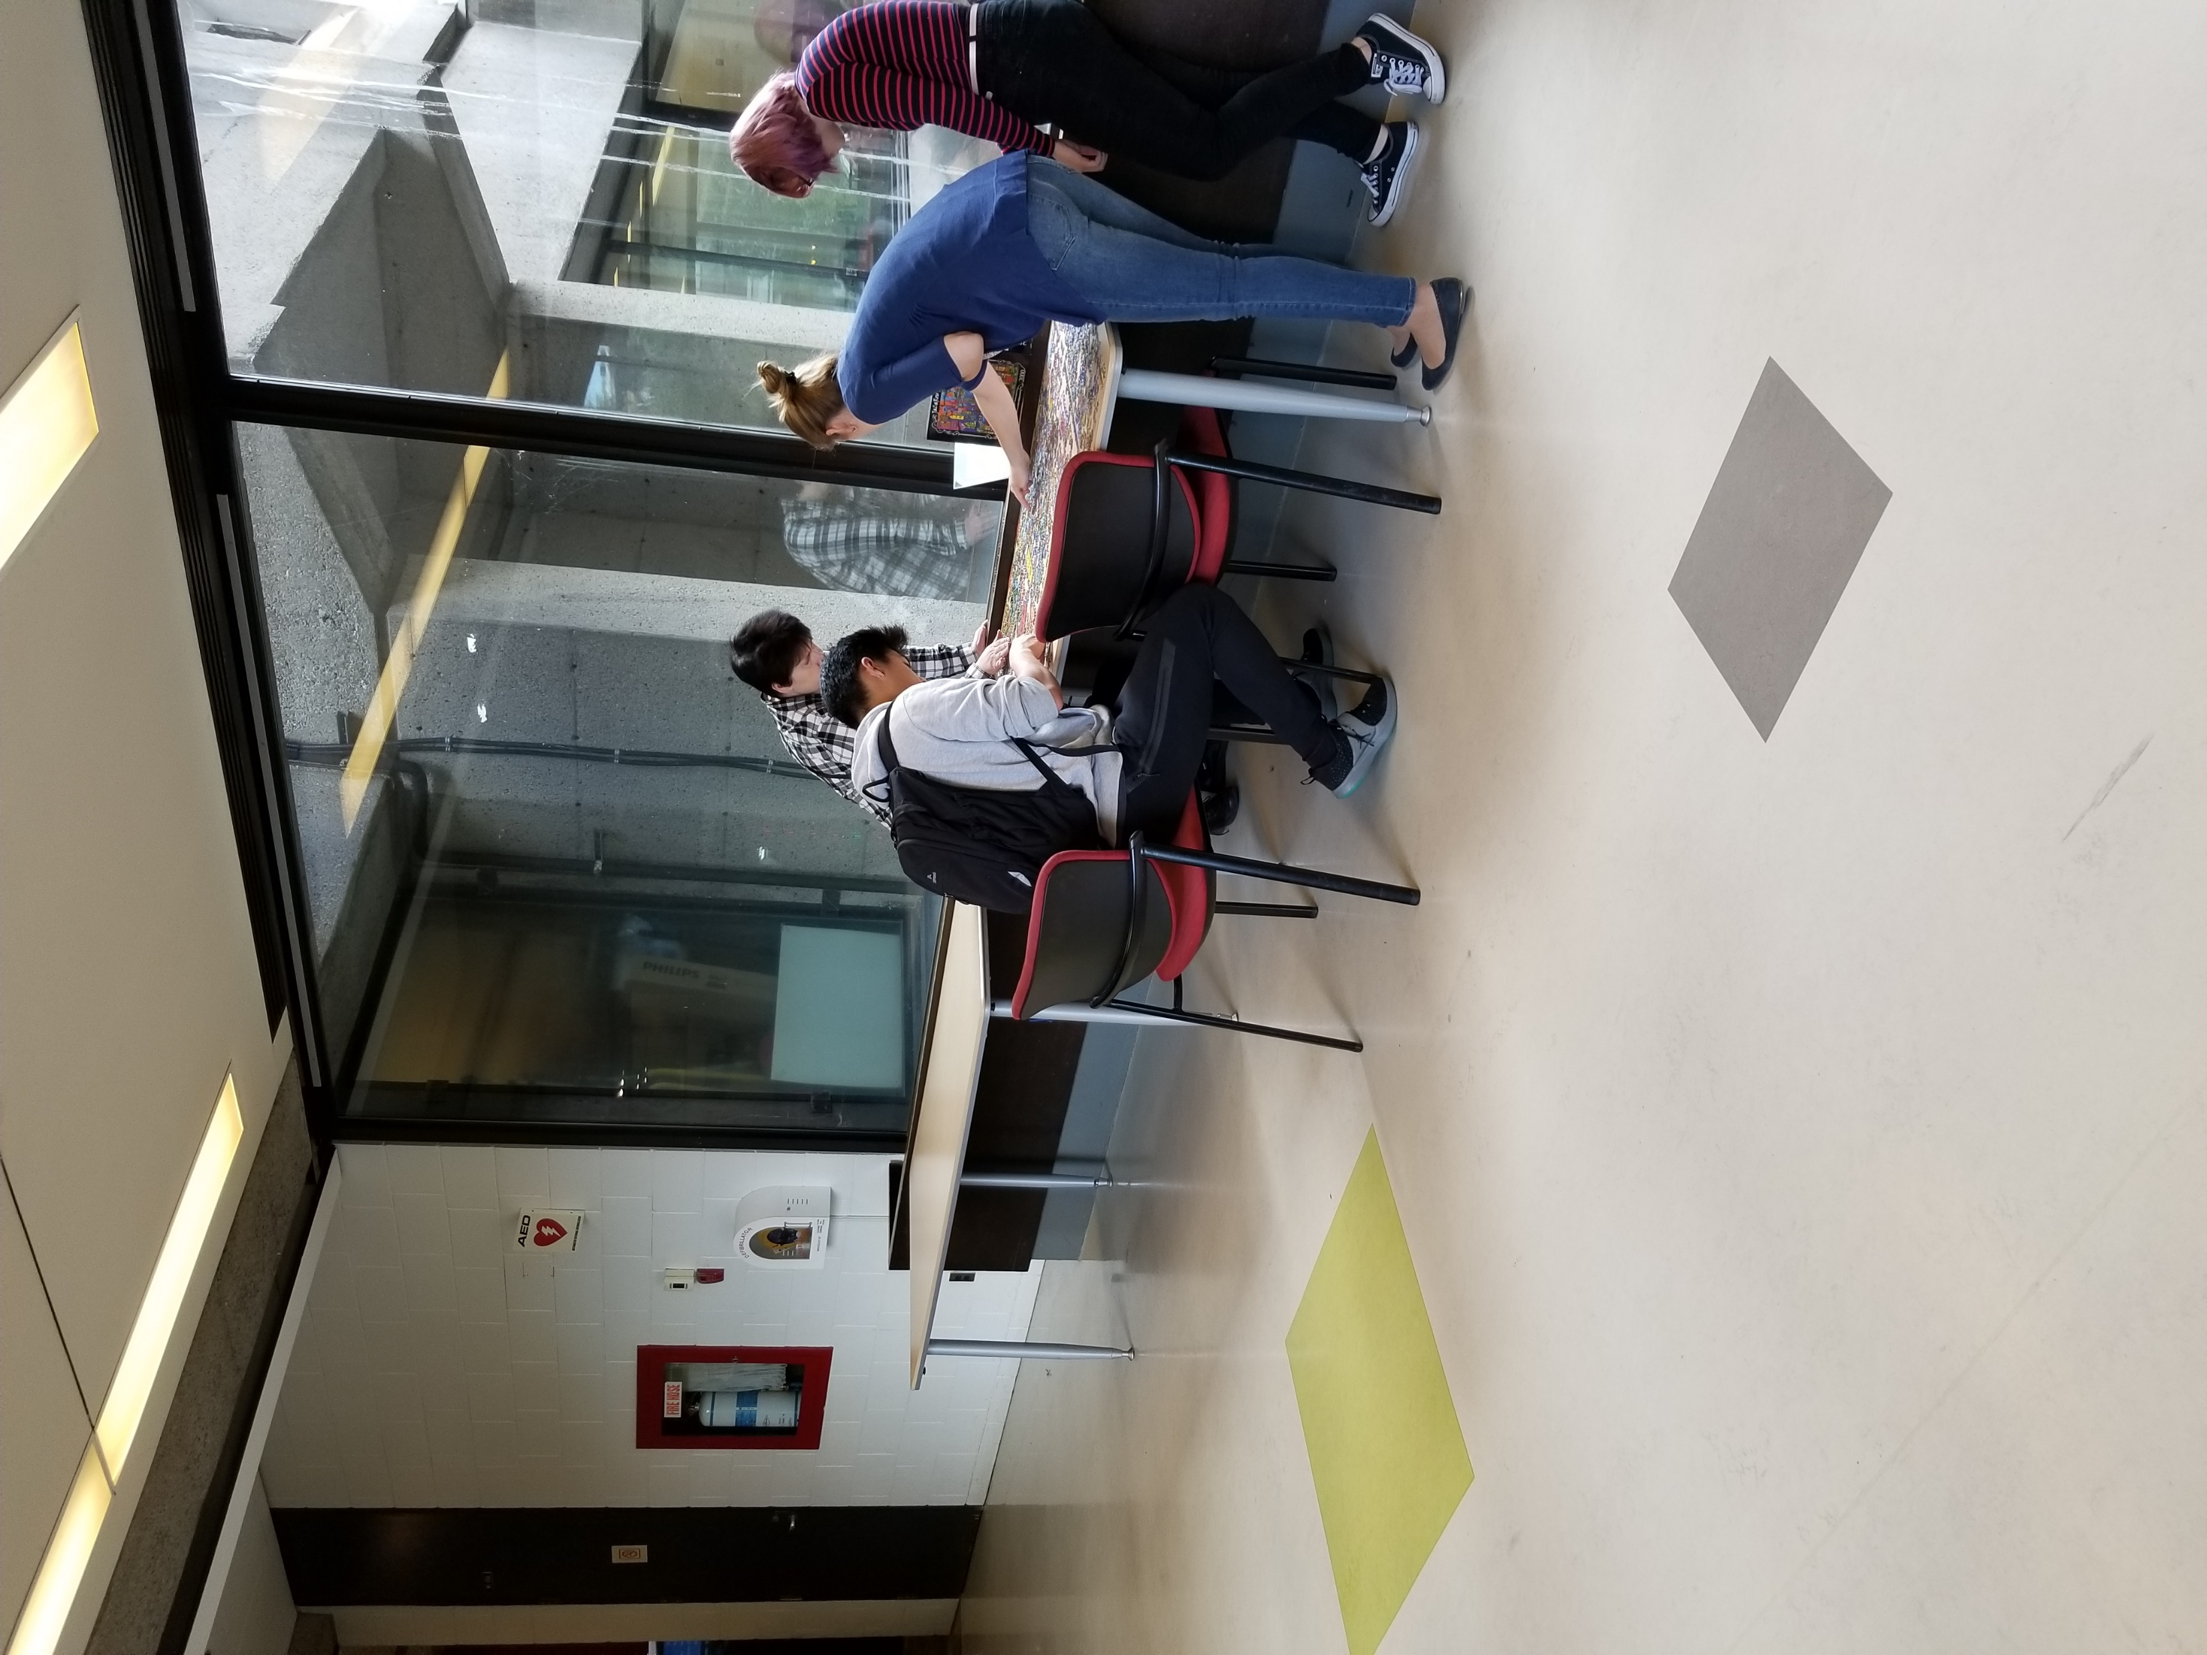
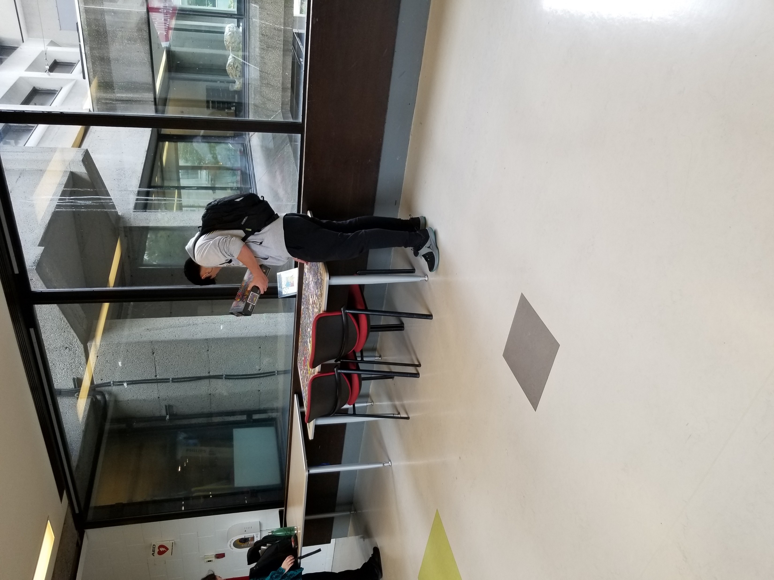
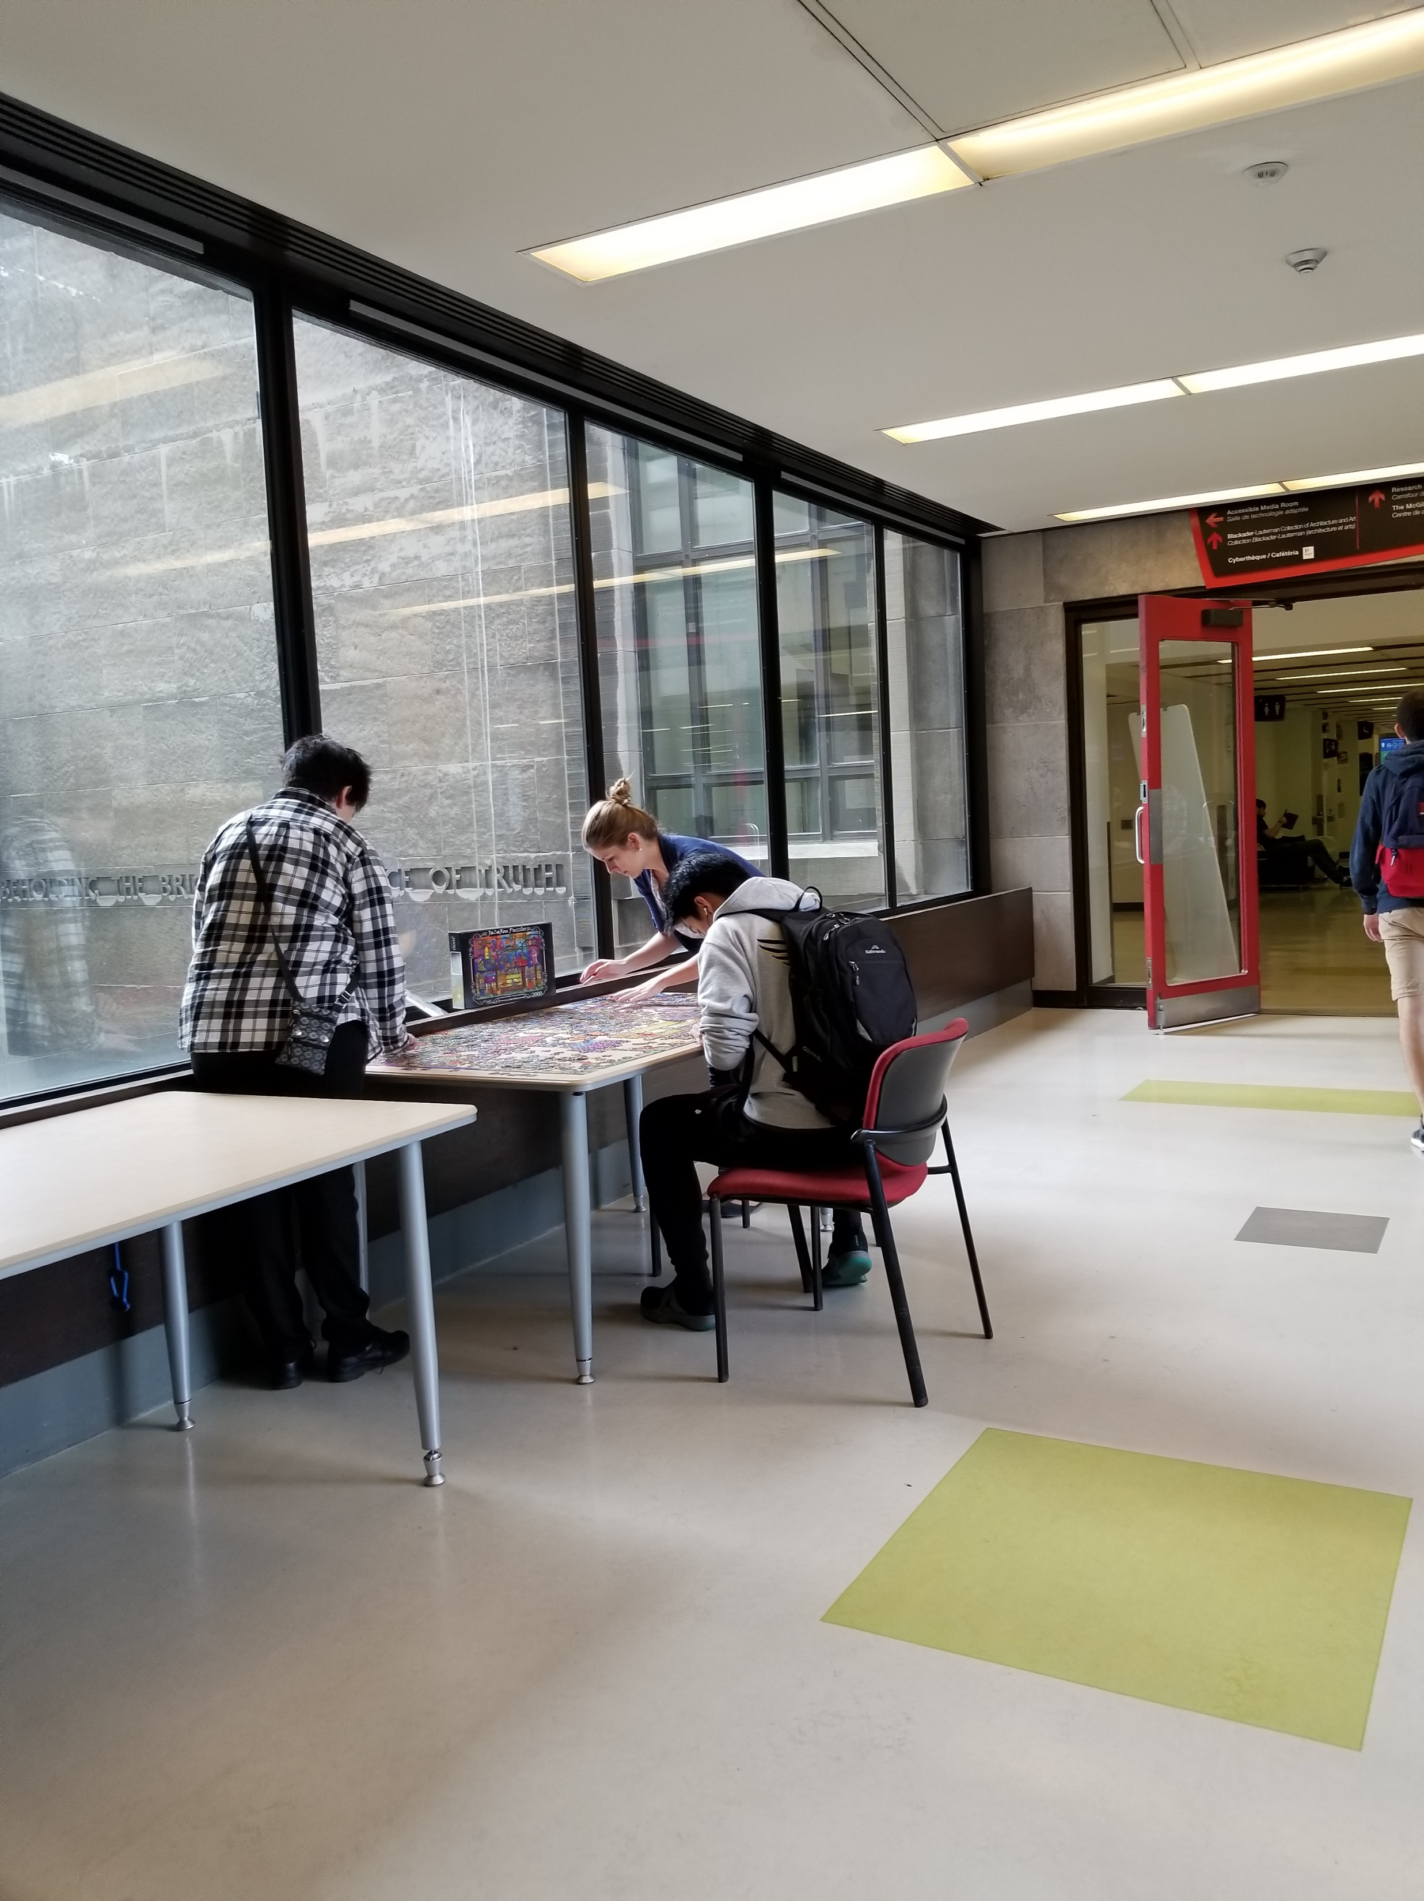

Slide 24
https://www.mcgill.ca/library/channels/event/therapy-dogs-visit-library-during-exams-296306

Slide 25
MENGHUBUNGI PERPUSTAKAAN McGILL
https://www.mcgill.ca/library/contact/askus

Slide 26
PERPUSTAKAAN McGILL DI ERA COVID
https://www.mcgill.ca/library/covid-19-latest

Slide 27
LAYANAN PERPUSTAKAAN ERA COVID

Slide 28
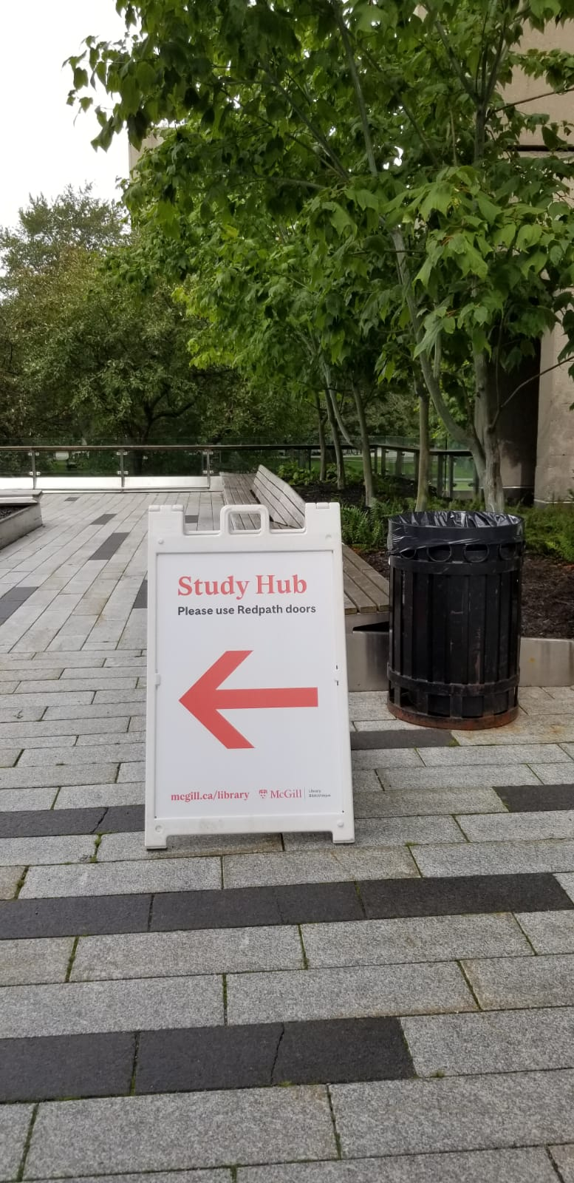

Slide 29
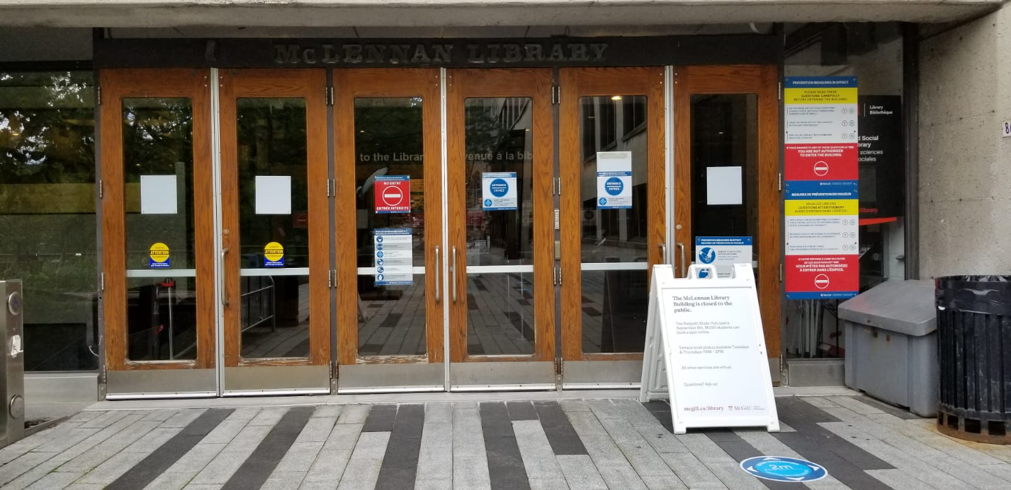

Slide 30
STUDY HUBS : Tampilan Ruang Baca era Covid-19
https://www.mcgill.ca/library/about/study-hubs

Slide 31
https://www.mcgill.ca/library/about/hathitrust

Slide 32
TERIMA KASIH

