Slide 1
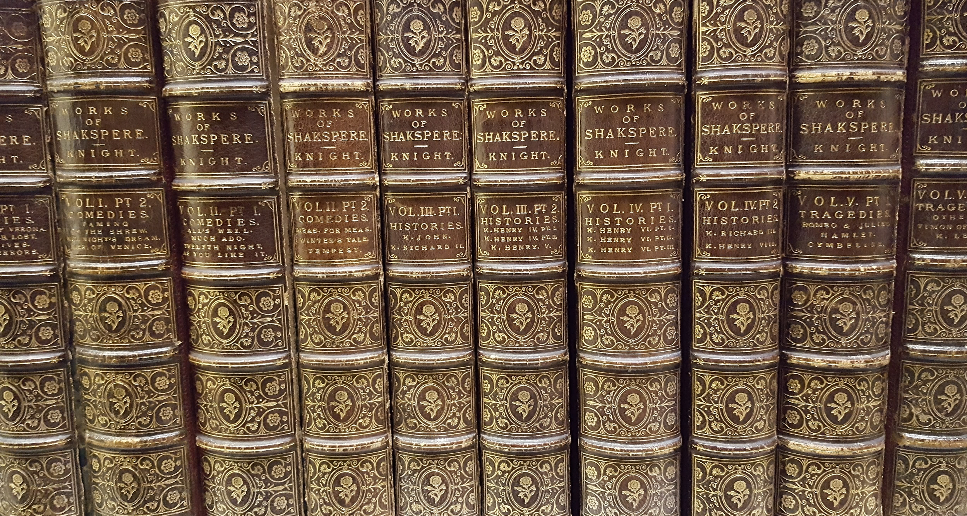
Gold that’s put to use more gold begets

Slide 2
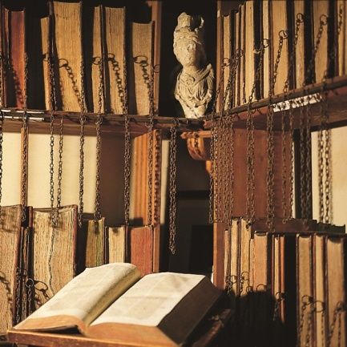

Slide 3
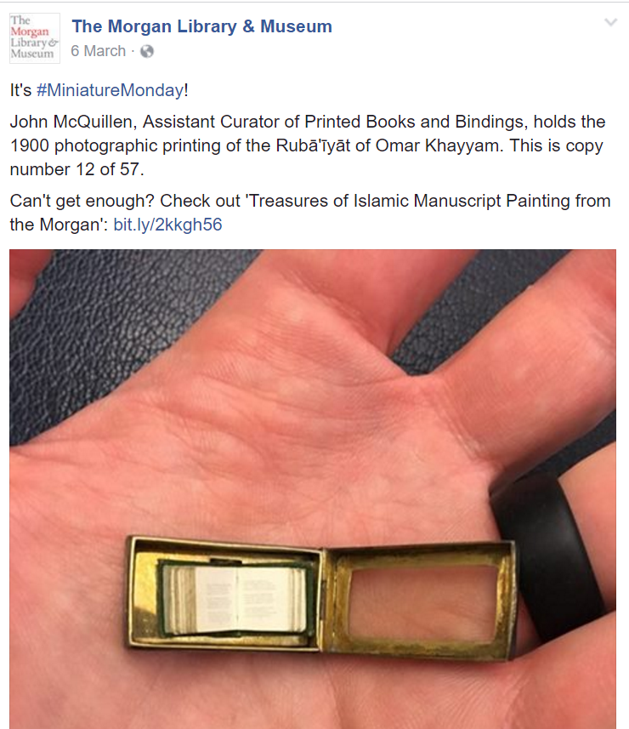

Slide 4
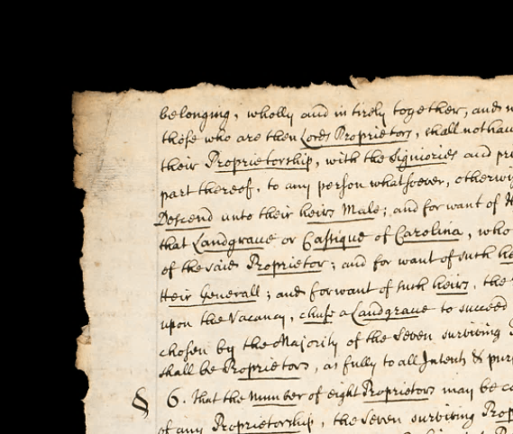
© The Royal Society

Slide 6
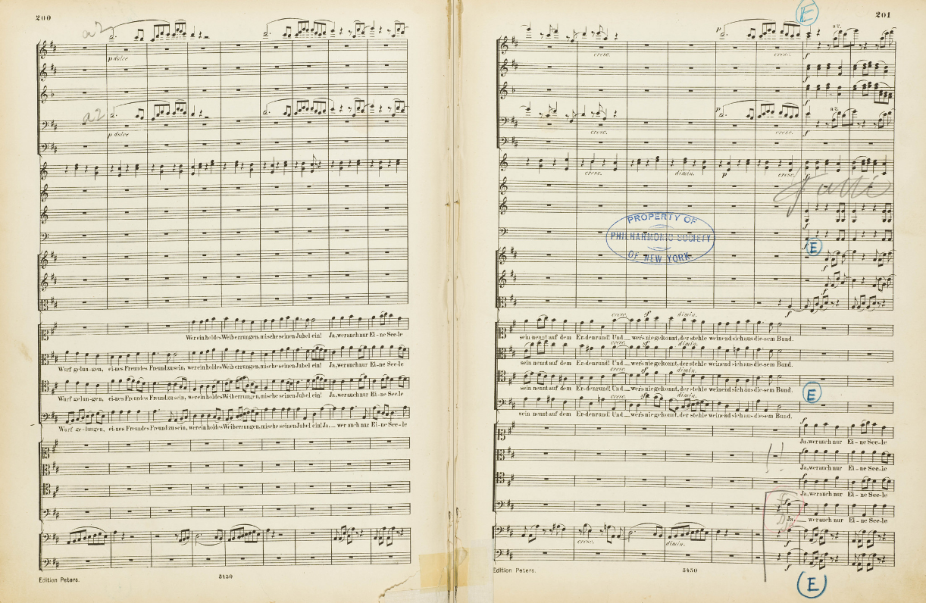

Slide 7
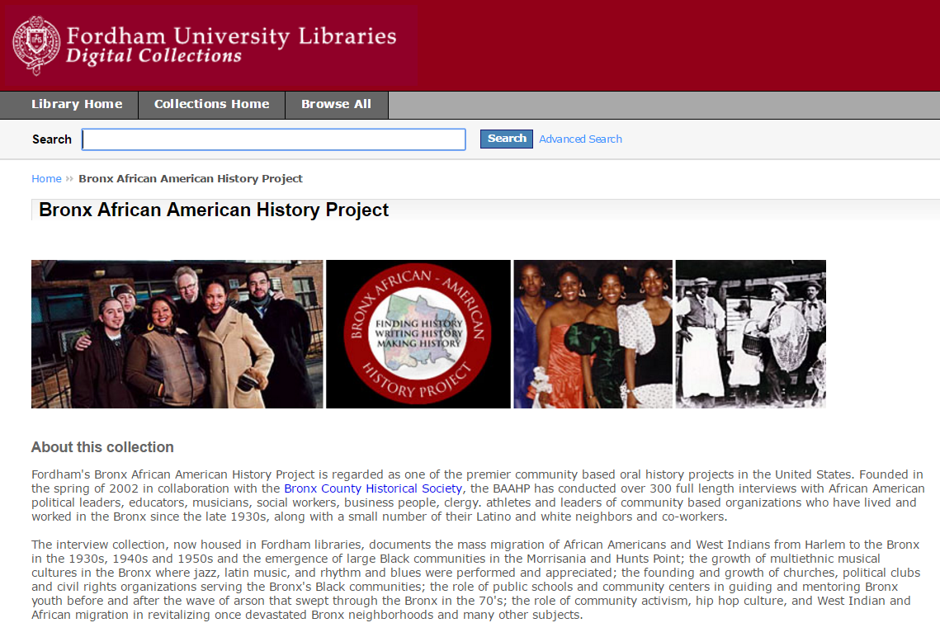

Slide 8
Experience SLA for career success

Slide 12
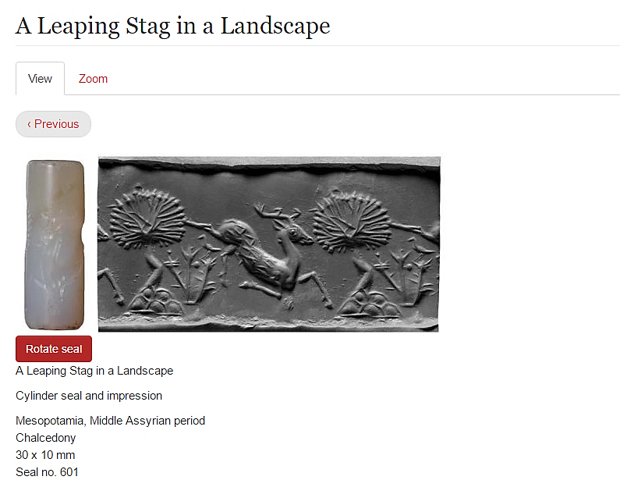

Slide 13
Thank you.
Emma Davidson
SLA Chapter Cabinet Chair-Elect
@el399
emmadavidson2010@gmail.com
linkedin.com/in/emmadavidson2010/

Slide 14
Image Source Credits
1. https://scolarcardiff.files.wordpress.com/2016/12/shelf.jpg (quotation from Shakespeare’s Venus & Adonis)
2. https://www.flickr.com/photos/dorsetforyou/6876070751
3. https://www.facebook.com/morganlibrary/
4. https://royalsociety.org/collections/turning-pages/
5. http://www.libertyproject.com/media/photos/2015/07/22/Olga_Berrios_Flickr_Creative_Commons_Puzzle.jpg
6. http://archives.nyphil.org/index.php/artifact/5893c748-9fb0-45a0-84ef-d6a50dab655f/fullview#page/206/mode/2up
7. http://digital.library.fordham.edu/cdm/landingpage/collection/baahp
8. https://www.flickr.com/photos/128502164@N07/20817035945/
10. https://connect.sla.org/network/members/profile?UserKey=eb7424ae-88fd-4fcb-a289-c1688438a407
12. http://www.themorgan.org/collection/ancient-near-eastern-seals-and-tablets/84229#

