Slide 1
Marketing Communication on Cultural Program "Lokakarya Nasional 2016"
Department of Library and Information Science, Faculty of Humanities
Universitas Indonesia, Depok 16424, Indonesia
Fahru Abdhul Aziz
Tamara Adriani Susetyo-Salim

Slide 2
Outline of presentation
Introduction
Objective
Literature Review
Research Method
Discussion
Conclusion
Suggestion

Slide 3
Introduction
In the implementation of a program or event, it would require participants. One way to obtain the participant is with marketing communications.
Marketing communication is necessary in a cultural program, especially those held by special library.
In this case, PDII-LIPI as an institution that is tasked with carrying documenting scientific information, provide access to scientific information, and studies and research in the field of documentation and information which also promoting cultural program.
One of the cultural program conducted by PDII-LIPI is Lokakarya Nasional 2016.

Slide 4
Objective
Analyzing the implementation of marketing communication methods on “Lokakarya Nasional 2016" held by PDII-LIPI

Slide 5
Literature Review
Cultural Programs
Programs presented by libraries that seek to entertain, enlighten, educate, and involve adult and family audiences, primarily in the disciplines of the arts, humanities, sciences, and public policy or com-munity issues. (Deborah,2005)
Special Library
A type of library in form by the institutions (of government/private) or companies that deal with or have a specific field mission with the aim to meet the needs in their environment. (Sukarman, 2000).
Marketing communications
A process of exchange of information is done in a persuasive marketing process so that it can run effectively and efficiently. (William,1984)

Slide 6
Methods of Marketing Communications
Publicity
The publicity can be done by sending an announcement related to the event which will be held through the media such as newspaper and magazine articles, announcements on websites, radio and television programs, web publicity, public service announcements and letters to the editor.
Direct Marketing
Direct marketing are done by direct mail, mass e-mail messages, and web marketing.
Personal Contact
Personal contact can be done through the mouth to mouth, the announcement in front of the public, phone, email, letter
Advertising
Advertising can be done through printed ads, TV and radio ads, banners, brochures, bookmarks, posters

Slide 7
Research Method
Qualitative approach
Observation
Interview

Slide 8
Discussion (1)
PDII-LIPI
It is one of the work units under the Indonesian Scientific Knowledge Institute which has the task of undertaking the documentation of scientific information, providing access to scientific information, and assessment and research in the field of documentation and information.
In PDII-LIPI there is a special library also commonly referred to the dissemination of information division.
The services provided by PDII-LIPI library are among others information services, literature search services, industrial technology information packages, or the dissemination of selected information.

Slide 9
dISCUSSION (2)
Lokakarya Nasional 2016
It is an implementation of the PDII-LIPI task of carrying out the documentation of scientific information, providing access to scientific information and assessment and research in the field of documentation and information;
Lokakarya Nasional 2016 takes the theme of "Data, Information and Knowledge Management in National Repository Development“;
The workshop was held on 10-11 August 2016;
Present 6 speakers as informants and there are 16 people as presenters.

Slide 10
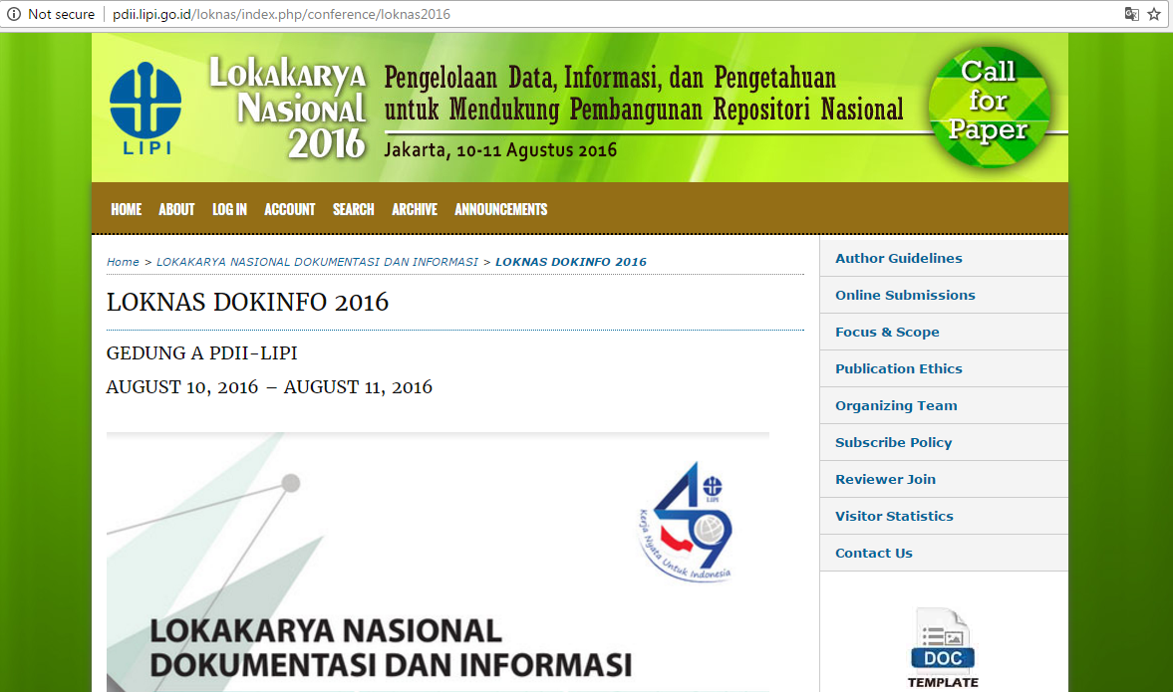
Discussion (3)
Marketing Communications in Lokakarya Nasional 2016
Publicity
Announcement on the web site
Announcement on social media
Notes:
In the use of social media as a media publication, PDII-LIPI using facebook to publish lokakarya Nasional 2016. There are four times posted on facebook PDII-LIPI counted from January 2016 until the day of this event that is on 10th and 11st August contents promote Lokakarya Nasional 2016 pursuits. But in the use of social media as a media publication of PDII-LIPI does not take advantage of the social media other than facebook. The publication of Lokakarya Nasional 2016 does not perform the publication through social media twitter. Visible on the Twitter account of PDII-LIPI namely @PDIILIPI no tweets that contain about the publication of Lokakarya Nasional 2016. Even in August month where the holding of Lokakarya Nasional 2016 no Tweets posted on Twitter account of PDII-LIPI.

Slide 11
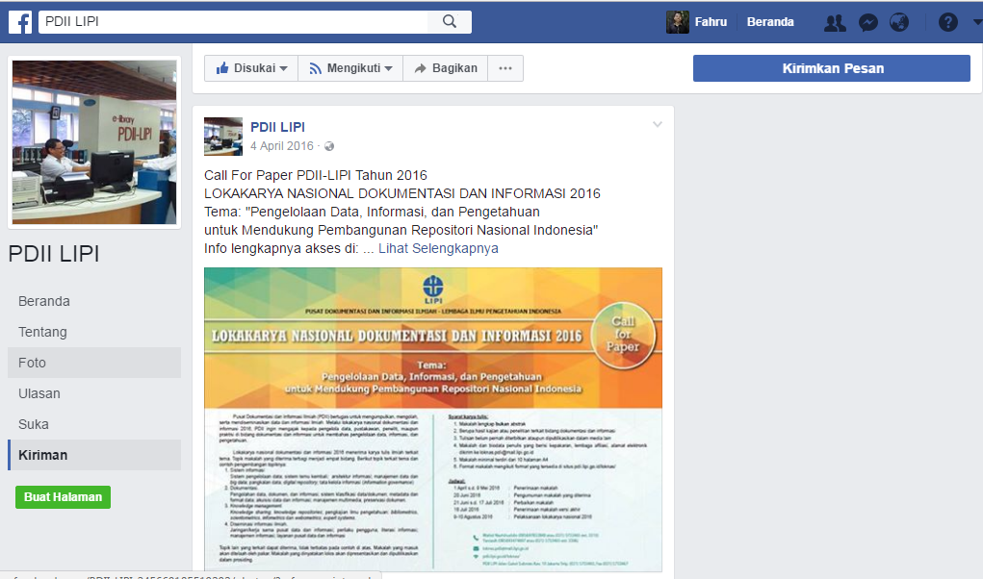
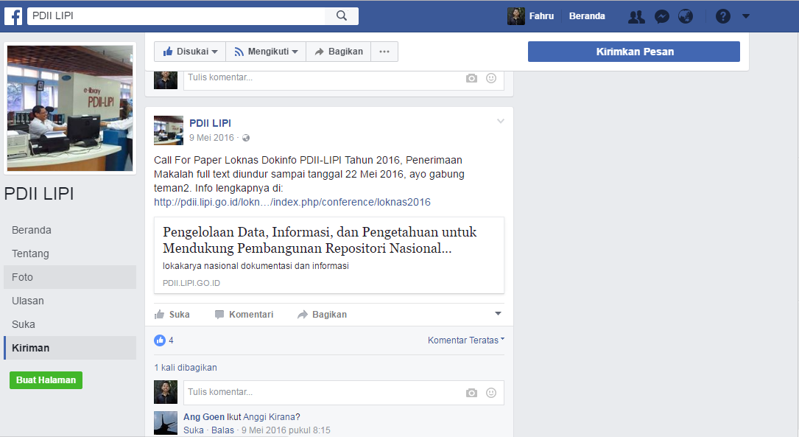
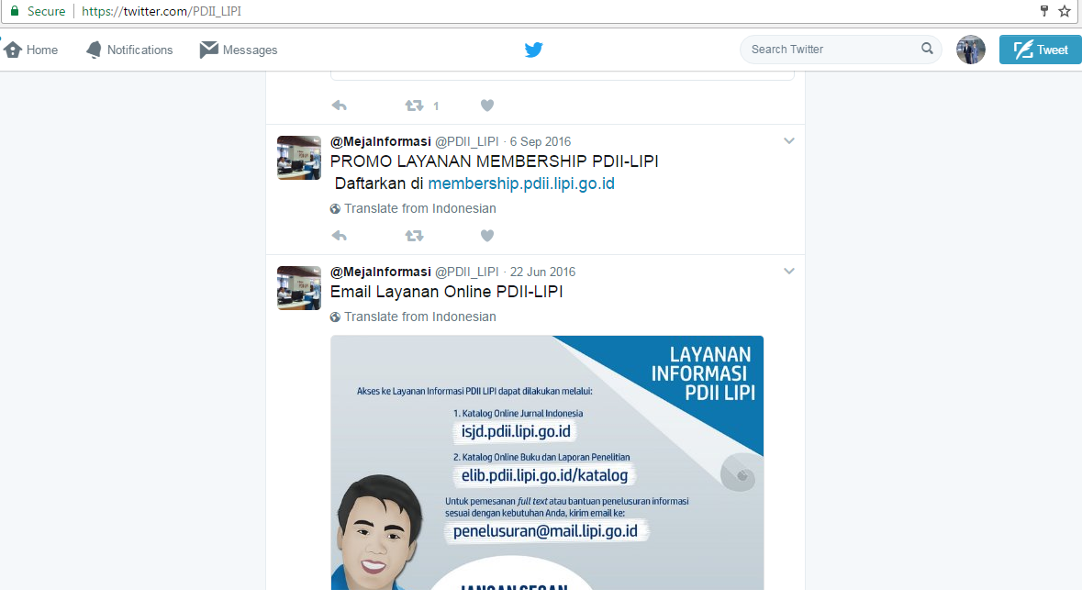

Slide 12
Direct Marketing
Direct mail delivery
Personal Marketing
Mouth to mouth
WhatsApp group
Advertising
Brochures
Posters
Notes:
To further marketing communications with direct marketing which can be done with how to do the direct mail delivery, sending bulk e-mail, and web marketing. On Lokakarya Nasional 2016, is PDII-LIPI do it with direct mail delivery. Direct mail delivery is directed to the leadership of the institution or the head of the institution that has become a working partner of PDII-LIPI. Direct mail delivery is intended to market Lokakarya Nasional 2016 and also to invite the recipient of the letter in order to participate and become an expert from Lokakarya Nasional 2016.

Slide 13
Discussion (4)
Supporting and Inhibiting Factors PDII-LIPI in Doing Marketing Communications for Cultural Program
Supporting factors
PDII-LIPI has a facebook account that has been liked by approximately 3000 facebook users
PDII-LIPI has an email database of library visitors
Inhibiting factors
Server is down or damaged

Slide 14
Conclusion
The implementation of the event that called " Lokakarya Nasional 2016 " that was held by PDII LIPI, has already used four methods of marketing communication. In which those methods are publicity, direct marketing, contact personal, and advertisement. However, the implementation of marketing communication method in "Lokakarya Nasional 2016" hasn't maximally applied because, in the execution itself, there are still several media from marketing communication that could be beneficial, but haven't optimalized by PDII-LIPI. PDII-LIPI has not yet fully maximizes the role of social media as a means to provide information about a program to the community. There is some kind of advertisements, such as through radio, tv, banner, bookmark, that haven't done by PDII LIPI to marketing the event of "Lokakarya Nasional 2016".

Slide 15
Suggestions
In implementing cultural programs should maximize media marketing is in four methods of marketing.
Also use social media in addition to facebook in the cultural program marketing tools
Publication of a more in depth by working with media partners is also required in the conduct of marketing communication on the implementation of the cultural program of the library, and,
Maximize all the benefits that owned PDII-LIPI such as the existence of the email database visitors who owned by PDII-LIPI as a means to perform an event marketing communications.

Slide 16
References
Kotler, Philip & Keller, K Lane. (2007). Manajemen Pemasaran, Analisis Perencanaan, Pengendalian, Prentice Hall, Edisi Bahasa Indonesia. Jakarta: Salemba Empat.
Martoatmojo, K. ( 1999). Manajemen Perpustakaan Khusus. Jakarta: Universitas Terbuka.
Nickles, W. G. (1984). Marketing Communication and Promotion (Third Edition). New York: John Wiley & Sons. Inc.
Purba, Amir, dkk. (2006). Pengantar Ilmu Komunikasi. Medan: Pustaka Bangsa Press.
Robetson, D. A. (2005). Cultural programming for libraries : linking libraries, communities, and culture. Chicago: American Libraray Association.
Sutarno. (2006). Manajemen Perpustakaan Suatu Pendekatan Praktik. Jakarta: CV Sugeng Seto.
Tjiptono, F. (1995). Strategi Pemasaran. Yogyakarta: Andi Offset.

