Slide 1
Facebook for Support Knowledge Management
at Rifka Annisa Women’s Crisis Center

Slide 2
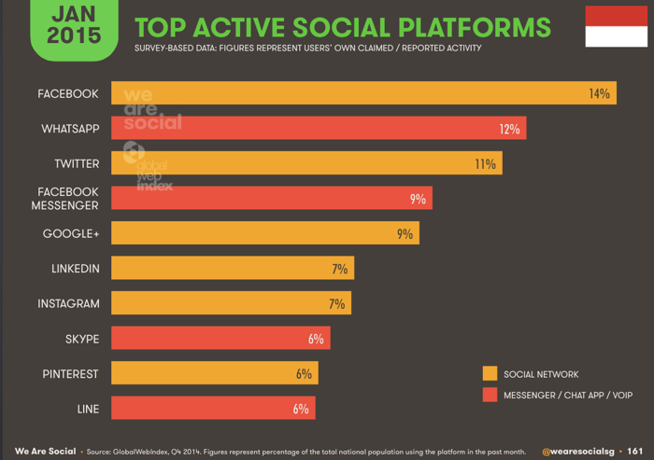
Introduction
The social function in social media has already transformed.
In connection with the foregoing, if you see the market opportunities of social media usage in Indonesia comparatively quite large.
Currently, many organizations are using facebook as a promotional medium (knowledge sharing) or to other goals.
Rifka Annisa is a non-profit organization committed to the elimination of violence against women (Rifka Annisa, 2015). In an effort to disseminate information and knowledge (knowledge sharing) to the general public.

Slide 3
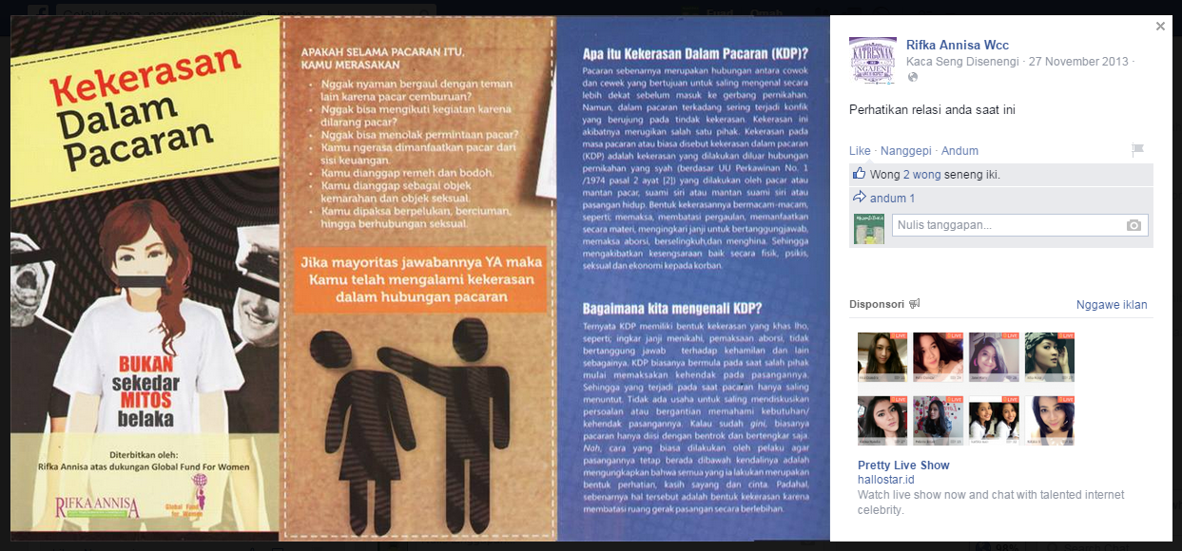
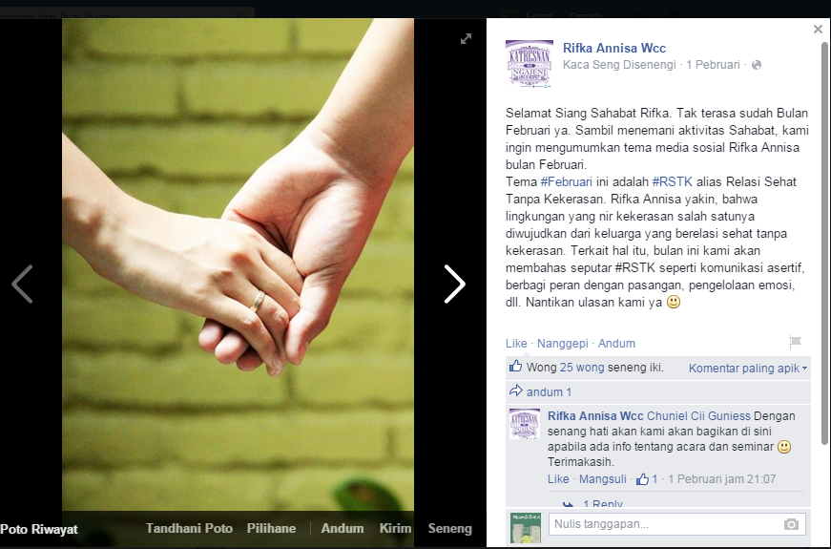
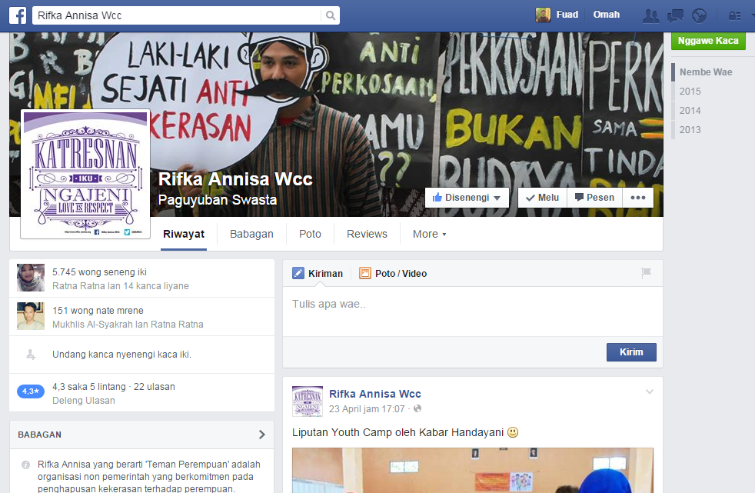
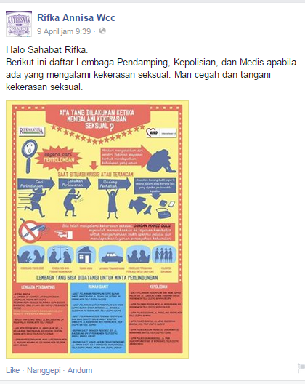
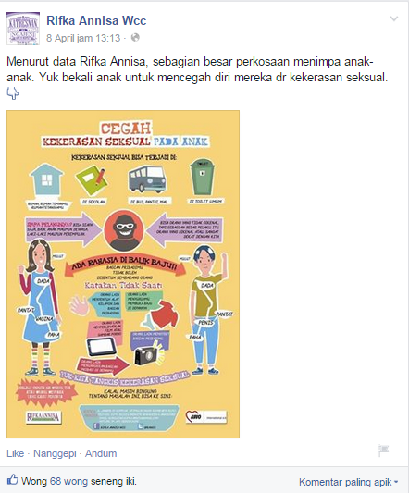
Knowledge Sharing

Slide 4
Literature review
Social media
Social media as a group on the internet applications are built using web 2.0 technology platform (Kaplan, 2010). Social media is able to facilitate a variety of activities such as integrating web sites, social interaction, and community-based content creation (O'Reilly, 2005). Users can create/co-create, organize, edit, commenting, tagging, discuss, merge, connecting, and share content. Social media can be grouped into several broad categories, although some applications may fall into more than one specific categories depending on how the application is used. Including the following (Supradono, 2011):
Facebook includes social media applications in the social networking category. This makes Facebook users can have a bond / network with other users online.Facebook is a social networking website where users can join the community such as city, workplace, school, and region to connect and interact with other people (Eni, 2009). The Computer Language Company Inc. (2015) said that several facilities owned facebook is as follows:
Timeline / Wall, News Feeds and Ticker
Profiles, Pages and Groups
Explosive Growth
Facebook Platform

Slide 5
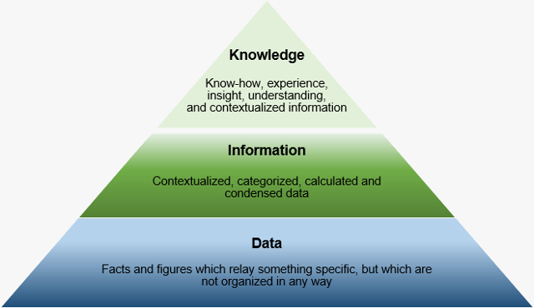
Knowledge and knowledge management
Knowledge is an impression in the minds of men as a result of the use of her senses and different beliefes, superstition, and misinformation (Soekanto, 1942). It is highly influenced by the intensity of attention and perception of the object (Notoatmodjo, 2005). Knowledge can also be defined as facts or information which we think is based on the premise that involves empirical testing (thought the observed phenomena directly) or based on the thought processes such as logical reasoning or problem solving (Basford, 2006). Divided into two forms of knowledge, tacit and explicit.

Slide 6
There are different notions of knowledge management. This occurs due to the breadth and diversity of scientific approaches to experts in view knowledge management. Knowledge management includes several scientific disciplines, including: organizational sciences, the science of logic, linguistics and computational linguistics, knowledge-based information technology systems, documents and data information management, support performance electronic systems and database technology, information and library science, technical writing and journalism, anthropology and sociology, education and training, storytelling and communication research, such collaboration is supported by computer technology and groupware collaborative work, as well as intranets, extranets, portals and other web technologies (Dalkir, 2005).
more comprehensive regarding knowledge management, which according to most practitioners and professionals, knowledge management is defined as a way of treating tacit and explicit knowledge in creating a value to the organization (Dalkir, 2005).

Slide 7
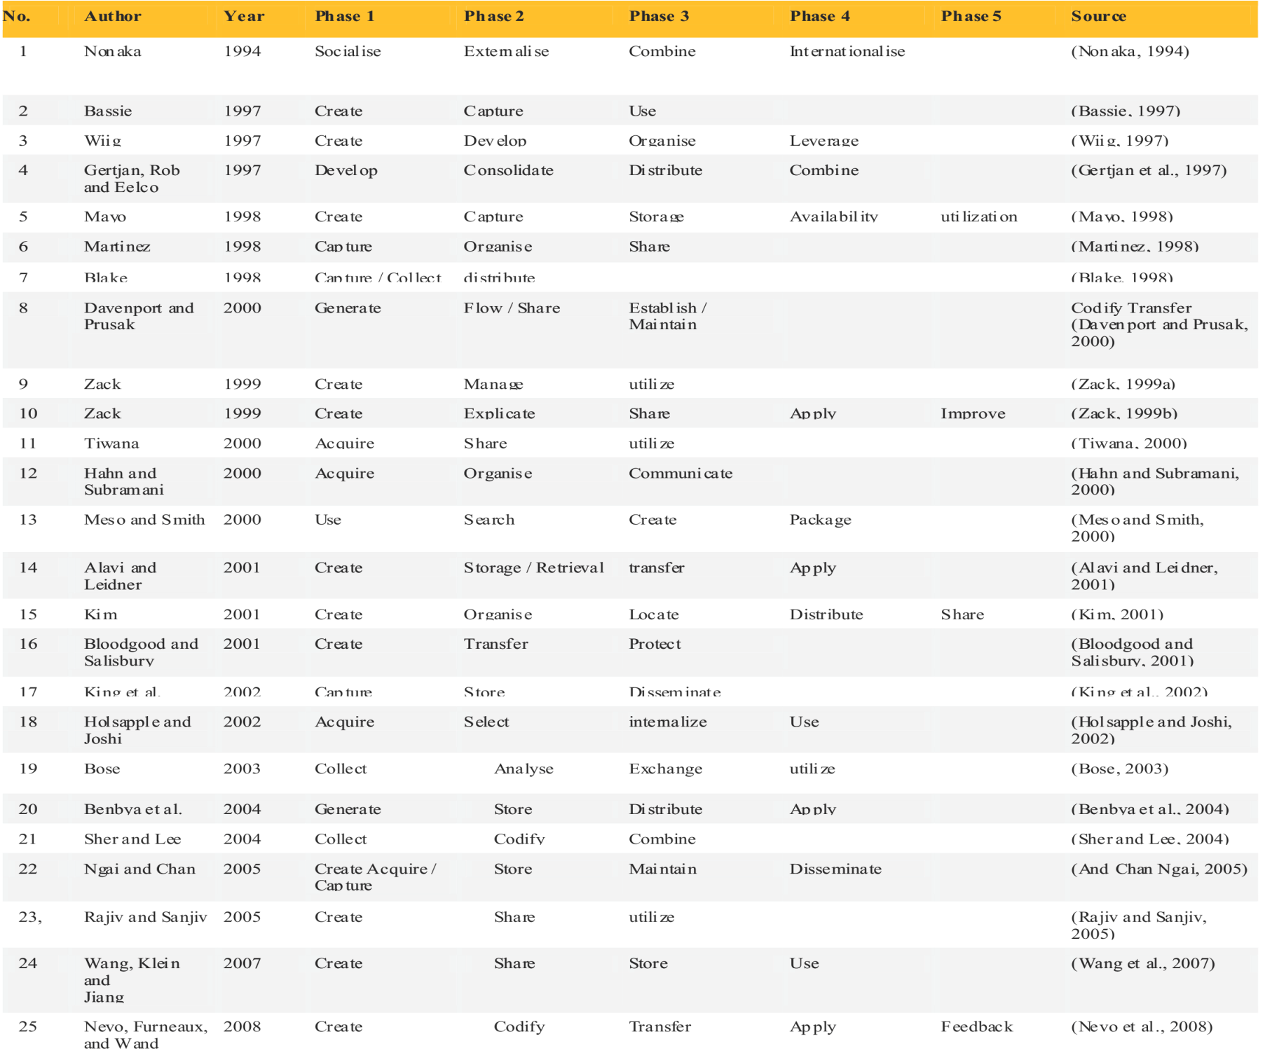

Slide 8
Methodology
The research method is basically a scientific way to get data with a specific purpose and usefulness (Sugiyono, 2009). In this study, researchers used a qualitative research method approach in order to understand in depth the role of Facebook as a tool to support knowledge management at the Institute of Rifka Annisa. The qualitative method is a method used to examine the condition of the object that is natural, (as his opponent experiment) where the researcher is a key instrument, data collection techniques as triangulation (combined), data analysis is inductive, and qualitative research results further emphasize the significance of generalization (Sugiyono, 2009).
The main data sources in qualitative research is that the words and actions rest is additional data such as documents and others. Where the research data obtained through two sources of data: 1)primary data source that directly provide data to data collectors(Sugiyono, 2009). Data obtained directly from interviews obtained from sources or informants who are considered potentially useful in providing relevant information. The primary data is merely the expression of a manager facebook Rifka Annisa WCC and facebook followers Rifka Annisa WCC, both oral and written. 2)Secondary data sources are data sources that do not provide information directly to the data collector.
Data analysis techniques used in this research is the analysis of the data during field model of Miles and Huberman. Qualitative data analysis using words that are always arranged in an expanded text or described(Sugiyono, 2012). The activities of qualitative data analysis model of Miles and Huberman includes data reduction, data display, and Conclusions drawing / verification(Sugiyono, 2009).

Slide 9
Discussion
Overview Rifka Annisa
Rifka Annisa which means 'Friends of Women' is a non-governmental organization committed to the elimination of violence against women(Rifka Annisa, 2015). Founded on August 26, 1993, the organization initiated by several women activists: Suwarni Angesti Rahayu, Sri Kusyuniati, Latifah Iskandar, Desti Murdijana, Sitoresmi Prabuningrat and Musrini Daruslan. Rifka Annisa present because deep concern at the tendency of patriarchal culture that on the one hand strengthen the position of men but on the other hand to weaken the position of women. As a result, women are vulnerable to violence, whether physical, psychological, economic, social, and sexual abuse as abuse and rape. The extent of gender-based violence that emerged in the community encouraged us to do work for the elimination of violence against women. Rifka Annisa believes that violence against women occurs due to various factors are mutually supportive.

Slide 10
In an effort to expand the dissemination of information to the public, NGOs Rifka Annisa utilize multiple social media such as facebook, twitter and website. It is not separated from the development trend of today's society, especially for adolescents, who incidentally is the native generation. Facebook social media applications Rifka Annisa Institute named "Rifka Annisa WCC". Facebook Rifka Annisa WCC registered since 2013. Facebook Rifka Annisa WCC used by Governmental Organization Rifka Annisa in several activities, including the following: 1) facebook Rifka Annisa WCC used to further friendship between our network tie Governmental Organization 2) facebook Rifka Annisa WCC used as a tool to advocate to the public 3) facebook be used Rifka Annisa WCC as the dissemination of information and knowledge gained from knowledge management activities. facebook Rifka Annisa WCC in spreading information regarding violence victim support services, photo Rifka latest activities, and information on violence against women. Here's a picture facebook Governmental Organization Rifka Annisa WCC:
Figure 2. Facebook Rifka Annisa WCC

Slide 11
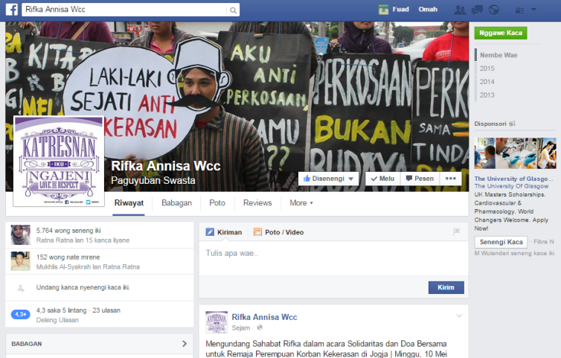

Slide 12
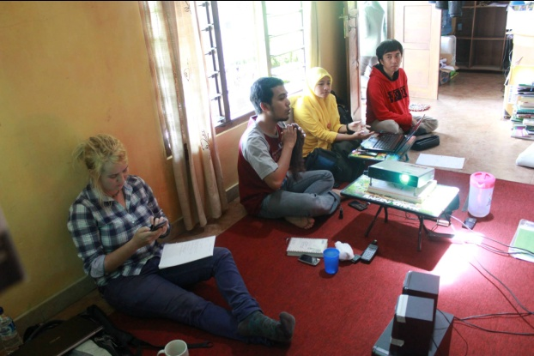
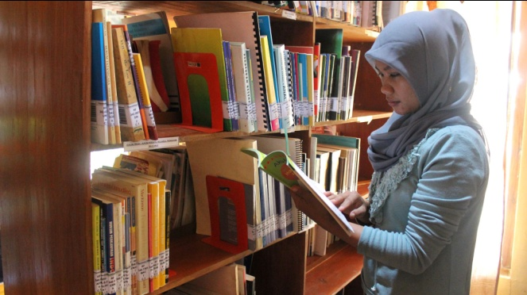
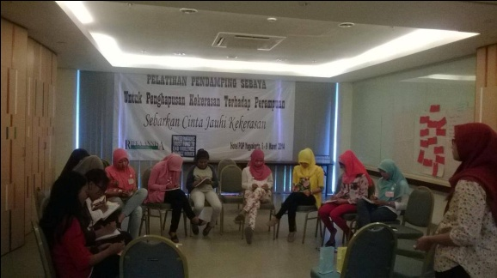
Knowledge management practice at Rifka Annisa
1 Discussion
2 Library
3 Internship Program
4 Module
5 Training

Slide 13
Facebook as a a tool for supporting knowledge management at Rifka Annisa Wcc
1 Facebook as a tool for supporting knowledge evolution
2 Facebook as a tool for supporting knowledge use/re-use
3 Facebook as a tool for supporting knowledge sharing

Slide 14
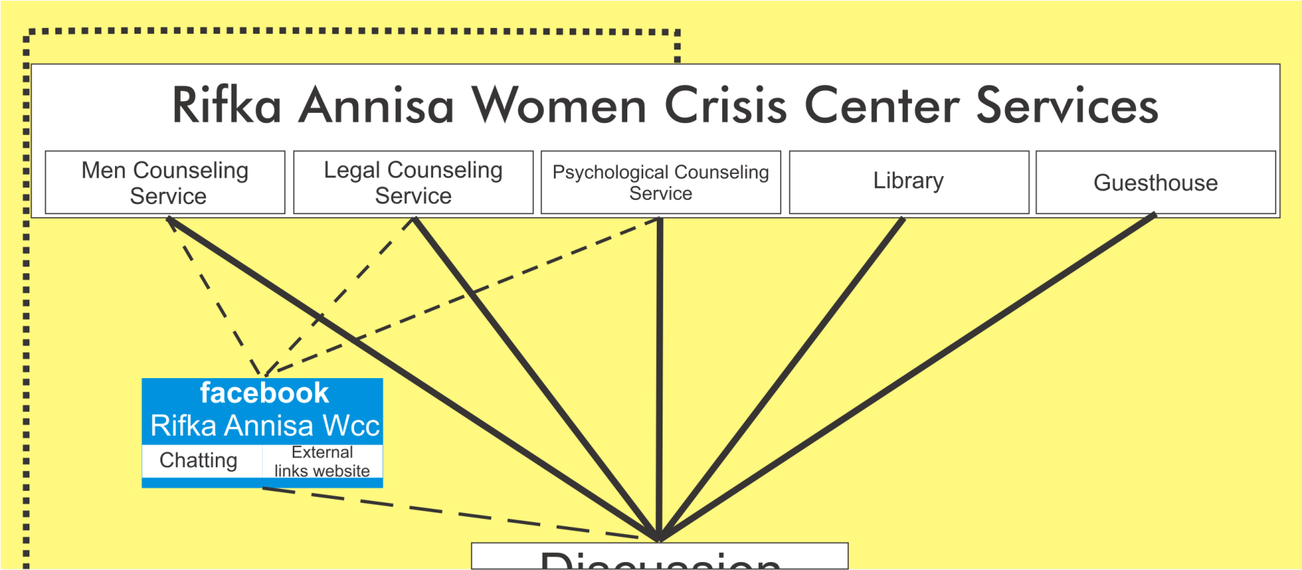
1 Facebook as a tool for supporting knowledge evolution

Slide 15
2 Facebook as a tool for supporting knowledge use/re-use

Slide 16
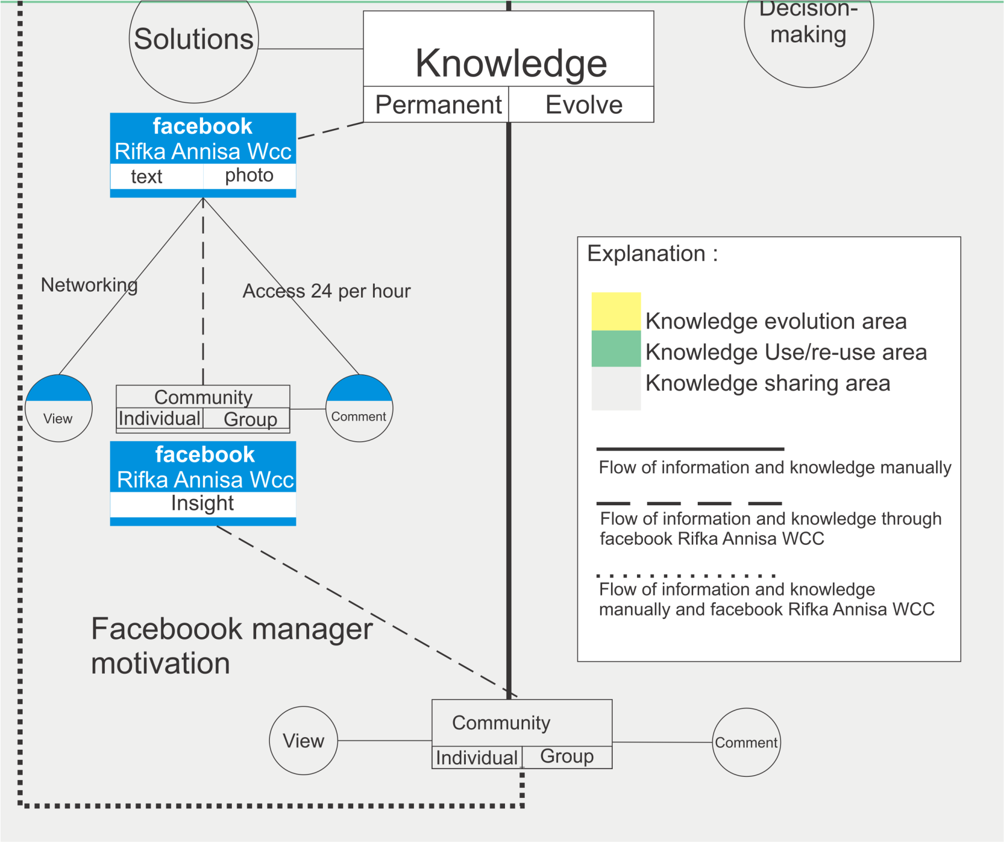
3 Facebook as a tool for supporting knowledge sharing

Slide 17
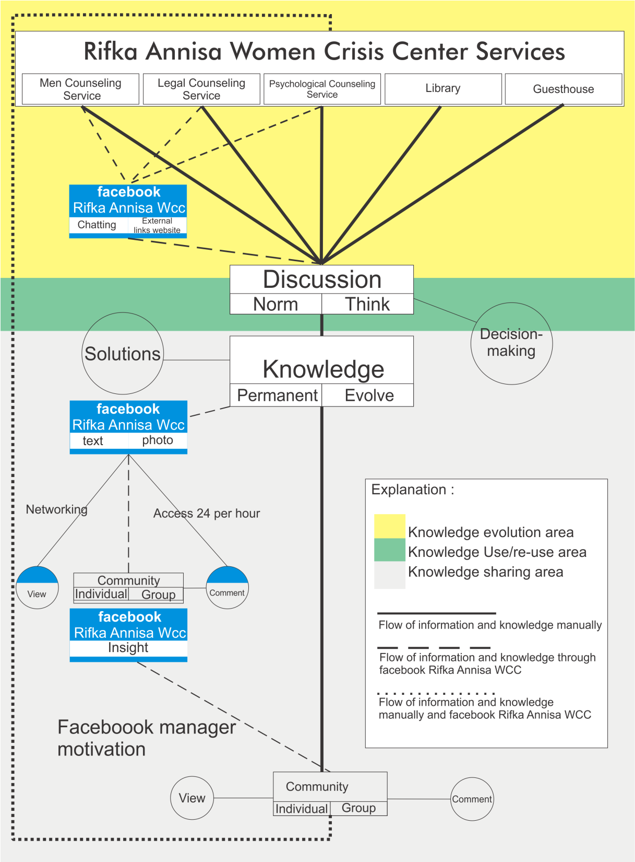

Slide 18
Conclussion
From the overall results have been described above, can be mapped facebook Rifka Annisa role as a support tool in knowledge management activities, namely in the activities of the development, use/re-uses, and sharing of knowledge. In accordance with the objectives and benefits of the research, the research is expected make contributions the relevant institutions. Therefore there are several suggestions and input from the author in order to increase facebook Rifka Annisa WCC's role in supporting knowledge management activities in Rifka Annisa Women’s Crisis Center. The suggestion of the author is as follows: recommend the use of facebook Rifka Annisa WCC more on optimizing the client data retrieval violence victims through chat facilities. It is associated with the development of knowledge in management phases pengetahuuan Governmental Organization Rifka Annisa. We recommend a response to the comments in the discussions in the Rifka Annisa facebook can be done more quickly. This will certainly increase the level of client trust towards institutions Rifka Annisa WCC in the stage of sharing knowledge.

Slide 19
References
APO Asian Productivity Organization. (2008). Knowledge Management in Asia: Experience and Lesson. Tokyo: Asian Productivity Organization.
Basford, Lynn. Oliver, Slevin. (2006). Teori dan Praktik Keperawatan Pendekatan Integral Asuhan Pasien. Jakarta: EGC.
Bateman, Thomas. (2004). Management: The New Competitive Landscape. McGraw Hill: New York.
Dalkir, Kimiz. (2005). Knowledge Management in Theory and Practice. McGill University. New York: Elsevier Inc.
Eni, Eunike. Wahyono, Teguh. (2009). Kupas Tuntas Facebook “Era Baru Pergaulan di Dunia Maya”. Yogyakarta: Penerbit Gava Media.
Kaplan, Andreas M. Michael Haenlein. (2010). Users of the world, unite! The challenges and opportunities of Social Media. Business Horizons.
Kardi. (2007). Revitalisasi Peran Pustakawan dalam Implementasi Knowledge Management. Journal Visi Pustaka 9(2).
Kemp, Simon. (2015). “Digital, Social & Mobile in APAC in 2015”. www.wearesocial.net.
Lexy J., Moleong. (2007). Metodologi Penelitian Kualitatif. Bandung: PT.Remaja Rosdakarya.
Nonaka, Ikujiro and Takeuchi, Hirotaka. (1995). “The Knowledge-Creating Company: How Japannese Companies Create the Dynamics of Innovation”. Oxford University Press. books.google.com.
Notoatmodjo, Sekidjo. (2005). Metodologi Penelitian Kesehatan. Jakarta: Rineka Cipta.
O'Reilly, Tim. (2005). “What Is Web 2.0: Design Patterns and Business Models for the Next Generation of Software”. www.oreilly.com.
Pendit, Putu Laxman. (2003). Penelitian Ilmu Perpustakaan dan Informasi: Suatu Pengantar Diskusi Epistimologi dan Metdologi. Bandung: Alfabeta.
Peraturan Menteri Negara Pendayagunaan Aparatur Negara dan Reformasi Birokrasi Nomor 14 Tahun 2011. Pedoman Pelaksanaan Program Manajemen Pengetahuan (Knowledge Management). 2011. Jakarta
Phosaard, Satidchoke. (2011). “Knowledge Management via Facebook: Building a Framework for Knowledge Management on a Social Network by Aligning Business, IT and Knowledge Management”. in Proceedings of the World Congress on Engineering, volume III.
Rifka Annisa. (2015). “Tentang Kami”. www.rifka-annisa.org.
Soekanto, Suryono. (1942). Sosiologi Suatu Pengantar. Jakarta: CV. Rajawali.
Spradono, Bambang dkk. (2011). Peran Sosial Media Untuk Manajemen Hubungan Dengan Pelanggan Pada Layanan E-Commerce. E-Journal www.unimus.ac.id 7
Sugiyono. (2009). Metode Penelitian Kuantitatif Kualitatif dan R&D.Bandung: Alfabeta.
________. (2012). Memahami Penelitian Kualitatif. Bandung: Alfabeta.
Sumarsono, Sonny. (2009). Teori dan Kebijakan Publik Ekonomi Sumber Daya Manusia. Yogyakarta: Graha Ilmu.
The Computer Language Company Inc. (2015). “Definition of: Facebook”. www.pc-magz.com.
Uzer, Usman. (2008). Menjadi Guru Profesional. Bandung: PT. Remaja Rosdakarya.
Yanlin Zheng dkk. 2010. “Social Media Support for Knowledge Management”. Proceedings of the Management and Service Science (MASS) International Conference.

