Slide 1
The Increasing of Reading Culture among Employees through Special Library
in Synergy with Reading Community (Case Study Ministry Of Education and Culture)
Created By :
Rina Tri Utami
Dr. Tamara Adriani Susetyo-Salim, M.A
Department Of Library and Information Science,
Faculty of Humanities
Universitas Indonesia, Depok
Paper submitted to International Conference of Asian Special Libraries 2017

Slide 2
Introduction
Literature Review
Outline
Research Question
Research Method
Results
Conclusion
FINISH

Slide 3
Introduction
Reading is something like a bridge to learn science through the media that can be read.
Indonesia has the minimum level on reading interest.
Not only the students who become the spotlight in the low level of reading interest in Indonesia, but among employees of any level is also very low. Therefore, reading interest among employees also need to be noticed.

Slide 4
Introduction
In that case, library could be expected to contribute in increasing reading interest in Indonesia, not only public libraries, but also a special library. For example: The library of Ministry of Education and culture.
Talking about the reading interest, there is a group of individuals who have an interest in reading, it named reading community. The common activity carried out by this community is about sharing the books that has been read by its member.
This paper discuss about how if the library of ministry of education and culture collaborates with the reading community to enhance reading interest of their employees.

Slide 5
Literature Review
Special Library
According to the National Library of Indonesia in 2002, it is mentioned that the special library is one of the libraries established by the institution (public or private) or companies or associations that handle or have specific fields missions with the aim to meet the needs of library information on the environment to support the development and enhancement of institutions and human resources capabilities.
Community
Reading Interest
the sense of community refers to a group of people who share a concern, problem, or a passion for a topic and deepen their knowledge and expertise by interacting continuously. (Wenger, 2002)
A reading interest is a source of someone’s strong motivation to analyze, remember, and evaluate the texts that have been read, which is an exciting learning experience and will affect the form and the intensity of a person's role in determining his goal in the future ( Pety & Jensen (1980) in Hurlock (1993)

Slide 6
Research Question
Question 1
Question 2
What is the effort from the library of ministry of education and culture in order to enhancing the reading interest among its employees?
Does the library of ministry of education and culture collaborates with the reading community and involving its employees in the activity?

Slide 7
Research Methods
Qualitative Method
Observation
Interview

Slide 8
Results
Special Library ; Library of the Ministry of Education and Culture
Address :
Jl. Sudirman Senayan,
Ministry of Education and
Culture Building A Floor 1.
Collections :
Books, Casette, DVD.
Rooms :
Reading Room, Computer
Room, Children Room, Mini-Theater Room
Services :
Circulation service,
Reference service,
Audio-visual service

Slide 9
Results
Special Library ; Library of the Ministry of Education and Culture
There is in fact no specific efforts yet from the from the library of ministry of education and culture to enhance the reading interest among their employees.
There are many communities that has been collaborated with the ministry of education and culture, such as the reading community. However, The ministry doesn’t urge its employees to participate in activities that collaborate with the reading community.

Slide 10
Results
Example of Reading Community in Jakarta ; Jakarta Book Club
Jakarta Book Club was build since 2010 and founded by Shirley and then followed Ms. Dina and Mrs. Ollie who join and interested to build this reading community .
Currently, Jakarta book club already has a membership of approximately about 1,700 registered members, of which there are about 25-40 active members who often attend regular activity of monthly meetings that held by the Jakarta Book Club.
The Activities that carried out by Jakarta Book Club is very good and very helpful in order to realizing the reading culture in this country. The regular activities that carried out by Jakarta Book Club is the "sharing" about the books that have been read by its members, then discussing it with other members. The atmosphere of each meeting goes with warm and friendly.

Slide 11
Existing Condition
Indonesia has the minim level on reading interest.
the low awareness level of the how important the reading among employees not only happens at the Ministry of Education and Culture, but it might happened to employees in other government agencies.
The Library of Ministry of Education and Culture library has never urged their employees although there is a reading community that cooperate with the library

Slide 12
The Mechanism
Low reading culture
Special library attempts to improve reading culture in Indonesia
Collaboration with reading community
The community could affect the employee to be more aware about how important the reading is.
Increase the reading culture in Indonesia, especially in the scope of the employees

Slide 13
Results
The Importance of Collaboration with Reading Community
If the community could collaborate with the government’s library, the employees are hopefully affected or inspired to do more reading.
Awareness of the reading importance among employees will increase along with collaboration between a special library and the reading community. The communities will share their experience and knowledge to employees regarding the benefits of reading and the positive impact that employees will get when they read.
If this collaboration can be created, the impacts are not only obtained by employees but it would also affect the development of the reading community. By conducting the collaboration between the special library and the community, this community activities can be assisted or supported by the library. For example, the special library may participate in the activities carried out by the community (such as facilitating rooms or area to some events)

Slide 14
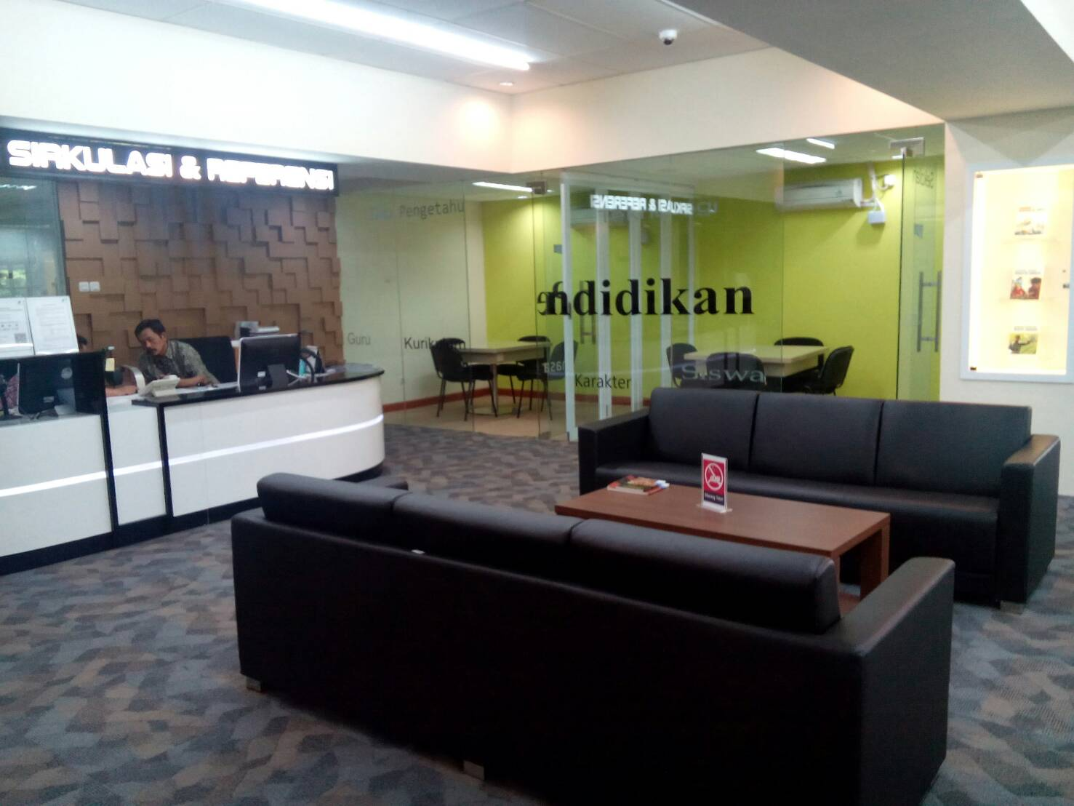
Documentations
Circulation And Referencee Service

Slide 15
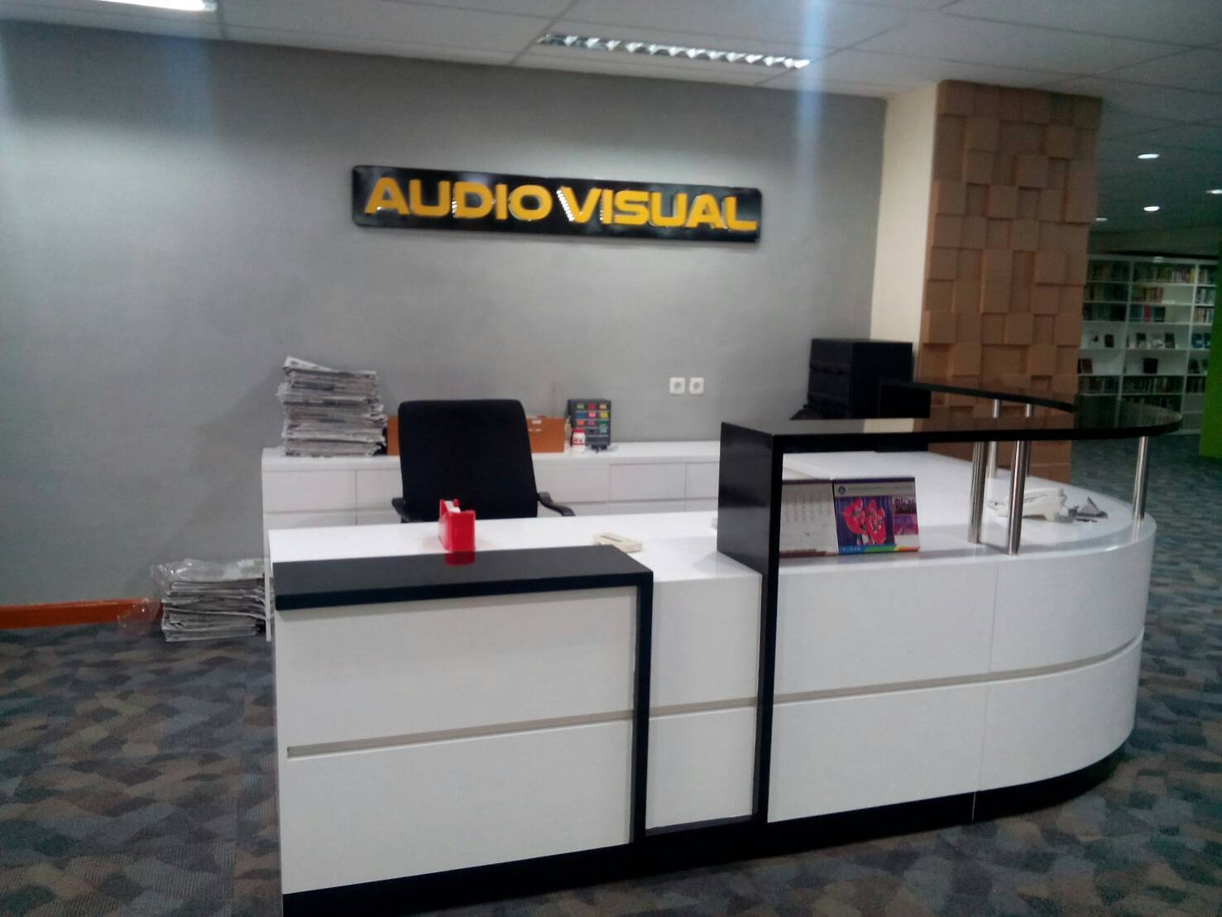
Documentations
Audiovisual Service

Slide 16
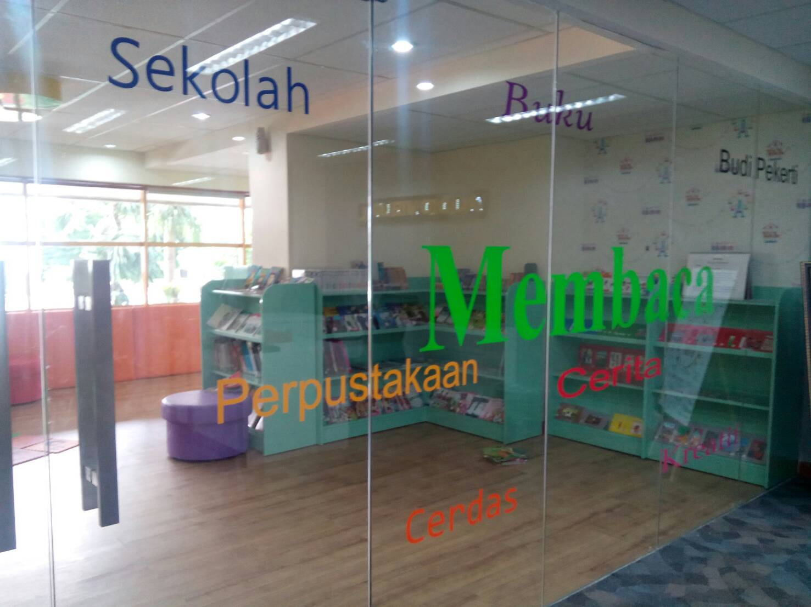
Documentations
Kid’s service

Slide 17
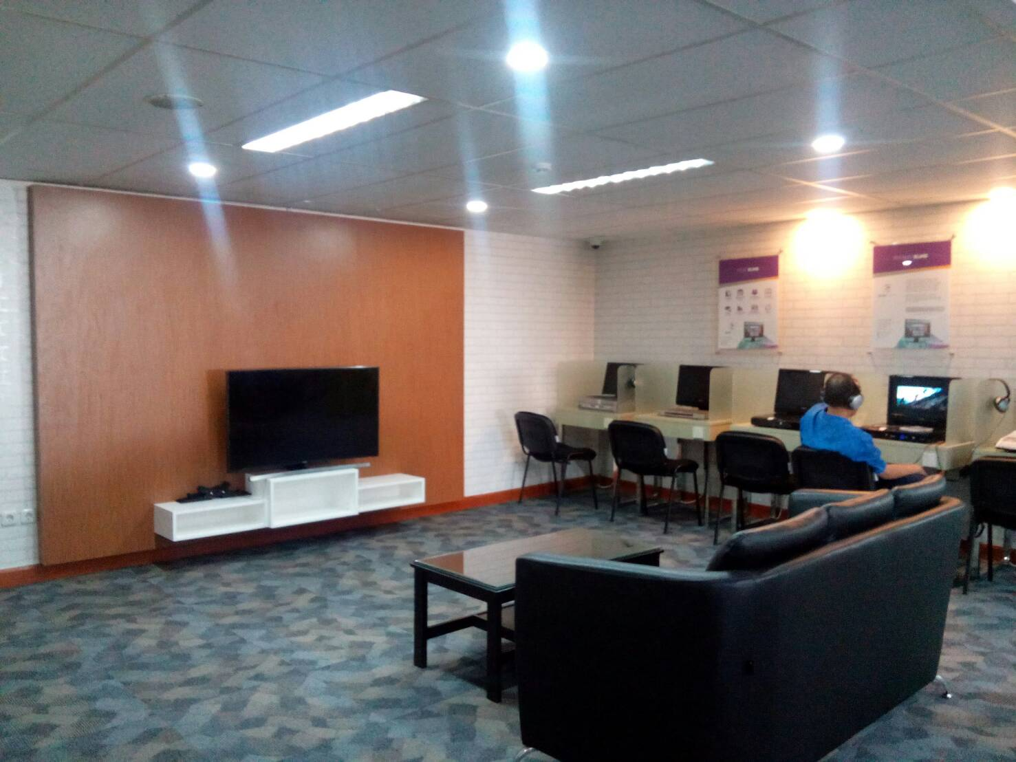
Documentations
Audiovisual room

Slide 18
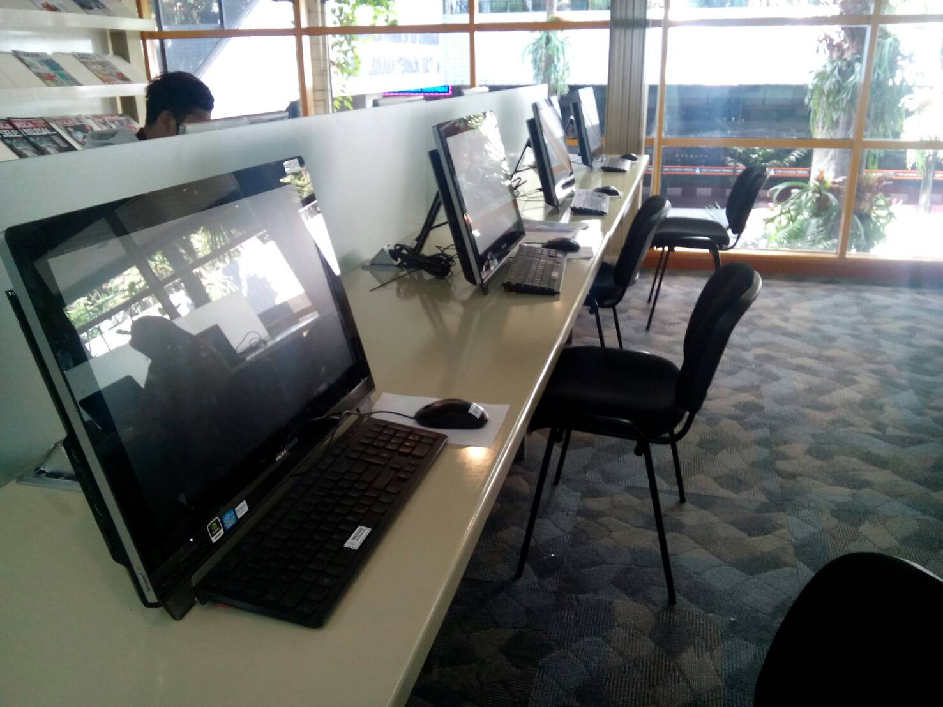
Documentations
Computer corner

Slide 19
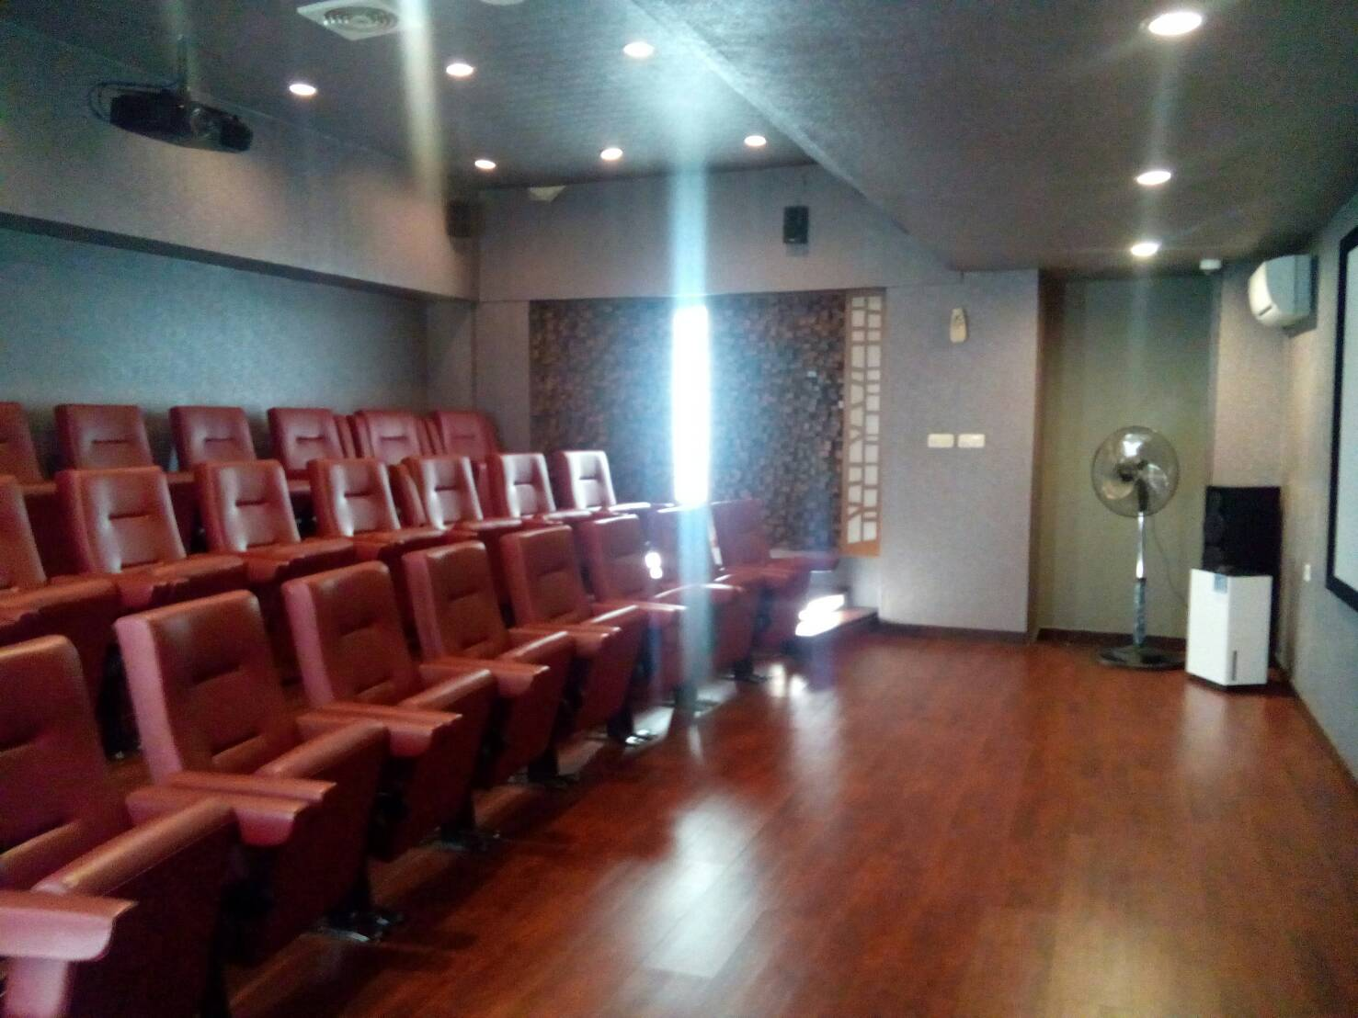
Documentations
Theatre Room

Slide 20
Conclusions
The level of interest reading in Indonesia, especially among employees is still relatively low, for example : among the employees of the Ministry of Education and Culture.
The special library also has a role to enhance reading interest in their environment. Therefore, an effort to improve the reading culture among employees at Ministry of Education and Culture could happen by conducting the collaboration with the reading community and involve their employees. It is expected that the community can inspire the employees to do more reading and increasing the reading culture.

Slide 21
References
Wenger, Etienne (et.al.). (2002). Cultivating communities of practice: a guide to managing knowledge. Boston: Harvard Business School Press
Hurlock, E. B. (1993). Psikologi Perkembangan. Alih bahasa: Dra. Istiwidayanti dan Drs. Soedjarwo, Msc. Jakarta: Erlangga
Sutarno. (2006) Manajemen Perpustakaan Suatu Pendekatan Praktik. Jakarta, CV. Sagung Seto
Perpustakaan Nasional RI. (2002) Standar Perpustakaan Khusus. Jakarta, Perpustakaan Nasional. http://www.perpusnas.go.id
M. Nugroho. (2010). “Perubahan Melalui Membaca”. http://bataviase.co.id./detailberita-10521661.html
Ridwan Siregar. (2004). “Pengembangan Budaya Baca Masyarakat Melalui Perpustakaan.” Universitas Sumatera Utara. http://library.usu.ac.id

Slide 22
THANK YOU

