Slide 1
SUMPAH PEMUDA CLASSIFICATION SYSTEM AT GELARAN IBUKU LIBRARY
Sri Andayani¹, Okky Rizkyantha²
Islamic State University of Sunan Kalijaga Yogyakarta
Email: sandayaniapk91@gmail.com¹, orizkyantha@gmail.com²

Slide 2
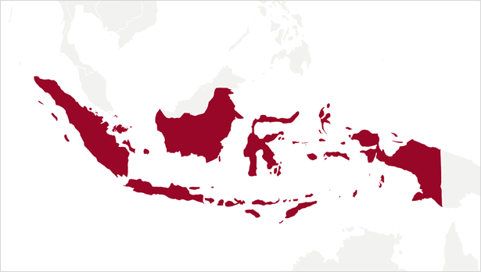
OUTLINE
I. INTRODUCTION
II. METHOD
III. RESULTS AND DISCUSSION
IV. CONCLUSION
REFERENCES

Slide 3
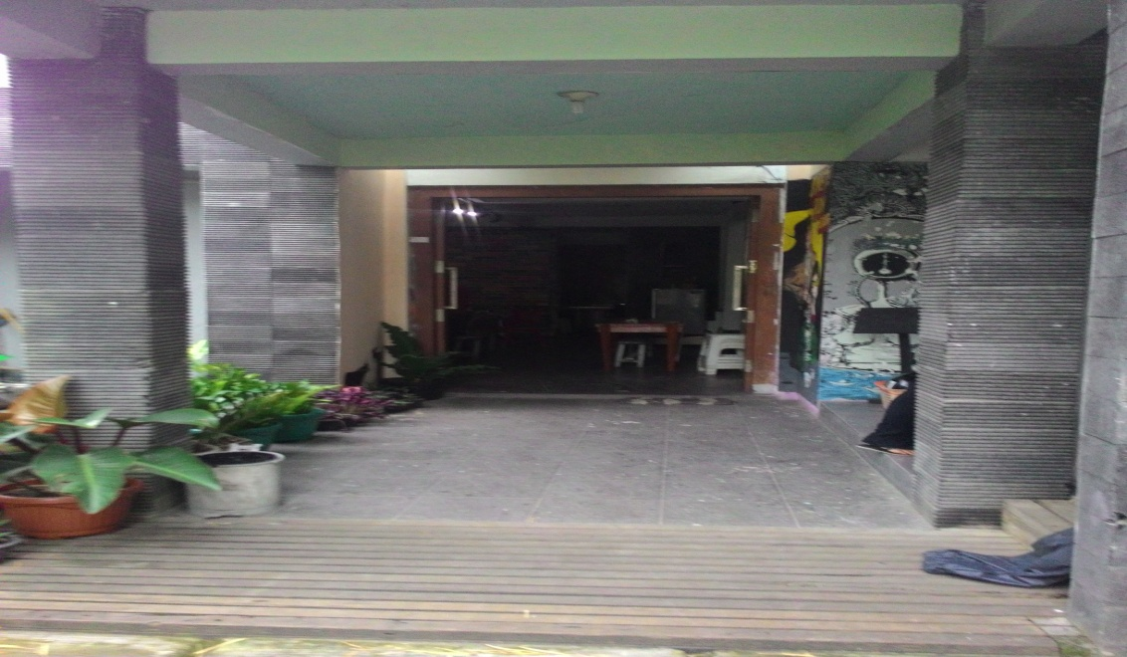
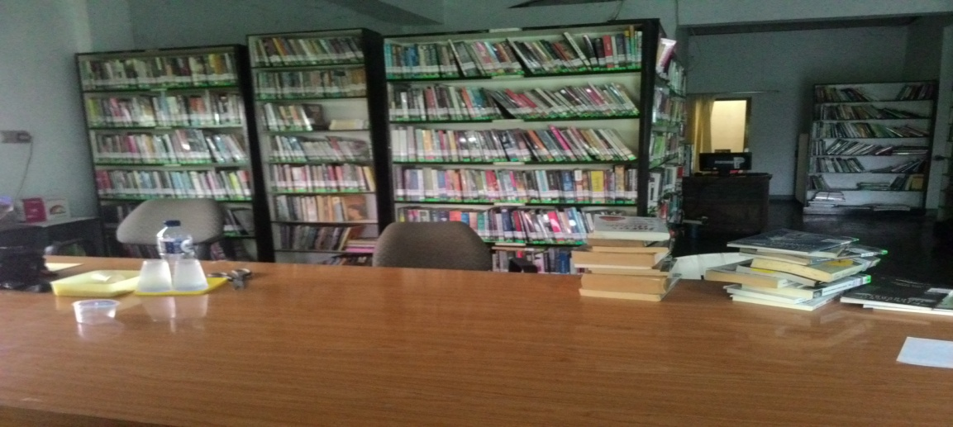
GELARAN IBUKU PROFILE

Slide 4
Sumpah Pemuda
Sumpah Pemuda is one of the historical evidence Indonesian people's struggle to gain independence from the colonizers. From the words we know that the Sumpah Pemuda established by the youths on October 28, 1928 as a symbol of unity the youth to gain the freedom colonialisms
Sumpah Pemuda
Kami Putra dan Putri Indonesia, mengaku bertumpah darah yang satu, tanah air Indonesia.
Kami Putra dan Putri Indonesia, mengaku berbangsa yang satu, bangsa Indonesia.
Kami Putra dan Putri Indonesia, menjunjung bahasa persatuan, Bahasa Indonesia.

Slide 5
II. METHOD
This research uses the analysis description method.
Research object is Gelaran Ibuku Library, located at Jl. Sewon Indah no. 1 Sewon, Panggungharjo, Bantul, DIY 55188.
Data were taken by various methods, they are observation, document review, in-depth intervewing.
The samples were taken by purposive and snowball.
Then we have 2 informans as a sources to this research.

Slide 6
Discussion
Gelaran Ibuku Library is a public library that is managed by a few people who are very interested in the history of Indonesia. Collections on the history became the main priority that is collected in this library. However, if there are contributing books in other topics and subject such as religion course, they are still accepted to be a collection of the library. Most of the collection owned is history, biography, and literature.
As a symbol of love to Indonesian history, the library sets its own policies in managing the materials. The collections grouped based on the Sumpah Pemuda. Sumpah Pemuda has three points as follows:
Tanah Air, Bangsa, Bahasa

Slide 7
Discussion
The collection is processed by very simple method. Grouping collection on the shelf based on the Sumpah Pemuda divided into three groups, with details as follows:
Tanah Air, consists of collection of the area (region), is collection that talks about areas in Indonesia
Bangsa, consisting of collection of figures and history, is collection of figures and history in Indonesia
Bahasa, consisting of collection of Indonesian literature.
Collections that besides the three groups mentioned above, classified into General Works, such as collections of religion. And they will be given code 4. So, the library is established their own collection into four groups.

Slide 8
IV. CONCLUSION
Based on the above, it can be concluded that Classification System in Gelaran Ibuku using a very simple method and is not specific to the subject of the book. The Classification is not the standards which created by library associations, but only the policies established by Gelaran Ibuku Library. The main reason of library to making the Sumpah Pemuda policy for classification of books is that every element in the library should contain values and historical nationalism of Indonesia.

Slide 9
REFERENCES
_______, Isi Teks / Naskah Sumpah Pemuda Yang Benar dan Lengkap, http://www.edukasippkn.com/2015/08/isi-teks-naskah-sumpah-pemuda-yang.html(Accessed December 28, 2016)
HS, Lasa, (2009), Kamus Kepustakawanan Indonesia, Yogjakarta: Pustaka Book Publisher.
K. Widodo, Sutejo, Memaknai Sumpah Pemuda di Era Informasi, http://ejournal.undip.ac.id/index.php/humanika/article/view/4604/4185 (Accessed December 28, 2016).
Miswan, Klasifikasi dan Katalogisasi: Sebuah Pengantar, Delivered at “Workshop Perpustakaan dan Kearsipan” which held by STAIN Purwokerto, 17 Juli 2003. Pansila, Herry dkk, (2011), Warta Depok: informasi dan komunikasi masyarakat kota depok 10th. Ed. Depok: Dinas Komunikasi dan Informasi Kota Depok.
Soedibyo, Noerhayati, (1988), Pengelolaan Perpustakaan, Jakarta: Offset Alumni.
Sugiyono, (2013), Metode Penelitian Pendidikan: pendekatan kuantitatif, kualitatif dan R&D, Bandung: Alfabeta.
Sukmadinata, (2006), Metode Penelitian Pendidika, Bandung:Rosdakarya.

Slide 10
Have a nice day..!!
THANK YOU

