Slide 1
Ahmad Anwar Annisa Rohmawati Arif Cahyo Bachtiar
The Preservation Strategy of Ancient Text as An Effort to Protect the Heritage of Javanese Culture in Pura Pakualaman Library

Slide 2
Indonesian History
kingdom era
colonialism
independence era

Slide 3
Many kingdoms in Java

Slide 4
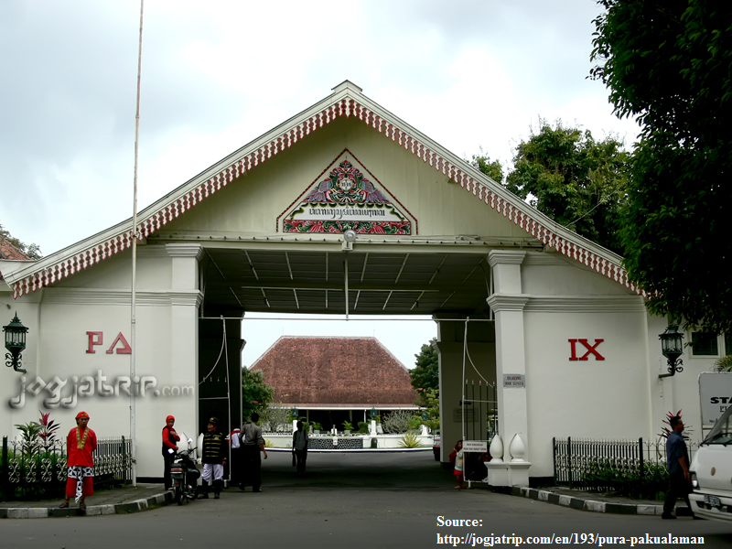
Pura Pakualaman Kingdom

Slide 5
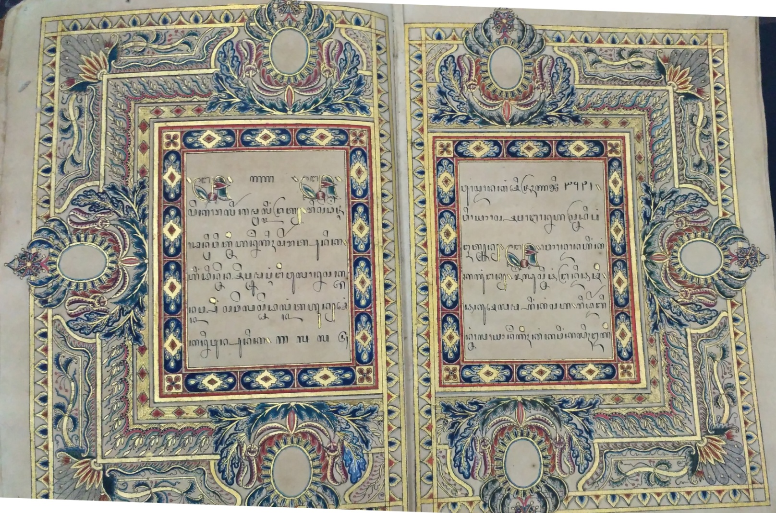
Ancient Text in Pura Pakualaman

Slide 6
Literature Review
Ancient text
Ancient texts are any documents that are written or printed and not duplicated in another way, while the age of the document is more than fifty years and has important value to culture, history, and science (Lasa HS)

Slide 7
Special library
special library is a library which is established for special interest. This special interest is an information necessity of an institution which establishes the library. The institution can be from the government or not, like private companies. The special library serves the information necessity of the society who works for that institution. The information that is managed by this kind of library is the special information that is usually produced by the related institution.

Slide 8
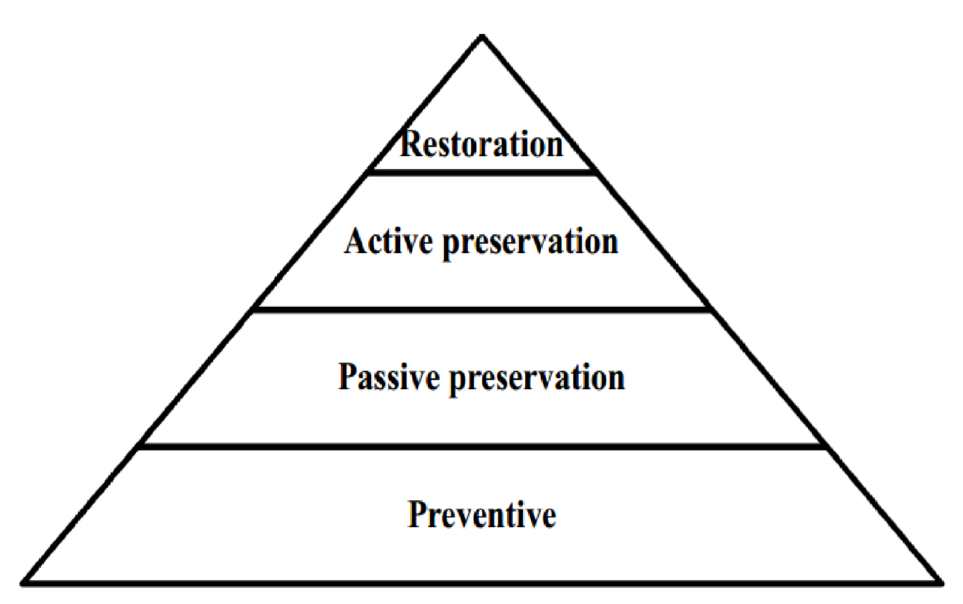
The preservation of the collection

Slide 9
Methodology
This research uses qualitative method
It is a procedure of research that produces descriptive data of written or spoken words from many people and their behavior that can be observed or accomplished as the source of information.
The data collecting technique uses three methods, which are observation, interview, and documentation
The activity in data analysis, that us reduction, data display, and conclusion drawing / verification

Slide 10
Pura Pakualaman Library
Pura Pakualaman Library is a special library located in Sultan Agung street. All the collections in this library belong to the royal family of Paku Alam. Most of the collections were literature works that written at the time of Paku Alam I (1812-1829) until Paku Alam VII (1906-1937).
Library do not only collect scriptorium-text, but it also collects some granted printed books.
The bookkeeping and revamping is then continued on December 2002 until November 2003. It aims to make scripts catalog of Pura Pakualaman library collection. This activity also produces 251 finding scripts which then kept in a data basic.
One becomes the head of the library, another one is Abdi Dalem Tepas, and the rest are Abdi Dalem Caos

Slide 11
Preservation
Phisical
Content

Slide 12
The physical preservation strategy
Preventive
Passive preservation
Active preservation

Slide 13
The content preservation strategy
Piwulang (teaching)
Batik
The dance art

Slide 14
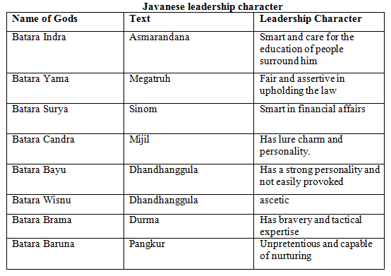
Piwulang (teaching)

Slide 15
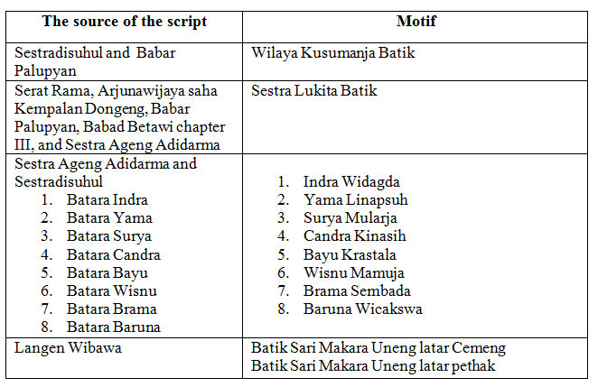
Batik

Slide 16
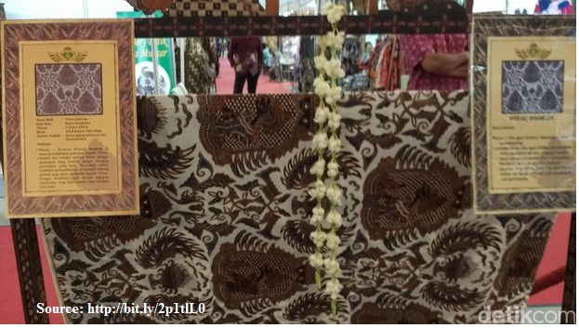
Example...

Slide 17
Example 2...

Slide 18
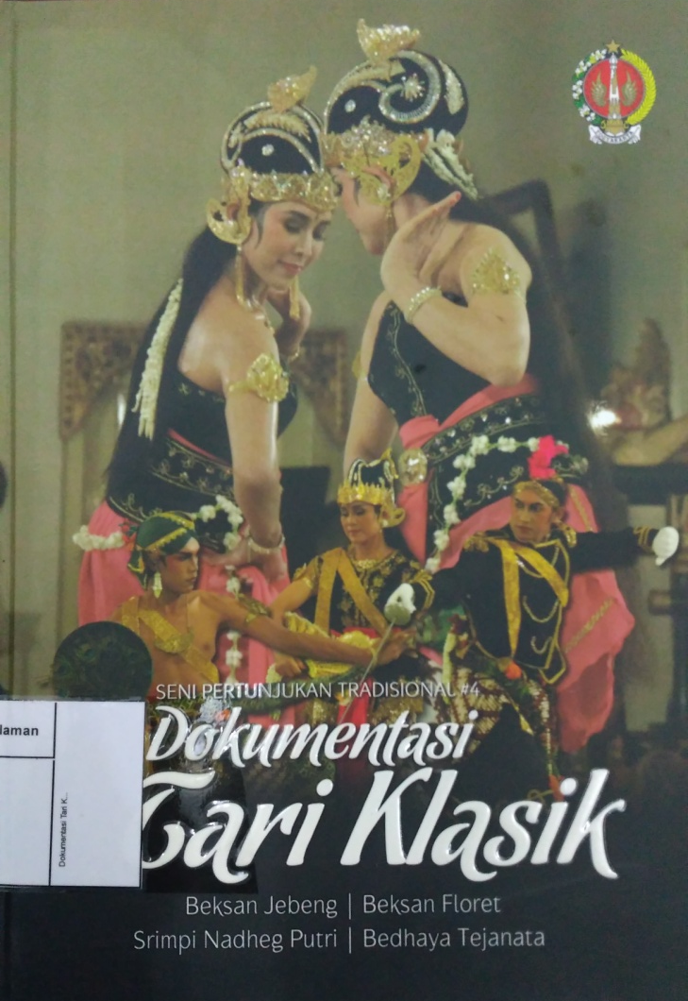
The Dance Art

Slide 19
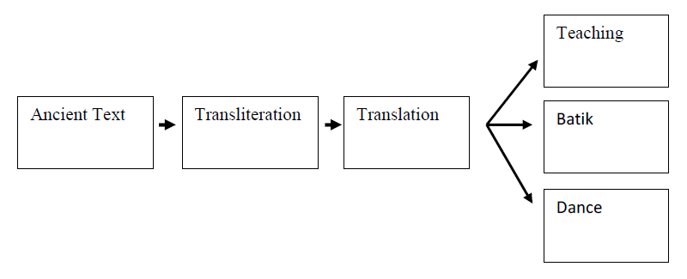
Text Preservation Process

Slide 20
Conclusion
Pura Pakualaman Library conducts ancient texts preservation in the form physical and content preservation
For suggestion, the writer takes a note from the financial problem that limits the preservation process. It can be overcome by searching for donors outside of Pakualaman

