Slide 1
“Ekspedisi Budaya” as a Program in the Special Library of Ministry of Education and Culture to Improve Research Productivity in Indonesia
Erlin Novita Sari
Tamara Adriani Susetyo-Salim
INDONESIA

Slide 2
International survey on the number of publications research showed that Indonesia was in the number 58 of 163 countries.
Is still far from the other Asian countries such as Japan (5), India (13), Singapore (17), and Thailand (43).
Source: http://www.natureindex.com/country-outputs/generate/All/global/All/weighted_score, December 2016

Slide 3
Several factors that affect to low productivity in research:
1. The quality of research is low
2. Lack of research culture
3. Lack or limited knowledge of research methodology

Slide 4
Ministry of Education and Culture is an institution that conducting the affairs in the field of education as well and the management of culture in Indonesia.
Ministry of Education and Cultural has an important role to improve the interest of research.
One of many ways is through the cultural program which hosted by special library.

Slide 5
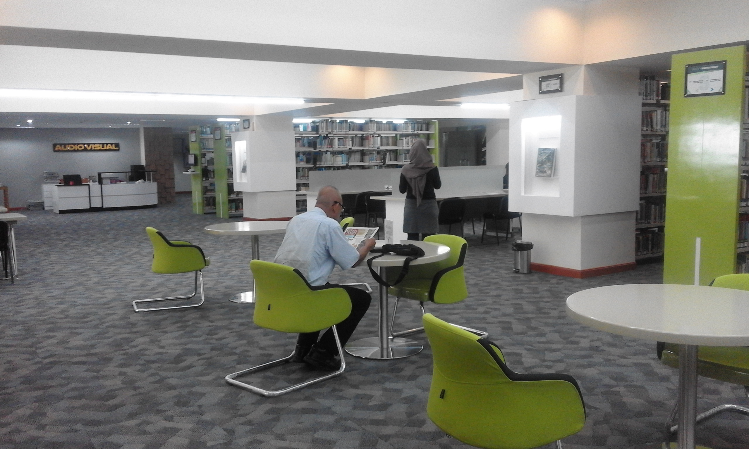
Ministry of Education and Culture Special Library
The outside of Ministry of Education and Culture Special Library
The atmosphere in the Ministry of Education and Culture Special Library
Doc: personal

Slide 6
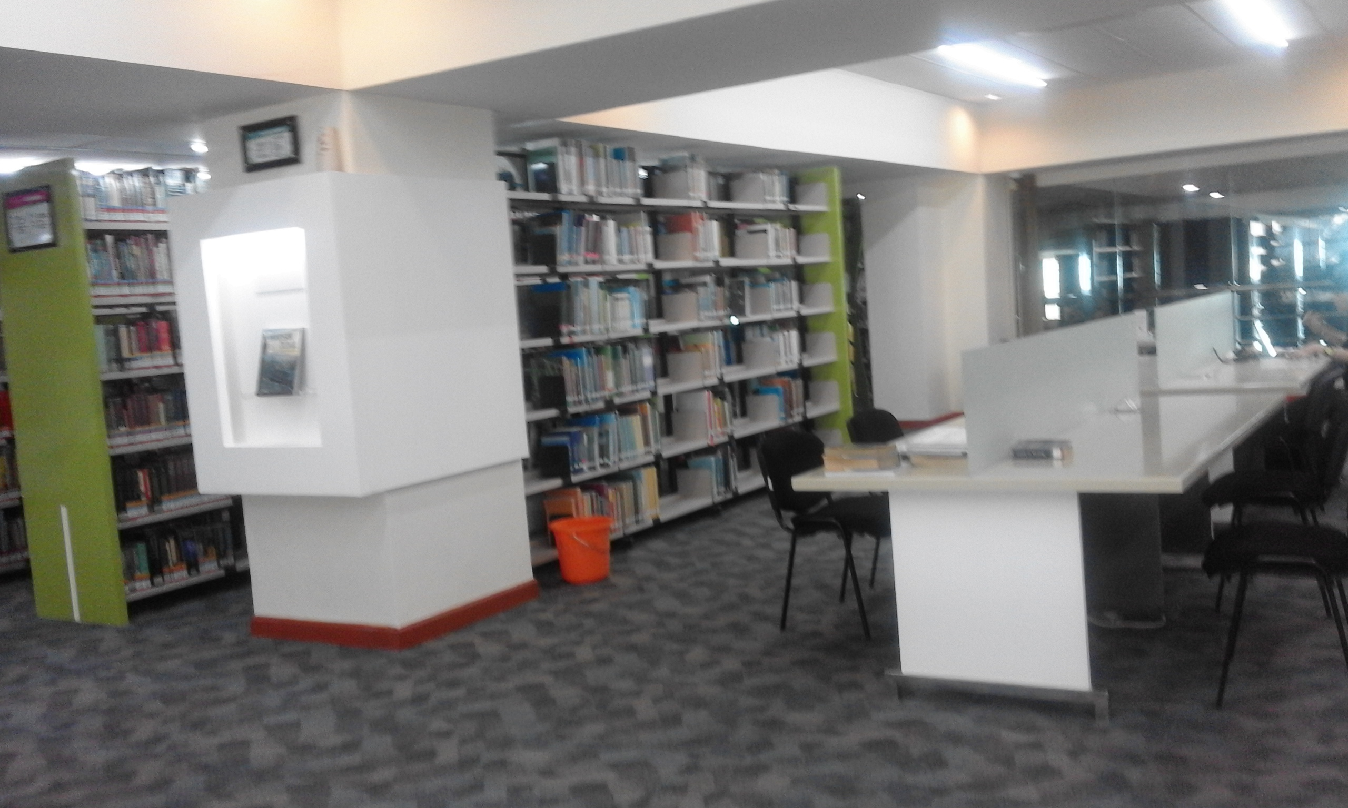
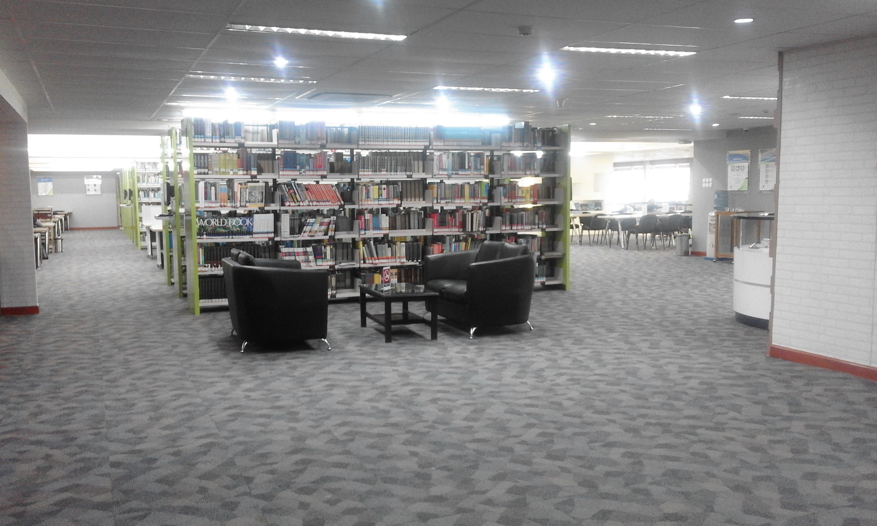
Reading room and collection of Ministry of Education and Culture Special Library
Reading room and collection of Ministry of Education and Culture Special Library
Doc: personal

Slide 7
Ekspedisi Budaya (Cultural Expedition)
Event of cultural studies which is hosted by Faculty of Humanities of the University of Indonesia.
To improve the interest of students toward science-based research and build concern of society and academia toward the culture of Indonesia.

Slide 8
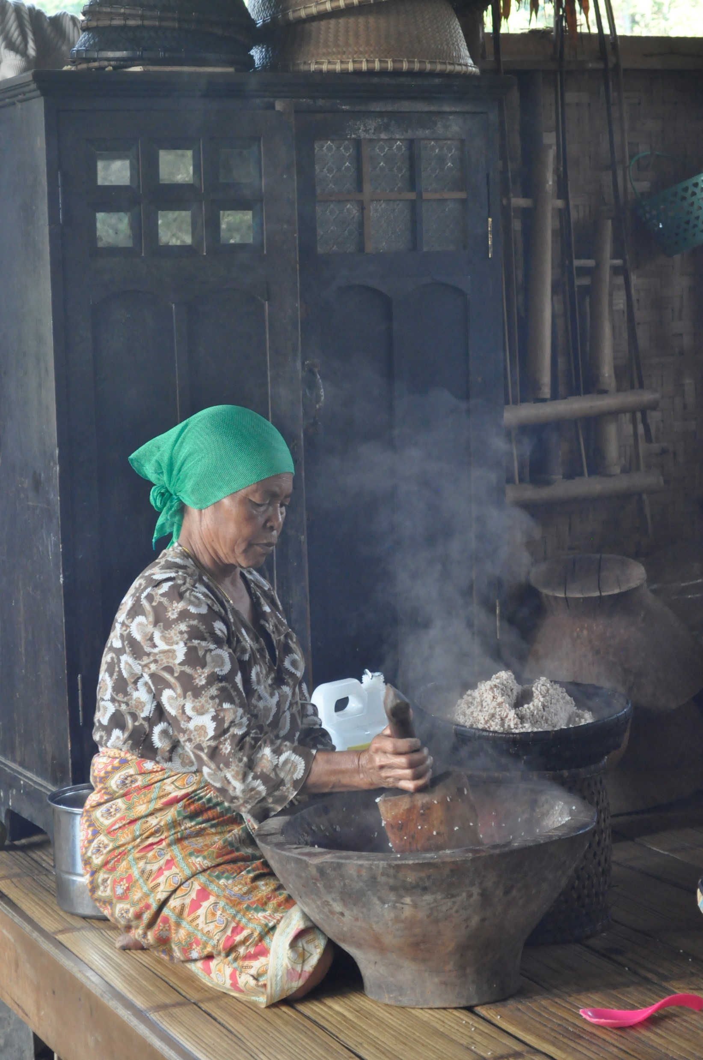
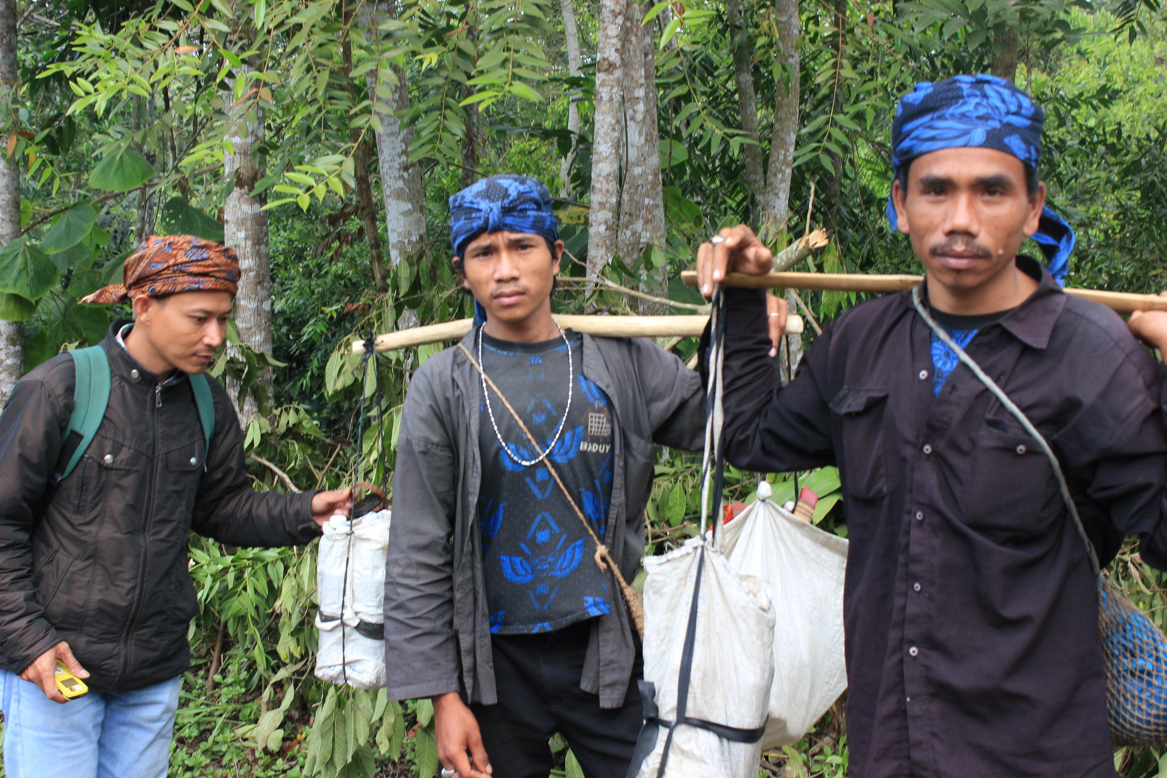
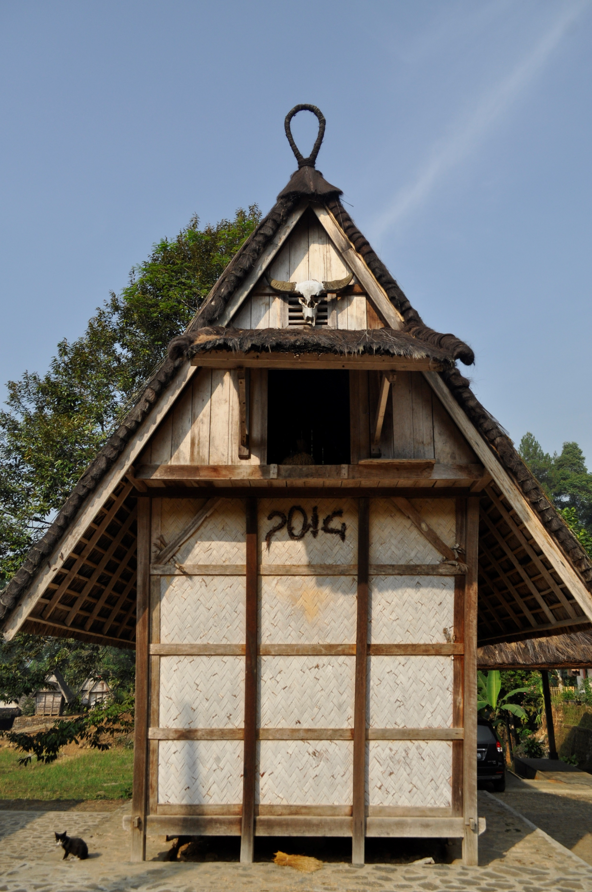
Citizens of Cisungsang are preparing food
Citizens of Cisungsang
Rice barn or Leuit
Credit to: Ekspedisi Budaya Committee

Slide 9
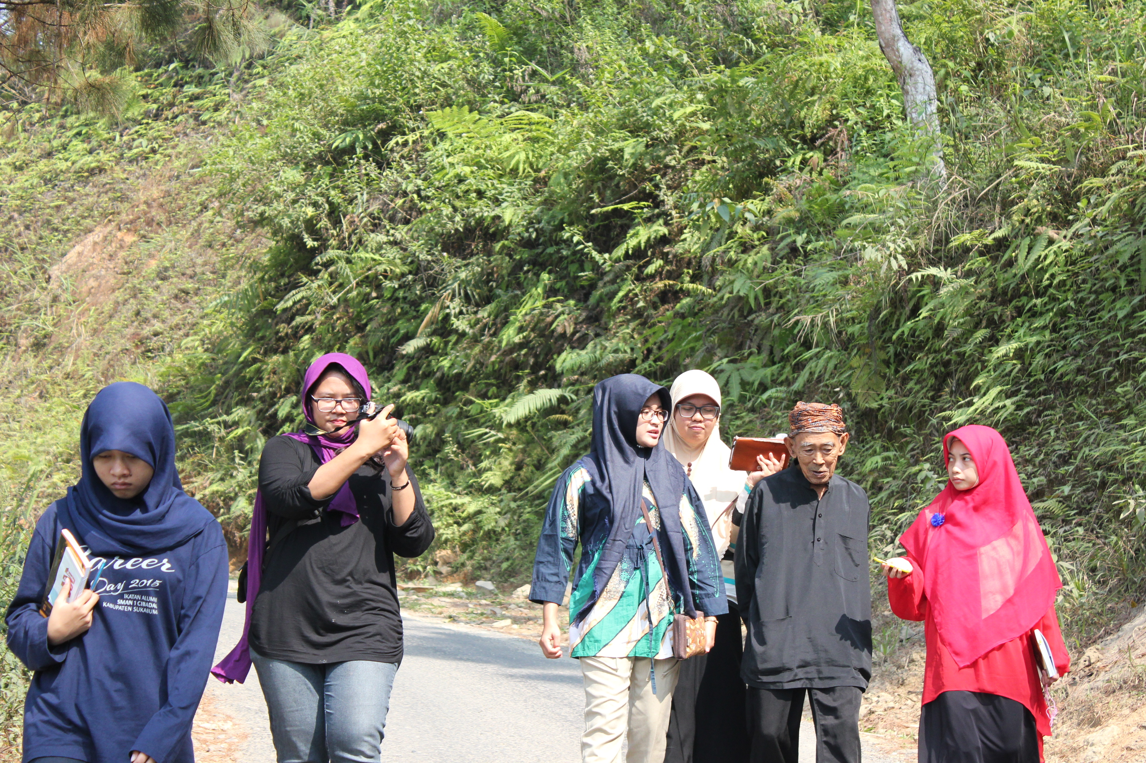
Rice barn or Leuit
Researchers and community leaders in Cisungsang are in discussion
Credit to: Ekspedisi Budaya Committee

Slide 10
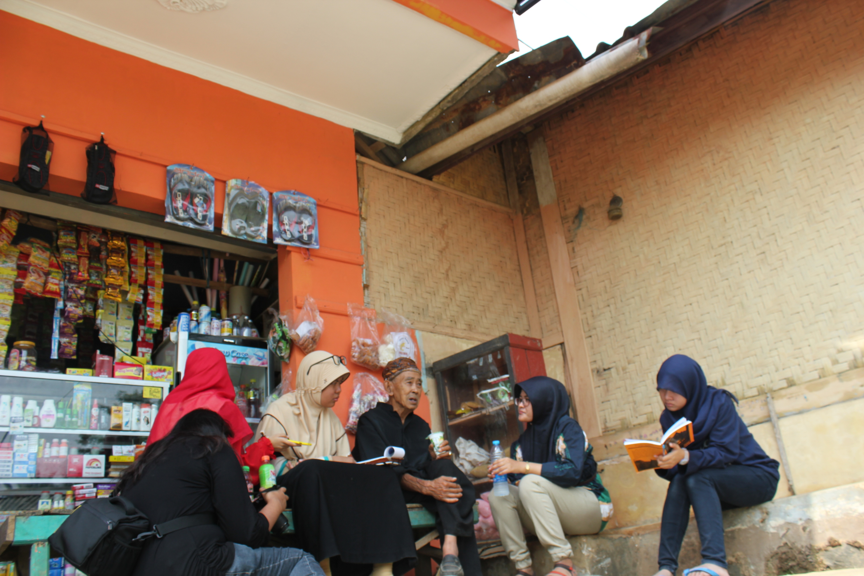
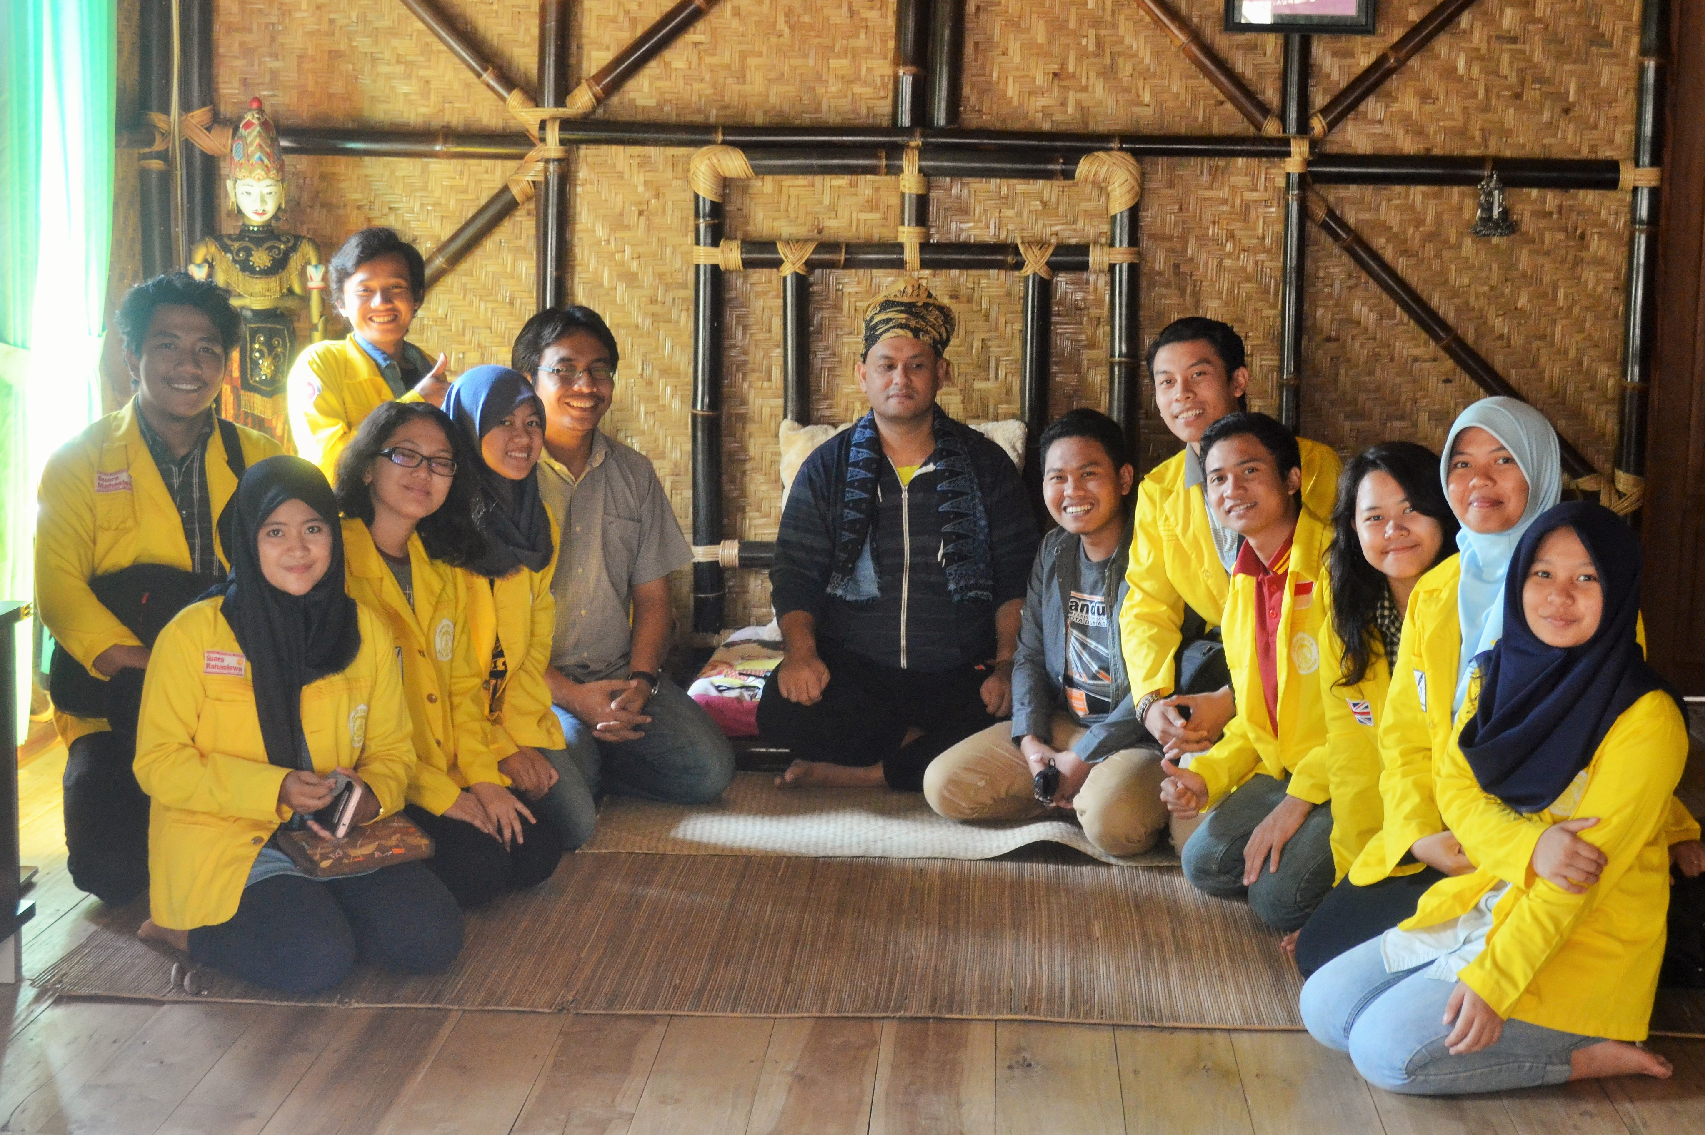
Researchers and community leaders in Cisungsang are in discussion
Researchers and community leaders
Credit to: Ekspedisi Budaya Committee

Slide 11
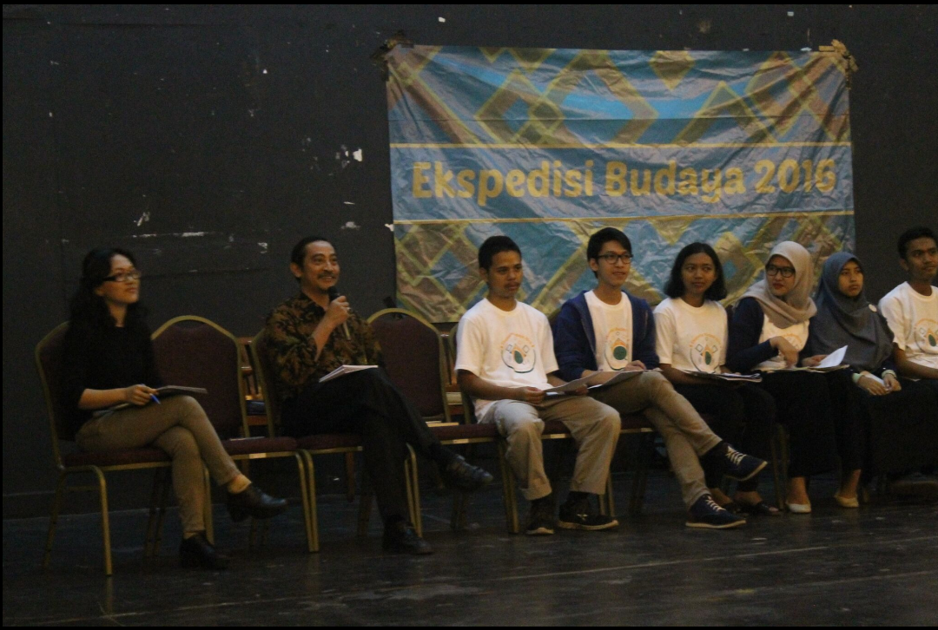
Researchers doing a discussion about the result of research
Credit to: Ekspedisi Budaya Commitee

Slide 12
Role of Special Library
“Special library is a place of research and development, the central of studies, and the supporter of education and training for human resources/worker." -Sutarno NS (2000:39)
In this case, “Ekspedisi Budaya" can be a reference to doing the research program in a Ministry of Education and Cultural special library by doing a collaboration.

Slide 13
The special library of the Ministry of Education and Cultural is not involved directly in the research field.
Library of the Ministry of Education and Cultural has a role as a support that provides the information about research materials.

Slide 14
According to Poernomowati (2010:4, one of the special library functions is to publish the secondary and tertiary literature in their main institution, both print and electronic
The special library of the Ministry of Education and Culture also can have collaboration with “Ekspedisi Budaya” for publishing literature works such as a journal.

Slide 15
A Constraint
This collaboration has not been made by both of parties
“Ekspedisi Budaya” is an internal event of students from Faculty of Humanities of the University of Indonesia.

Slide 16
Conclusion
Special library as a library which is built by an institution to confront the needs of the environment has another aim in research
The library should have their own research unit
“Ekspedisi Budaya" can be one of the references to deliver the program in a library of the Ministry of Education and Culture as a form of collaboration.

Slide 17
Sources
Book
Malo, M. (1989). Pengembangan ilmu-ilmu sosial di Indonesia sampai dekade '80-an. Jakarta: Rajawali Pers.
Robertson, D. A. (2005). Cultural Programming for Libraries Linking Libraires, Comunities and Culture. Chhicago: American Library Association.
World Wide Website
Nature Index. (2017, March 2). Country Outputs. Retrieved from Nature Index: http://www.natureindex.com/country-outputs/generate/All/global/All/weighted_score
Perpustakaan Nasional RI. (2002) Standar Perpustakaan Khusus. Jakarta, Perpustakaan Nasional. http://www.perpusnas.go.id
Putri, R. L. (2017, March 17). Pemanfaatan perpustakaan khusus sebagai sarana penelusuran informasi oleh peserta diklat di Pusdiklat Mineral dan Batubara Bandung. Retrieved from Repositori UPI: http://www.repository.upi.edu/89/
Slameto. (2016, December 29). Membangun Budaya Penelitian. Retrieved from elib Unikom: elib.unikom.ac.id

Slide 18
Thank You

