Slide 1
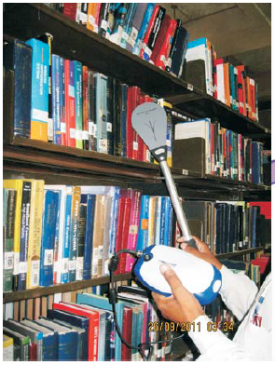
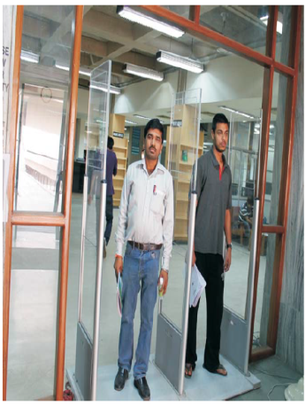
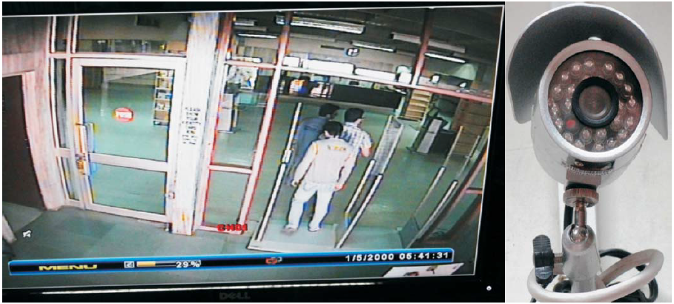
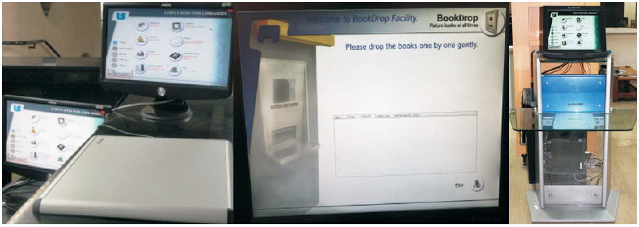
Survey of Use and Impact of RFID: A case study of IIT Delhi
Nabi Hasan
University Librarian
Aligarh Muslim University (AMU), India
www.nabihasan.in nabihasan@gmail.com
The 5th International Conference of Special Asian Libraries, May 10-12, 2017

Slide 2
Outline of Presentation
Background
RFID@IIT Delhi Central Library
Components
Major Advantages
Major Disadvantages
Statement of the Problem
Scope
Objectives of the Study
Methodology and Limitations
Data Analysis and Interpretation
Findings
Suggestions
Conclusion

Slide 3
Background
Britishers first pioneered the RFID technology during the World War II for their Aircraft identification
Late 1960s- US Government began using RFID to tag and monitor nuclear and other hazardous materials
The first US patent for an active RFID tag with re-writable memory was obtained by Mario E. Cardullo on January 23, 1973
RFID in India was developed in the 1940s for defence applications. First time it was used for commercial purpose in 1980 for cattle tracking applications
The first library RFID suppliers started to market their systems in mid 1990s
Today, RFID is used for automatic toll collections, access control, security, tracking objects and humans in shops, libraries, hospitals, etc.

Slide 4
RFID@IIT Delhi Central Library
IIT Delhi Central Library has implemented the Radio Frequency Identification (RFID) system.
It is the best automated library automation system used world wide and is an effective way of managing collections of the library and providing enhanced services to the users having benefits like:
self check-out of books
self-check-in (book drop)
to control theft
to find misplaced reading material
sorting
inventory accuracy
stock verification procedures
security control
video surveillance
people counter
Smart Card issuance etc.
It is an automatic data capture technology that uses tiny microchips and miniature antennas affixed to documents.
RFID plays a vital role in redefining the library processes to make everyone’s job easier right from the users to library staff.

Slide 5
Components
RFID tag (or transponder): These are paper-thin smart labels which are electronically programmed, consisting of an integrated circuit and antenna coil that communicates with a reader by means of a radio frequency signal. Many types of RFID tags are available, viz. Active, Passive, HF/UHF/Hybrid… etc.
Notes:
Low frequency (LF) Tags perform well affixed to virtually any surface, with data storage capability up to 2048-bit read-write memory.
High frequency (HF) Tags offer anti-collision technology for faster data processing, larger memory storage, and improved read ranges. HF IN Tag devices are available with up to 1 kbit EEPROM or 8 kilobyte FRAM - the highest memory possible in an ISO 15693 compliant tag. FRAM tags are radiation resistant to survive Gamma sterilization and offer an exceptional speed with up to 10 billion write cycles.
UHF IN Tag Tags are compatible with international standards, and can be read from up to 9.8 ft (3 m). Entire pallets of individual containers or equipment can be identified and item level status updated as articles roll through distribution and receiving points. On Metal tag versions guarantee excellent performance when mounted on metallic surfaces.

Slide 6
Tag Details
Paper thin 50x50mm
with atleast 1024 bits
ISO 15693/18000-3 compliant
Read-only or
Read/writable
Storage capacity varies
Tags come in many flavors: passive, battery assisted, active, different frequencies, various anti-collision technologies, printed/wire wounded antenna etc.

Slide 7
Tag Details
 | Parameter | Active RFID tags | Passive RFID tags
 | Power source | Internal | Energy transferred from the reader
 | Power availability | Continuous | When it is in the field of the reader
 | Communication range | Long range | Short range
 | Data storage | Large | Small
 | Signal strength from tag to reader | High | Low
 | Signal strength from reader to tag | Low | High
 | Weight | 120-130 grams | 6-54 grams
 | Operational life | Five to ten years | Unlimited
 | Memory | 2 MB | Up to 16 KB
 | Cost | Rs. 25 ? | Rs. 15

Slide 8
Operating Frequencies
Band | LF Low frequency | HF High frequency | UHF Ultra high frequency | Microwave
Frequency | 30–300kHz | 3–30MHz | 300 MHz–3GHz | 2–30 GHz
Typical RFID Frequencies | 125–134 kHz | 13.56 MHz 433 | 433MHz or 865 – 956MHz 2.45 GHz | 2.45 GHz
Approximate read range | less than 0.5 metre | Up to 1.5 metres | 433 MHz = up to 100 metres 865-956 MHz = 0.5 to 5 metres | Up to 10m
Typical data transfer rate | less than 1 kilobit per second (kbit/s) | Approximately 25 kbit/s | 433–956 = 30 kbit/s 2.45 =100 kbit/s | Up to 100 kbit/s
Characteristics | Short-range, low data transfer rate, penetrates water but not metal | Higher ranges, reasonable data rate (similar to GSM phone), penetrates water but not metal | Long ranges, high data transfer rate, concurrent read of <100 items, cannot penetrate water or metals | Long range, high data transfer rate, cannot penetrate water or metal
Typical use | Animal ID Car immobiliser | Smart Labels Contact-less travel cards Access & Security | Specialist animal tracking Logistics | Moving vehicle toll

Slide 9
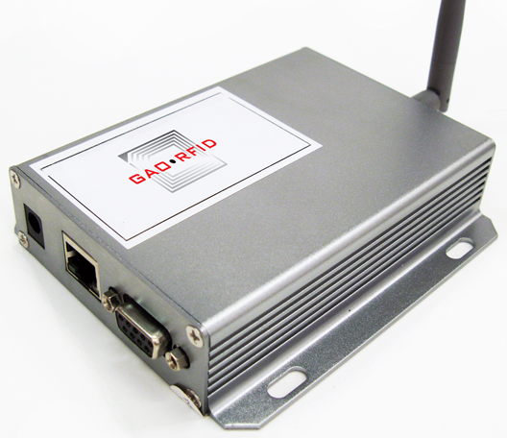
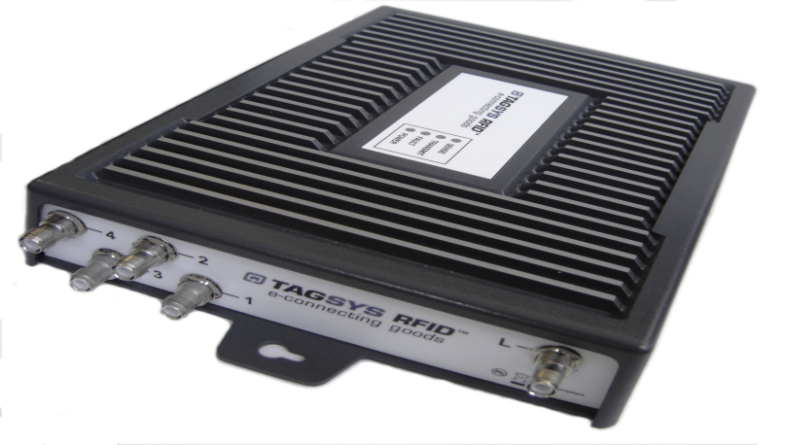
RFID reader (or interrogator)
RFID reader consists of a transmitter, receiver, antenna and a decoder. It communicates with RFID tags, identify them and receive data stored in the tag

Slide 10
RFID Default Main Menu- LSmart based
(iCode based )
Courtesy- LibSys/IIT Delhi

Slide 11
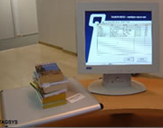
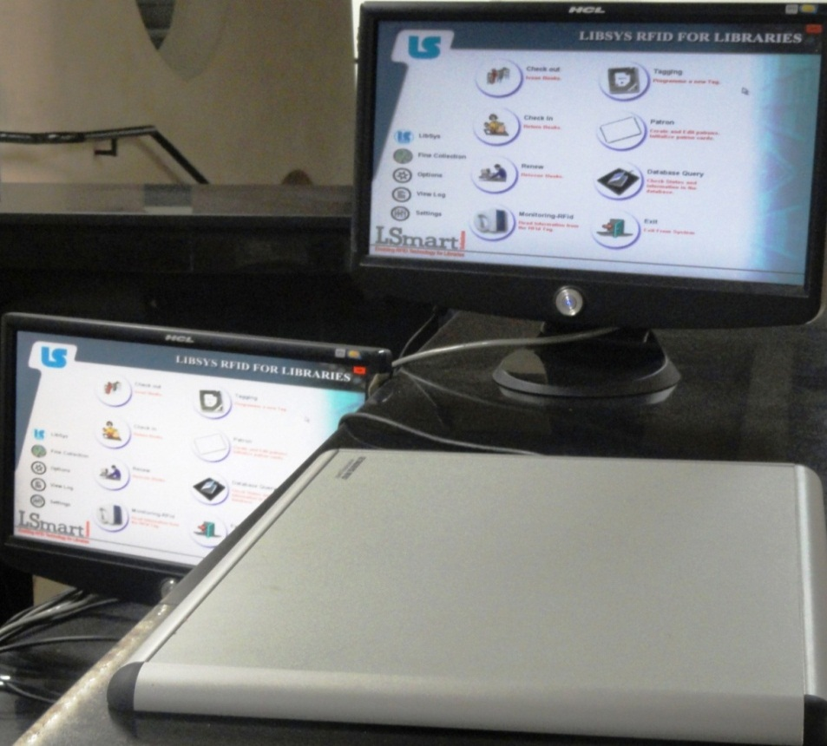
Staff workstation
Used for the issue, return, renewal by the staff in the Library and also for label personalization/tagging, etc.
Courtesy-IIT Delhi

Slide 12
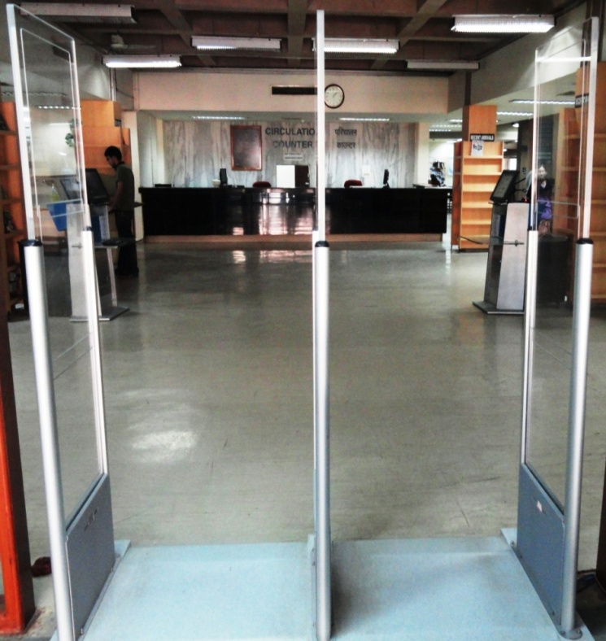
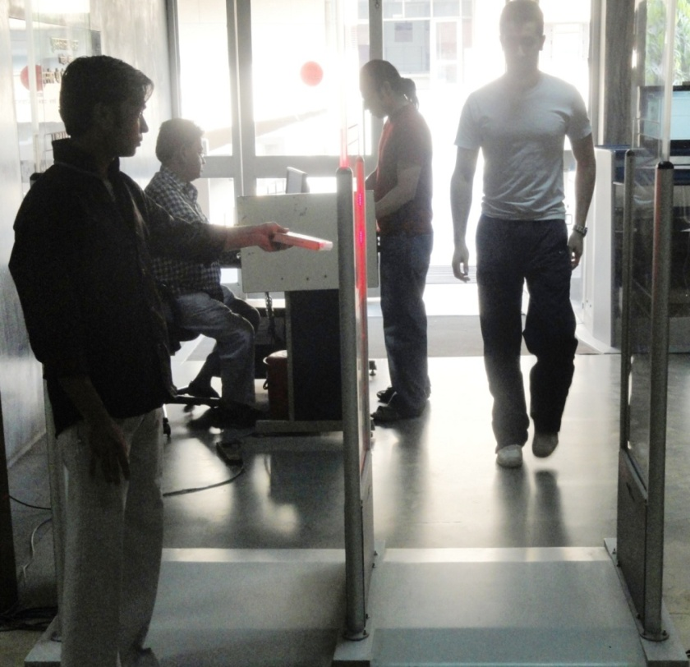
Exit Sensors /EAS Pedestal
Gate Antennas issue a warning signal and activate the alarm system if a document pasted with a label is leaving the premises without an authorized issue/outward entry into software
It may also be used to count the incoming/outgoing people with a facility to record their movement
The system may be integrated with electronic counter, webcam trigger, CCTV recordings, etc.
Courtesy-IIT Delhi

Slide 13
Integrated Self Issue/Return
Self Check-out/ check-in Station
Drop Box facility

Slide 14
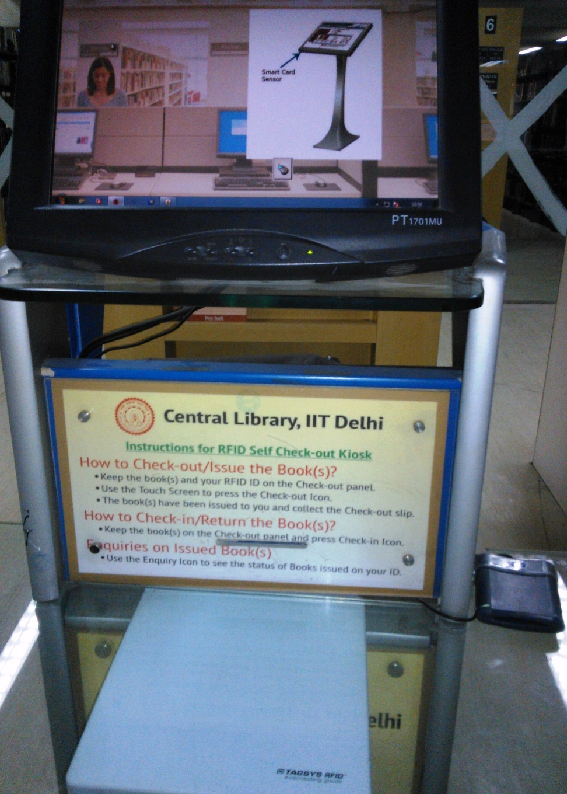
Integrated Self Issue/Return (MiFare based)
Notes:
This is a better system as there are no chances of collision of Tags because there are two separate Readers for Books and Smart Card

Slide 15
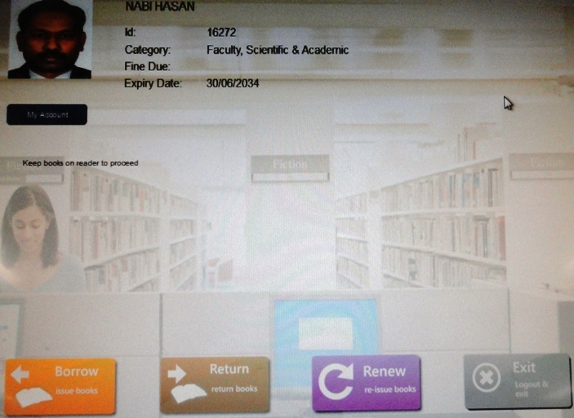
RFID@IITD-Only Most Useful Options
Notes:
Only relevant Icons may be given to facilitate the users

Slide 16
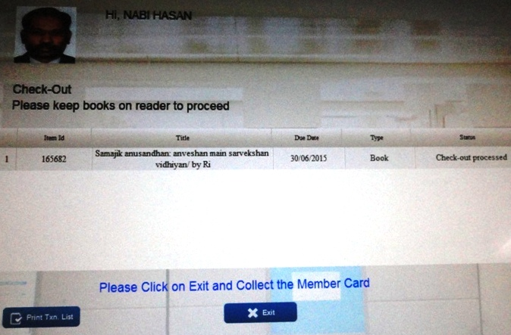
RFID@IITD-Check-out Processed
Notes:
U can print the receipts of Issue or Return to double sure urself

Slide 17
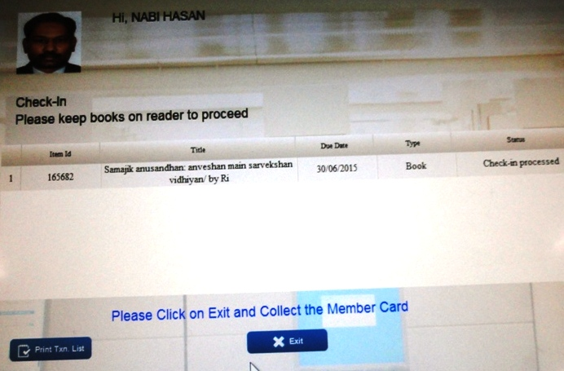
RFID@IITD-Check-in Processed

Slide 18
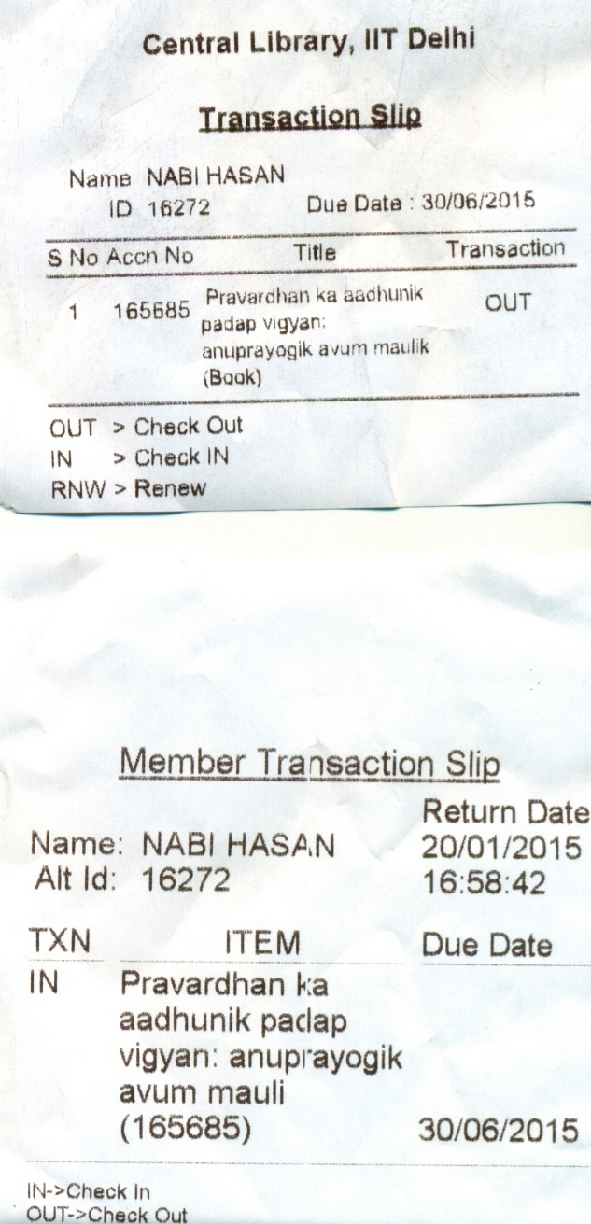
Check-in/Out Slips

Slide 19
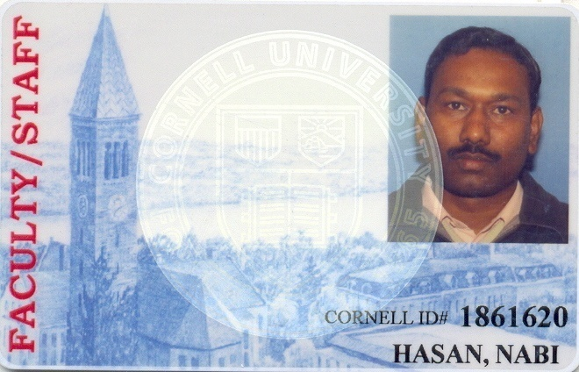
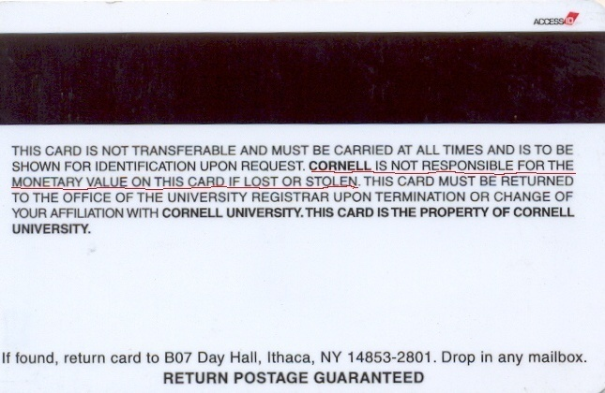
Patron/Smart cards
These cards can also be used as institute ID card, for paying fees, fines, printing or other fee-based services; for gaining Internet access; for photocopying and more (proposed)
IIT Delhi vs Cornell, USA
Notes:
Working Cornell ID vs IIT Delhi ID

Slide 20
Shelf/Inventory management system
Portable Shelf scanner allows library staff to take inventory and find wrongly shelved books without having to pull the books off the stacks. It is very useful for stock verification purpose

Slide 21
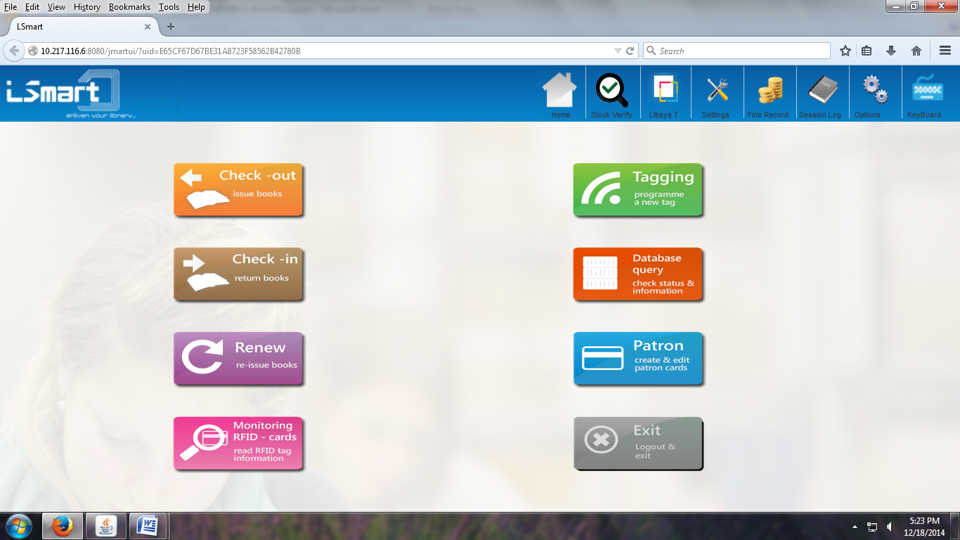
Stock Verification using RFID
(LSmart/Main Menu)

Slide 22
Application software/ Middleware/ RFID Server Layer
Used for Integration with RFID devices and the LMS
Provide reader connectivity to other systems on the network
Translate data and transmit to its other applications
It is used for the reader to transmit or receive data from a tag. Software integrates the reader hardware with the existing library automation software for seamless functioning of circulation section
Notes:
This is the most important component while migrating from Commercial software to an Open Source as the commercial people do not support in providing server integration layer

Slide 23
Server/docking station
It is one on which the software that interfaces with the integrated library automation software is loaded
The server is the heart of comprehensive RFID system. It is the communication gateway among the various components
It receives the information from one or more of the readers and exchanges information with the circulation database
Its software includes the API (Applications Programming Interfaces), necessary to interface it with the automated library system. The server typically includes a transaction database so that reports can be produced

Slide 24
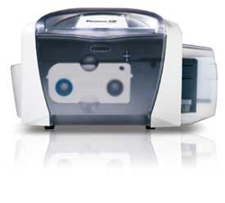
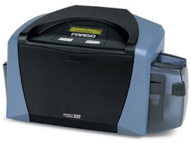
Patron/ Smart Card Printer

Slide 25
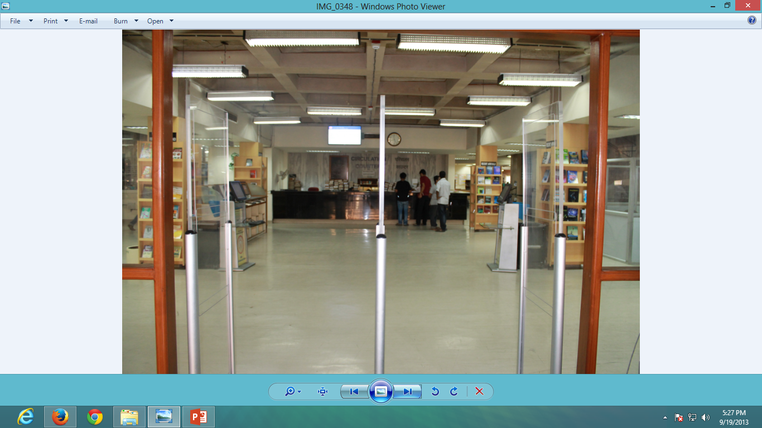
Integrated video surveillance
Courtesy-IIT Delhi

Slide 26
People Counter
RFID system may also have the facility to record the movement of incoming/outgoing members of the library with their details
If a library member is passing through the EAS pedestals with Smart Card, its movement is recorded with details which help in maintaining the statistics and other details for various uses

Slide 27
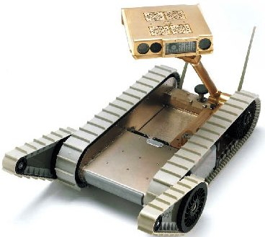
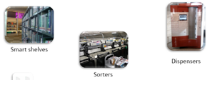
Integrated Robotic circulation system & Smart Library System
Some of the libraries in developed countries like USA are also using the Robots for circulation, integrated with the RFID system
Books/documents in this system are arranged in different enclosures and not as per the classified order to enable the robot to identify the required documents for the users for the issue and then to place it back after return at its original location
Use of Smart shelves, Smart accessioning, Sorters, Dispensers, Conveyer belts
Examples: Mansueto Library-University of Chicago; Valparaiso University, Indiana; Colgate University, Hamilton, NY; USA, etc.
See the Video/Details at: http://singularityhub.com/2011/05/24/robots-not-humans-retrieve-your-books-at-81-million-library-of-the-future-video/

Slide 28
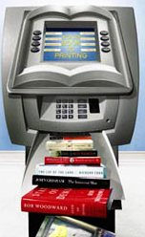
Book ATMs
The machine is a sort of "book dispenser" similar to an ATM in many aspects, which allows library card holders to borrow and return books without needing to visit a library. There are also the Book ATMs which are used for Book selling
Book dispenser machine in Dongguan (www.lias.nccu.edu.tw)
http://money.cnn.com/magazines/fsb/fsb_archive/2006/12/01/8395114/index.htm
http://www.newsgd.com/news/guangdong1/content/2009-09/15/content_5794176.htm

Slide 29
RFID Standards for Libraries
Important ISO standards pertinent to library RFID systems: ISO/IEC 15693, ISO/IEC 18000-3, ISO 28560, ISO 14443A
These standards works on 13.56 Mhz
The tags and the equipments used may carry the FCC & EN-ETSI Certifications
They may follow the NCIP V2.0 or SIP2 protocol
Voltage : 230 Volt
Data Interface: RS 232
http://www.iso.org
http://www.iec.ch
Notes:
ISO/IEC 15693, is an ISO standard for vicinity cards, i.e. cards which can be read from a greater distance.
ISO/IEC 18000-3 is an international standard for passive RFID item level identification.
ISO/IEC 14443 Identification cards -- Contactless integrated circuit cards -- Proximity cards is an international standard.
Federal Communications Commission (FCC)
European Telecommunications Standards Institute (ETSI)
NCIP (NISO Circulation Interchange Protocol, also known as Z39.83). NCIP services facilitate the automation of tasks, the exchange of data, the ability to provide information to library staff, and the empowerment of patrons.
Standard Interchange Protocol (SIP) is a proprietary standard for communication between library computer systems and self-service circulation terminals. Version 2.0 of the protocol, known as "SIP2", is a de facto standard for library self-service applications.
ISO 28560 provides the framework to ensure interoperability between libraries in exchange of library items with RFID tags, the freedom of the library to acquire or renew equipment or library items from different vendors and interoperability of a single RFID application from the vendor's perspective.

Slide 30
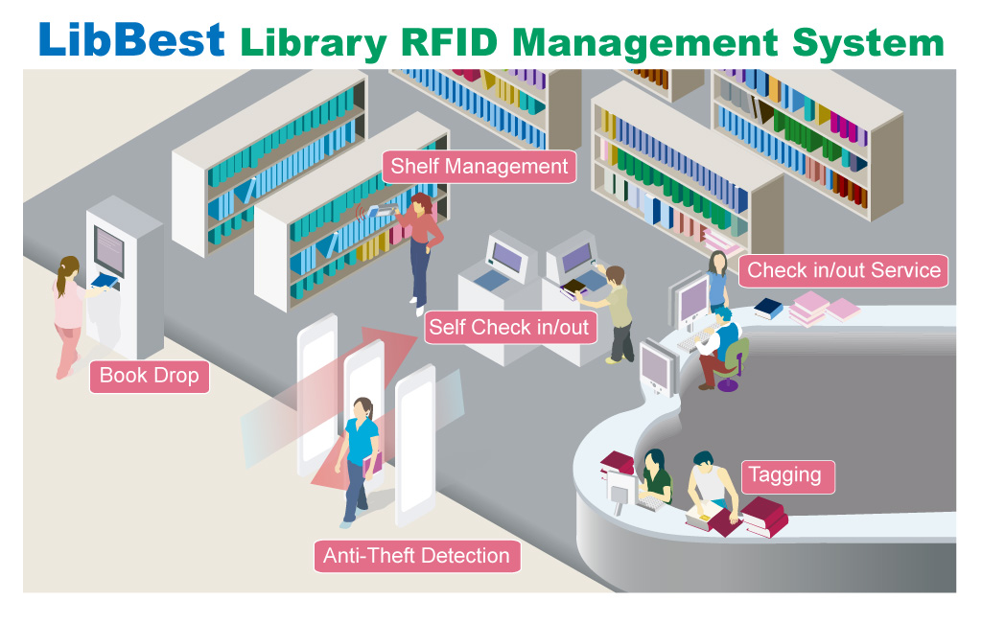
Library RFID Diagram
(Source-http://www.rfid-library.com)

Slide 31
How does Library RFID System work?
The RFID reader sends out electromagnetic waves in the RF (Radio Frequency) spectrum
When the tag enters the RF field, the tag’s electronic circuits are powered by energy from the RF field
The tag then modulates the waves and sends them back to the reader
The reader converts the signals received from the tag into digital data and sends it to the host computer

Slide 32
Major Advantages
RFID tag does not have to be visible for detection
Hassle free issue/return/renewal
Increases the security function in library
Improved utilization of resources like manpower, infrastructure, etc.
Flexible library timings by use of Self Charging and Book Drop Kiosk
Quick Inventorying, shelf reading, re-shelving, sorting, searching, weeding and exception finding
Enhanced customer services and improved process efficiency
Highly reliable, claims an almost 99.9 percent detection rate
RFID tags last longer than barcodes
RFID vendors claim a minimum of 100,000 transactions per tag
EAS exit gates have option to keep record of incoming and outgoing library users with recording
Fingerprint or picture or Signature of the cardholder can be stored onto the card

Slide 33
Major Disadvantages
High cost
Technology still developing, Interoperability and Standardization issues
Integration problem of RFID solution with the software/hardware
RFID system may be compromised with certain devices
Moisture, metal, mist, distance and incorrect positioning of antennas may affect functioning
Physical damage to the tags/removal by the library users
When the distance among the tags is very close, interference between them may be made or erroneous access may occur
RFID reader range depends on its power and antenna size
Documents like magazines, pamphlets, CDs, DVDs may not have good location for bulky RFID tags and tag cost is also significant in their case
Transition phase may lead to a chaos
Privacy and Ethical issues
Vendor support and technology compatibility issues
Annual maintenance charges of post warranty period are very high
Training/adoption by the staff and users
Notes:
IIT Delhi pays heavy amount per annum for the AMC

Slide 34
RFID in Indian Libraries
Anna University, Chennai
Bank of Baroda, Mumbai
IGCAR, Kalpakkam
IIM Indore
IIM Lucknow
IISc Bangalore
IIT Delhi
IIT Madras
IIT Kharagpur
IIT Patna
IIT Roorkee
NASSDOC, New Delhi
NCL Pune
Nirma University, Ahmedabad
NIT Rourkela
NIT Surat
Parliament Library, New Delhi
Panjab University, Chandigarh
Sapru House, New Delhi
University of Pune, etc.

Slide 35
Global Scenario
Worldwide, RFID is used maximum in the United States, Singapore, United Kingdom and Japan
The largest RFID implementation in academic libraries is in the University of Hong Kong Libraries which has over 1.20 million library items tagged
The largest implementation for public institutions is in Seattle Public Library in the United States
RFID program of Netherland Library service, connecting all the libraries of the country with RFID based circulations is the most innovative
Major jobbers are now including RFID tags in all library materials purchased from them
(http://en.wikipedia.org/wiki/Radio-frequency_identification#Libraries)

Slide 36
Statement of the Problem
This study is on the use and impact of RFID Technology, implemented in the IIT Delhi in 2010.
Based on survey, the present study is a sincere attempt to know as how the RFID technology implementation has impacted IIT Delhi and its effect on the library staff, users and services.

Slide 37
Scope
The study uses Questionnaire and Interview method to identify the impact of the system on different types of library users of the IIT Delhi.
The study may be useful for all the categories- students, teachers, library professionals and any individual who is interested in RFID technology, its implementation and impact.

Slide 38
Objectives
To know as how RFID technology can be implemented in a library (here Central Library of IIT, Delhi)
To know the RFID technology and the areas where this technology can be implemented in a library.
To know the changes resulted in library services, library environment, staff and user behaviour after the implementation which also includes benefits and limitations.

Slide 39
Methodology and Limitations
Population: Students, Faculty, Staff and Others of Central Library, IIT Delhi
Sampling Method: Simple Random Sampling Method
Data Collected through Questionnaire & an unstructured interview was conducted with those staff members who were in the team for the implementation of RFID in the library along with other library staff
The collected data has been presented in tabular form along with interpretation of data
The responses have been analyzed with the help of MS Excel.

Slide 40
Data Analysis & Interpretation

Slide 41
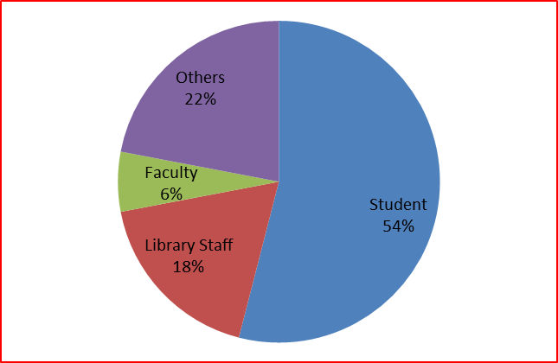
Table 1. Types of users
Status of the User | Number of users | Percentage (%)
Student | 27 | 54
Library Staff | 9 | 18
Faculty | 3 | 6
Others | 11 | 22
Total | 50 | 100

Slide 42
Table 2. Educational qualification of library users
Educational Qualification | No. of users | Percentage (%)
Bachelor | 14 | 28
Master | 28 | 56
Doctorate | 7 | 14
Other | 1 | 2
Total | 50 | 100

Slide 43
Table 3. Age group of users
Age Group | No. of users | Percentage (%)
18-30 | 36 | 72.00
31-40 | 5 | 10.00
41-50 | 4 | 8.00
51 and above | 5 | 10.00
Total | 50 | 100

Slide 44
Table 4. Gender of users
Gender | No. of users | Percentage (%)
Male | 36 | 72.00
Female | 14 | 28.00
Total | 50 | 100

Slide 45
Table 5. Source of awareness for RFID
Source | No. of users
Not aware | 8
Friend | 8
Library staff | 14
Internet | 16
Other | 3
No response | 3

Slide 46
Table 6. Use of RFID
Use of RFID | No. of users
Issue-Return | 34
Security | 23
Stock verification | 12
Other | 1
No | 9

Slide 47
Table 7. Awareness of Issue-Return through Smart Card
Response | No. of users | Percentage (%)
Yes | 34 | 68.00
No | 15 | 30.00
No response | 1 | 2.00
Total | 50 | 100.00

Slide 48
Table 8. Use of drop-box for return of books
Response | No. of users | Percentage (%)
Yes | 47 | 94.00
No | 1 | 2.00
No response | 2 | 4.00
Total | 50 | 100.00

Slide 49
Table 9. Method of returning books
Method | No. of users | Percentage (%) | Reasons | No. of users who mentioned reason
Circulation counter | 8 | 16.00 | Authenticity Easy Fully satisfied that book has been returned Can know about the fine | 1 2 1 1
Drop box | 40 | 80.00 | Easy Saves time No need of staff Can return books on holidays No need to stand in queue Freedom Convenient and fast No time boundation of circulation counter Can be used anytime when library is open | 12 21 2 1 2 1 3 1 1
No response | 2 | 4.00
Total | 50 | 100.00

Slide 50
Table 10. Ranking of users’ preference for RFID use
Reasons |  | Rank 1 | Rank 2 | Rank 3 | Rank 4
Saves time | No. of users | 32 | 10 | 4 | 2
Multiple book transactions | No. of users | 5 | 18 | 18 | 5
Self issue/return | No. of users | 8 | 16 | 21 | 2
Increased circulation timings | No. of users | 2 | 3 | 3 | 38
 | Total | 47 | 47 | 47 | 47
No | 2
No response | 1

Slide 51
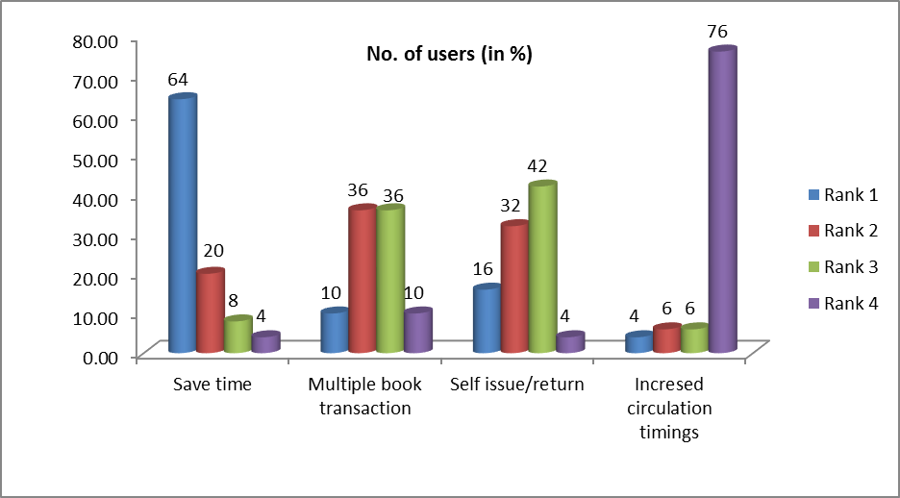
Figure 2. Ranking of users’ preference for RFID use

Slide 52
Table 11. Use of RFID in different library collections
Type of collection | No. of users
Text Book & Book Bank | 15
General Collection | 6
Reference Collection | 3
All of the above | 25
No response | 4

Slide 53
Table 12. Frequency of the use of RFID system
Frequency | No. of users
Once in a Month | 8
More than once in a Month | 27
Once in a Semester | 2
Rarely | 9
No response | 4
Total | 50

Slide 54
Table 13. Rating of circulation system
Rating | No. of users
Excellent | 14
Very Good | 25
Good | 7
Do not know | 3
No response | 1
Total | 50

Slide 55
Table 14. Ranking of users’ preference for RFID use
Response | No. of users | Percentage (%)
Yes | 37 | 74.00
No | 3 | 6.00
Do not know | 8 | 16.00
No response | 2 | 4.00
Total | 50 | 100.00

Slide 56
Table 15. Positive change in the attitude of users
Item | No. of users | Percentage (%)
Yes | 39 | 78.00
No | 4 | 8.00
Do not know | 6 | 12.00
No response | 1 | 2.00
Total | 50 | 100.00

Slide 57
Table 16. Positive change in the attitude of the library staff
Item | No. of users | Percentage (%)
Yes | 33 | 66.00
No | 8 | 16.00
Do not know | 9 | 18.00
Total | 50 | 100.00

Slide 58
Table 17. Use of RFID in other areas
Use of RFID | No. of users
Payment of Fees/Fines, etc. through RFID Smart Card | 29
Drop box in Hostels | 20
Drop box in Departments | 16
Book ATMs | 11
No response | 4

Slide 59
Table 18. Effectiveness of RFID system for security of books
Item | No. of users | Percentage (%)
Yes | 45 | 90.00
No | 1 | 2.00
Do not know | 3 | 6.00
No response | 1 | 2.00
Total | 50 | 100.00

Slide 60
Table 19. Assistance by staff in use of smart cards
Item | No. of users | Percentage (%)
Yes | 43 | 86.00
No | 5 | 10.00
No response | 2 | 4.00
Total | 50 | 100.00

Slide 61
Table 20. Arrangement of training/user education for use of RFID
Item | No. of users | Percentage (%)
Yes | 16 | 32.00
No | 15 | 30.00
Need based | 16 | 32.00
Other (no idea) | 1 | 2.00
No response | 2 | 4.00
Total | 50 | 100.00

Slide 62
Table 21. Difficulty/ limitations in use of RFID system
Item | No. of users | Percentage (%) | Reasons
Yes | 11 | 22.00 | Tag identification related problem Chances of removal of tags and hence book can be easily stolen Power cut problem Books dropped in drop box gets damaged Technical problem
No | 35 | 70.00
No response | 3 | 6.00
Do not know | 1 | 2.00
Total | 50 | 100.00

Slide 63
Table 22. RFID v/s Other Circulation methods
Item | No. of users | Percentage (%)
Yes | 46 | 92.00
No | 0 | 0.00
Do not know | 3 | 6.00
No response | 1 | 2.00
Total | 50 | 100

Slide 64
Table 23. Future of RFID in Libraries
Item | No. of users | Percentage (%)
Good future | 43 | 86.00
Short lived | 0 | 0.00
Do not know | 4 | 8.00
No response | 3 | 6.00
Total | 50 | 100

Slide 65
Findings…
The majority of users are aware about RFID through Internet, then by library staff and friends. Few users are aware through some kind of projects during their library science course.
According to maximum number of users, the library uses this technology for Issue/ Return followed by security of books and stock verification.
Around 68% users in the library can do self-issue/return using smart cards through issue/return kiosk.
Remarkably, 94% users find it easy to return the book in drop-box.
64% users find time saving as the most preferable reason for RFID usefulness in circulation system whereas increased circulation timings was ranked last.
There are 54% users who use the RFID system more than once in a month where as only18% rarely use it.
50% users rate their circulation system as very good, 28% as excellent and 14% as good.
78% users see a positive change in their attitude regarding the use of the library services after the implementation of the RFID system and 66% users (both students and staff) find a positive change in the attitude of library staff.

Slide 66
Findings…
Most of the users want the extended use of RFID technology for Payment of Fees/Fines, etc. through RFID Smart Card and Drop box in Hostels.
Ninety (90) percent users find RFID system effective for security of books.
According to 86% users, library staff provides assistance in the use of smart cards for various purposes.
According to 32% users, library provide training and user education about the use of RFID technology as and when required in some cases.
70% of the users do not find any difficulty in the use of RFID system in the library as compared to 22% of users who find some limitations of this technology. They cited reasons like technical problems- tag identification, tag collision, etc.
Staggering 92% users find RFID technology far better than any other technologies like manual, bar coded, EM etc. and 86% of users see a good future of this technology in libraries.

Slide 67
Suggestions
More user awareness programmes needed regarding the use of the RFID in library.
Highlight the uses of RFID technology in front of main gate of IIT Delhi library.
Availability of RFID smart cards to all faculty, staff and students.
After implementing RFID technology, students now want that they should be allowed to bring their personal books in the library.
Attach the RFID tag inside the spine of the book for safety of books.
RFID cards should also be made capable of carrying out campus related monetary transactions.
Use of RFID in departmental libraries should be started.
Drop boxes in hostels and departments are needed.
Popularize the technology among the users.

Slide 68
Conclusion…
The present study investigates and narrates the success story of the implementation of RFID technology in the Central Library, IIT Delhi.
The findings of this study advocate the use of RFID by libraries in various areas.
Majority of users are aware of the RFID technology and its uses in the library and find it very useful in all respects.
While the cost is one of the major factors influencing acceptance of this novel technology in libraries but keeping in view the advantages, the benefits have an edge over cost.
Although RFID can improve efficiency, the essence of service will not change; therefore, innovating services is an essential factor for libraries.
Now the RFID costs are coming down, efficiency is going up, and libraries can improve their systems enormously.

Slide 69
Conclusion…
RFID technology is taking off in libraries at an increasingly rapid pace. It has the capability of making our lives in the library more convenient
The only barrier in the journey is the high cost. However, RFID applications lead to significant savings in staff costs, enhance services and provide efficient results, which leads to almost fool proof security and access control
It is recommended that smaller and new libraries should adopt RFID at an early stage and with Hybrid technology
Currently, only about 8 percent of libraries world-wide are using RFID, but this figure is rapidly increasing as libraries understand the benefits and convenience of incorporating RFID into their system (Mehrjerdi, 2011)
A good Material Handling System (MHS) as it is used in large warehouses can be tremendously helpful in RFID based libraries
Finally, we can say that despite all its limitations, the RFID technology is the future of libraries but we should also remember that it is a supporting technology and not a competing one

Slide 70
Thanks for your kind
cooperation & patience hearing
nabihasan@gmail.com
nabihasan.webs.com
@nabihasan
@nabihasaniit

